Slide 1
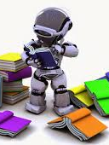
Basic Intro Tutorial on Machine Learning and Data Mining
Prof. Carolina Ruiz
Department of Computer Science
WPI
Most figures and images in this presentation were obtained from Google Images

Slide 2
Reminder: What is AI?
There are many definitions of Artificial Intelligence. Two of them are:
“AI as an attempt to understand intelligent entities and to build them“ (Russell and Norvig, 1995)
"AI is the design and study of computer programs that behave intelligently" (Dean, Allen, and Aloimonos, 1995)
But what is an “intelligent entity" or what does it mean to “behave intelligently"?
Intelligence is the degree of accomplishment exhibited by a system when performing a task" (Allen, AAAI97 invited lecture)

Slide 3
WHAT IS AI? (Cont.)
AI can be seen as an ensemble of ideas & techniques for:
representing knowledge
using knowledge to solve problems
with two goals:
Engineering Goal:
To solve real-world problems using AI
Scientific Goal:
To explain various sorts of intelligence

Slide 4
What is AI? (cont.)
Core AI:
Knowledge Representation Techniques:
Semantic Nets, Rules, Propositional Logic, 1st Order Logic, Probability, . . .
Problem Solving Strategies:
Blind Search, Heuristic Search, Optimal Search, Adversarial Search (Game Playing), Constraint Satisfaction, Logical Inference, Planning, Probabilistic Reasoning, . . .
AI Areas:
Machine Learning
Machine Vision
Natural Language Processing (NLP)
←

Slide 5
What is Machine Learning?
Writing computer programs that learn from experience
More precisely (Mitchell, 1997):
Given:
A class of tasks T
(e.g., recognizing faces)
A performance measure P
(e.g., accuracy)
Training experience E
(e.g., dataset of faces with names)
Write computer programs that can learn from experience E to improve their performance, as measured by P, on tasks in T

Slide 6
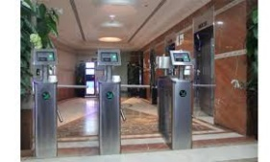
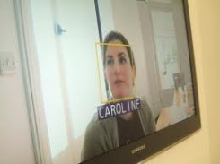



Supervised vs. Unsupervised Learning (e.g., automatic face recognition “doorman” )
Supervisor or Teacher
No supervisor
Training experience:
face teacher says:
yes
no
yes
no
Training Experience:
Reinforcement learning: + and - rewards are provided

Slide 7


How to provide “experience”?
Using Data: experience is recorded in data
Not using data: Direct experience
(e.g., medical records)
(e.g., robot motion)
Learning from data is also
called data mining

Slide 8

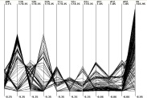
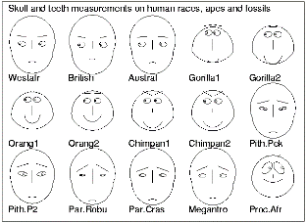
What do you want to learn from your data?
regression
IF A & B THEN
IF A & D THEN
classification
clustering
Data
change/deviation
detection
summarization
dependency/assoc. analysis
0.5
IF a & b & c THEN d & k
IF k & a THEN e
A B
C D
A, B -> C 80%
C, D -> A 22%
0.3
0.75
Notes:
Regression:
Parametrically summarize data points

Slide 9
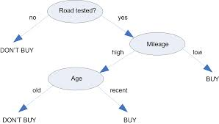
Decision Trees
Decision trees are used for classification
Regression trees follow a similar idea and are used for regression

Slide 10
Artificial Neural Networks (ANNs)
Can be used for:
classification
regression or
unsupervised learning (self-organizing neural networks)
No!

Slide 11
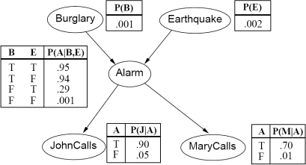
Bayesian Networks
Based on Probability
Can be used for:
classification
regression or
dependency analysis

Slide 12
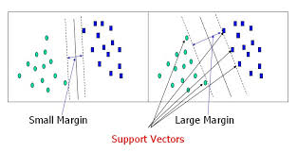
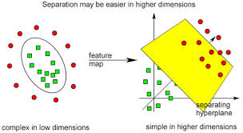
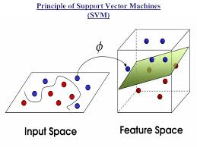
Support Vector Machines (SVMs)

Slide 13
We’ll learn these and other machine learning methods

