Slide 1
Python Project Workflows – Continuous Deployment Friendly
Abhijit Gadgil
<gabhijit@hyphenos.io>

Slide 2
About Me
Run a consultancy company – mostly Python and/or Go
Mainly come from a systems background
Worked in the past mainly in networking, software switches
Mostly use Python for trying out ideas
  Analytics of historical NSE stocks data
  Looking at IP prefixes from BGP updates

Slide 3
A Quick Survey
How many of you do ‘pip install foo’ and when it cribs ‘sudo pip install foo’? Is there anyone who does ‘apt-get install python-foo’ ?
How many of you use ‘requirements.txt’?
How many of you use some code linting tool?
  Like pyflakes, pylint or pep8?

Slide 4
Why Continuous Deployment At All
Because we can? And everybody else is doing it?
There are of course usual answers – Faster release of features, quicker bug fixes etc.
A collateral benefit is – faster onboarding of new developers and that translates to direct $$ and better engineering practices that save a lot of trouble

Slide 5
What are we really trying to solve? Why?
Non trivial project is going to have some third party dependencies and you want to be sure about what really is getting deployed
Python – being an interpreted language, everything becomes ‘runtime’, better not to leave things for runtime, if we can do something early enough, let’s do that and also ensure certain conventions are followed in code
Sans the above two – We can “build faster – break things”, but often, they’ll remain broken. Of course something we don’t want.

Slide 6
More Concretely
Better Dependency Management (virtualenv, pip, pipenv)
  Deterministic Builds – Across time and environments
  Know precisely what versions get deployed
  Keep production and development specific dependcies separate
  Allow multiple projects to co-exist trivially on developer’s machine
Better Code Quality (pylint)
  Capture potential run-time errors (bad attribute acces, undefined variables and so on)
  Enforce coding standards

Slide 7
Before We Begin
What we discuss here is ‘a workflow’ and every project / team should choose what suits them
Most of the talk assumes we are using ‘git’ for version control, not a bad assumption, but explicit is better than implicit
Also most of the talk assumes a Linux based development environment, so if you are using Windows or Mac some things might be slightly different

Slide 8
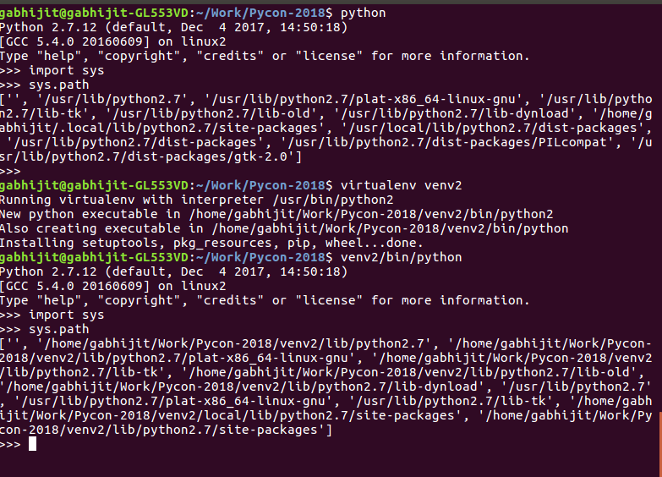
‘virtualenv’

Slide 9
...
Creates a self contained environment in a directory on file-system
All third-party packages are installed in this environment
Keeps Python’s stdlib in the sys.path

Slide 10
Recommended workflow
Start with a virtual environment for a project
$ virtualenv venv
virtualenv also installs tools like ‘pip’, ‘wheel’ - which is very handy
Install dependencies in the virtual environment
$ venv/bin/pip install requests
Start tracking dependencies in a projects ‘requirement.txt’ file -
$ cat > requirements.txt
requests
Ctrl-D

Slide 11
So Should I track a `virtualenv` in the VCS?
No!!!!
Instead track ‘requirements.txt’ in VCS and use a pip feature
  $ pip install -r requirements.txt
Are We good? Not yet
  Dependencies are tracked, but we’ve no control over the versions that will get installed.

Slide 12
Semantic Versioning
It’s basically common sense. Main idea is –
  major.minor.patch[-optional.qualifiers]
you can specify dependency and their versions that don’t break, in theory off course (eg. I can specify dependency like ‘requests>=2.0.0,<3.0.0’ or ‘requests==2.19.1’)

Slide 13
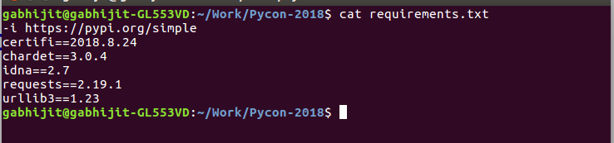
Enter ‘pip freeze’
Basically the way it works is – it goes through - `$PWD/venv/lib/python2.7/site-packages/` and records all the packages installed there. (This is a simplification)
So now what we do is -
`pip freeze > requirements.txt`

Slide 14
Pushing it a bit
We’ve so far managed to track dependencies along with their versions.
So are we good, now?
Well almost, except if we had some packages that are required only for development/build/unit-testing also spill into `requirement.txt` . A consequence of `pip freeze`.
Can we Fix that? Enter `pipenv`

Slide 15
It basically stands for a combination of `pip` and `virtualenv`.
We are mainly going to be concerned about -
How to use `pipenv` to separate, ‘dev’ and ‘prod’ dependencies.

Slide 16
Pipenv
Relatively new tool – main purpose is to address the problems mentioned. It’s recommended in PyPA and will eventually be part of pip
`pipenv` workflow is mainly around two files – `Pipfile` and `Pipfile.lock`
Think of this as `requirements.txt` split into two files
  One specifying dependencies alone (without explicit versions)
  One specifying the versions that are currently installed
And some more metadata (Python version, Pip index location etc.)

Slide 17
Pipenv – Workflow
Pipenv Install – To generate Pipfile
Edit Pipfile to specify dependencies
Pipenv update – To install and lock dependencies
Pipenv lock -r and pipenv lock -r --dev

Slide 18
Are we good now?
Yes -
  Use Pipefile to track dependencies (don’t specify exact versions here)
  Generate Pipfile.lock to install and lock dependencies
  Generate requirements.txt and dev-requirements.txt files from Pipfile.lock
  Track all four in VCS
  Don’t track virtual environment directory in VCS
  Clone and use pip install -r to install requirements and get started
  New dependency? Go to 1) again

Slide 19
We’ve solved the problem of “deterministic builds” - What about the code that we write?
Can we do something better to ensure some baseline quality and conformance? Enter ‘pylint’

