Slide 1
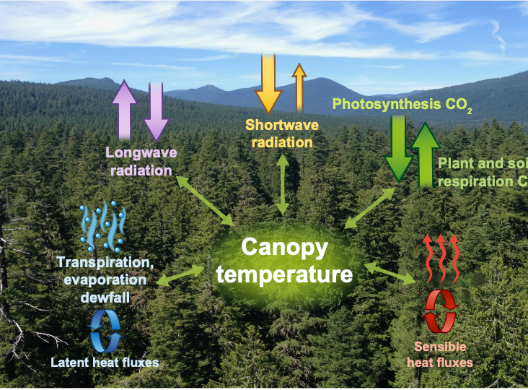
Progress to date on LTER8-funded work
Canopy connections: linking microclimates to ecological processes
(Chris Still, Posy Busby, Julia Jones, Mark Schulze)
Completed the canopy wetting and drying project by former Ph.D. student, Adam Sibley (published in Ag. & Forest Meteorology)
Mark and Adam S. added new canopy microclimate monitoring stations at differing landscape positions beyond the Discovery Tree area (unfortunately, some of the new installations some were lost to Lookout fire)
New MS student, Gabby John, has been working to assemble, screen, and analyze the large amounts of stem dendrometry data from multiple sites at the Andrews Forest for her Masters thesis research. She has also been compiling and merging updated microclimate observations from PRIMET and the Discovery Tree

Slide 2
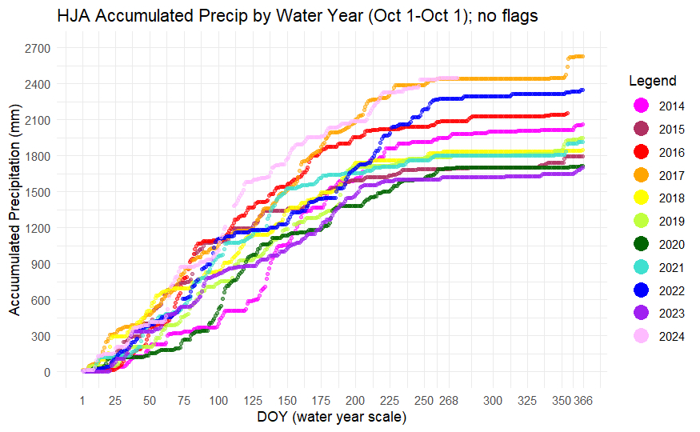
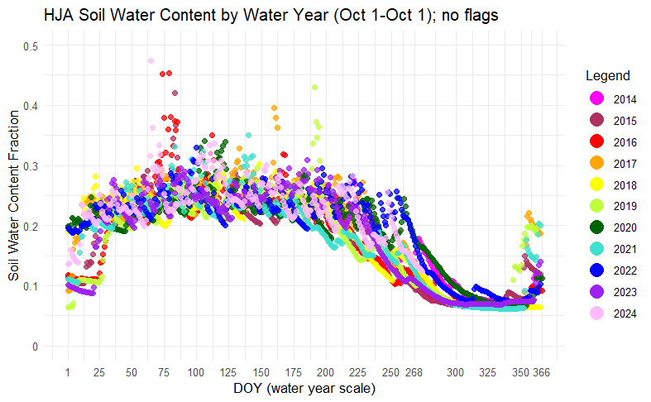
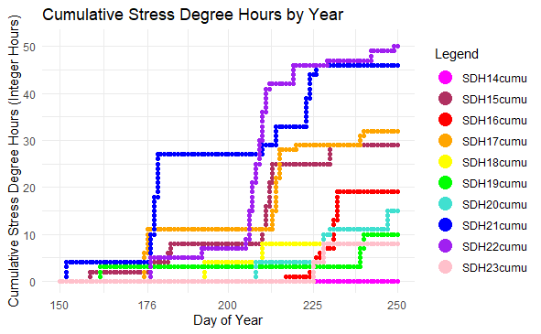
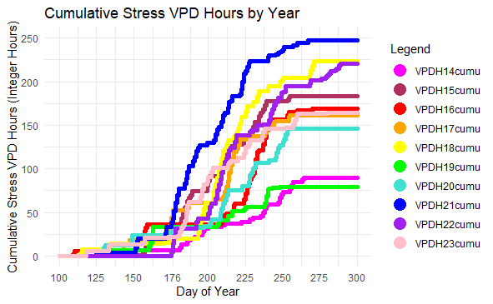
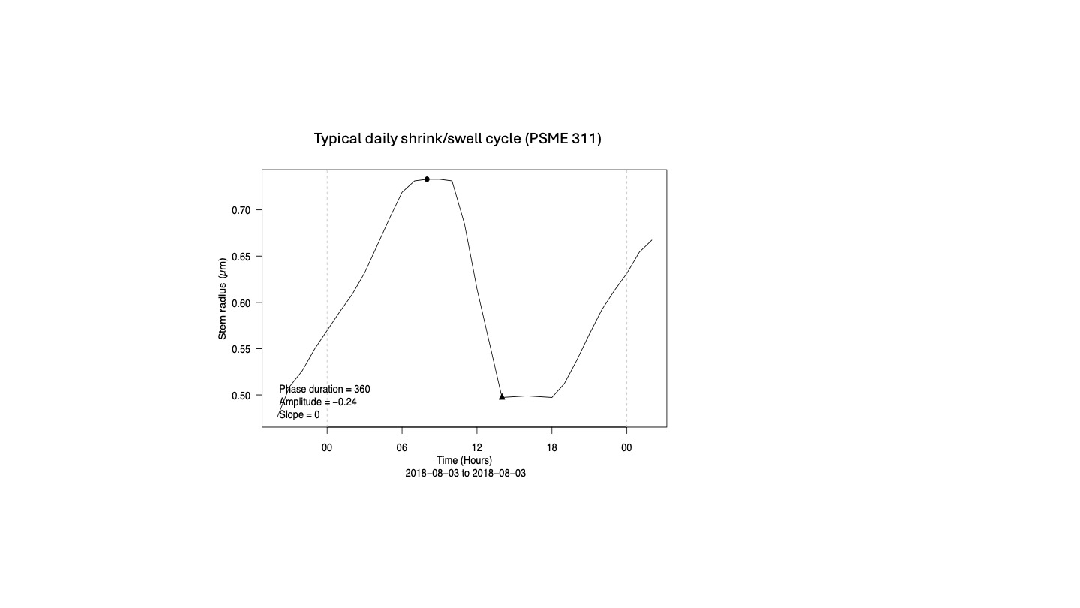
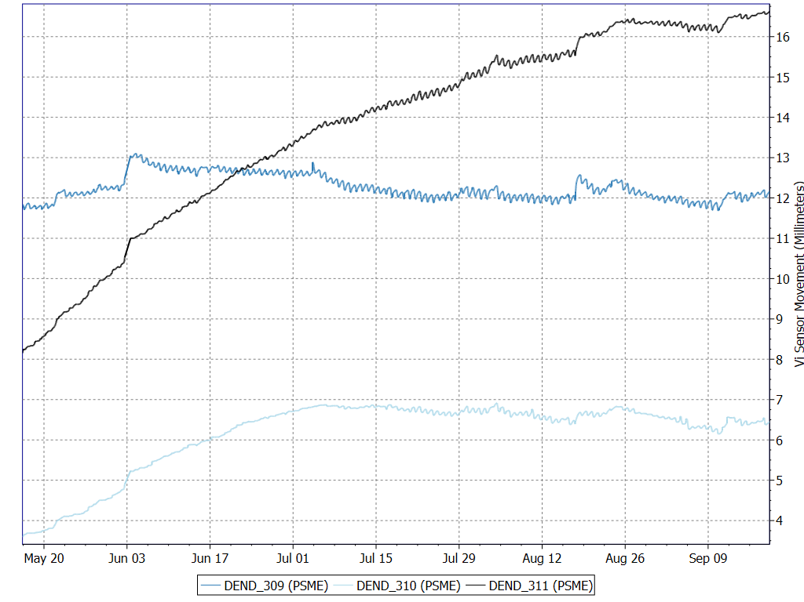
Plans for future LTER8-funded work
Gabby will continue her MS research on stem dendrometry variations and connections to climate and other drivers. Expect a publication to be submitted in summer 2025
Annual growth (PSME 309, 310, 311)

Slide 3
List and timeline of products and publications from LTER8-funded work.
Sibley, A., Schulze, M., Jones, J., Kennedy, A., & Still, C. (2022). Canopy wetting patterns and the determinants of dry season dewfall in an old growth Douglas-fir canopy. Agricultural and Forest Meteorology, 323, 109069.
Still, C. J., Rastogi, B., Page, G. F., Griffith, D. M., Sibley, A., Schulze, M., ... & Helliker, B. R. (2021). Imaging canopy temperature: shedding (thermal) light on ecosystem processes. New Phytologist, 230(5), 1746-1753.
Still, C. J., Sibley, A., DePinte, D., Busby, P. E., Harrington, C. A., Schulze, M., ... & Page, G. F. M. (2023). Causes of widespread foliar damage from the June 2021 Pacific Northwest Heat Dome: more heat than drought. Tree Physiology, 43(2), 203-209.
Brackett, A. E., Still, C. J., & Puettmann, K. J. (2024). Residual canopy cover provides buffering of near-surface temperatures, but benefits are limited under extreme conditions. Canadian Journal of Forest Research, 54(9), 1018-1031.
In review or in prep publications (HJA researchers in blue)
2021 Pacific Northwest heat wave highlights widespread forest vulnerability to extreme heat (in review)
Adam Sibley, Christopher Still, Matthew Gregory, Constance Harrington, David Shaw, Nina Ferrari, Alex Dye, Mark Schulze, Glenn Howe, David Rupp, Chris Daly, Daniel DePinte, Cameron Naficy, Chaney Hart, David M. Bell
Impacts of Extreme Heat: Tree and Forest Responses to the June 2021 Pacific Northwest Heat Dome (in prep).
Chris Still, Linnia Hawkins, Bharat Rastogi, Jen Diehl, Paola Arroyo-Vargas, Chris Daly, Cole Doolitte, Rich Fiorella, Bill Hammond, Chad Hanson, Connie Harrington, Manual Helbig, Andrés Holz, Kyle Jones, Joe Lamanna, Gerald Page, Andrew Richardson, David Rupp, Catalina Segura, John Talberth, Ben Vierra, David Woodruff, Adam Sibley, Mark Schulze, Peter Beedlow

