Slide 2
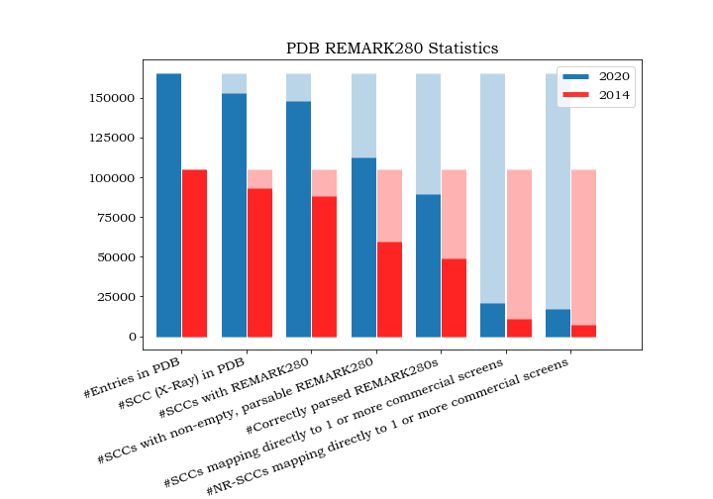
SCC: Successful Crystallisation Condition
NR-SCC: Non-Redundant SCC

