Slide 1
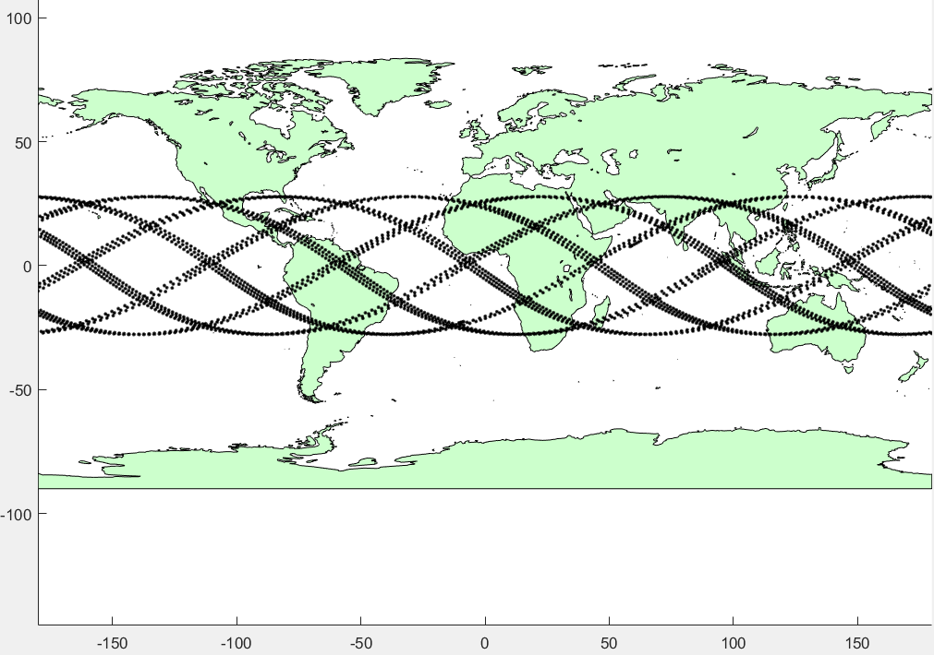
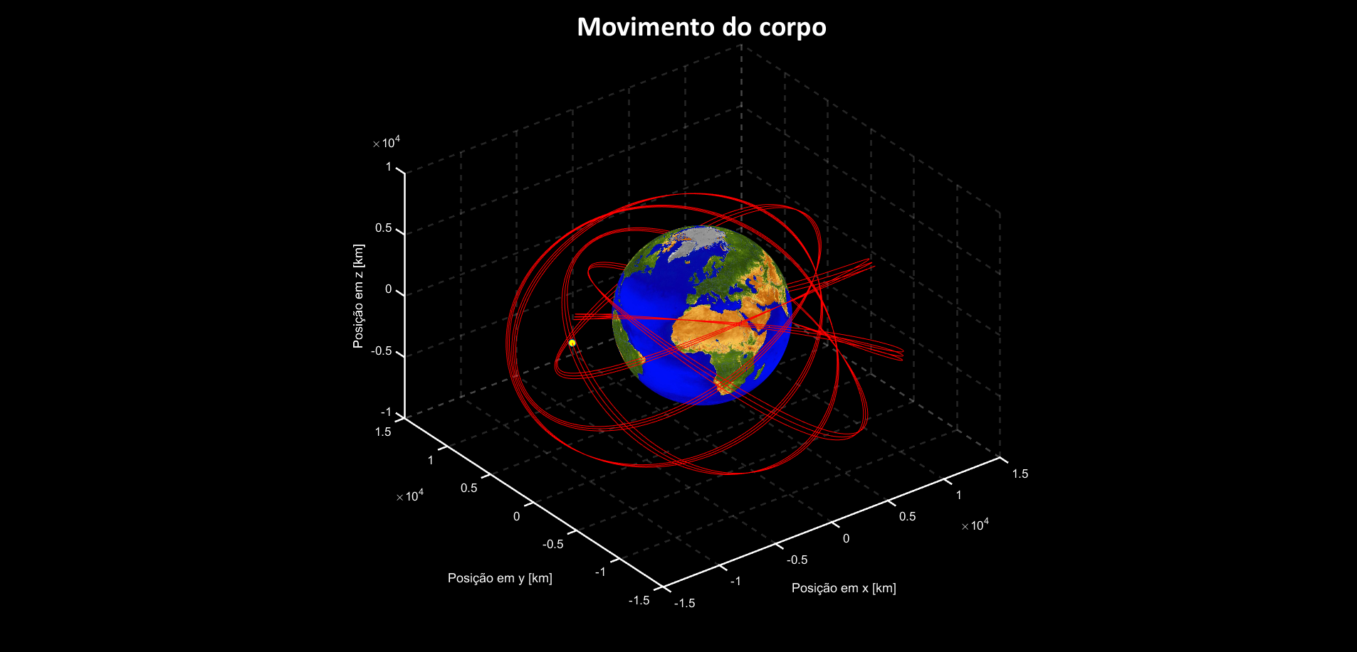


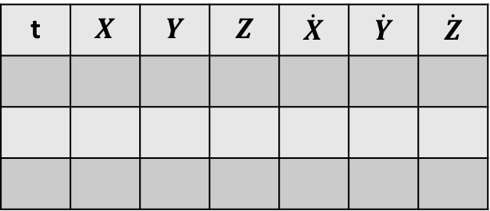
$$X_{{terra}_{0}}=$$
$$Y_{{terra}_{0}}=$$
$$Z_{{terra}_{0}}=$$
$${\dot{X}}_{{terra}_{0}}=$$
$${\dot{Y}}_{{terra}_{0}}=$$
${\dot{Z}}_{{terra}_{0}}$ =
Data início =
Data fim =
$$a=$$
ϵ =
$$i =$$
$$ω=$$
$$Ω=$$
$$T=$$
Data início =
Data fim =
INPUT
OUTPUT
____/___/___
____/___/___
____/___/___
____/___/___
Simular
Simular
t | $$X$$ | $$Y$$ | $$Z$$ | $$\dot{X}$$ | $$\dot{Y}$$ | $$\dot{Z}$$
Exportar

