Slide 1
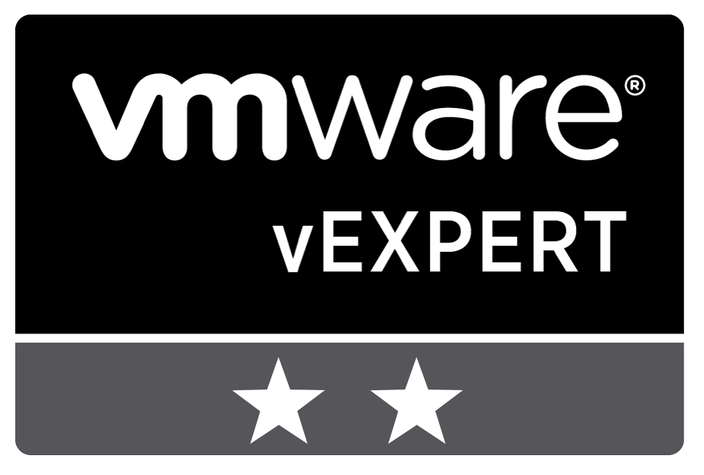
CODE 2742 – Tales from the Trenches
Real-World VMware Cloud on AWS Migrations
Stephen Barron (He/Him)
Senior Cloud Solution Architect, VMC
Patrick Kremer (He/Him)
Staff Cloud Solution Architect, VMC
CODE2742
#vmworld #code2742

Slide 2
SDDC Import/Export Demo
iSim – HOL 2287-04
Advanced Use Cases
Converting Cisco ASA Config to VMC NSX-T
Interfaces/Segments
Groups
Network Objects
Service Objects
Group Objects
Access-lists
Compute Gateway Firewall
Distributed Firewall

Slide 3
Two Flings for VMware Cloud on AWS
Python-based, open source
SDDC Import/Export for VMware Cloud on AWS
Exports an existing SDDC network configuration into JSON
Imports JSON into a blank SDDC (greenfield)
Can sync objects (brownfield)
Supports CGW/MGW/DFW groups and firewall rules, network segments, NAT, public IP remap, VPN, and service access.
Sync CSP user roles from a template account
Python Client for VMware Cloud on AWS
Command-line interface for VMC
Abstracts API calls
Practical examples of API invocation
Can work in both greenfield and brownfield
Dozens of commands to show and create objects including CGW/MGW/DFW groups and firewall rules, network segments, NAT, VPN, etc.

Slide 4
DEMO – SDDC Import/Export
A preview of HOL 2287-04

Slide 5
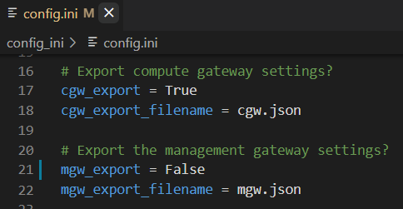
Configuration Options – Selective Sync
Enable or disable any of the network configurations
Notes:
Selective Sync – Multiple Horizon Clusters. Web Farms
AWS S3 – Education lab
On-prem DFW – Migration to VMC

Slide 6
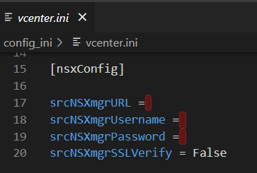

Configuration Options – On-prem NSX DFW Export
Export on-prem NSX-T DFW
Notes:
Selective Sync – Multiple Horizon Clusters. Web Farms
AWS S3 – Education lab
On-prem DFW – Migration to VMC

Slide 7
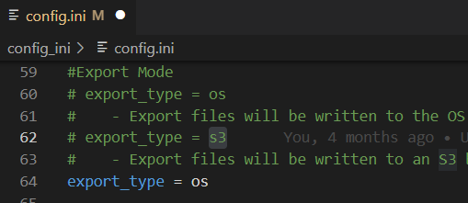
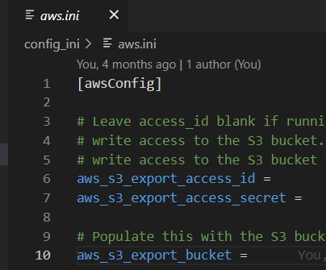
Configuration Options – AWS S3
Archive network configuration in an S3 bucket
Notes:
Selective Sync – Multiple Horizon Clusters. Web Farms
AWS S3 – Education lab
On-prem DFW – Migration to VMC

Slide 8
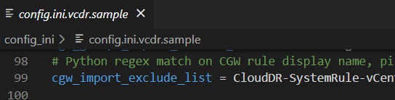
Configuration Options - VCDR
Speeding up RTO for VCDR
Notes:
VCDR – config.ini.vcdr.sample – Exclusions for default network and FW rules
cgw_import_exclude_list
mgw_import_exclude_list
network_import_exclude_list
vCenter Folder – Migrations into VMC

Slide 9
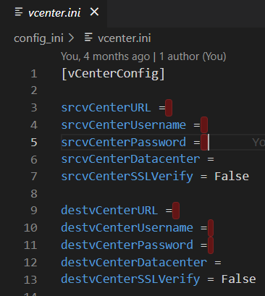
Configuration Options – vCenter Folder
Clone your on-prem folder structure into VMC
Notes:
VCDR – config.ini.vcdr.sample – Exclusions for default network and FW rules
cgw_import_exclude_list
mgw_import_exclude_list
network_import_exclude_list
vCenter Folder – Migrations into VMC

Slide 10
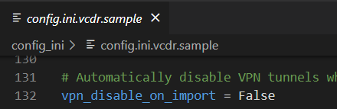
Configuration Options – Disable VPN
Don’t break your live VPN
Notes:
VCDR – config.ini.vcdr.sample – Exclusions for default network and FW rules
cgw_import_exclude_list
mgw_import_exclude_list
network_import_exclude_list
vCenter Folder – Migrations into VMC

Slide 11
Converting Cisco ASA Config to VMC NSX-T

Slide 12
Traditional Firewall vs NSX-T
Traditional Firewall Design
Distributed Firewall Design
Act as a centralized network point to inspect, allow, drop, tunnel, and route traffic within a datacenter or environment
Simplified network routing and administration
Most data center traffic has to be processed by a single device, potentially 100’s of gbps
Segmentation occurs at the network/VLAN level, so either there are large VLANs with limited segmentation or small VLANS requiring the firewall to hairpin more traffic
NSX-T is designed to be distributed across the SDDC
Security policy enforcement is performed at the Compute gateway and/or a distributed firewall
As the SDDC scales out, so does the NSX-T environment
Segmentation occurs at the vNIC, so segmentation is uniform regardless of segment size/counts

Slide 13
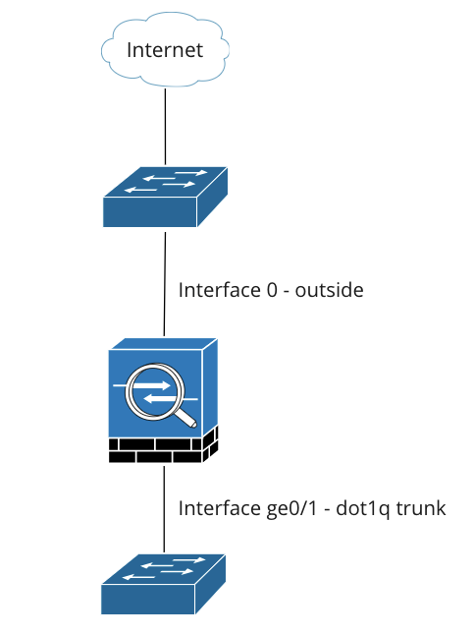
Example Architecture
Interface ge 0/0 – Outside
not converted to VMC
Interface ge 0/1 – dot1q trunk
VLAN | Name | IP Address | Security Level
100 | desktops | 10.40.10.1/24 | 20
101 | database_servers | 10.41.101.1/24 | 90
102 | middleware_servers | 10.41.102.1/24 | 80
103 | internal_web | 10.41.103.1/24 | 70
104 | external_web | 172.20.104.1/24 | 20
105 | B2B_Intranet | 172.20.105.1/24 | 20

Slide 14
ASA Interfaces to VMC NSX-T Segments
Using pyVMC Client
*** Python client example ***
 | python pyVMC.py new-network networkname routed 10.10.1.1/24
 |  |  |  | Routed Disconnected Extended
*** Python Client commands *** | script | command | network-name | type | Gateway Address/CIDR
 | python pyVMC.py | new-network | desktops | routed | 10.40.10.1/24
 | python pyVMC.py | new-network | database_servers | routed | 10.41.101.1/24
 | python pyVMC.py | new-network | middleware_servers | routed | 10.41.102.1/24
 | python pyVMC.py | new-network | internal_web | routed | 10.41.103.1/24
 | python pyVMC.py | new-network | external_web | routed | 172.20.104.1/24
 | python pyVMC.py | new-network | B2B_Intranet | routed | 172.20.105.1/24
*** Original Config *** | interface GigabitEthernet0/1.100
 | vlan 100
 | nameif desktops
 | security-level 20
 | ip address 10.40.10.1 255.255.255.0
 | !
 | interface GigabitEthernet0/1.101
 | vlan 101
 | nameif database_servers
 | security-level 90
 | ip address 10.41.101.1 255.255.255.0
 | !
 | interface GigabitEthernet0/1.102
 | vlan 102
 | nameif middleware_servers
 | security-level 80
 | ip address 10.41.102.1 255.255.255.0
 | !
 | interface GigabitEthernet0/1.103
 | vlan 103
 | nameif internal_web
 | security-level 70
 | ip address 10.41.103.1 255.255.255.0
 | !
 | interface GigabitEthernet0/1.104
 | vlan 104
 | nameif external_web
 | security-level 20
 | ip address 172.20.104.1 255.255.255.0
 | !
 | interface GigabitEthernet0/1.105
 | vlan 105
 | nameif B2B_Intranet
 | security-level 20
 | ip address 172.20.105.1 255.255.255.0
ASA command: show run interface
Parse config, segmenting by spaces

Slide 15
ASA Network Objects to VMC NSX-T Groups
Using pyVMC Client
Prerequisites: none
ASA command: show run object-group network
Parse config, segmenting by spaces
Host implies /32
Comma separated members host and network
*** Python Client examples *** |  | new-group cgw groupname ip-based 10.10.10.10,10.10.20.0/24,10.10.10.12
*** Python Client commands *** |  |  | cgw mgw |  | ip-based member-based criteria-based group-based
 | script | command | type | Group Name | group-type | members
 | python pyVMC.py | new-group | cgw | MonitoringServices | ip-based | 10.41.50.0/24,74.88.88.45
 | python pyVMC.py | new-group | cgw | DB-CRM | ip-based | 10.41.101.11,10.41.101.12,10.41.101.13,10.41.101.14
 | python pyVMC.py | new-group | cgw | DB-TRXN | ip-based | 10.41.101.21,10.41.101.22,10.41.101.23,10.41.101.24
 | python pyVMC.py | new-group | cgw | DB-ACCT | ip-based | 10.41.101.32/27
 | python pyVMC.py | new-group | cgw | MiddleWare | ip-based | 10.41.102.0/24
*** Original Config ***
object-group | network | MonitoringServices
 | network-object | 10.41.50.0 | 255.255.255.0
 | network-object | host | 74.88.88.45
object-group | network | DB-CRM
 | network-object | host | 10.41.101.11
 | network-object | host | 10.41.101.12
 | network-object | host | 10.41.101.13
 | network-object | host | 10.41.101.14
object-group | network | DB-TRXN
 | network-object | host | 10.41.101.21
 | network-object | host | 10.41.101.22
 | network-object | host | 10.41.101.23
 | network-object | host | 10.41.101.24
object-group | network | DB-ACCT
 | network-object | 10.41.101.32 | 255.255.255.224
object-group | network | MiddleWare
 | network-object | 10.41.102.0 | 255.255.255.0

Slide 16
ASA Nested Groups to NSX-T Nested Groups
Using pyVMC Client
*** Python Client examples ***
 | new-group cgw groupname group-based group1,group2,group3
*** Python Client commands ***
*** Python Client commands *** |  |  |  | cgw mgw | cgw mgw |  |  | ip-based member-based criteria-based group-based | ip-based member-based criteria-based group-based
 | script | command | command | type | type | Group Name | Group Name | group-type | group-type | members | members
 | python pyVMC.py | new-group | new-group | cgw | cgw | MonitoringServices | MonitoringServices | group-based | group-based | DB-CRM,DB-TRXN,DB-ACCT | DB-CRM,DB-TRXN,DB-ACCT
 | python pyVMC.py | new-group | new-group | cgw | cgw | B2B-AllCustomers | B2B-AllCustomers | group-based | group-based | B2B-Customer1,B2B-Customer2,B2B-Customer3 | B2B-Customer1,B2B-Customer2,B2B-Customer3
*** Original Config ***
 | object-group | network | network | All-DB | All-DB
 |  | group-object | group-object | DB-CRM | DB-CRM
 |  | group-object | group-object | DB-TRXN | DB-TRXN
 |  | group-object | group-object | DB-ACCT | DB-ACCT
 | object-group | network | network | B2B-AllCustomers | B2B-AllCustomers
 |  | group-object | group-object | B2B-Customer1 | B2B-Customer1
 |  | group-object | group-object | B2B-Customer2 | B2B-Customer2
 |  | group-object | group-object | B2B-Customer3 | B2B-Customer3
Prerequisites: sub groups must exist
ASA command: show run object-group look for group-objects
Parse config, segmenting by spaces

Slide 17
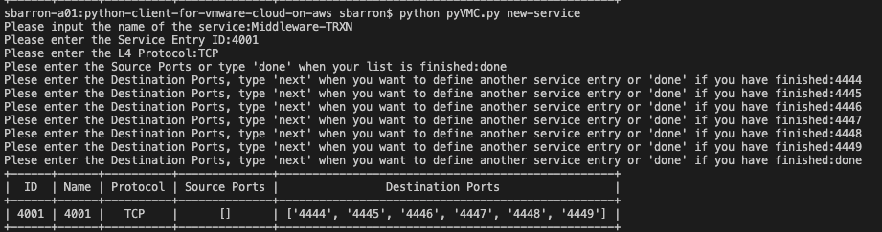
ASA Service Object Groups to NSX-T Services
Using pyVMC Client
Prerequisites: None
ASA command: show run object-group service
Parse config, segmenting by spaces
The pyVMC new-service command is prompt driven
object-group | service | Middleware-TRXN
 | service-object | tcp | destination | eq | 4444
 | service-object | tcp | destination | eq | 4445
 | service-object | tcp | destination | eq | 4446
 | service-object | tcp | destination | eq | 4447
 | service-object | tcp | destination | eq | 4448
 | service-object | tcp | destination | eq | 4449
object-group | service | Middleware-ETL
 | service-object | tcp | destination | eq | 5500
 | service-object | tcp | destination | eq | 5501
 | service-object | tcp | destination | eq | 5502
 | service-object | tcp | destination | eq | 5503
 | service-object | tcp | destination | eq | 5504

Slide 18


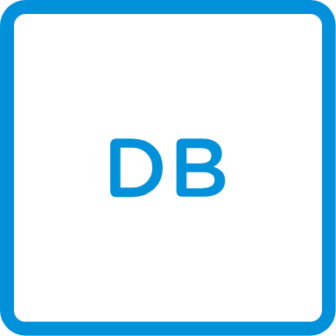

ASA Access-list to VMC NSX-T CGW and DFW
Using pyVMC Client
Prerequisites: Network Services, network groups must be created.
ASA command: show run access-group (See what Access-lists need review)
ASA command: show run access-list <access-list-name>
Parse config, segmenting by spaces
We need to decide where to write the firewall rules (Compute Gateway Firewall, Distributed Firewall, Both, or Neither)
Network A
DFW
CGW
Network B
DFW
Router
Compute
Storage
SDDC
Network
VMware Cloud on AWS

Slide 19
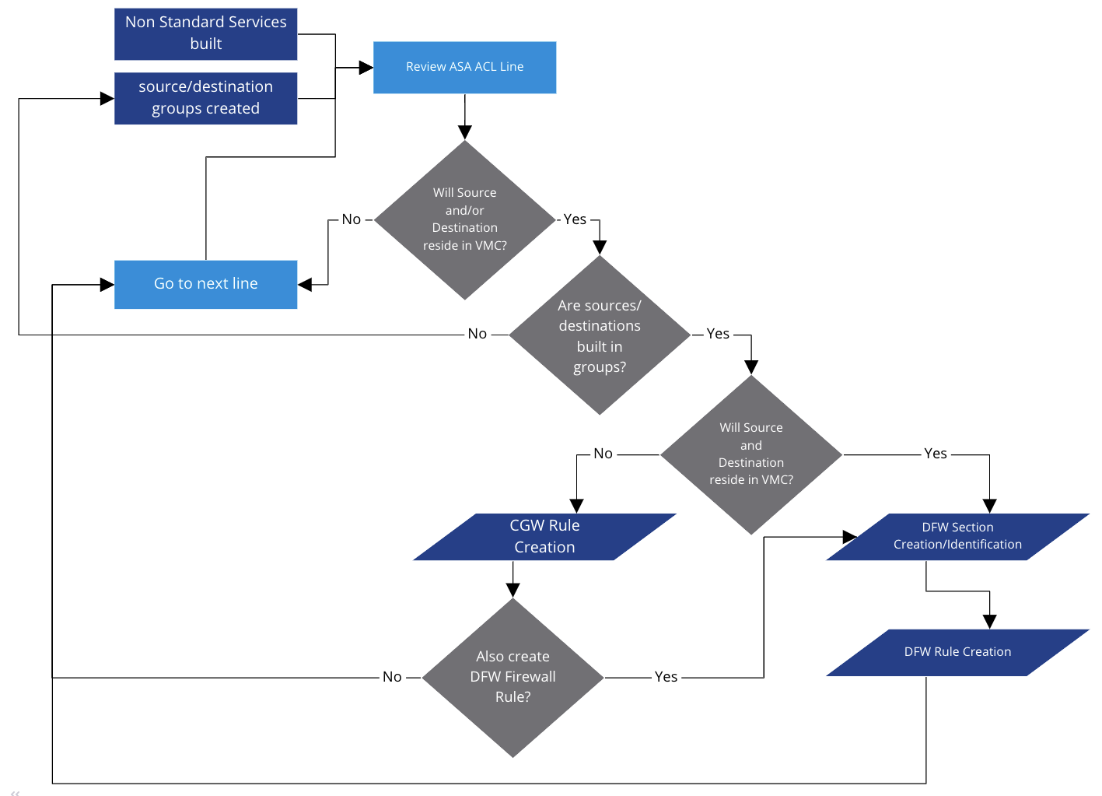
ASA Access-List to VMC NSX-T Workflow
Using pyVMC Client
VMC VM <-> VMC VM access-list entries must be configured as DFW rules
External <-> VMC VM access-list entries require Compute Gateway FW rules and potentially DFW rules
Create groups as you proceed through the ACLs for reuse after

Slide 20
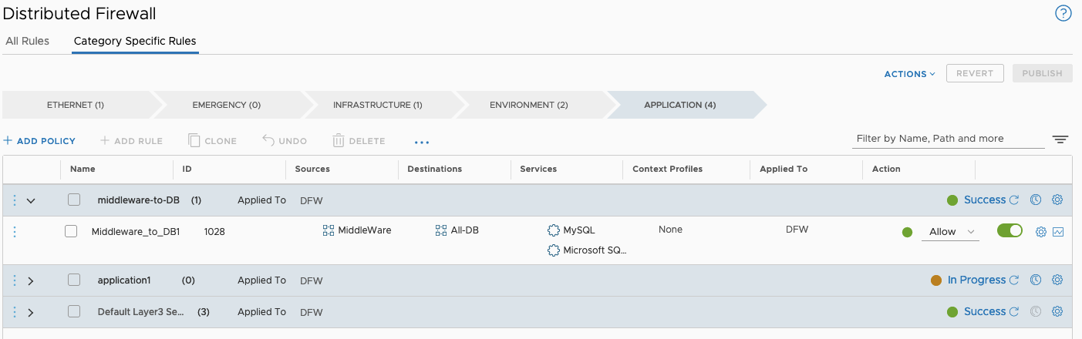
ASA Access-List to VMC NSX Distributed Firewall
Using pyVMC Client
DFW is broken down into categories
DFW Sections are created in categories
DFW Rules are created in sections

Slide 21
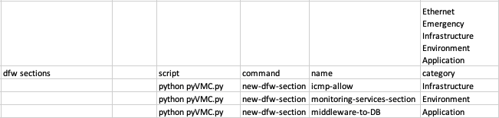
VMC NSX Distributed Firewall Sections
Using pyVMC Client
Prerequisites: none
Most rules will be application category rules

Slide 22
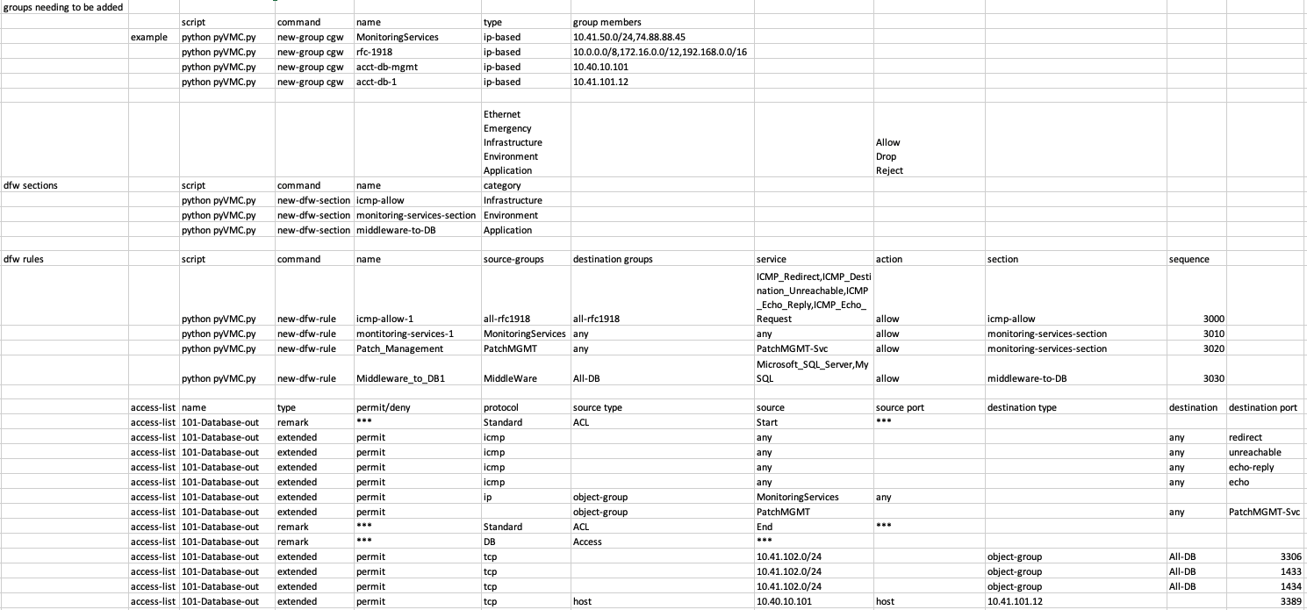
VMC NSX Distributed Firewall Rules
Using pyVMC Client
Prerequisites: DFW Sections, Source/Destination Groups, Services Defined
As you process the ACLs, more groups will most likely need to be created

Slide 23
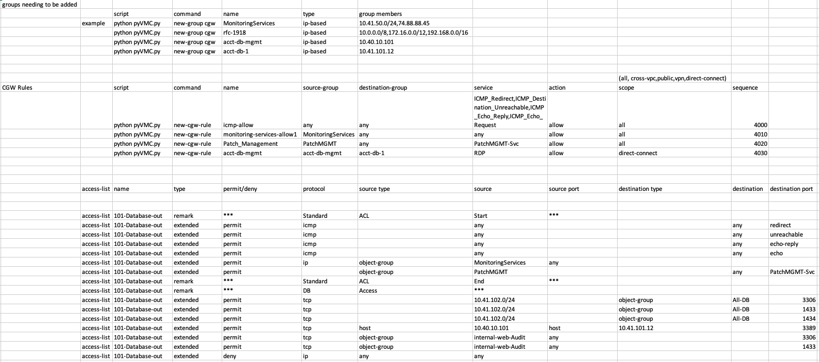
VMC NSX Compute Gateway Firewall Rules
Using pyVMC Client
Prerequisites: Source/Destination Groups, Services Defined
As you process the ACLs, more groups will most likely need to be created

Slide 24
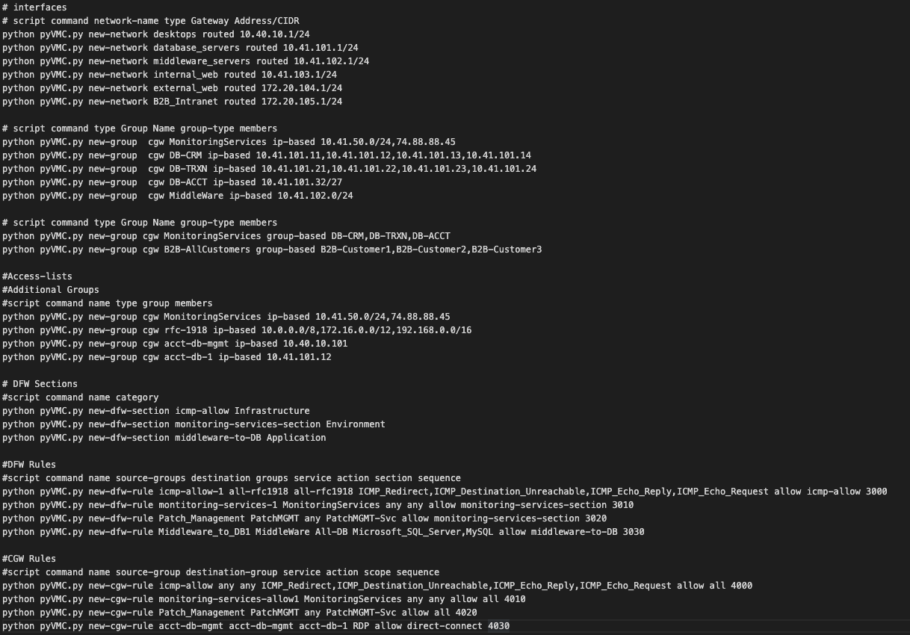
Results
Line by line scripting
Validate outputs of the commands, remember prerequisites
Spot validate operation success via GUI

Slide 25

Please take your survey.

Slide 26
Thank you!

