Slide 1
Capstone Project
Gabija Vaisvilaite
2020

Slide 2
Introduction
The aim of the project is to work on a case study which is to predict the severity of an accident using machine learning models and data science techniques learned on previous courses. To do that we will try to gain some insight from the data: under what weather, conditions of the road and lighting the incidents resulting in injuries occur more often? Are they more likely to happen in during the day or during the night? Do accidents occurring at an intersection tend to be more severe? Does speeding on average increase the severity of the accident? We will try to answer such questions using data. Specifically, we will try to find out which factors have the most impact on severity of the accident, create machine learning algorithms and train them to predict the severity of a possible accident.

Slide 3
Data Understanding
The given data set Data-Collisions.csv contains all collisions provided by Seattle Police Department from 2004 to present. The attributes in the data set include:
Time and Location
Conditions
Involved parties
Behaviour of involved parties
Details of the incident
Severity of the incident

Slide 4
Data Understanding: Time and Location
Coordinates of the collision X and Y
Description of the general location of the collision LOCATION
Type of the location (alley, block or intersection) ADDRTYPE
Category of junction at which collision took place JUNCTIONTYPE
Key that corresponds to the intersection associated with a collision INTKEY
Key for the lane segment in which the collision occurred SEGLANEKEY
Key for the crosswalk at which the collision occurred CROSSWALKKEY
Date of the incident INCDATE
Date and time of the incident INCDTTM

Slide 5
Data Understanding: Conditions
Description of the weather conditions during the time of the collision WEATHER
Condition of the road during the collision ROADCOND
Light conditions during the collision LIGHTCOND

Slide 6
Data Understanding: Involved Parties
Number of people PERSONCOUNT
Number of pedestrians PEDCOUNT
Number of pedal
cyclists PEDCYLCOUNT
Number of vehicles VEHCOUNT

Slide 7
Data Understanding: Behaviour
Whether or not speeding was a factor in the collision (Y/N) SPEEDING
Whether or not the collision involved hitting a parked car (Y/N) HITPARKEDCAR
Whether or not the pedestrian right of way was not granted (Y/N) PEDROWNOTGRNT
Whether or not collision was due to inattention (Y/N) INATTENTIONIND
Whether or not a driver involved was under the influence of drugs or alcohol UNDERINFL

Slide 8
Data Understanding: Behaviour
Code given to the collision by SDOT SDOT_COLCODE (for more information see the State Collision Code Dictionary)
Description of the collision corresponding to the collision code SDOT_COLDESC
Code provided by the state that describes the collision ST_COLCODE
Description that corresponds to the state’s coding designation ST_COLDESC
Number given to the collision by SDOT SDOTCOLNUM
Collision type COLLISIONTYPE

Slide 9
Data Understanding: Severity
Code that corresponds to the severity SEVERITYCODE
3—fatality
2b—serious injury
2—injury
1—property damage
0—unknown
Detailed description of the severity SEVERITYDESC

Slide 10
Data Understanding
The data set attributes also include:
a unique number for each incident OBJECTID
a report number REPORTNO
the column SEVERITYCODE copy SEVERITYCODE.1
INCKEY and COLDETKEY
whether INCKEY matches COLDETKEY column STATUS
EXCEPTRSNCODE and EXCEPTRSNDESC.

Slide 11
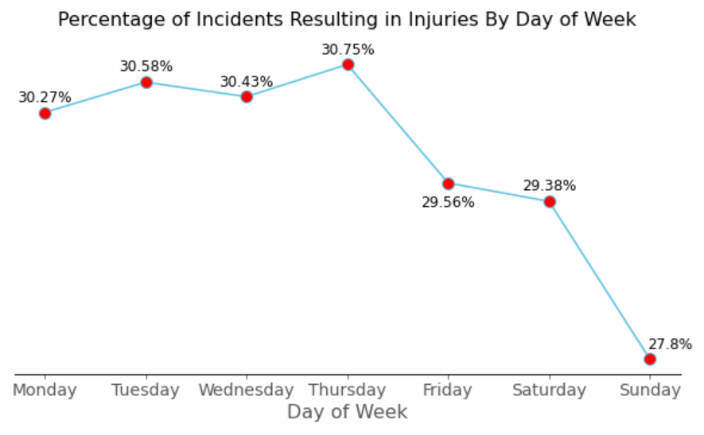
Explanatory Data Analysis: Day of Week

Slide 12
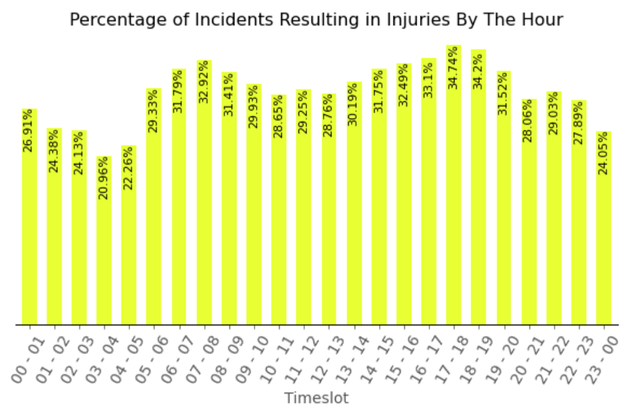
Explanatory Data Analysis: Time of Day

Slide 13
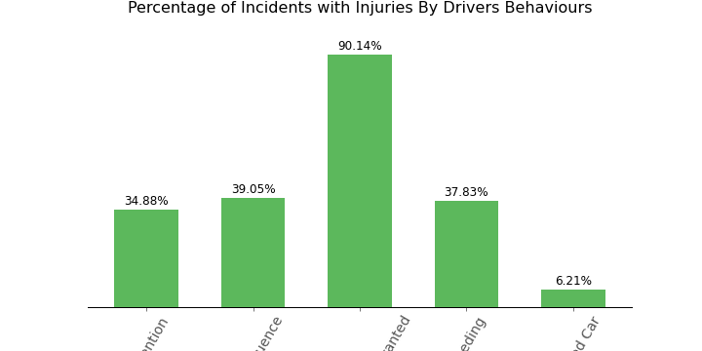
Explanatory Data Analysis: Behaviour

Slide 14
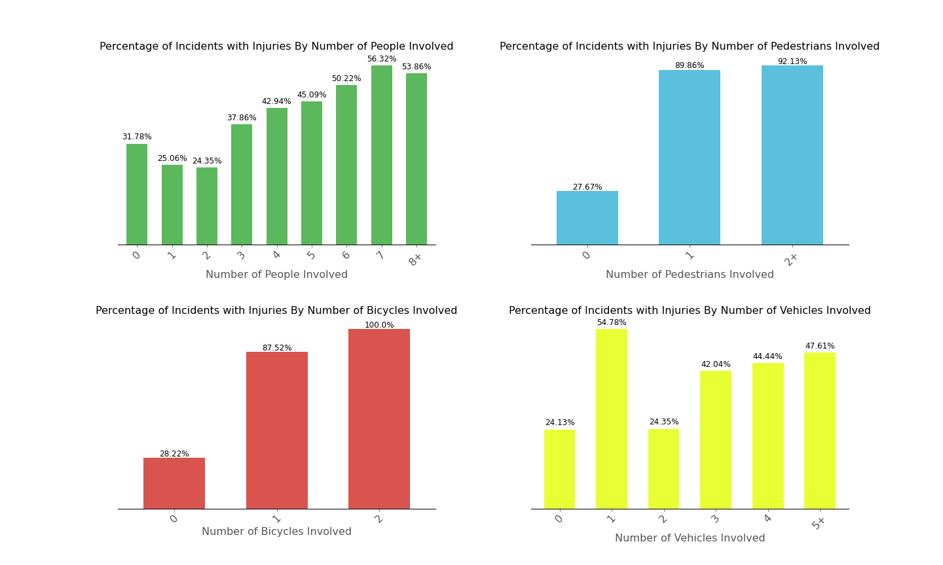
Explanatory Data Analysis: Parties Involved

Slide 15
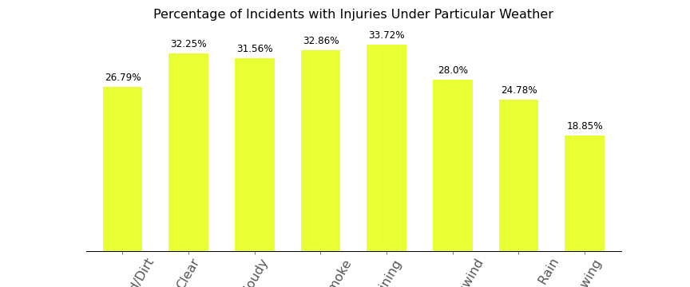
Explanatory Data Analysis: Weather

Slide 16
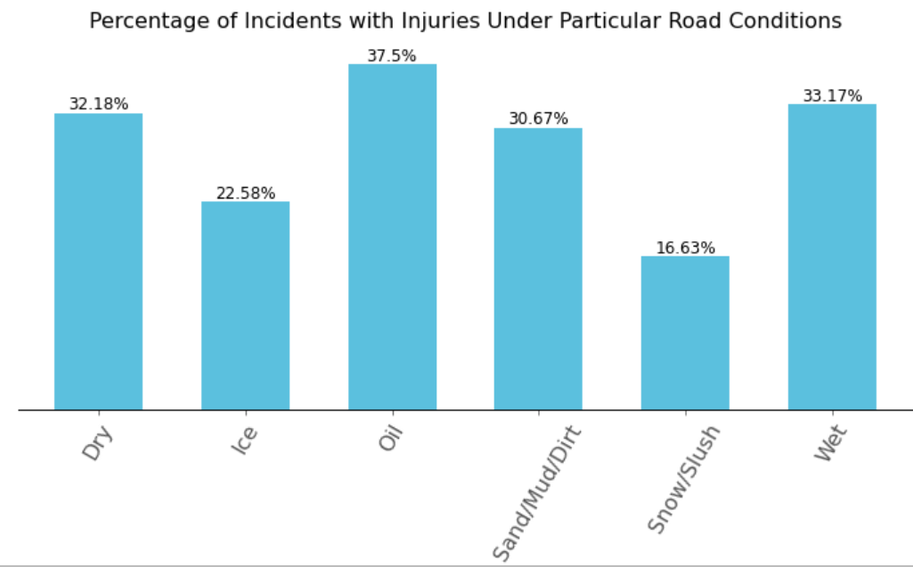
Explanatory Data Analysis: Road

Slide 17
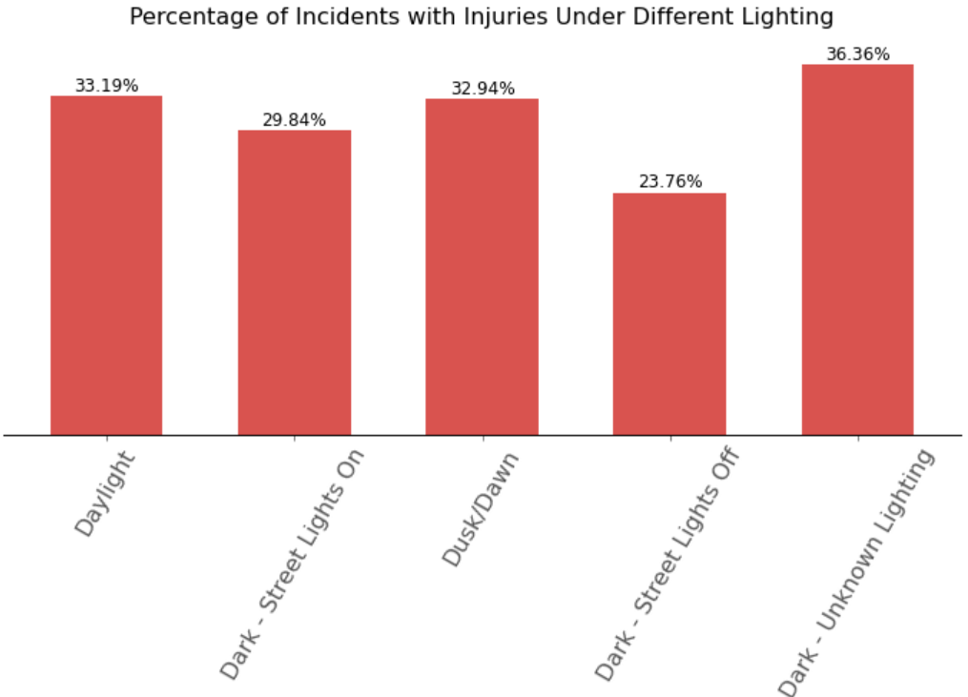
Explanatory Data Analysis: Lighting

Slide 18
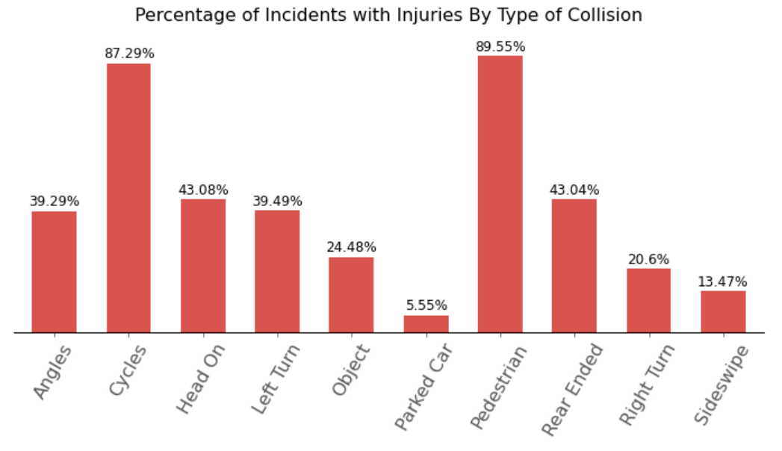
Explanatory Data Analysis: Type of Collision

Slide 19
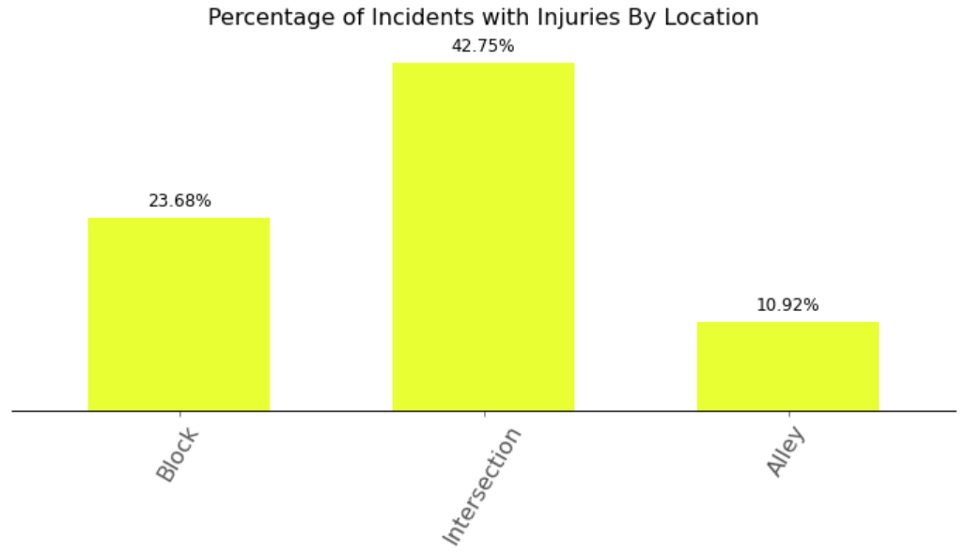
Explanatory Data Analysis: Location

Slide 20
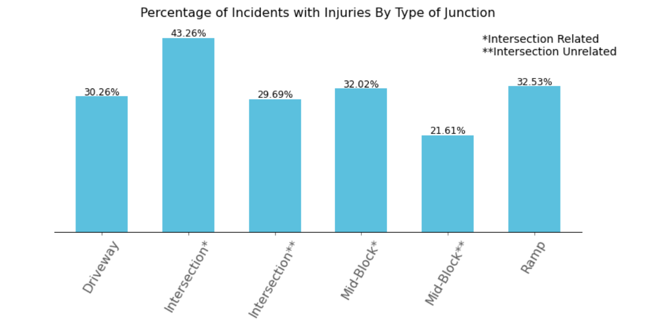
Explanatory Data Analysis: Junction Type

Slide 21
Modeling
For better accuracy we keep a lot of features, namely:
SEVERITYCODE (aim of the case study)
ADDRTYPE, JUNCTIONTYPE, COLLISIONTYPE
SDOT_COLCODE, ST_COLCODE
PERSONCOUNT, PEDCOUNT, VEHCOUNT
UNDERINFL, PEDROWNOTGRNT, SPEEDING, INATTENTIONIND, HITPARKEDCAR
WEATHER, ROADCOND
DAYOFWEEK, TIMESLOTS

Slide 22
Modeling
We pre-process data in two ways: we use MinMaxScaler for Gradient Boosting Classifier and XGBoost and StandardScaler for Decision Tree and Logistic Regression.
We also split our data into training and testing sets in order to train our models better.
For Gradient Boosting Classifier, Decision Tree and Logistic Regression we will use sample_weight function and for XGBoost we will use scale_pos_weight function.
We create all our models and make predictions with them.

Slide 23
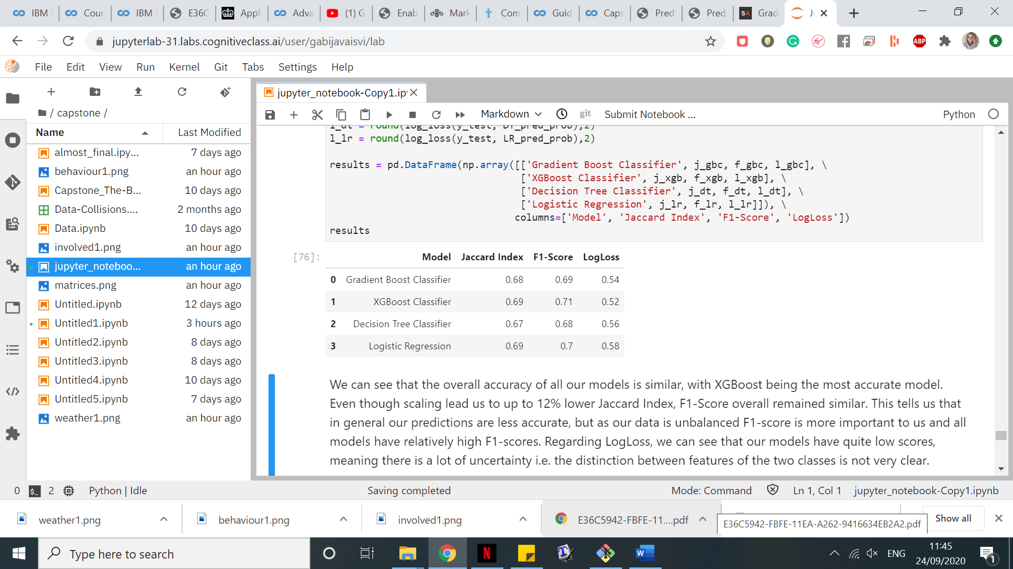
Accuracy of Models

Slide 24
Accuracy
We can see that the overall accuracy of all our models is similar, with XGBoost being the most accurate model. Even though scaling lead us to up to 12% lower Jaccard Index, F1-Score overall remained similar. This tells us that in general our predictions are less accurate, but as our data is unbalanced F1-score is more important to us and all models have relatively high F1-scores. Regarding LogLoss, we can see that our models have quite low scores, meaning there is a lot of uncertainty i.e. the distinction between features of the two classes is not very clear. Interestingly, even though Logistic Regression is mostly used for predicting continuous values, according to accuracy measures we can see that in our classification problem it has performed quite well. The worst performing model seems to be the Decision Tree.

Slide 25
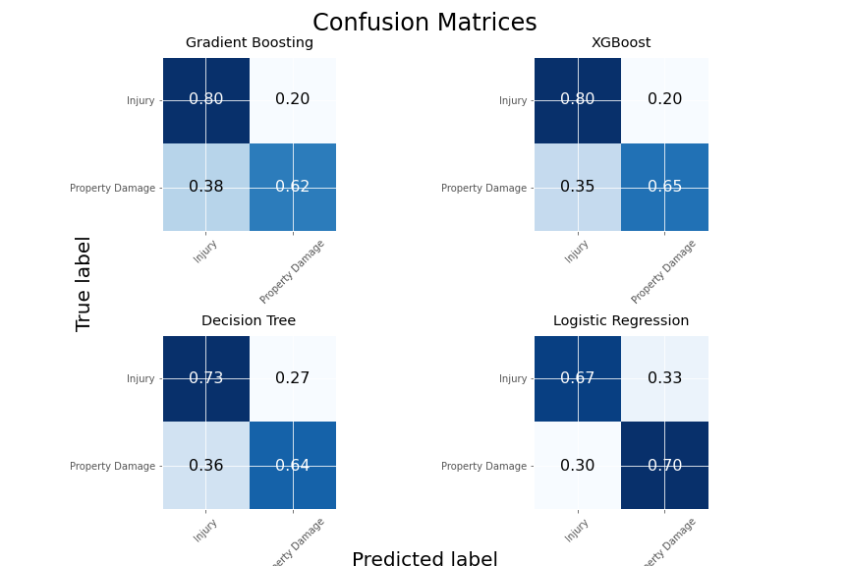
Accuracy
Interestingly, even though Logistic Regression is mostly used for predicting continuous values, according to accuracy measures we can see that in our classification problem it has performed quite well. The worst performing model seems to be the Decision Tree.

Slide 26
Accuracy
The Logistic Regression performs the worst in our problem i.e. it has the lowest rate of correctly predicting collisions resulting in injuries. In fact, 33% of the time it fails to predict which collisions will result in injuries. Not only that, 30% of the time it predicts that a collision will result in injury, even though it will not! In comparison, Decision Tree is slightly better and yet has similar flaws. Using these models could lead to too many resources spent on preventing severe collisions when in fact a high percentage of them would result in property damage only, and quite high percentage of them would be misclassified as property damage.
Gradient Boosting and XGBoost classifiers are the best for our problem, they both relatively accurately predict which collisions will result in injuries and have a comparatively small chance of failing to predict that a collision will result in property damage only. Out of these two, XGBoost is slightly more accurate. Thus, we conclude that XGBoost is the best classifier amongst the ones we tried.

Slide 27
Conclusion
In this project we have analysed the given data of collisions in Seattle between 2014 and now. We were tasked to find out which factors are the most influential on severity of a collision and create a machine learning model which predicts the severity of a collision. We have found out that more severe collisions tend to happen during peak hours when people go to/from work, that is, around 8A.M. and 5P.M. Collisions occurring at intersections or mid-block, but intersection related are also likely to be severe. If there are pedestrians and/or pedal cyclists involved, the collision is highly likely to result in injuries. We have created several machine learning models which predict whether the collision will result in injuries or property damage only, evaluated them and concluded that XGBoost was the best classifier in our case study.

