Slide 1
Microbee jobs
Semestral project for C# and .NET platform subject set
Author: Gabriela Suchopárová

Slide 2
Mobile Application
Cross platform (tested on Android & UWP, should work on iOS as well)
Micro job sharing
Creating jobs, accepting jobs of other users
Browsing through job list
Profile info

Slide 3
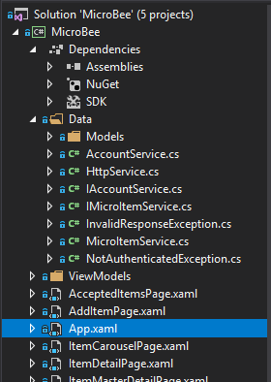
Xamarin forms project structure
Data access
HttpService
Models
MVVM
XAML
Styles
Some code also in .xaml.cs files

Slide 4
Httpservice
public bool Authenticated { get; private set; } public string Username { get; private set; } public async Task<bool> TryLoginAsync() public async Task LoginAsync(LoginModel model) public void Logout() public async Task RegisterAsync(RegisterModel model)
public async Task<T> GetAsync<T>(string path, List<KeyValuePair<string, object>> parameters = null, bool authorize = false)
public async Task PostAsync<T>(string path, T item, List<KeyValuePair<string, object>> parameters = null, bool authorize = false)
…

Slide 5
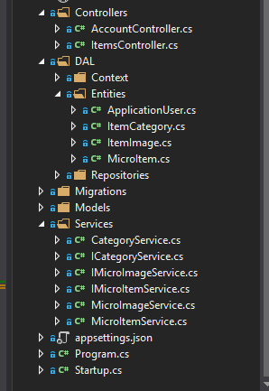
Asp.NET Core Web API
Controllers
DAL
Repositories
Context
Migrations
Models
Services

Slide 6
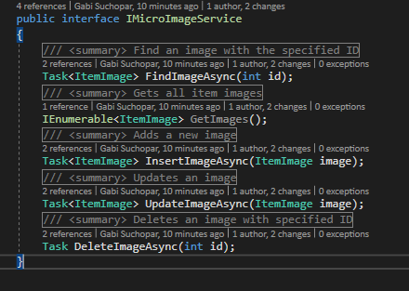
Service example
CRUD operations
Dependency injection

Slide 7
Models
1
*
Application
user
ItemCategory
1
MicroItem
1
ItemImage
*
1
Id
Username
Email
… asp net core identity properties …
Id
Name
Id
Title
Description
OwnerName
WorkerName
Category
ImageId
Id
ImageData : byte[]
0..1
*

Slide 8
Possible extensions
General
Payment
Messages
More data (jobs, profile,…)
Xamarin Forms
Better (or at least any at all ☺ ) style
Error handling (app crashes on error)
Profile update, data deletion
Currency converters

Slide 9
Azure
Deployed to Azure
Temporary

