Slide 1
Microbee jobs
Semestral project for C# and .NET platform subject set
Author: Gabriela Suchopárová

Slide 2
Mobile Application
Cross platform (tested on Android & UWP, should work on iOS as well)
Micro job sharing
Creating jobs, accepting jobs of other users
Browsing through job list
Profile info

Slide 3
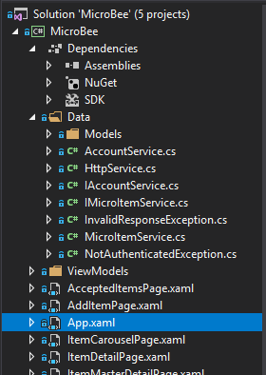
Xamarin forms project structure
Data access
MVVM
XAML
Styles
Some code also in .xaml.cs files

