Slide 1
Alicja’s part
Hi! Sorry for not being with you today:( That’s how I re-did clustering on Florida species:
-Clustering_1 - finding subpopulations of each species from habitats_fl.txt. The majority of them can be found worldwide so I did clustering on all of them - but if you want we can narrow it down to just Florida, let me know! However, I think it's interesting to see if there are any subpopulations in other places outside of Florida if we want to look into relocation. There are 36 maps of sub-populations, I only pasted 18 here, to see all of them open “meeting3.ipynb” but I don’t think it’s necessary
-Clustering_2 - finding ALL species subpopulations in Florida. Florida is small so I did all species available in the training data set, not just from habitats_fl.txt, however, if we want we can narrow it down, again - just let me know what you think will work better with our narrative. The bar plot of 5 most common species looks really interesting tho!

Slide 2
Clustering_1

Slide 3
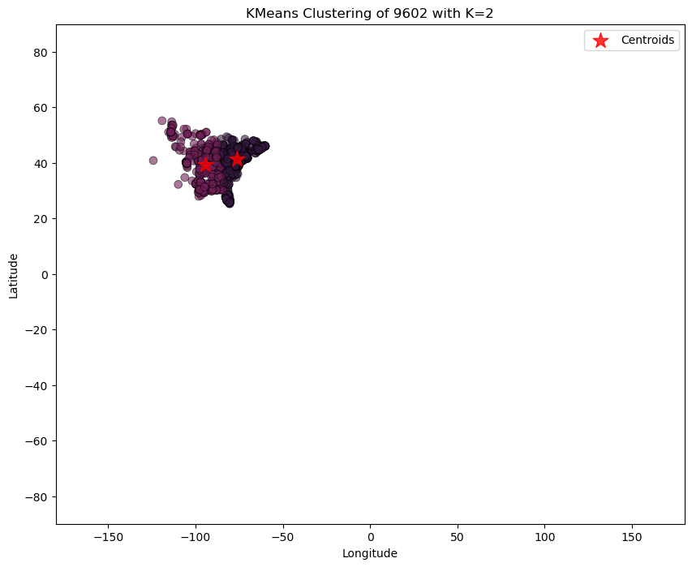
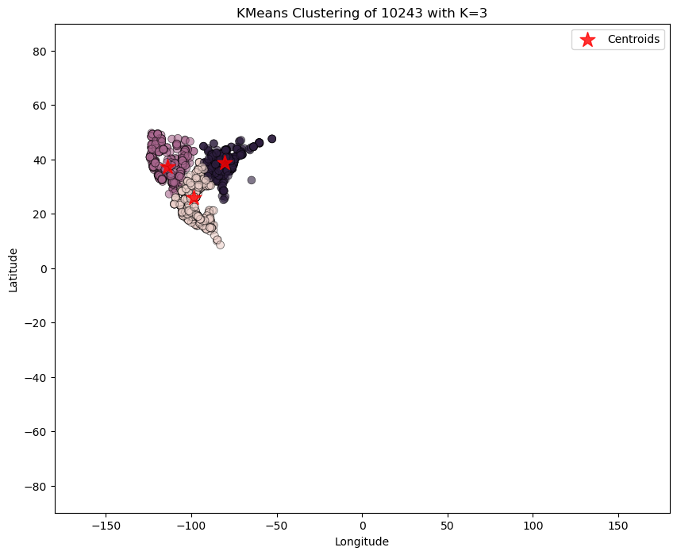
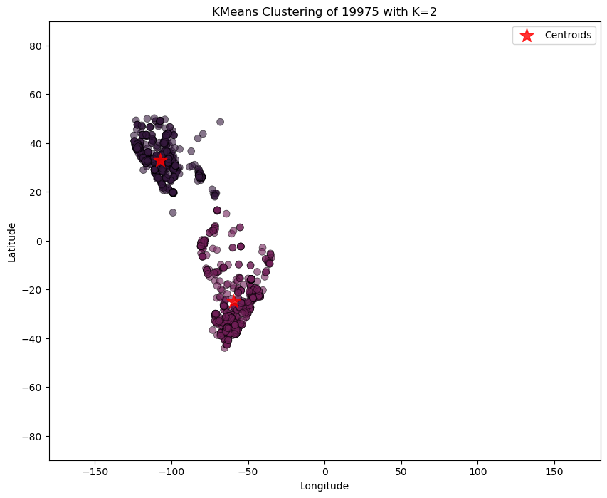
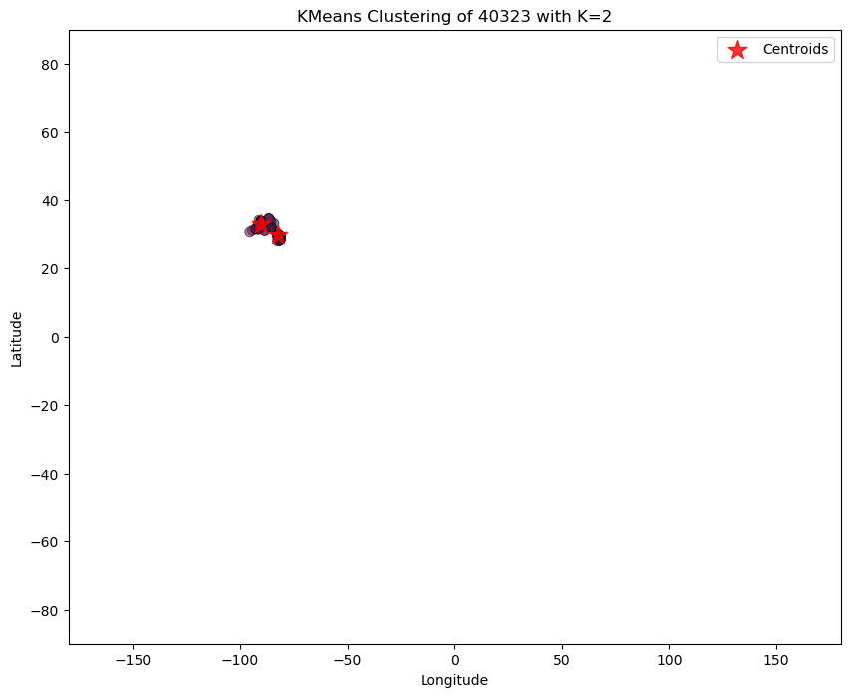
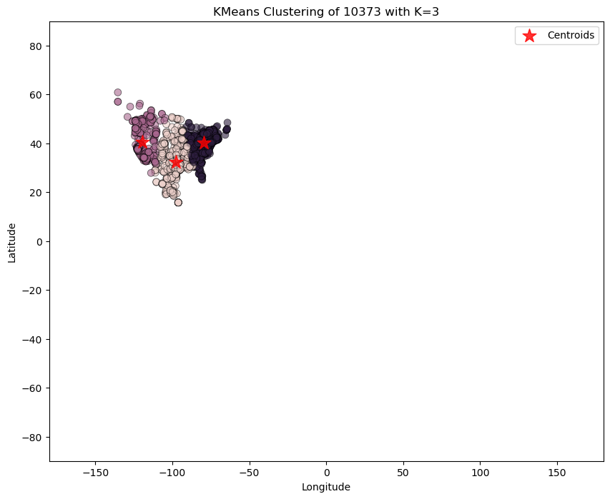
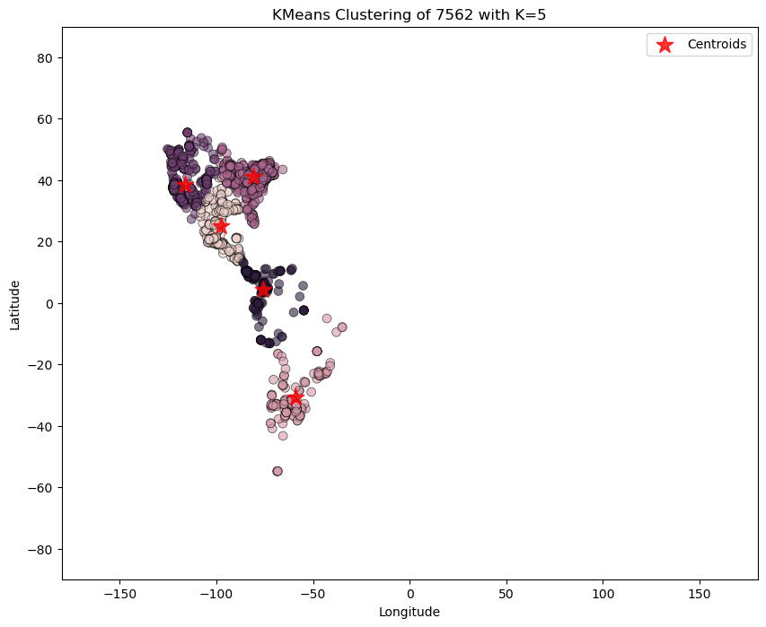

Slide 4
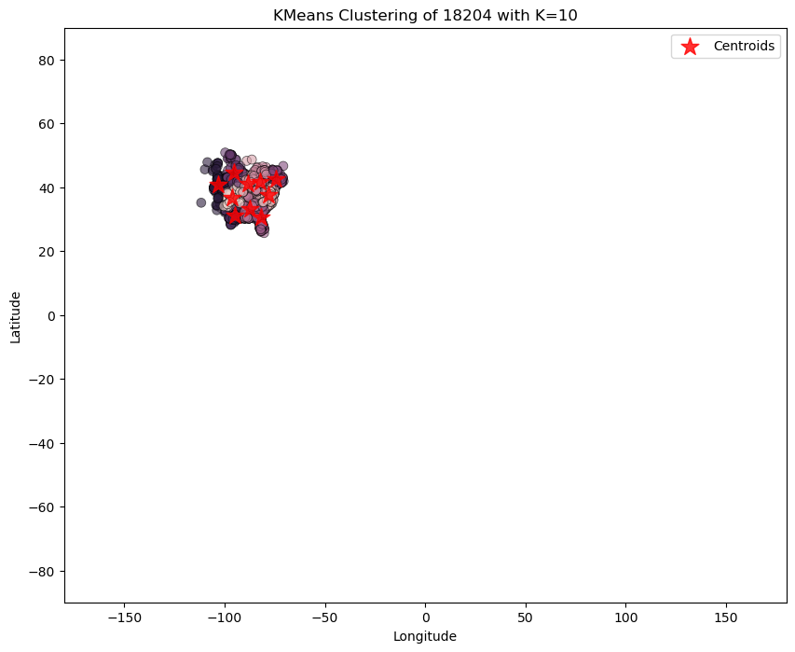
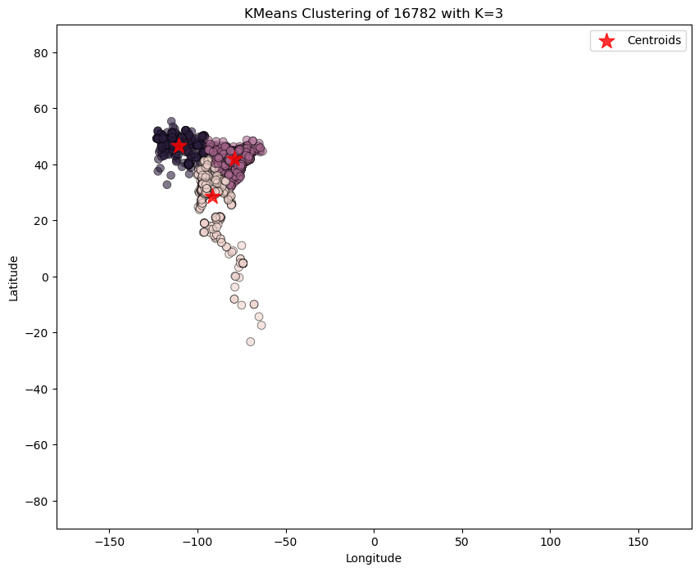
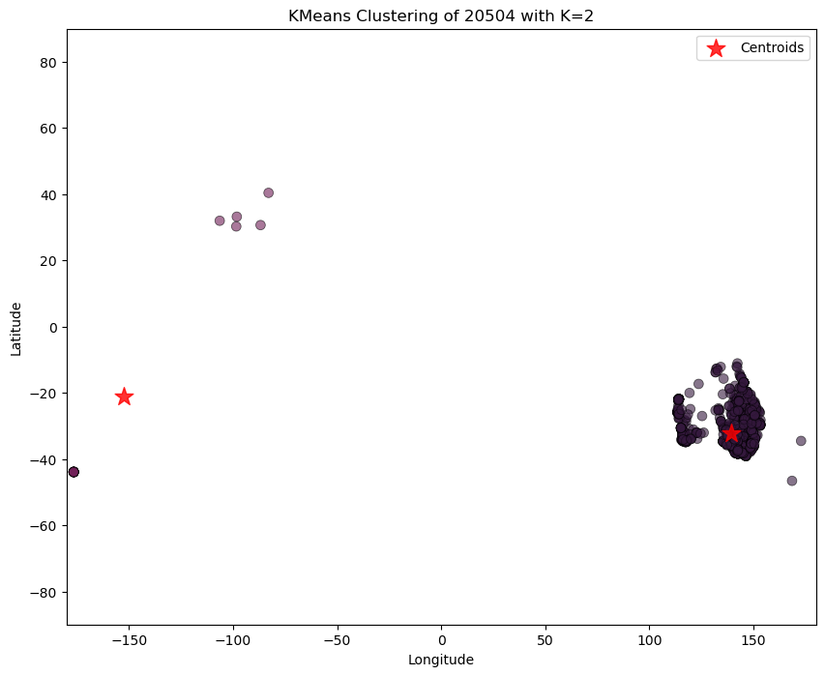
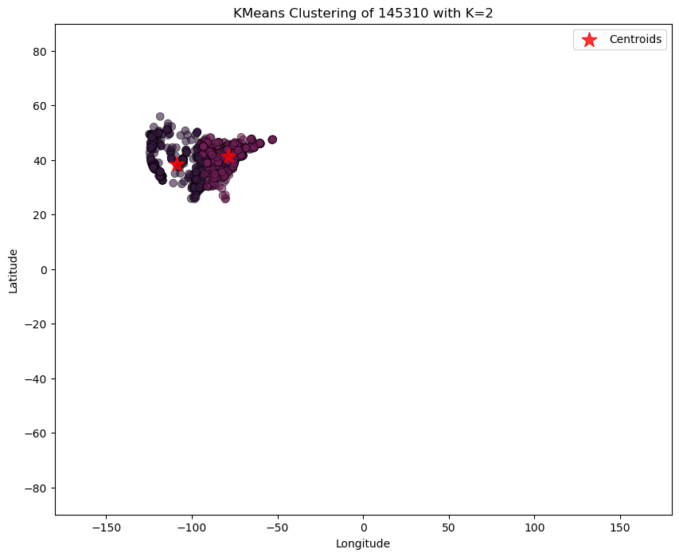
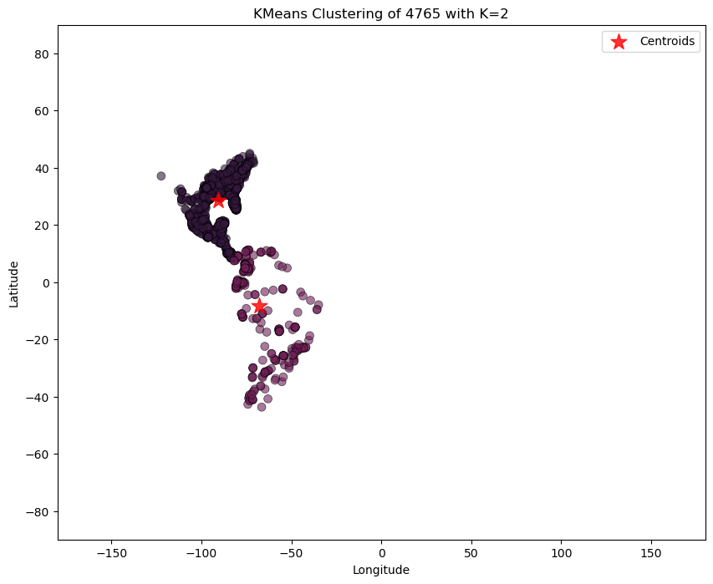
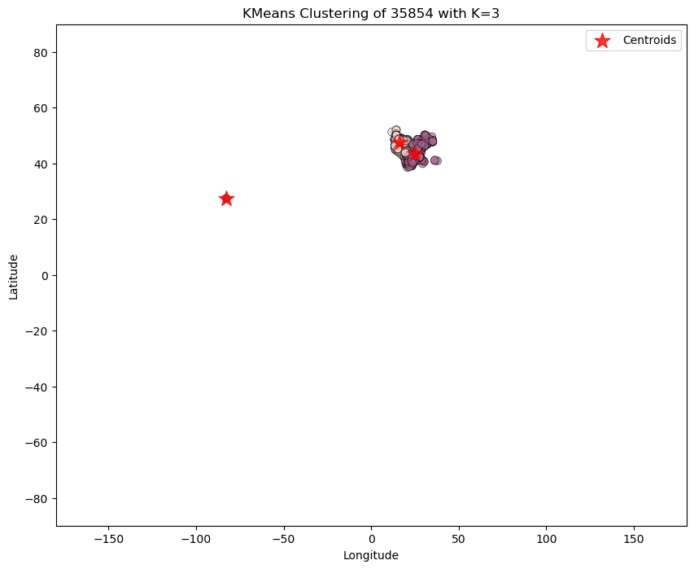

Slide 5
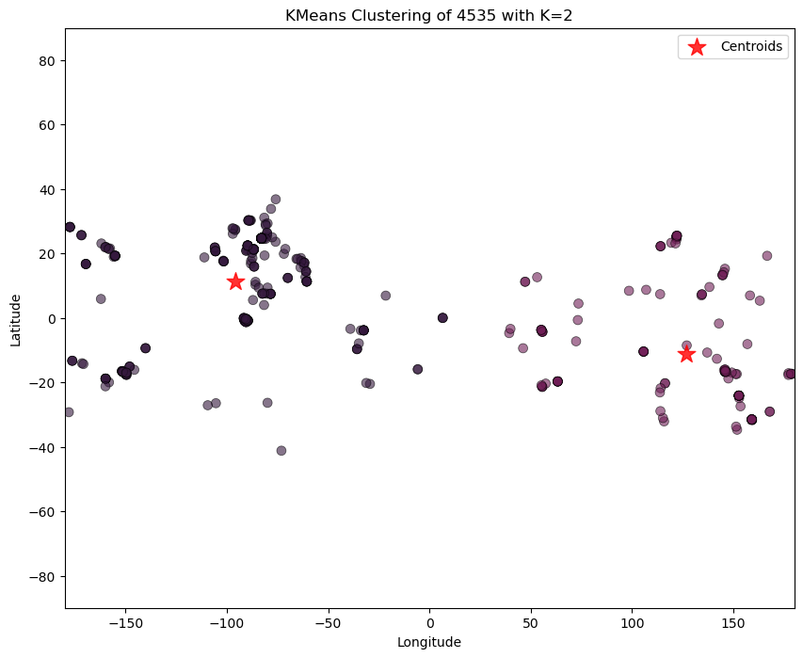
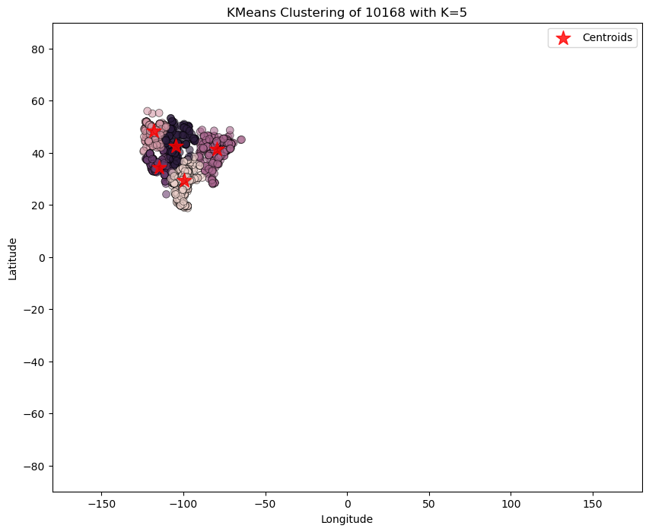
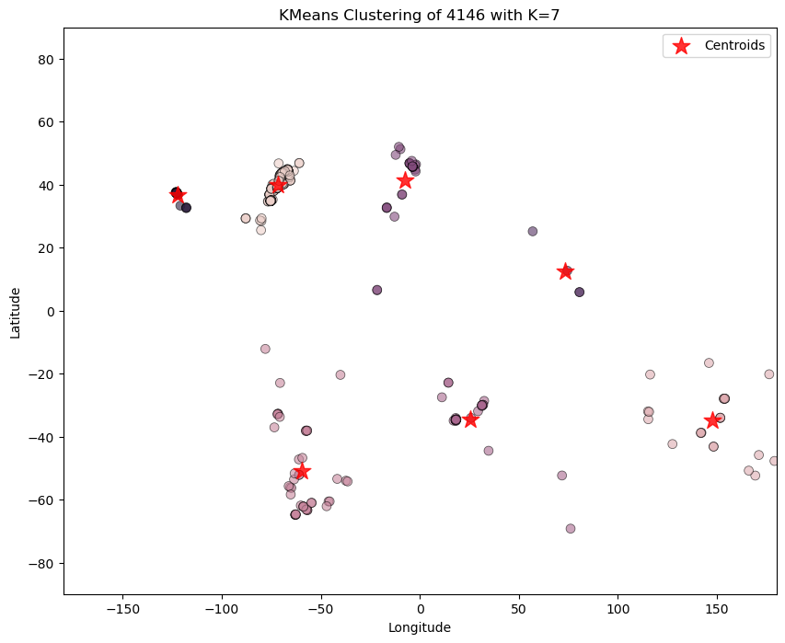
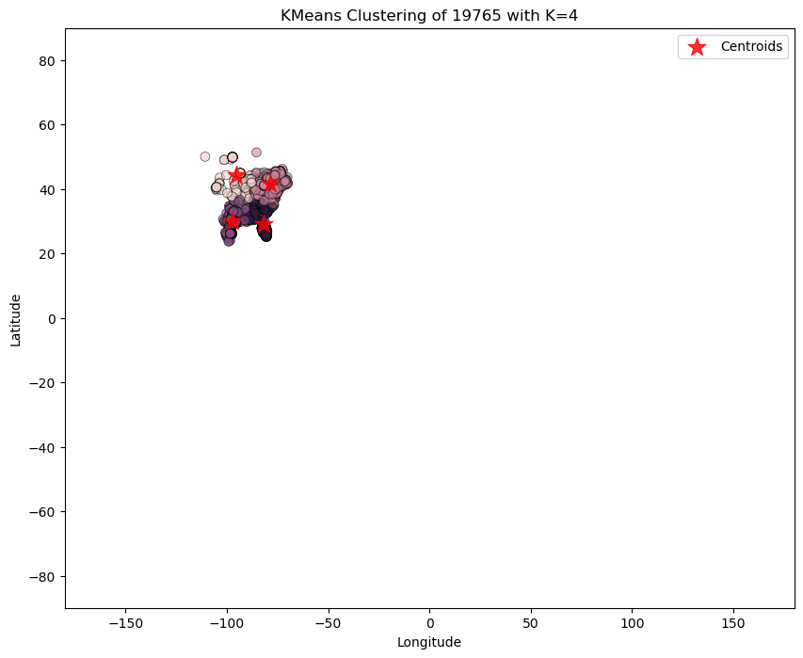
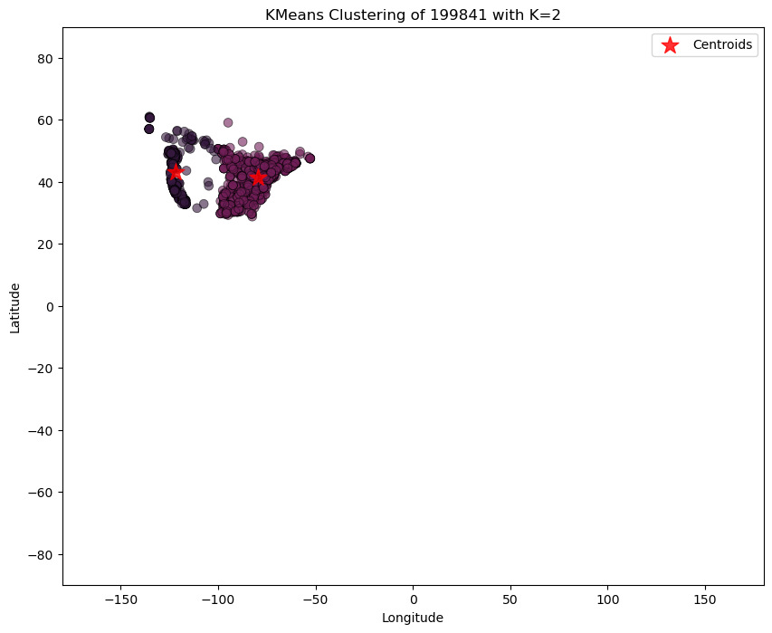
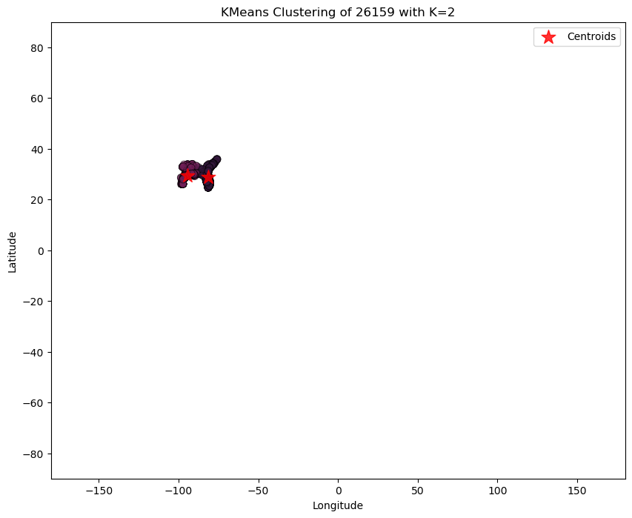

Slide 6
Clustering_2

Slide 7
