Slide 1

Computer simulation of a roadblock model of translational control
7th March 2024
Supervisors: Dr Edward Wallace
Dr Ramon Grima
Student: Gabin Rousseau

Slide 2
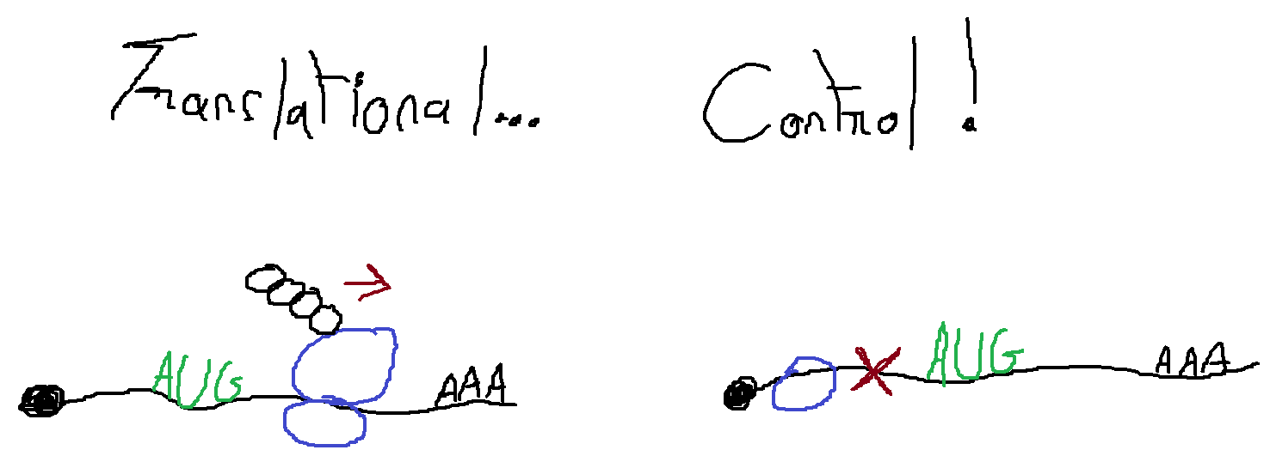
Translational control
Polypeptide
mRNA
Ribosome
(stuck at scanning)
Ribosome (elongating)

Slide 3
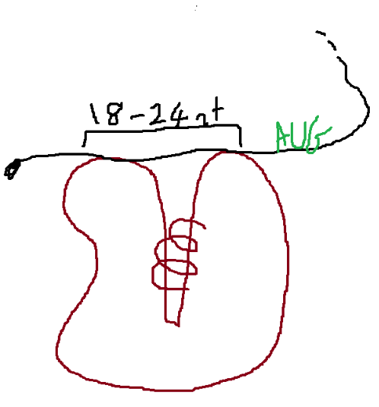
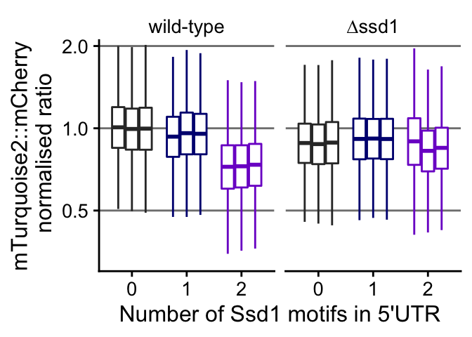
Ssd1, a hypothetical translation roadblock
Ssd1
KEYNOTE: 1 Ssd1 motif: ~5% protein production decrease
2 Ssd1 motifs: ~30% protein production decrease

Slide 4
Ssd1, a hypothetical translation roadblock
Ssd1
KEYNOTE: 1 Ssd1 motif: ~5% protein production decrease
2 Ssd1 motifs: ~30% protein production decrease

Slide 5
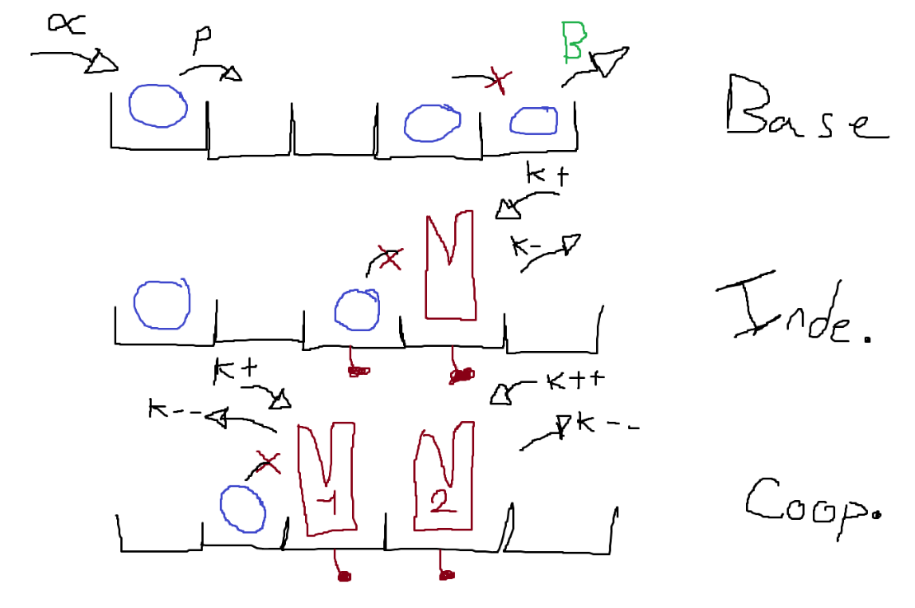
A modeling solution with TASEP? (Totally Asymmetric Simple Exclusion Process)
5

Slide 6
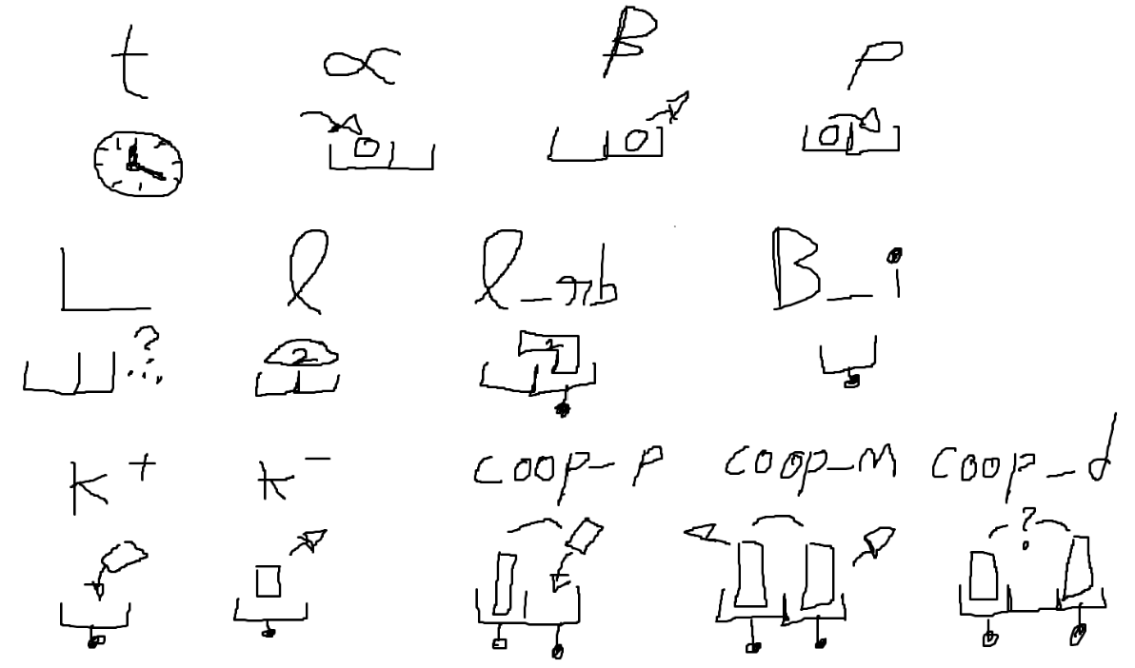
The parameters

Slide 7
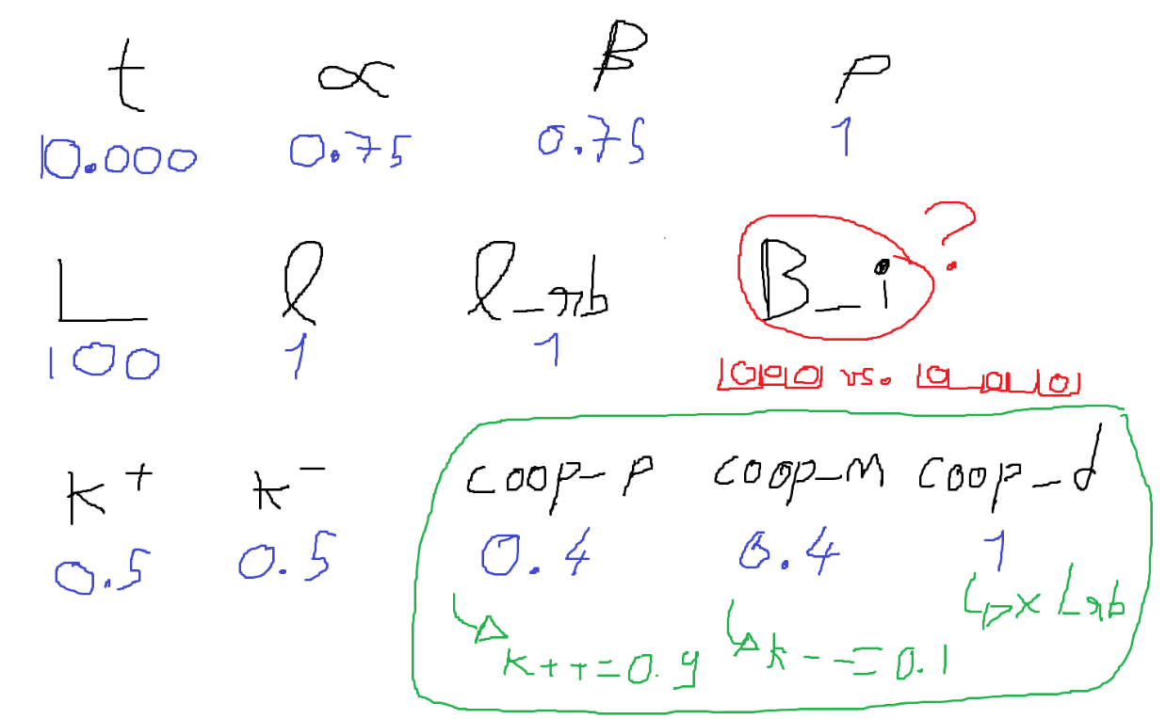
The parameter values

Slide 8
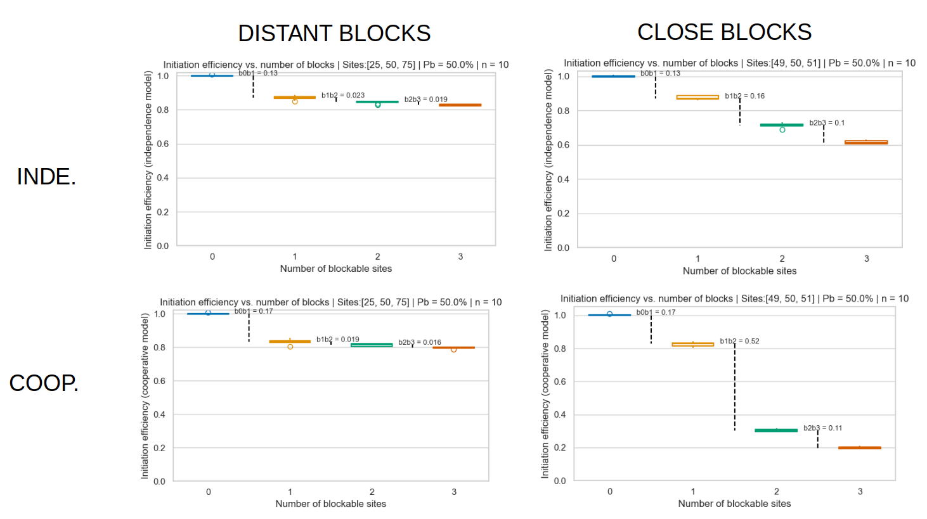

Slide 9
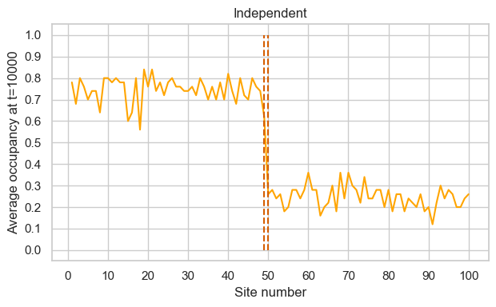
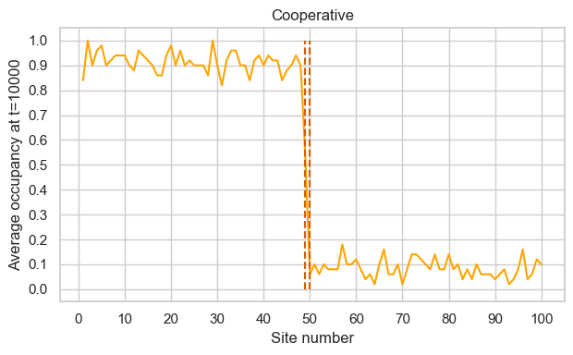
Over multiple runs, what is the average distribution of particles along the lattice?

Slide 10
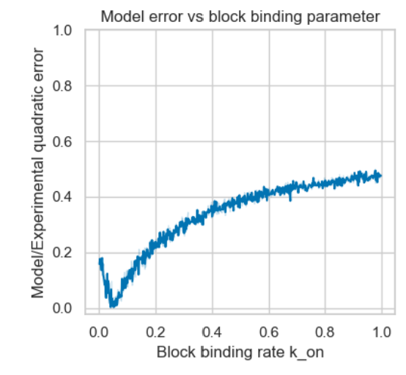
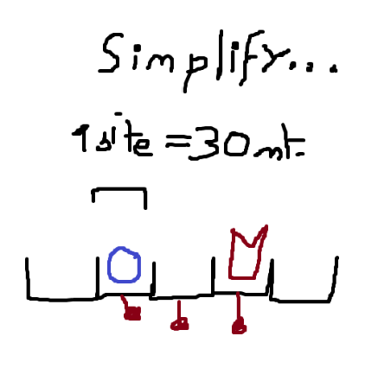
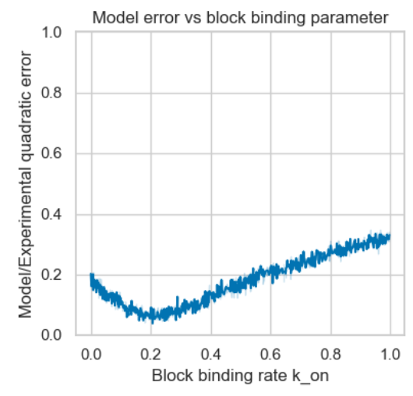
COOP.
INDE.
10

Slide 11
Thank you!

Slide 12
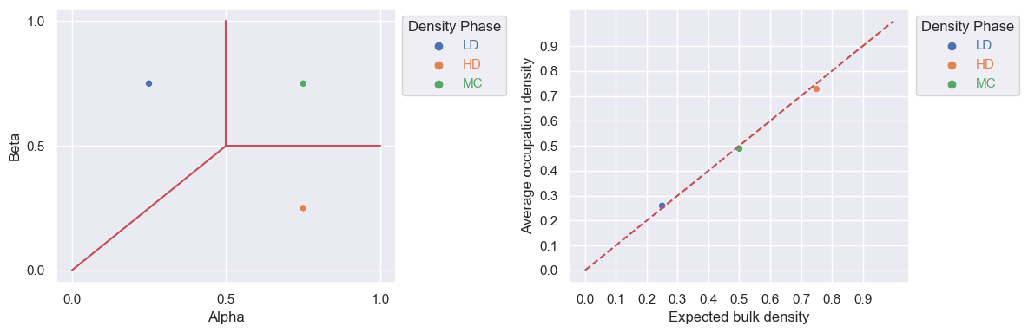
APPENDIX 1: Phase diagram

