Slide 1
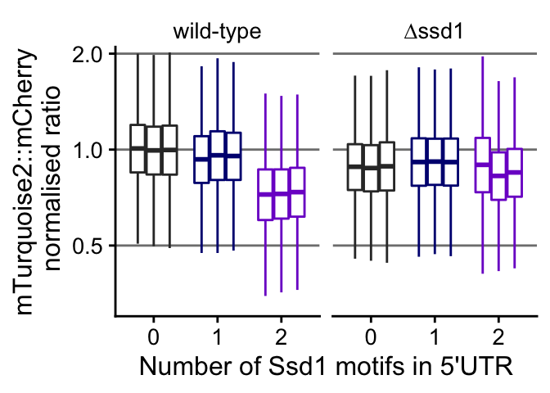
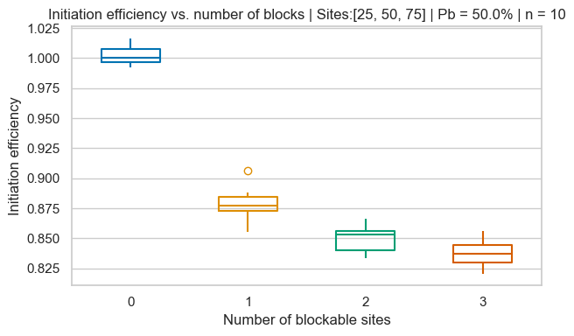
Modeling Ssd1 roadblocking: Independent OR Cooperative ?
Experimental results
Independent roadblocks model
QUESTION: Is roadblock independence sufficient to match experimental results, or can we only explain it by cooperativity?

Slide 2
