Slide 1
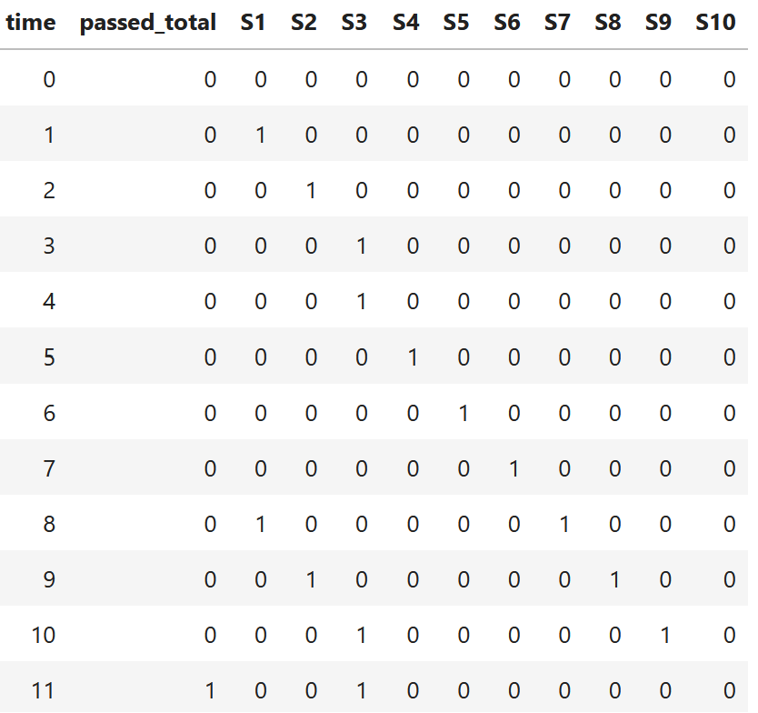
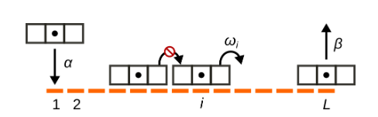
Getting used to TASEP formulaism to help model translation roadblocking in Python
Ssd1 (roadblock)
Ribosome
START
mRNA 5’
3’
Luca Ciandrini, Richmond L. Crisostomo, Juraj Szavits-Nossan; 2023

