Slide 1
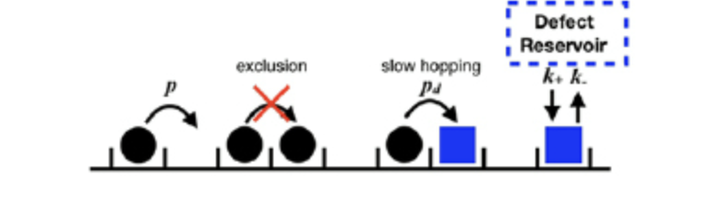
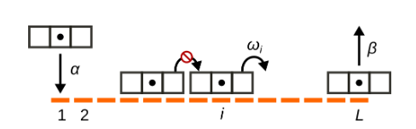
Harnessing TASEP to model roadblock dynamics in translation initiation
1.
Ssd1 (roadblock)
Ribosome
START
3.
mRNA 5’
2.
Warclaw et al; 2019
Luca Ciandrini, Richmond L. Crisostomo, Juraj Szavits-Nossan; 2023
QUESTION: What are the interactions between particle and roadblock dynamics in relation to initiation?

Slide 2
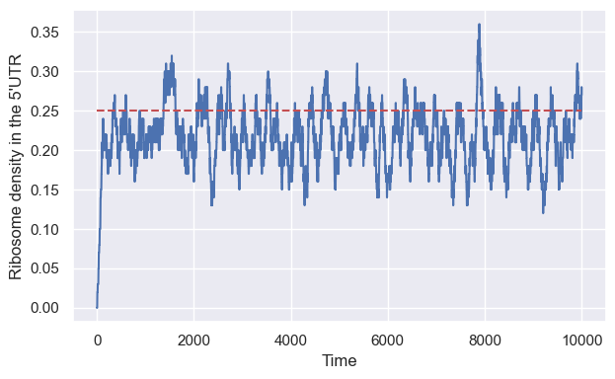
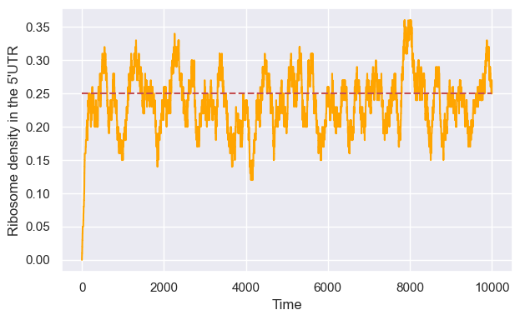
From discrete to indiscrete time (1)
LOW DENSITY
Expected = 0.25
CELLULAR AUTOMATON
GILLESPIE FORMULAISM

Slide 3
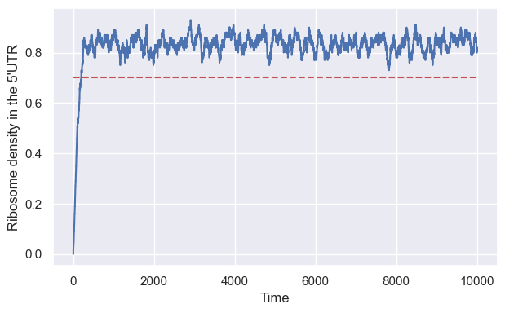
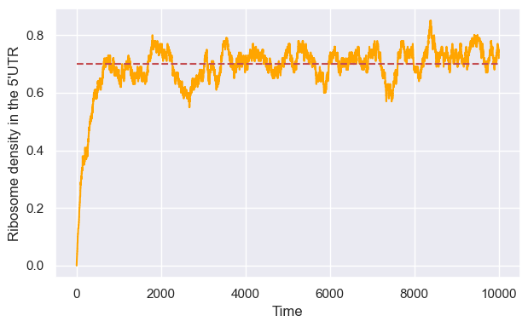
From discrete to indiscrete time (2)
HIGH DENSITY
Expected = 0.7
CELLULAR AUTOMATON
GILLESPIE FORMULAISM

