Slide 1

CARDIOVASCULAR HEALTH HOSPITAL ADMISSION INSIGHTS

Slide 2




Agenda
Problem Statement
Business Value
Methodology
Findings and Recommendations
Problem Statement
Business Value
Methodology
Findings and Recommendations
Future Work

Slide 3
Problem Statement
Agenda
Business Value
Methodology
Recommendations and Future work
Problem Statement
Objective:
Patients with diverse cardiovascular diseases are usually admitted through the emergency departments, into wards, or to the cardiac care units depending on whether they are acutely sick or being admitted for further evaluation. In general, at each stage, patients are triaged by clinical professionals to provide timely care. At the same time, a large set of demographic and clinical parameters are being recorded for each patient.
Problem: Manually analyzing and synthesizing information from all these variables proves to be challenging.
01
Proposed Solution:
In this project, we aim at building insights on this population (heart patients) by analyzing and correlating data collected from the triage and labs (blood pressure, hemoglobin, creatinine), pre-existing conditions such as diabetes and other factors such as residential areas (rural/urban) with multiple clinical outcomes such as duration of admission, deaths etc.
02
Benefits:
Develop a data driven decision support system to:
Healthcare Benefit: Assist clinicians in assessing patient risk.
Business Benefit: Providing quality and timely care,
Optimize resource utilization.
03

Slide 4
Business Value
Agenda
Problem Statement
Methodology
Recommendations and Future work
Patient Risk Assessment
Prediction of mortality
Duration of stay
Frequency of occurrence of heart failure
Identification of risk factors such as age.
Quality and Timely care giving
A risk factor assigned to a patient will ensure the right care is provided in good time.
Adoption of preventive care based on insights from data analytics
Policy guidance for health management e.g. trends or rural vs urban living on cardiovascular health
3 Resource Optimization
Risk stratification of patients to aid in resourcing of heart patients’ medication and specialists
Prediction of patients’ duration of stay can help in managing and allocating resources

Slide 5


Methodology
Agenda
Problem Statement
Business Value
Recommendations and Future work
Data Collection and Analysis:
Data was collected retrospectively on patients admitted over a period of two years (1 April 2017 to 31 March 2019) at Hero Dayanand Medical College Heart Institute Unit of Dayanand Medical College and Hospital, Ludhiana, Punjab, India.
During the data collection period, the cardiology unit had 14,845 admissions corresponding to 12,258 patients. For 1921 patients who had multiple admissions, the analysis only considered the data from their last admission for accuracy.
I760 patients who got discharged against medical advice (DAMA) were also excluded from the analysis.
Records from the remaining 11,498 patients were used to obtain features and outcomes. We used the admission records to obtain parameters related to demographics, admission details, lab measurements, and comorbidities.
Data Limitations:
Only two years of data from a single center; therefore, the generalizability of resulting models across multiple centers and multiple years must be investigated.

Slide 6
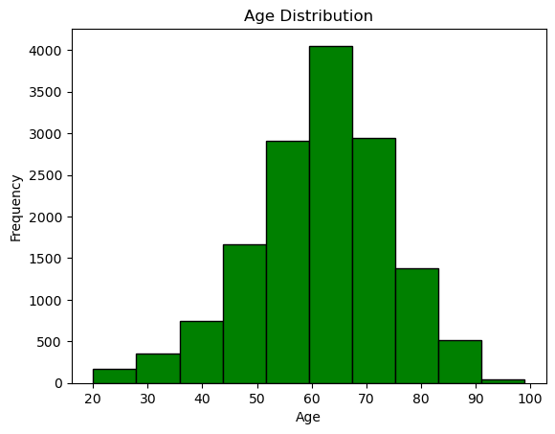
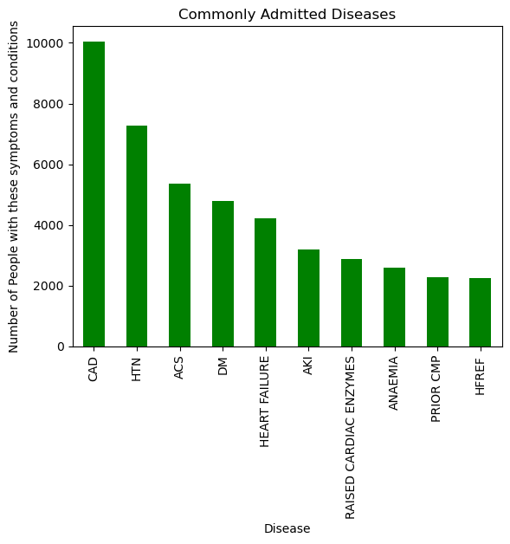
Findings and Recommendations
Agenda
Problem Statement
Business Value
Methodology
Coronary artery disease and Hypertension are the leading causes of admission for heart patients.
On average, patients admitted with heart conditions fall between the ages of 40 and 90.
The median age is however between 60 and 70.

Slide 7
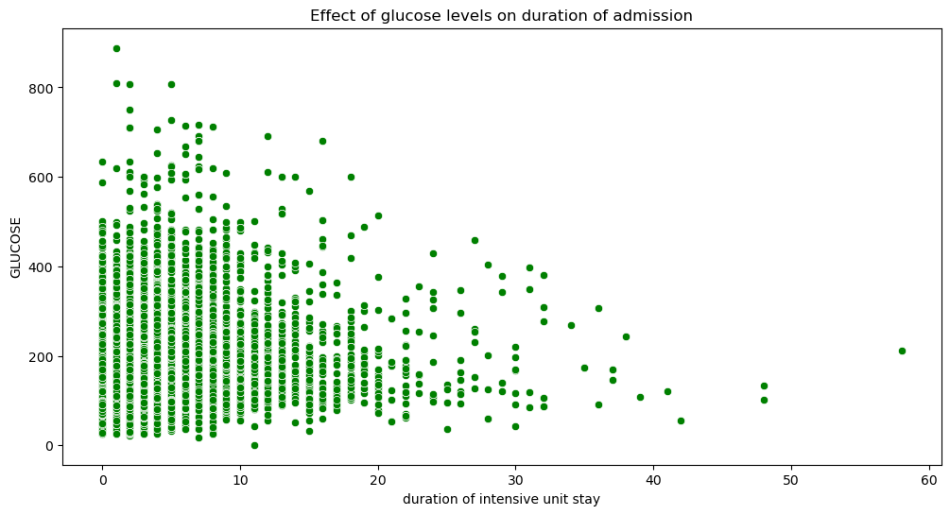
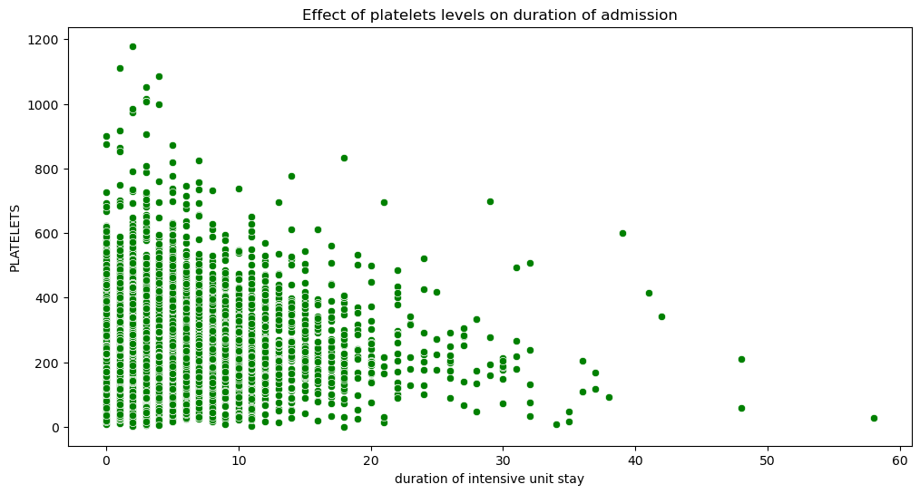
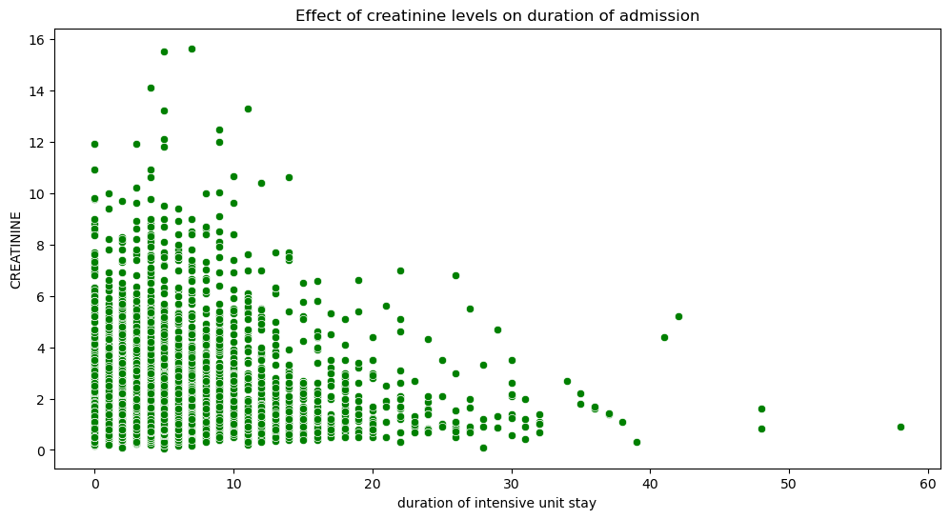
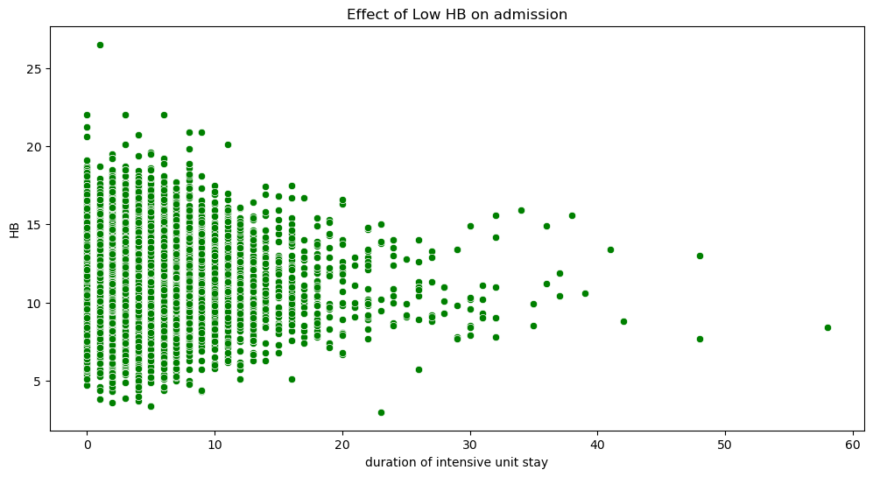
Findings and Recommendations
Agenda
Problem Statement
Business Value
Methodology

Slide 8
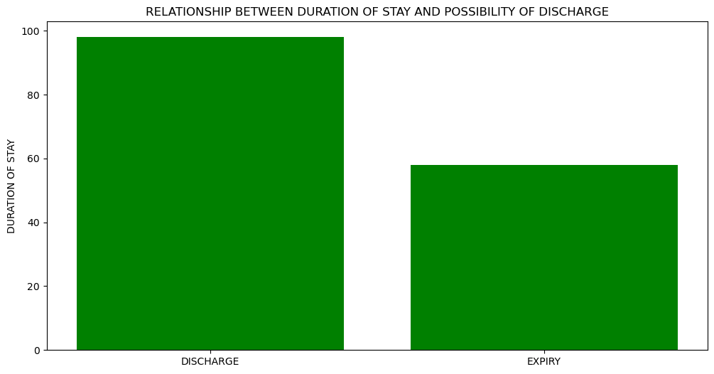
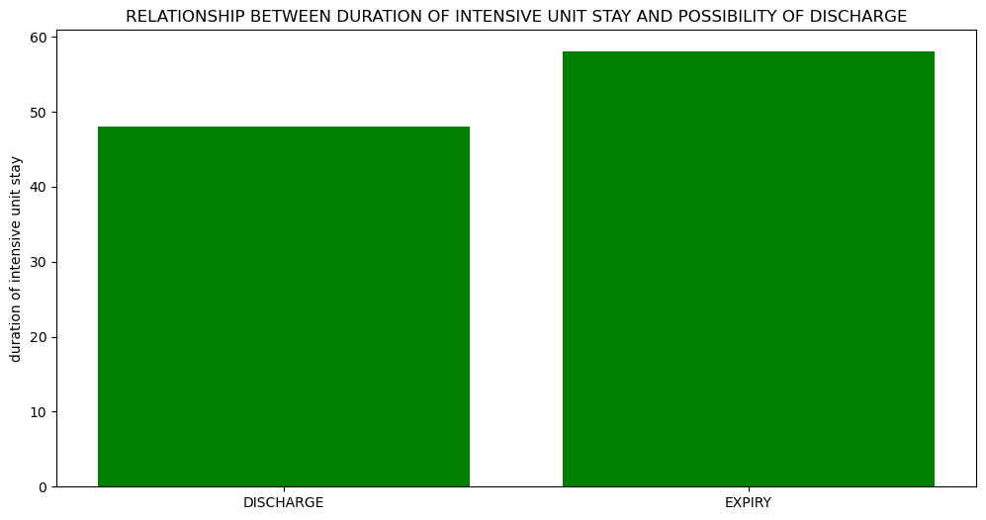
Findings and Recommendations
Agenda
Problem Statement
Business Value
Methodology
The longer the stay in hospital outside the ICU, probability of expiry(death) increases while that of discharge reduces.
However, the longer the stay in ICU, probability of expiry(death) decreases while that of discharge increases.
The insight is that the earlier the patient is elevated into ICU, the higher the chances of discharge.

Slide 9
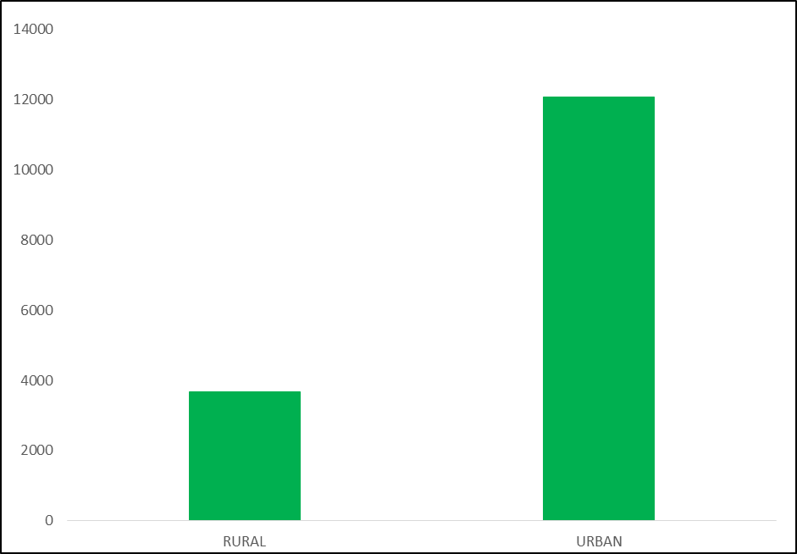
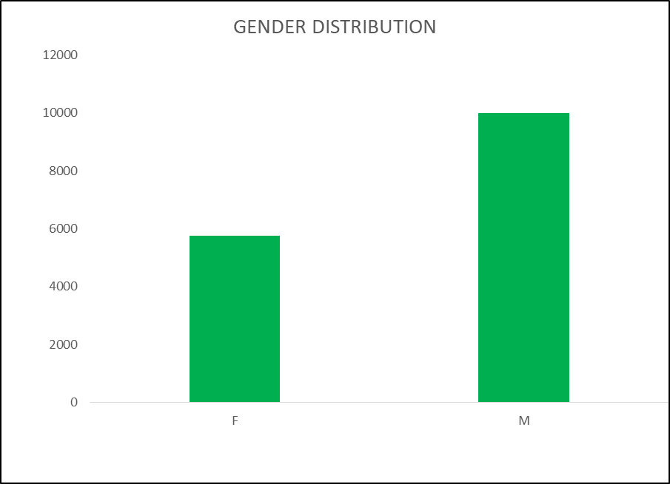
Recommendations and Future work
Agenda
Problem Statement
Business Value
Methodology
Of all admissions with heart problems, 63% are male while 37% are women.
77% live in urban areas while 23% are rural residents.
77% are between the ages of 51-75, 19% are over 75, 3% are between 18 and 35 while less than 1% are below 18years
Further, the algorithm can be enhanced to predict outcomes using all available parameters, including demographic and clinical parameters

Slide 10
Recommendations and Future work
Agenda
Problem Statement
Business Value
Methodology
1. Public health trends: {For Public and Research}
Disease prevalence: Identifying the most common heat related reasons for admission can inform public health initiatives for prevention and treatment.
Outbreak detection: Surveillance of admissions data can help detect potential outbreaks early and trigger rapid response measures.
Seasonal patterns: Identifying seasonal trends in admissions can improve resource allocation and planning for anticipated fluctuations in demand.
2. Healthcare resource utilization: {Hospital Management}
Bed occupancy and capacity: Admissions data can track bed utilization and identify potential shortages or inefficiencies in resource allocation.
Length of stay: Analyzing average length of stay for different conditions can improve discharge planning and optimize resource utilization.
Readmission rates: Identifying factors associated with readmissions can help improve patient care and reduce unnecessary readmissions, lowering costs.
3. Quality of care: {Improvements in Quality} Check for trends in expiries (deaths)
Outcome analysis: Linking admissions data with treatment outcomes and mortality rates can identify improvement aeas in healthcare quality and patient safety.
Patient satisfaction: Surveys integrated with admissions data can provide valuable insights into patient experiences and areas for improvement in patient satisfaction.
4. Demographic trends:
Socioeconomic disparities: Admissions data can highlight inequities in access to healthcare and identify vulnerable populations at increased risk of certain conditions.
Ageing population: Analyzing admissions data for older adults can inform policies and healthcare services tailored to their specific needs.
Geographic variations: Identifying regional disparities in admission rates can guide resource allocation and public health interventions in underserved areas.
5. Cost analysis:
Cost drivers: Linking admissions data with billing information can identify the most expensive conditions and treatments, informing cost-reduction strategies.

Slide 11

Appendix
Agenda
Problem Statement
Business Value
Methodology
Graphs used:
Bar Plots:
Bar plots were used for plotting duration of stay at the hospital after admission and either discharge or expiry. This is because bar graphs are used for comparing categorical data or discrete numerical values. They were also used to display differences in admissions between different segments e.g gender and residential areas.
2. Scatter Plots:
Scatter plots are best used for revealing relationships or patterns between two numerical variables.. In this review they were used to show the correlation between lab and triage health data and the length and duration of admission.
3. Histograms:
Histograms were used to show distribution of age of patients admitted.
They were used because histograms are used for showing the distribution of a single numerical variable.
4. Box Plots:
Future work
Machine learning models can be used to predict in-hospital mortality, heart failure, and duration of stay using data available at the time of admission to a cardiac care unit.
Further, the algorithm can be enhanced to predict outcomes using all available parameters, including demographic and clinical parameters

