Slide 1

CARDIOVASCULAR HEALTH HOSPITAL ADMISSION INSIGHTS

Slide 2




Agenda
Problem Statement
Business Value
Methodology
Findings and Recommendations
Problem Statement
Business Value
Methodology
Findings and Recommendations
Future Work

Slide 3
Problem Statement
Agenda
Business Value
Methodology
Recommendations and Future work
Problem Statement
Objective:
Patients with diverse cardiovascular diseases are usually admitted through emergency departments, into wards, or to the cardiac care units depending on whether they are acutely sick or being admitted for further evaluation. In general, at each stage, patients are triaged by clinical professionals to provide timely care. At the same time, a large set of demographic and clinical parameters are recorded for each patient.
Problem:
Manually analyzing and synthesizing information from all these variables proves to be challenging. This has led to minimal utilization of the huge amount of data collected from the triage as well as labs.
01
Proposed Solution:
In this project, we used the data collected from the heart patients to build insights. This was done through analysis and correlating data collected from the triage (risk factors such as tobacco and alcohol use, blood pressure, gender) and labs (platelets, hemoglobin, creatinine), pre-existing conditions such as diabetes and other factors such as the patient’s residence (rural/urban). The study also sought trends and patterns in the data collected.
02
Benefits:
Develop a data driven decision support system to:
Healthcare Benefit: Assist clinicians in assessing patient risk.
Business Benefit: Providing quality and timely care,
Optimize resource utilization.
03

Slide 4
Business Value
Agenda
Problem Statement
Methodology
Recommendations and Future work
Patient Risk Assessment
Prediction of mortality
Duration of stay to aid in resource allocation
Frequency of occurrence of heart failure
Identification of risk factors such as age.
Quality and Timely care giving
A risk factor assigned to a patient will ensure the right care is provided in good time.
Adoption of preventive care based on insights from data analytics
Policy guidance for health management e.g. trends or rural vs urban living on cardiovascular health
3 Resource Optimization
Risk stratification of patients to aid in resourcing of heart patients’ medication and specialists
Prediction of patients’ duration of stay can help in managing and allocating resources

Slide 5


Methodology
Agenda
Problem Statement
Business Value
Recommendations and Future work
Data Collection and Analysis:
Data was collected retrospectively on patients admitted over a period of two years (1 April 2017 to 31 March 2019) at Hero Dayanand Medical College Heart Institute Unit of Dayanand Medical College and Hospital, Ludhiana, Punjab, India.
During the data collection period, the cardiology unit had 14,845 admissions corresponding to 12,258 patients. For 1921 patients who had multiple admissions, the analysis only considered the data from their last admission for accuracy.
I760 patients who got discharged against medical advice (DAMA) were also excluded from the analysis.
Records from the remaining 11,498 patients were used to obtain features and outcomes. We used the admission records to obtain parameters related to demographics, admission details, lab measurements, and comorbidities.
Data Cleaning
Data cleaning was done on columns with missing values as well as non-numeric values.
Data Limitations:
Only three years of data from a single center; therefore, the generalizability of resulting models across multiple centers and multiple years must be investigated.

Slide 6
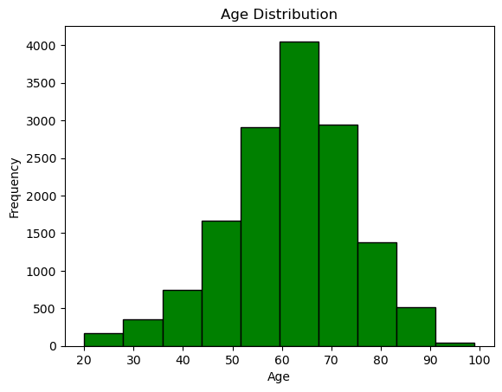
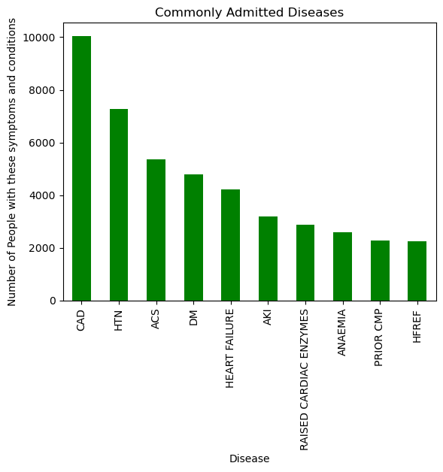
Findings
Agenda
Problem Statement
Business Value
Methodology
Coronary artery disease and Hypertension are the leading causes of admission for heart patients. On average, patients admitted with heart conditions fall between the ages of 40 and 90, with the highest number being between 60 and 70.

Slide 7
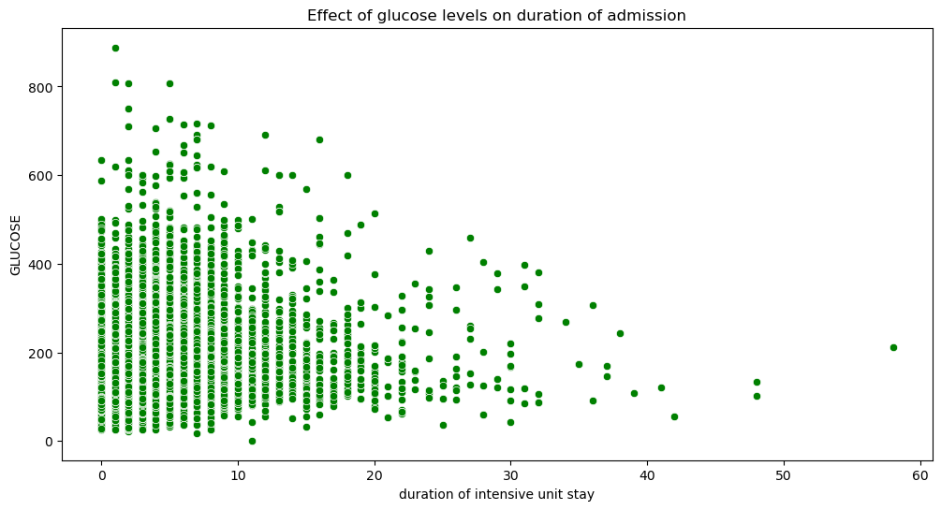
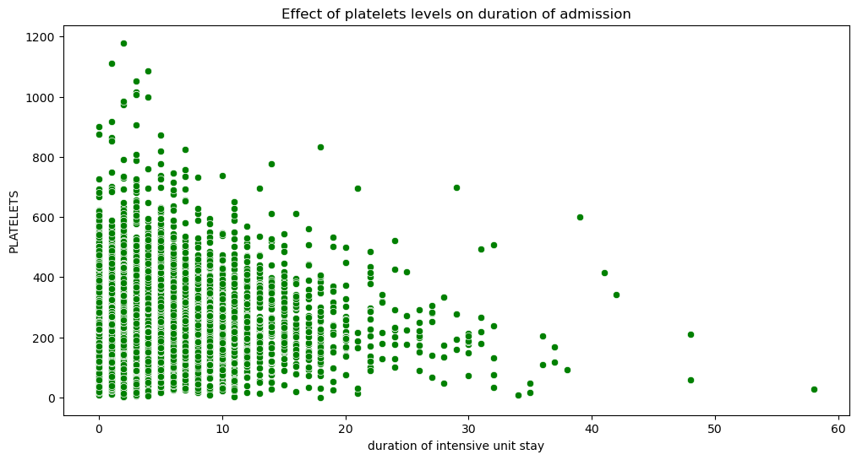
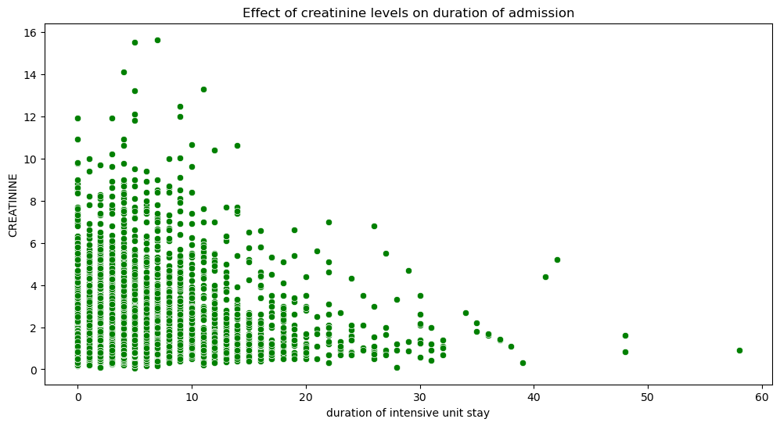
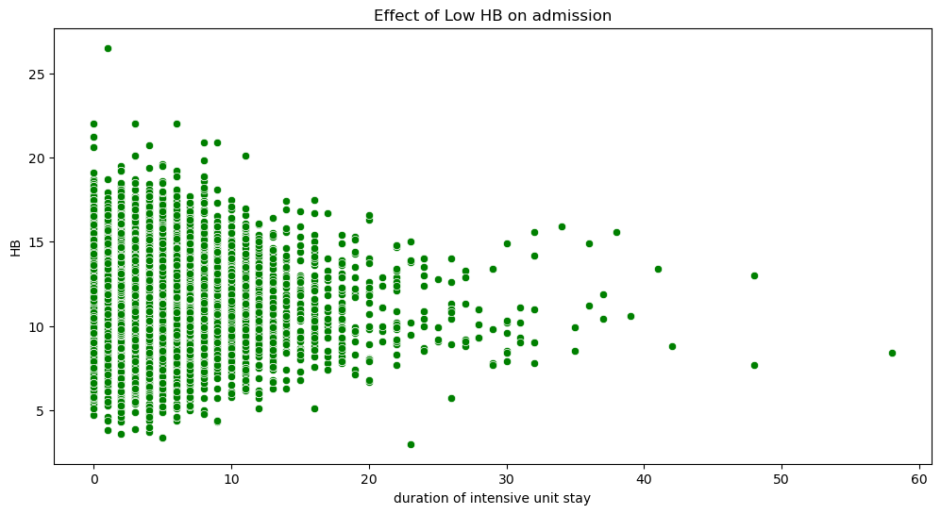
Findings
Agenda
Problem Statement
Business Value
Methodology

Slide 8
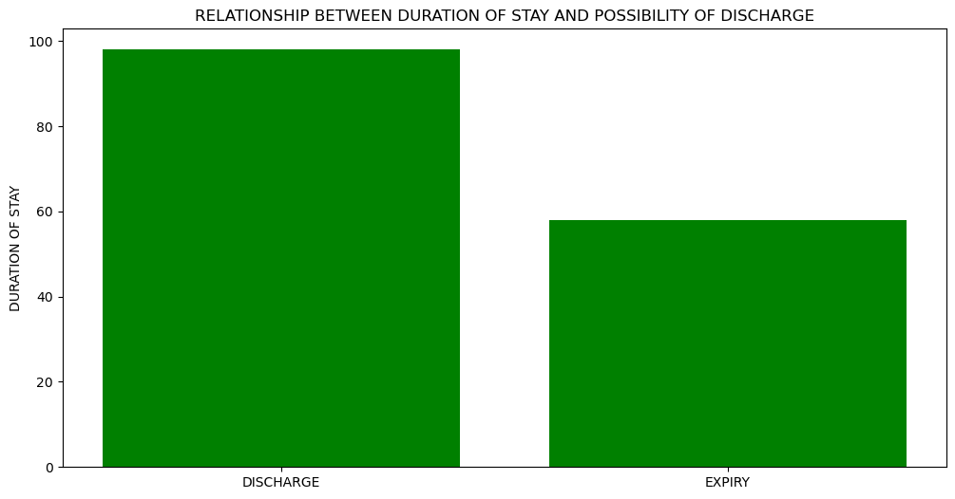
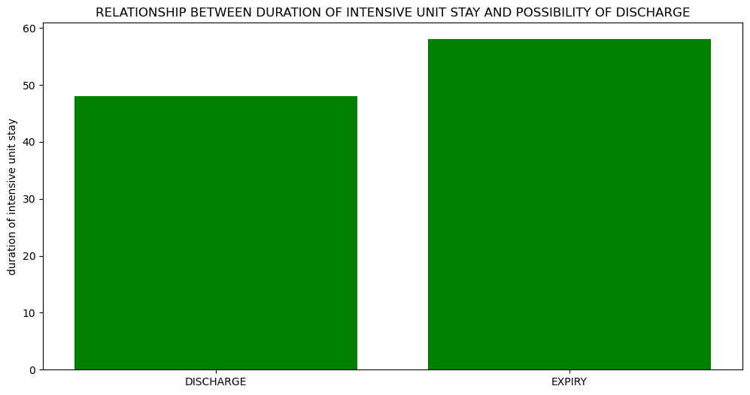
Findings
Agenda
Problem Statement
Business Value
Methodology
The longer the stay in hospital outside the ICU, probability of expiry(death) increases while that of discharge reduces.
However, the longer the stay in ICU, probability of expiry(death) decreases while that of discharge increases.
The insight is that the earlier the patient is elevated into ICU, the higher the chances of discharge.

Slide 9
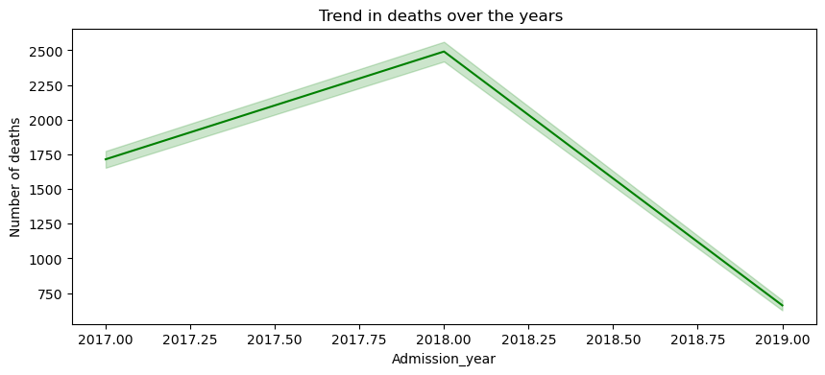
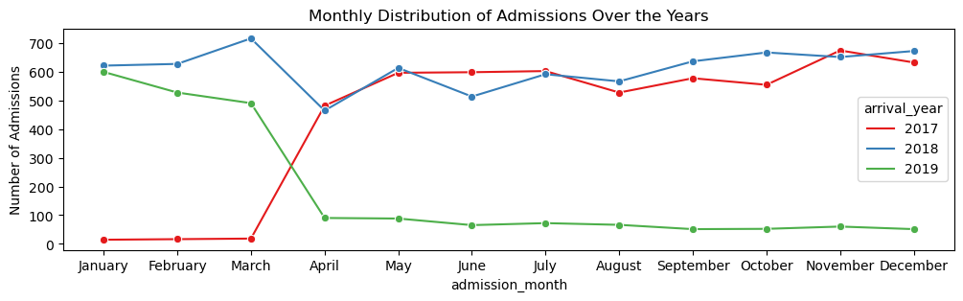
Findings
Agenda
Problem Statement
Business Value
Methodology
Steady rise in deaths from 2017 to 2018 and a subsequent decrease in 2019.
Fluctuations in monthly admissions in 2019.
Sudden rise in number of admissions from March to April 2017.
January had the highest number of admissions in 2019.
Admissions from April to December 2019 were roughly constant.
Highest number of admissions over the years from July to November 2018

Slide 10
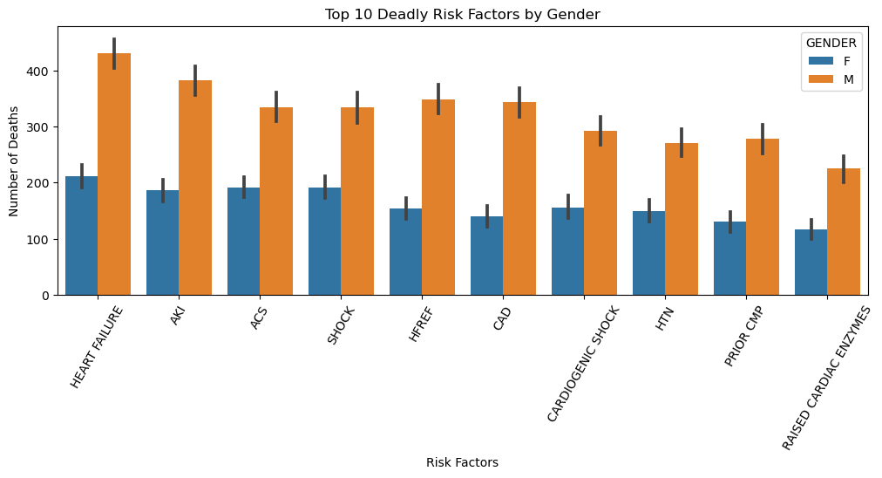
Findings
Agenda
Problem Statement
Business Value
Methodology
Heart failure, AKI, ACS, and SHOCK were the risk factors with the highest number of deaths.
More men by an average of 50% than women with the risk factors above died

Slide 11
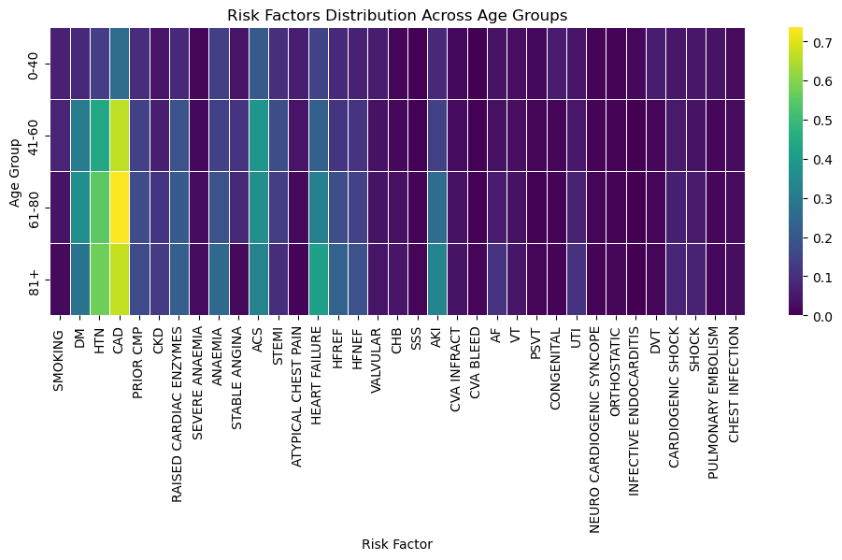
Findings
Agenda
Problem Statement
Business Value
Methodology
CAD mostly affected people aged 61-80, HTN with heart failure mostly affected those aged 81 and above, and ACS mostly affected individuals aged 41-60.

Slide 12
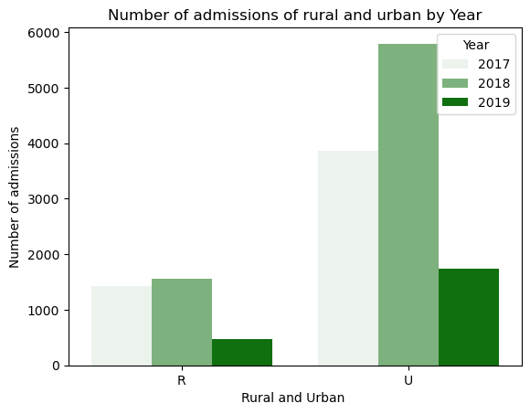
Findings
Agenda
Problem Statement
Business Value
Methodology
Of all admissions with heart problems, 63% are male while 37% are women.
77% live in urban areas while 23% are rural residents.
77% are between the ages of 51-75, 19% are over 75, 3% are between 18 and 35 while less than 1% are below 18years
Further, the algorithm can be enhanced to predict outcomes using all available parameters, including demographic and clinical parameters.
Heart failure, AKI, ACS, and SHOCK had the highest number of deaths, with more men leading across the causes of death.

Slide 13
Recommendations
Agenda
Problem Statement
Business Value
Methodology
From the admissions data:
The following should be considered as a risky population when diagnosed with heart conditions:
Males aged over 60 are at a higher risk of long-term admission and death.
Populations with heart conditions with pre-existing conditions like diabetes, chronic kidney disease are equally at a higher risk of death and long-term admission.
These populations should engage in regular preventive checks to reduce risk.
Early intensive care leads to lower chances of death.
Populations with heart conditions should seek medical help in good time. This will lead to reduced deaths from heart conditions, more so if the patient has pre-existing conditions.
There was a steady decrease in deaths from heart conditions in 2019. There was equally a similar drop in admissions in 2019 compared to the previous years showing that the cause was not related to medical services. A review should be done on what caused the downward drift and policy be aligned to it.
Medical service practitioners and hospitals should ensure that heart patients are elevated to intensive care immediately there is need. The data shows that the earlier the patient is elevated into ICU, the higher the chances of discharge and the lower the chances of death.

Slide 14

Appendix
Agenda
Problem Statement
Business Value
Methodology
Graphs used:
Bar Plots:
Bar plots were used for plotting duration of stay at the hospital after admission and either discharge or expiry. This is because bar graphs are used for comparing categorical data or discrete numerical values. They were also used to display differences in admissions between different segments e.g gender and residential areas.
2. Scatter Plots:
Scatter plots are best used for revealing relationships or patterns between two numerical variables.. In this review they were used to show the correlation between lab and triage health data and the length and duration of admission.
3. Histograms:
Histograms were used to show distribution of age of patients admitted.
They were used because histograms are used for showing the distribution of a single numerical variable.
Heatmaps: Heatmaps were used to uncover patterns, identify trends and identify insights from complex datasets.
Line graph: Line graphs were used to convey trends specifically on number of deaths in the period under review.
Future work
Based on the data and insights from this work, Machine Learning models can be used to predict in-hospital mortality rates, heart failure, and duration of stay using data available at the time of admission to a cardiac care unit.
Further, the algorithm can be enhanced to predict outcomes using all available parameters, including demographic and clinical parameters.

Slide 15
THANK YOU

