Slide 1

Cloud Networking
Gabriel Vasilescu
Andrei Turcu
Cosmin Chiriac
Mihnea Vorovenci

Slide 2
What is Cloud Networking or
Cloud Based Networking?
- is a term describing the access of networking
resources from a centralized third-party provider
using Wide Area Networking (WAN) or
Internet-based access technologies.

Slide 3
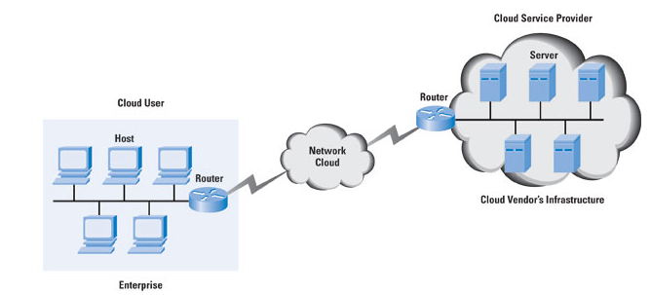
Cloud Networking Schemas

Slide 4
Cloud networking VS Cloud
computing
Cloud networking is related the concept of cloud
computing, in which centralized computing
resources are shared for customers or clients.

Slide 5
Wireless LAN Leads the Charge
The Companies popularized the use of cloud
networking techniques to create large, distributed
Wireless LANs that could be centrally managed in
the cloud.

Slide 6
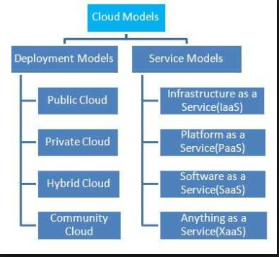

Cloud services and types

Slide 7
Software-Defined WAN
Cloud networking is a form of Software Defined Networking (SDN) technology, in which groups of networking switches and access devices can deploy
over the wide area as shared, virtual resources.

Slide 8
Software-Defined WAN- cont.
The basic concept of cloud networking, in which
fewer management devices are installed in the
branch offices or client premises and more routing
and management functions are pushed to the
cloud, is now being pursued resulting in a wider
range of networking products, which include branch
office routers, WAN optimization software, and
firewalls.

Slide 9
The modern workforce
Companies pursuing new technology for optimizing connectivity using SD-WAN:
Cloudgenix
Pertino
VeloCloud
Viptela

Slide 10
Examples of cloud networking
E-mail
Social Networking
Virtual Office - working

Slide 11

Questions

Slide 12


