Slide 1
Term 2 project
Hasan Mansoor Khan, Ahmed Mohammad, Gabriella Zsiros

Slide 2

Dataset
Migration data of European countries considering GDP per capita
Cross sectional analysis for the year 2019 (before COVID)
Eurostat:
Crude rate of net migration
Death rate (calculated)
Female population (not in focus >> dropped!)
Worldbank: GDP per capita
Auxiliary table for joins

Slide 3
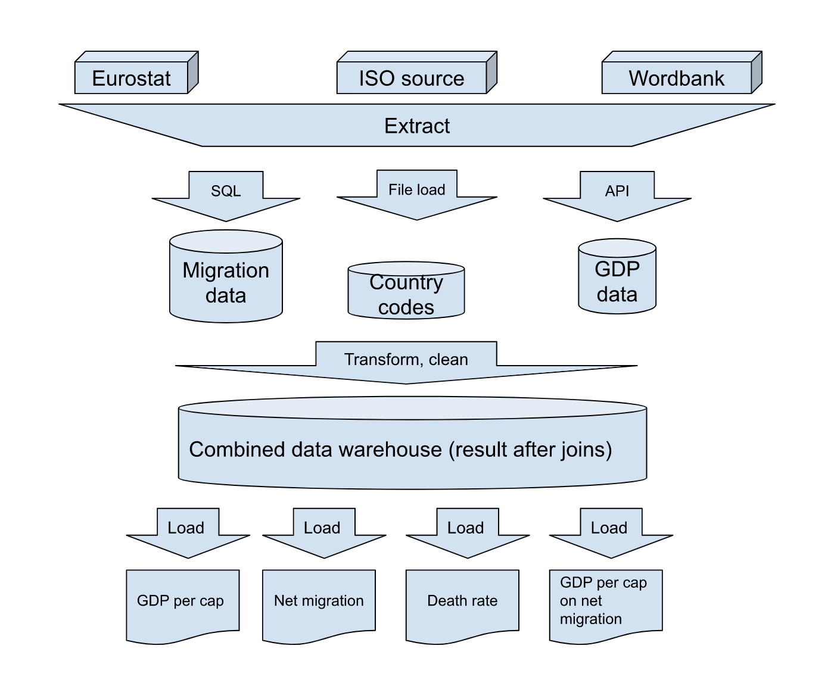
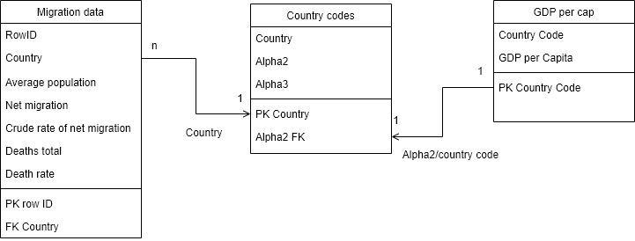
ETL/ER

Slide 4
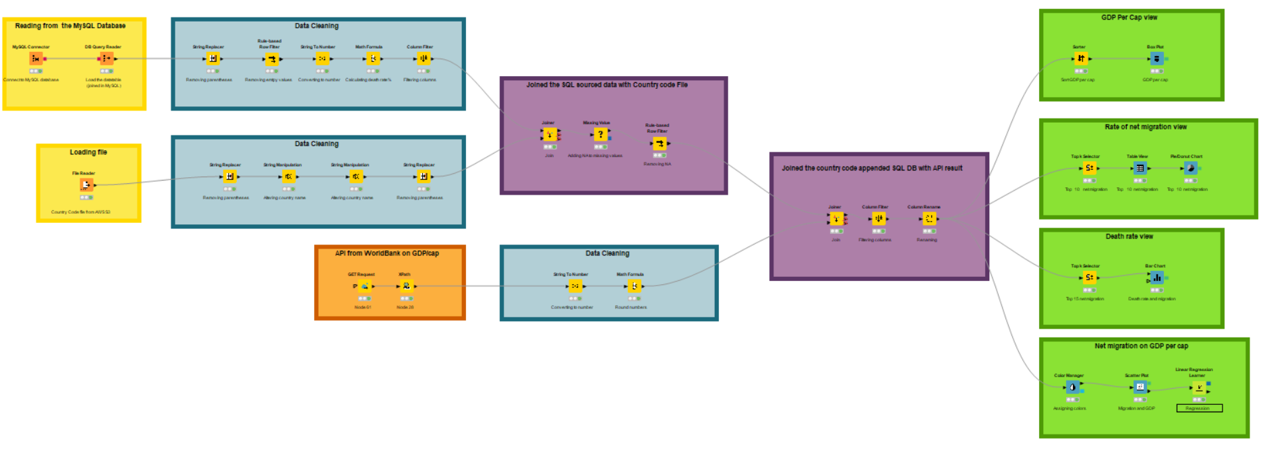
KNIME

Slide 5

Data extract
MySQL connector:
Migration Data
Using SQL script for creating schema and datatable referenced in KNIME node
File loader:
Country code (ISO)
Prepared .csv file loaded from AWS Cloud storage
API:
GDP data
Extracted as .xml

Slide 6
Cleaning
Country syntax
Dropping „....(the)”, longer country names (eg. United Kingdom incl. Northern Ireland after 19
Missing values
Taking average female population missing values (good indicator for completeness)
Eliminated aggregated „Euro” data
Disputed countries (Kosovo)
Missing
Replace

Slide 7
Transform
Country naming convention
Turkey/Türkiye, Macedonia/North Macedonia
Mathematical transformation:
Calculating death rate
Rounding up numbers
Syntax
Math

Slide 8
Join
Migration
Aux
GDP
DW
After the transformation and cleaning:
Datasets merged into one warehouse
Auxiliary table for country code based identification

Slide 9
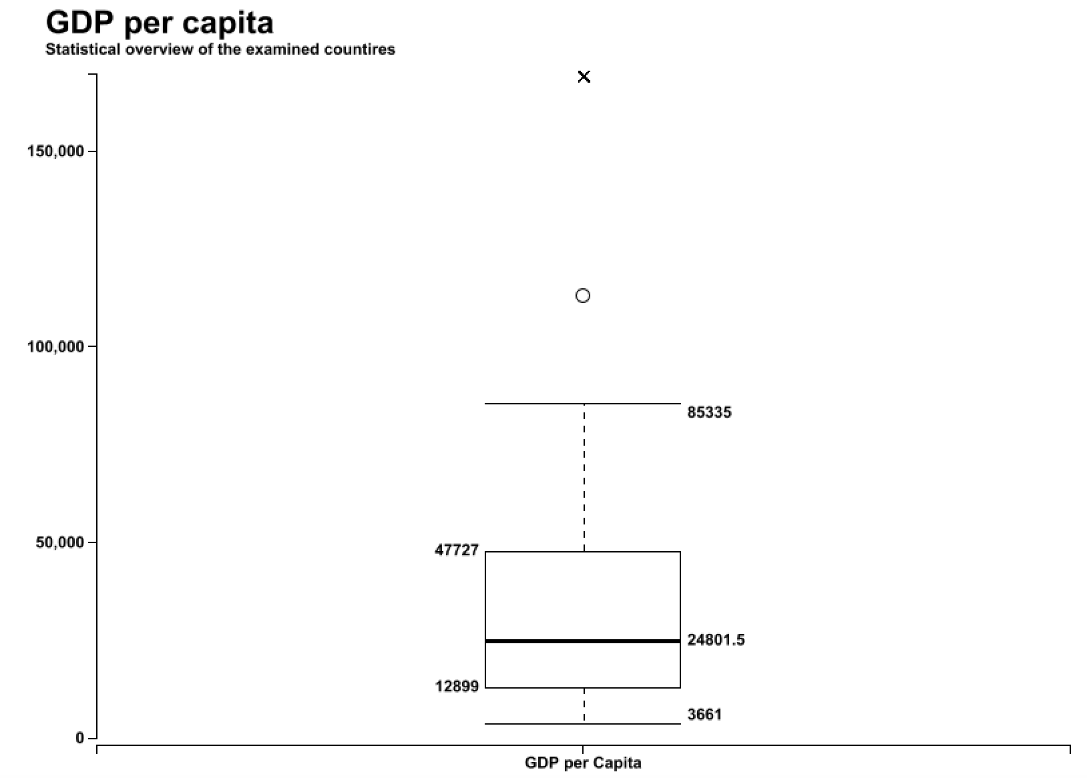
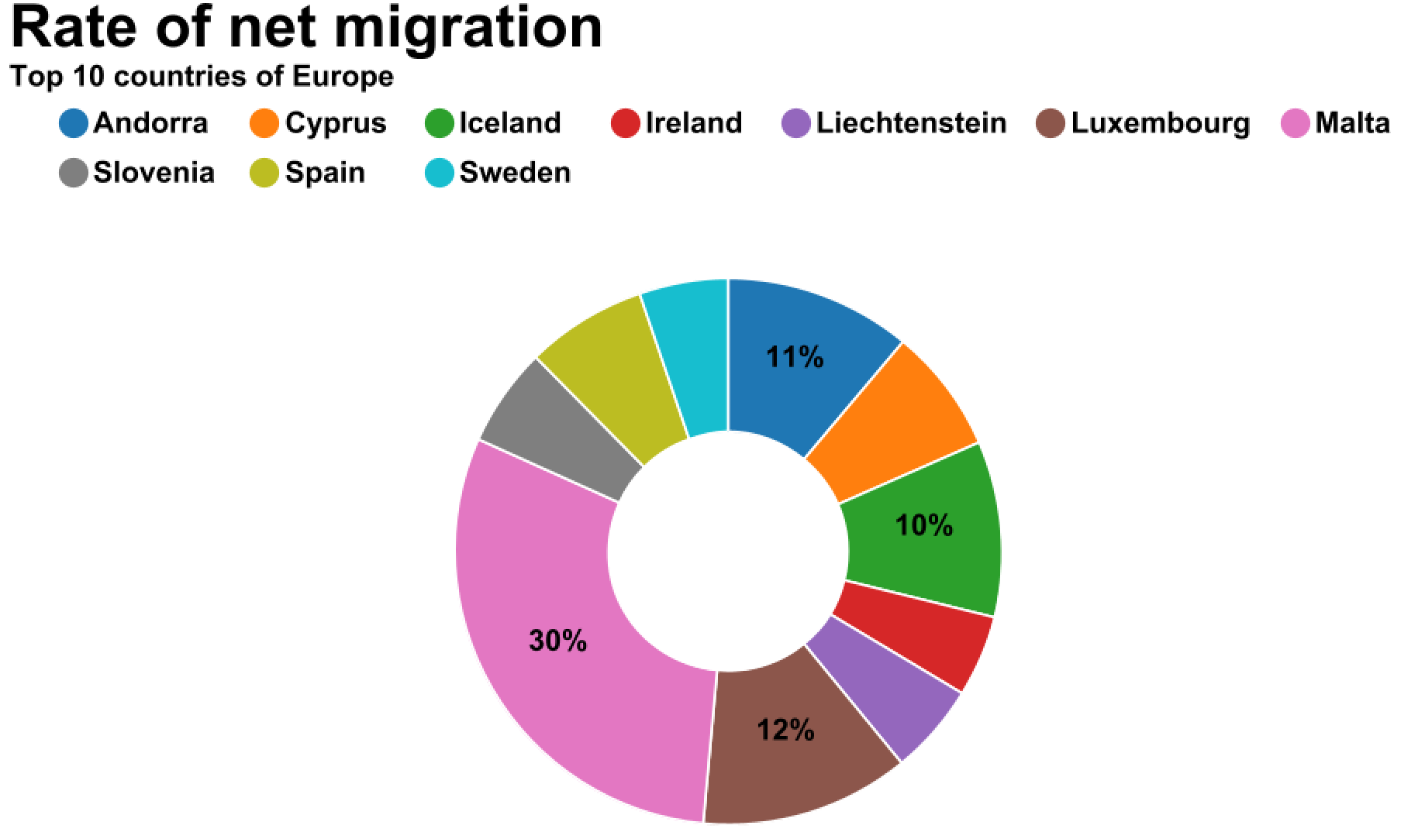
Views I.
Overview, outliers
Top 10 data, net migration table view

Slide 10
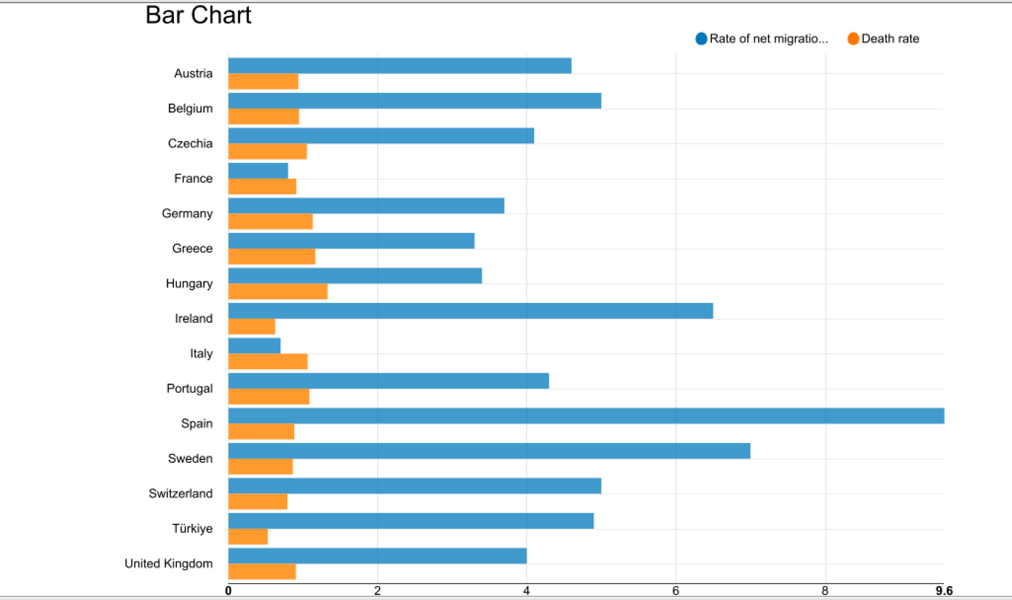
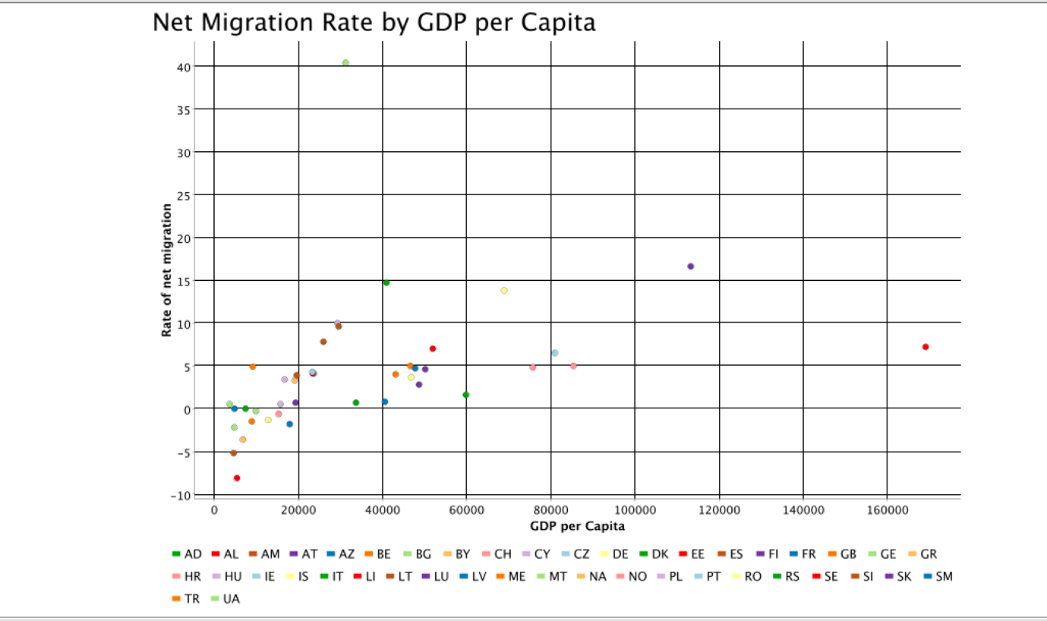
Views II.
Top 10 data (total migration), net migration
Interactive, selecting outlier data, regression

Slide 11
Thank you!
Questions?

