Slide 1
Routing Algorithm for Ocean Shipping and Urban Deliveries
Eduardo Ferreira (up202206628)
Gabriel Lima (up202206693)
Xavier Martins (up202206632)
FEUP – LEIC016
Desenho de Algoritmos

Slide 2
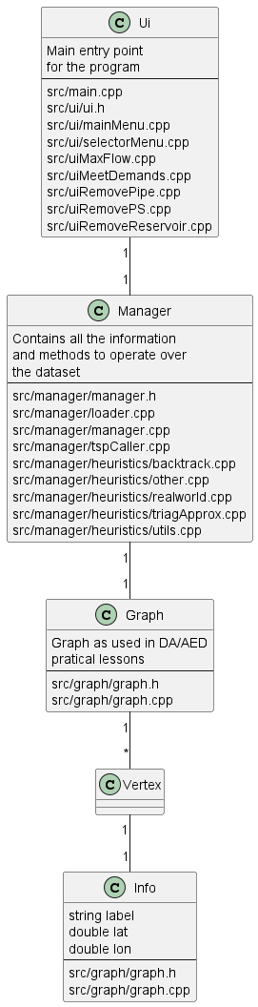
Class Diagram
This diagram can be also found in better resolution in:
(base folder)/docs/ClassScheme.png

Slide 3
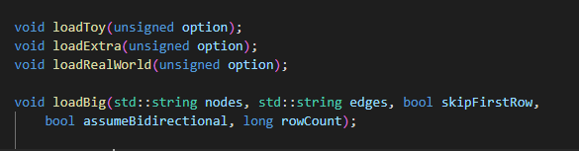
Reading the dataset Functions
There are 4 function responsible for reading the dataset:
loadToy() which will parse graphs of type Toy.
loadExtra() and loadWorld() which will both call the function loadBig() as their file structure is quite similar.
Both loadToy() and loadBig() read the .csv files (either a single file with edges or a file with nodes and a file with edges), create the respective element and add it to the graph.

Slide 4
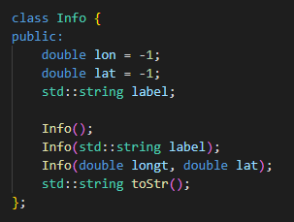
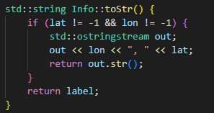
Reading the dataset​ Store Information
Data about each vertex is stored in an “Info” class. This class can have information about a geographical position or a label describing the vertex.
This class only contains a function (toStr()) which will return a string with the element’s content.

Slide 5
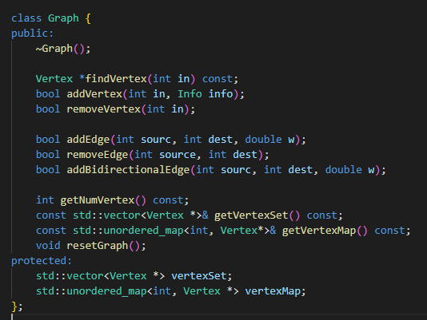
Graph Representation
For this project we decided to use a similar graph to the last project. The information is stored in structures that allow for constant time look up, which in necessary for the good performance and efficiency of the algorithms, those being:
Unordered map for the vertexes
Unordered map for the edges
These structures are additional to the existing “vertexSet” and “adj” vectors.

Slide 6
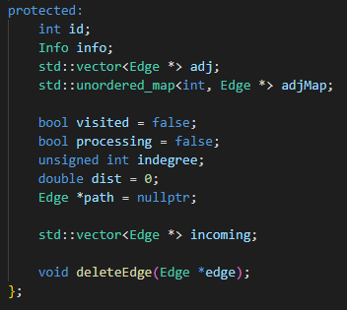
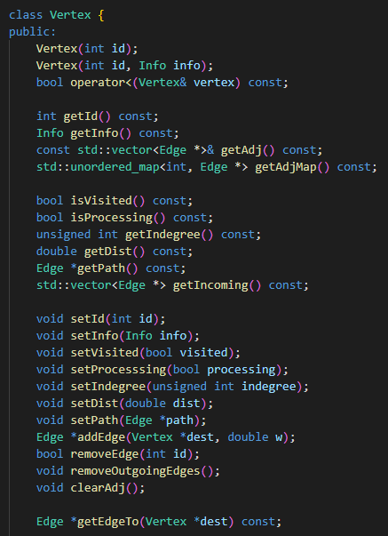
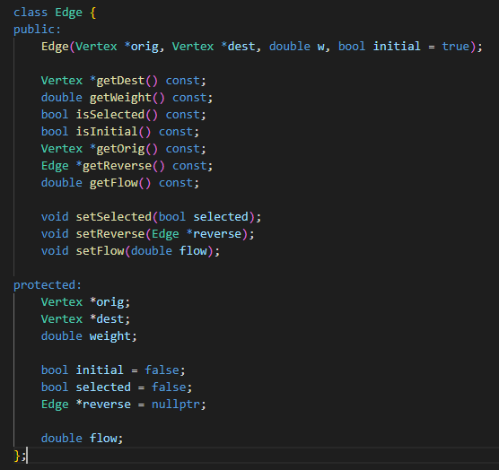
Graph Edges and vertexes
Edges and Vertexes are mostly unaltered, apart from some additions required to run the Travelling salesman heuristics, those being:
Vertex:
map of adjacent edges.
function to get the edge to a specific vertex, with access O(1) thanks to a unordered map.

Slide 7
Implemented functionalities Backtracking Algorithm Heuristic T(2.1)
It was implemented a backtracking algorithm that has the goal of find the shortest route starting at node 0, and that visits each other vertex returning to the starting one.
This is a recursive function that explores all possible paths. It adds the current vertex to the path, marks it as visited, and recursively explores its adjacent vertices. If a complete path is found, it updates the best path and distance. If in a middle of a path it verifies that the current distance is bigger than the best one, it ignores that path.
Complexity
O(V!)

Slide 8
Implemented functionalities
Other Heuristic (T2.3)
Triangular Approximation Heuristic (T2.2)
A simple 2-aproximation algorithm, as shown in class, that has a relative fast execution time using an MST followed by a DFS of the graph to find a feasible solution.
Here, instead of developing a simple heuristic, like nearest neighbor, we tried a variation of the last algorithm, using clustering based on vertex distance, as a way of improving its performance/results. The key in this approach is selecting the right distance, which can change significantly how the algorithm performs.
Complexity
O(E log V)
Complexity
O(E log V)

Slide 9
Implemented functionalities Real World Heuristic (T2.4)
As described in the documentation, the algorithm chosen, Christofides, can find an approximated solution for the TSP problem by calculating the MST, then the minimum cost perfect match for the odd degrees, followed by a Euler path and finally the Hamilton.
Its better in terms of correctness when compared to the algorithm developed in 3.2 as it is within the 3/2factor of the optimal solution length.
Complexity
O(E log V)

Slide 10
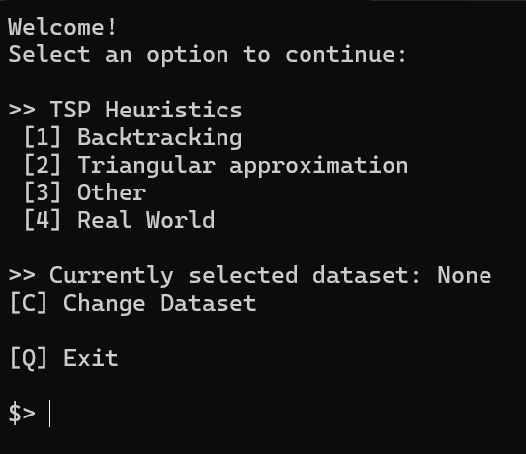
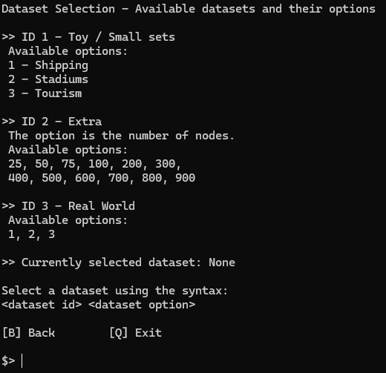
Interface Basic Usage
Main Menu
The “landing page” for the application. From here, all algorithms and their output can be accessed.
Our program is an CLI and takes inspiration from the terminal, waiting for the user to input a command. If the command is invalid, a message will be displayed. All available commands are always displayed above user input.
All datasets can be used, with the user being able to select their desired dataset from the selection menu (insert c and press ENTER in the main menu).
Dataset Selection Menu
A dataset can be selected using two numbers, corresponding to its type and its option respectively.

Slide 11

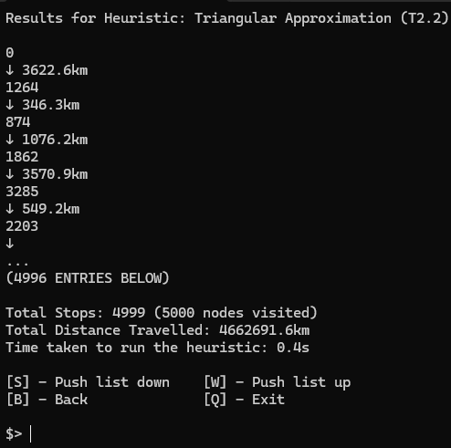
Interface Advanced Usage and Notes
Loading Screen
Loading Screen
Given the size of some networks, the load might take some seconds. To prevent the user thinking the program hanged, a clock is showed on the screen with the seconds elapsed since the start of the loading process.
Result Menu
After a heuristic is ran, a menu with the resulting path is shown. If the path has more thank 5 stops, the menu will split the path in various pages, which can be navigated using the W and S keys.
Important note: Some terminals do not support “cls” or “clean” system calls (e.g. CLion integrated terminal). Consequently, output won’t be as visible in such environments.
Result Menu

Slide 12
Conclusion
With this project, and the development and research of all this different heuristics and techniques we were able to understand the true complexity surrounding the TSP and the NP problems. We hope that one day a polynomial solution is found, as for now there's the need for balancing the efficiency and correctness of the result, depending on the problem in question.
Group Participation
All the group members had a similar participation in the project. That is around ~33%, give or take.

Slide 13
END

