Slide 1
Covid-19 World Tweet visualization
Visual analytics project
Gabriele Marcozzi, Nicolò Palmiero

Slide 2
Introduction
Why visualize Covid-19 related Tweets?
Temporal correlation between Tweets and Covid-19 cases
Spatial correlation between Tweets and Covid-19 cases
The goal of this project is to find out what relationships exist between the number of tweets related to covid-19 and the spread of the pandemic.

Slide 3
Related Work
Visualizing the Covid-19 Twitter chatter dataset
Similar solutions, objectives and views
heat map showing the different number of tweets according to the country.
bar-chart showing the comparison of number of tweets by country in a bar view.
Design and analysis of a large-scale COVID-19 tweets dataset
Similar solutions and views
representing the total number of tweets in a month-by-month representation, according to the country.

Slide 4
Related Work
Topics, Trends, and Sentiments of Tweets About the COVID-19 Pandemic: Temporal Infoveillance Study
Similar solutions and objectives
examines key themes and topics of English-language COVID-19–related tweets posted by individuals and explores the trends and variations of the COVID-19–related tweets.
Public risk perception and emotion on Twitter during the Covid-19 pandemic
Similar objectives and views
comparison of the proximity of each country

Slide 5
Dataset
The Coronavirus (Covid-19) geo-tagged tweets dataset from IEEE-DataPort contains information from March 2020 to January 2021 about covid-19 related tweets from all over the world.
Preprocessing
we decided to shrink the dimensions;
we decided to drop some columns which contained sparse data;
we created another column which indicates the ISO 3166 standard id of each country
Moreover, we added two more columns from two different datasets that are population, that is the number of people that live in each country, and cities that is the number of cities of each country, to have more contextual informations to conduct our analysis.

Slide 6
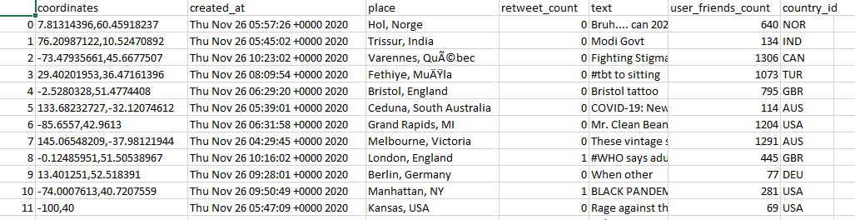
Dataset
At the end of this preprocessing final dataset is composed by 7 columns and 274242 rows. So respecting the AngeliniSantucci index with AS = 1,919,694.

Slide 7
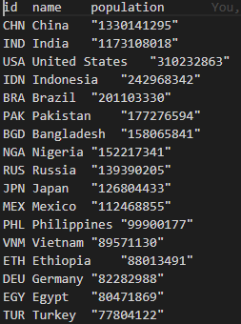
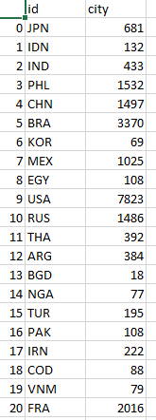
Dataset
Two auxiliary dataset:

Slide 8
Visualization Techniques

Slide 9
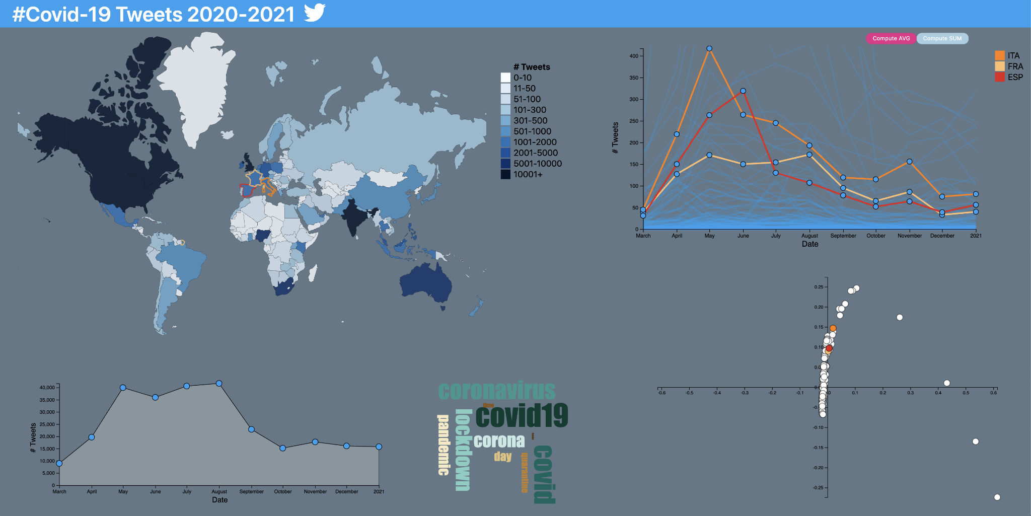
Overview

Slide 10
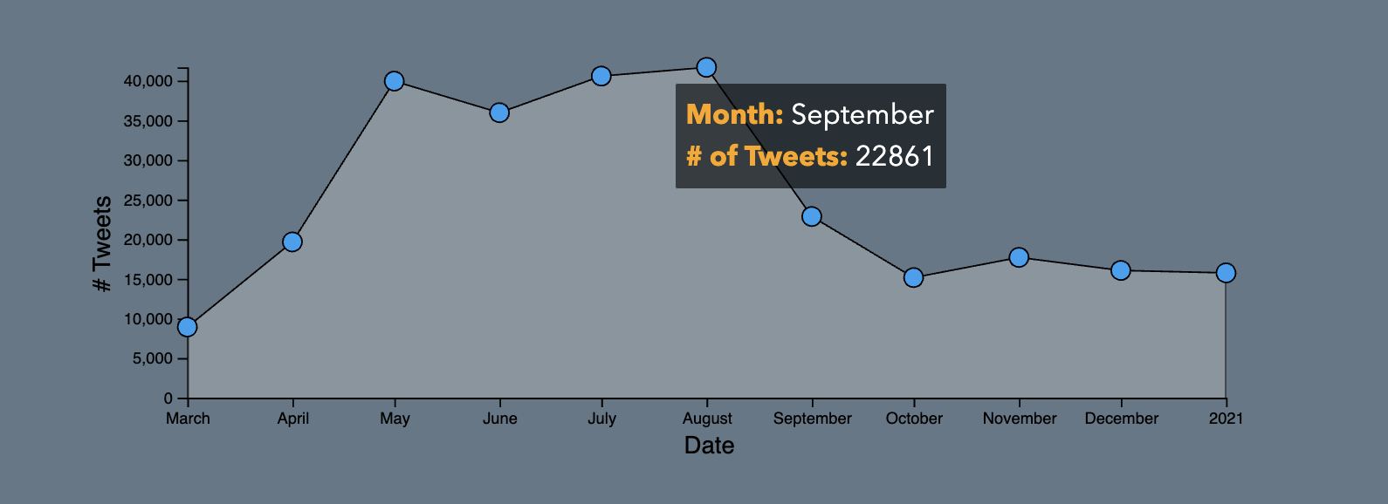
Number of tweets trend plot
Shows the trend of number of tweets
Brushing on the horizontal axis to select the period of interest for all the visualizations
Tooltip on each point with the exact number of tweets
Monthly aggregated data

Slide 11
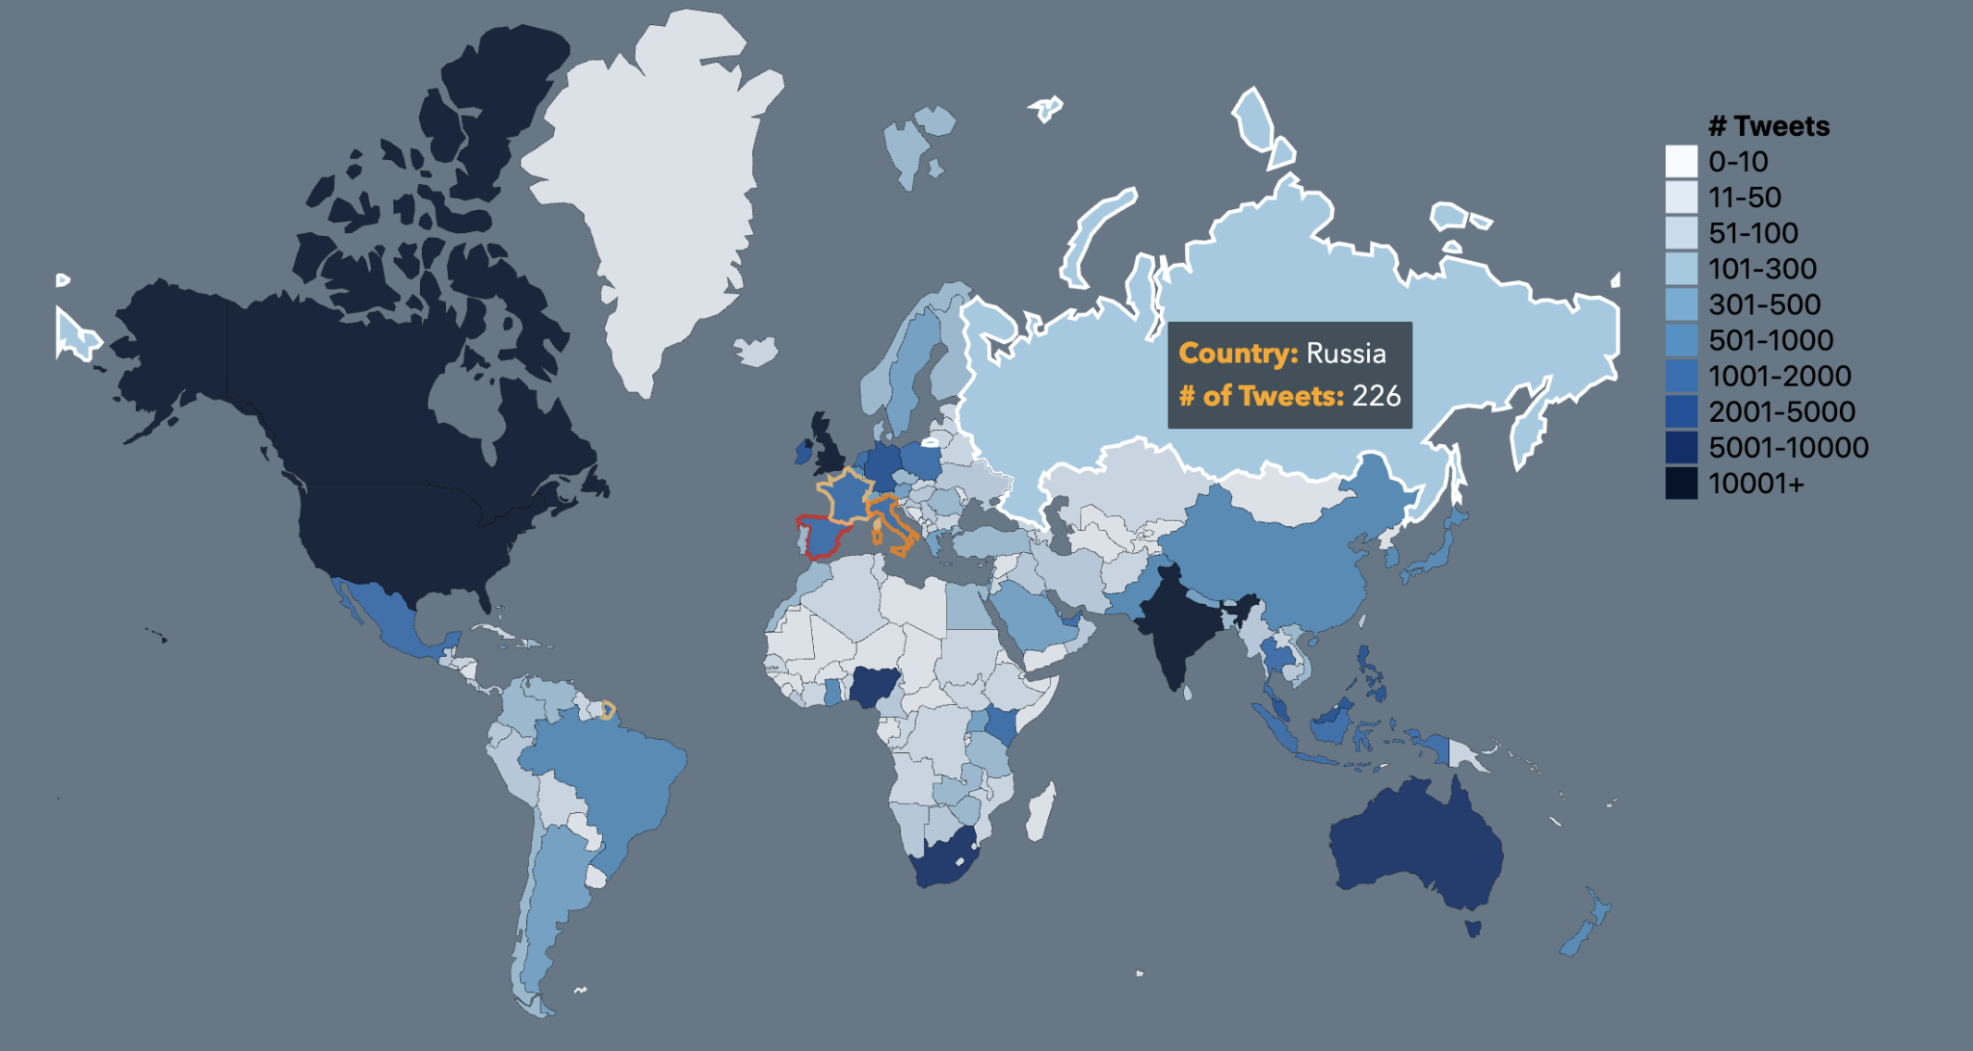
World Heatmap
Number of tweets grouped by nation
All nations are selectable, bidirectional interaction with MDS and nations trend plot
Tooltip on each nation to show exact number of tweets
Color scale shows the approximate number of tweets

Slide 12
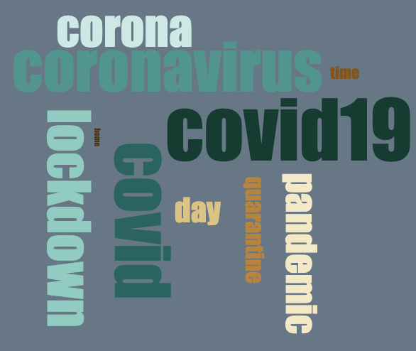
Wordcloud
Top 10 used words in all tweets
Bigger font size stands for more frequent word
Color scale that represents the frequency of a word
Interesting features coming up from the less frequent words of the word cloud

Slide 13
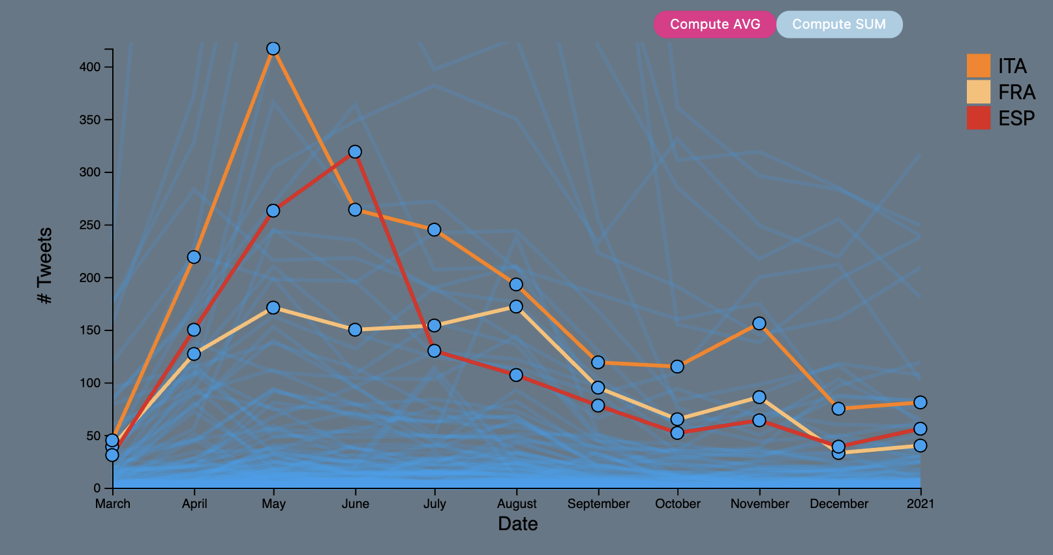
Nations trend plot
One trend for each nation
Selected nations are colored coherently with the other visualizations
Number of tweets for each month of the selected interval with a tooltip that shows the exact number of tweets
Compute average and sum of selected nations

Slide 14
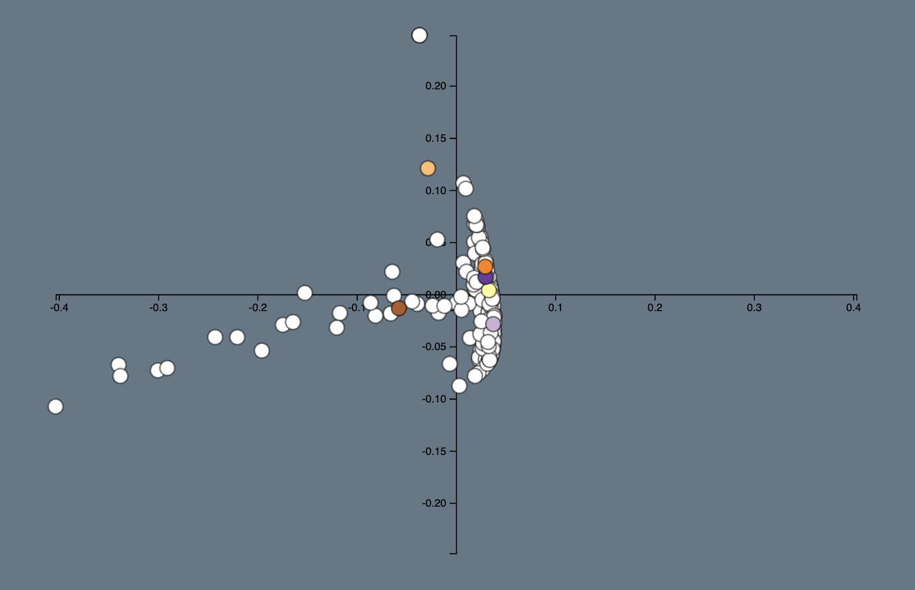
Multidimensional scaling
Dimensionality reduction scatterplot
Each point represents a nation, and points that are near to each other are considered similar
Bidirectional interaction with the world map and the nations trend plot through nation selection
Possibility of zooming by brushing

Slide 15
Future work
Animated temporal axis chart that when activated, triggers the the other plots and shows sequentially data month by month, in a way in which user can better appreciate all changes.
Include a dataset composed of tweets published in 2021 or live twitter data streaming.

Slide 16
Conclusion
This tool is useful for showing the spatial and temporal trends of tweets about Covid-19
Our period of study goes from March 2020 to January 2021
A potential user is capable of investigating on the number of tweets on any time within our period of study discovering some insights and maybe compare his result with Covid-19 trends of infection

