Slide 1

Network Exploration and Analysis of an Amazon co-purchasing dataset
Complex Data Analysis
Chen Cheng nº 64872
Gabriel Meirinho nº 64873
Leandro Duarte nº 64372

Slide 2
Introduction
The reality of co-purchasing is extremely important for large retail platforms, where the use of complex data and its analysis can highlight relevant purchasing patterns to understand consumption.
In this paper we will work on an Amazon dataset and also on how products can be related to each other.

Slide 3
Dataset
An Amazon dataset from March 2, 2003.
Products that are related with each other based on co-purchases.
The total number of products is 262110.

Slide 4
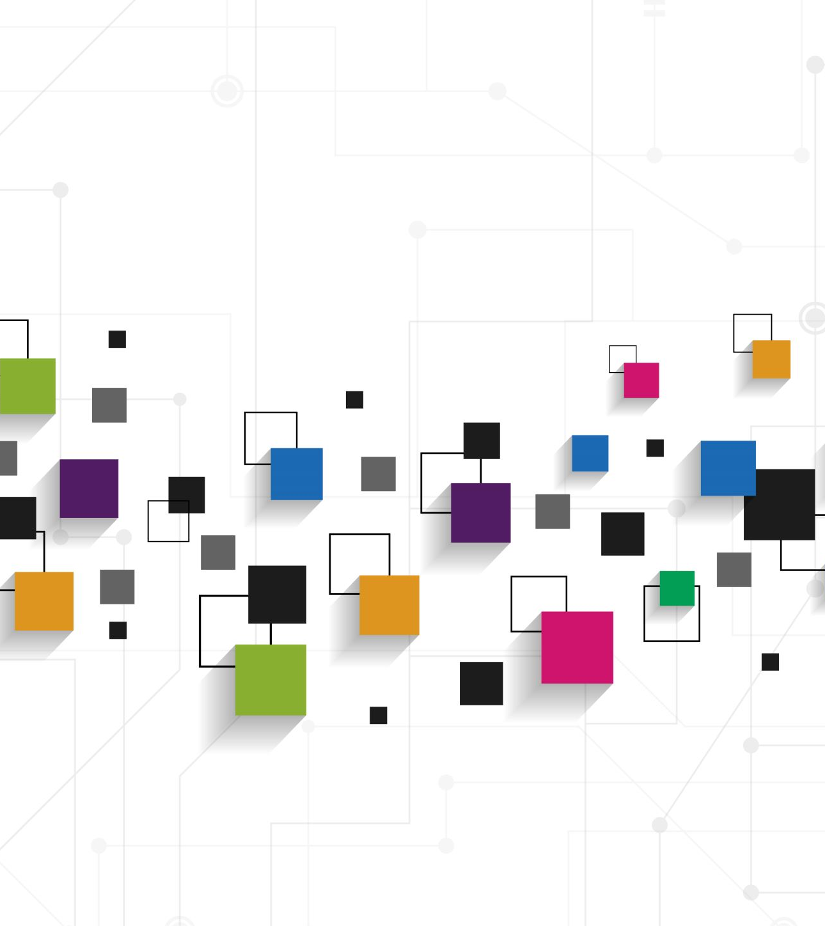
Objectives
Generating a subset through random sampling of the data and seeing how the original structure of the network is affected;
Understanding the relationship between products and other products and how this can be translated to Amazon's marketplace;
Consider the communities formed and the roles of the products within them.

Slide 5
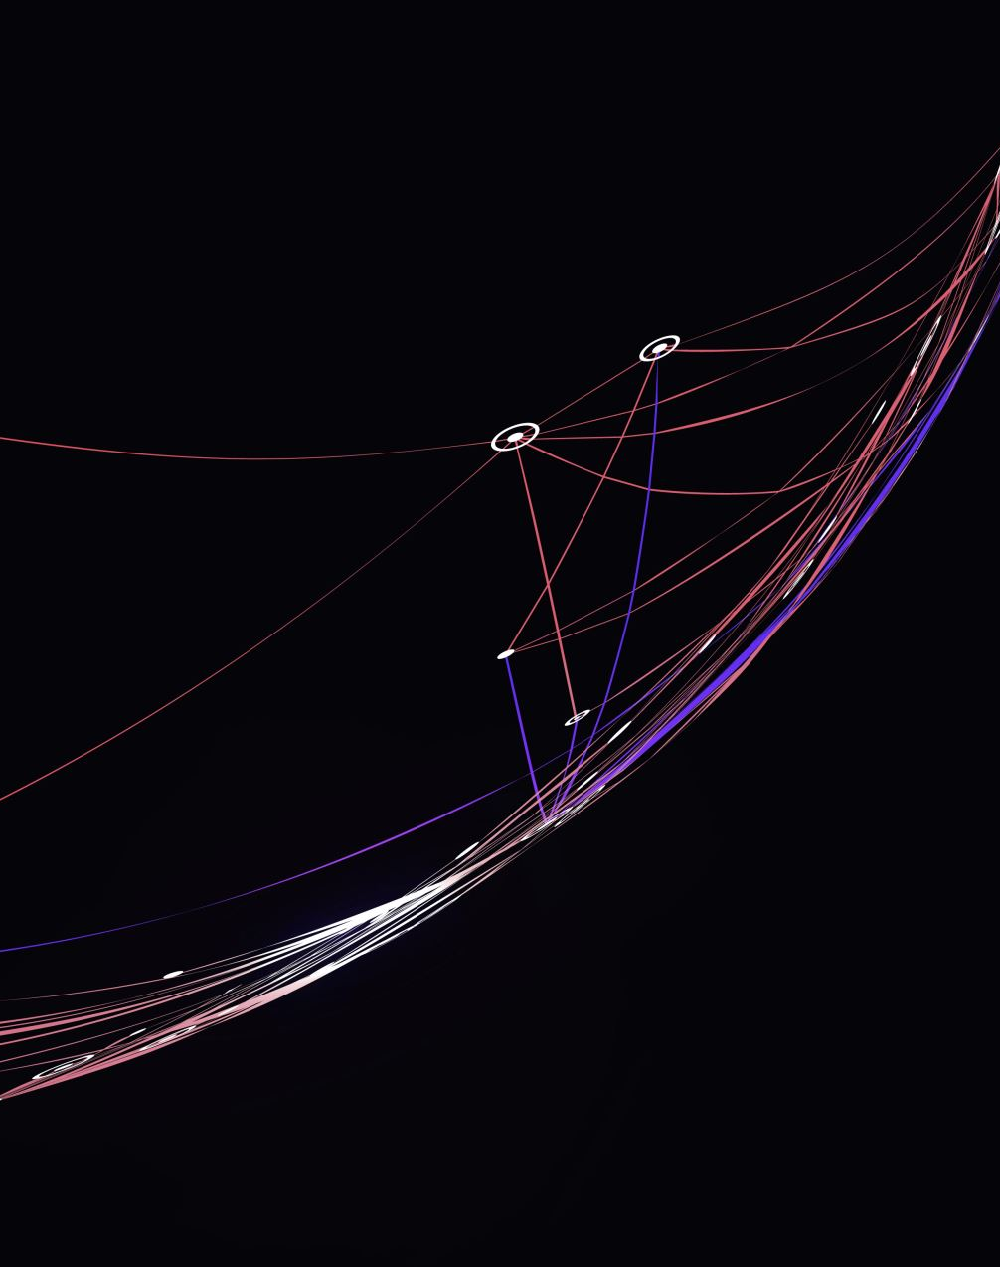
Methods
Subset creation
Represents 10% of the original dataset.
Utilizes the random.sample() function.

Slide 6
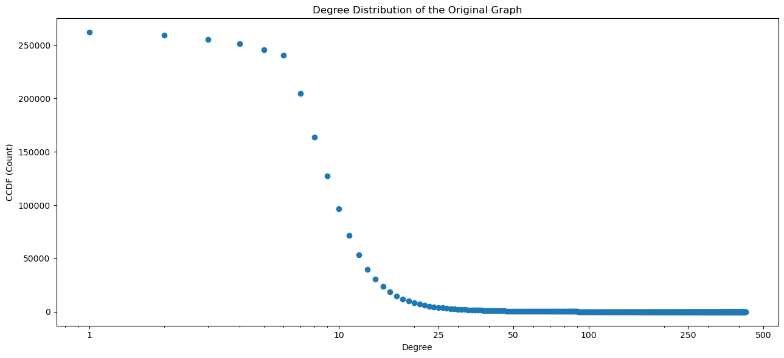
Properties analyses
Degree Distribution (Original Dataset)

Slide 7
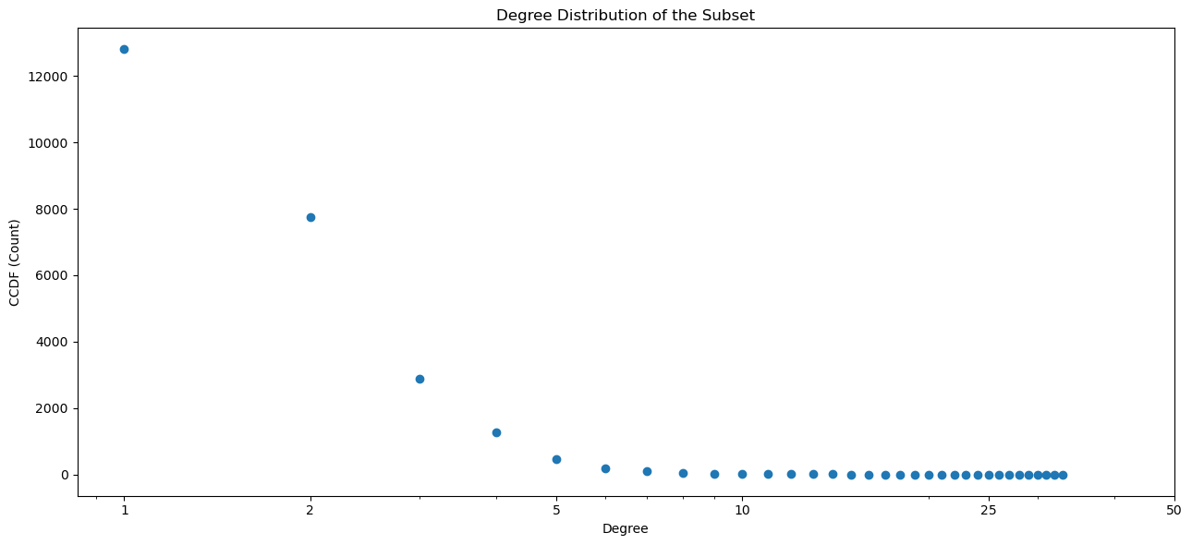
Properties analyses
Degree Distribution (Subset)

Slide 8
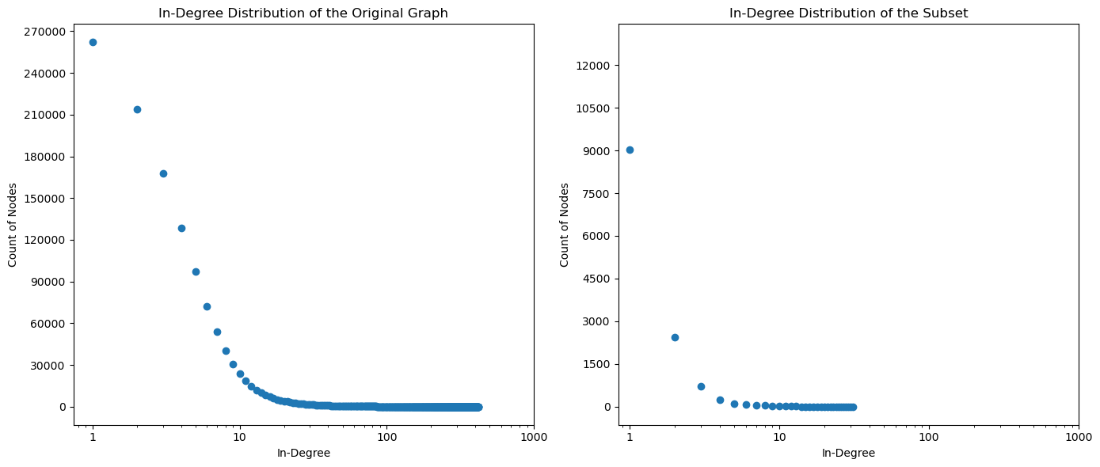
Properties analyses
In-Degree Distribution

Slide 9
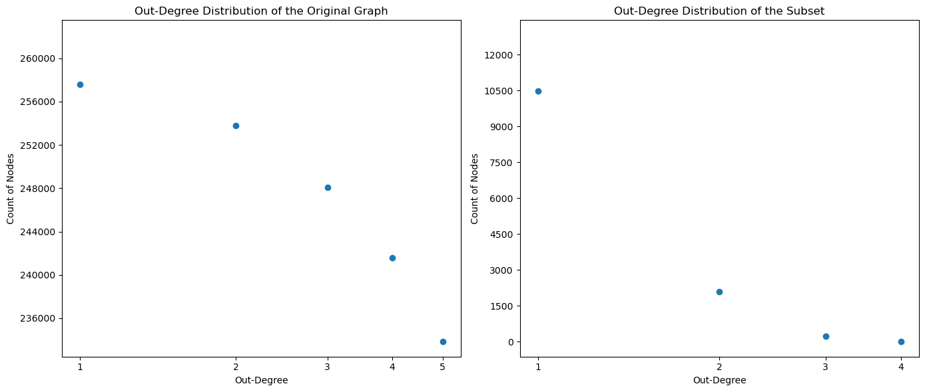
Properties analyses
Out-Degree Distribution

Slide 10
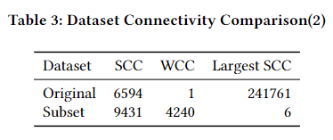
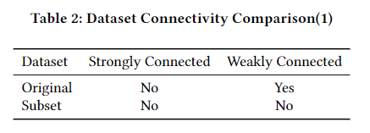
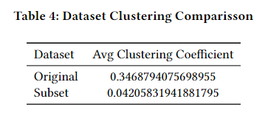
Properties analyses
Connectivity Measures
Clustering Measures

Slide 11
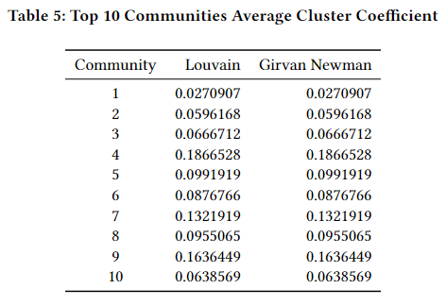
Communities
The ten communities with the highest number of nodes were chosen to compare the obtained results.

Slide 12
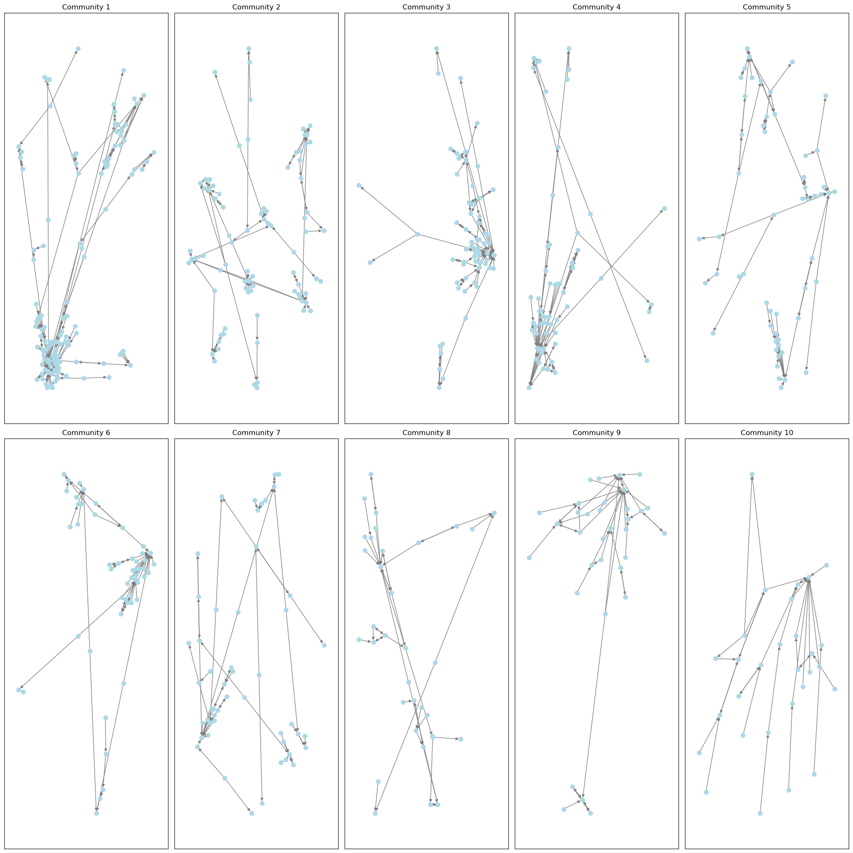
Top 10 Largest Communities

Slide 13
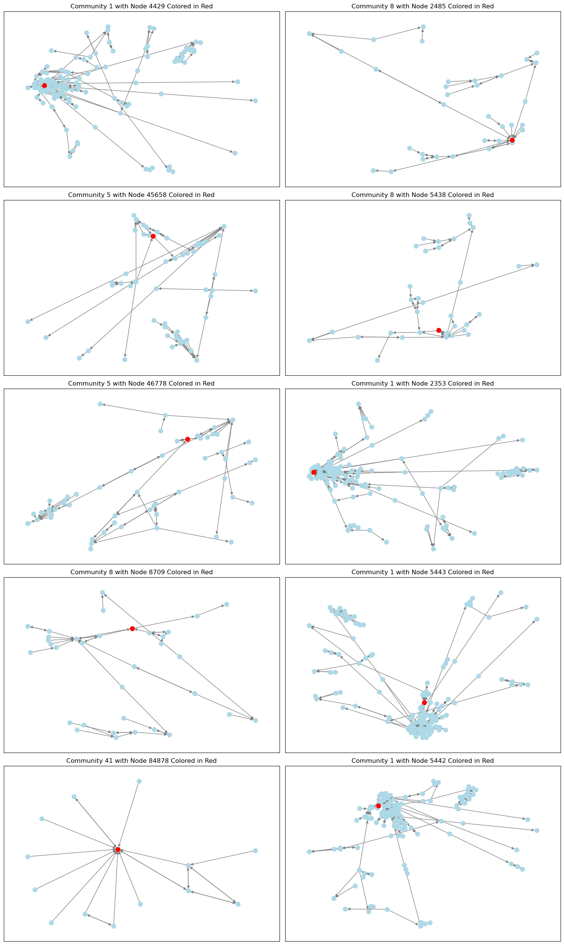
Top 10 nodes with highest betweenness and their communities

Slide 14
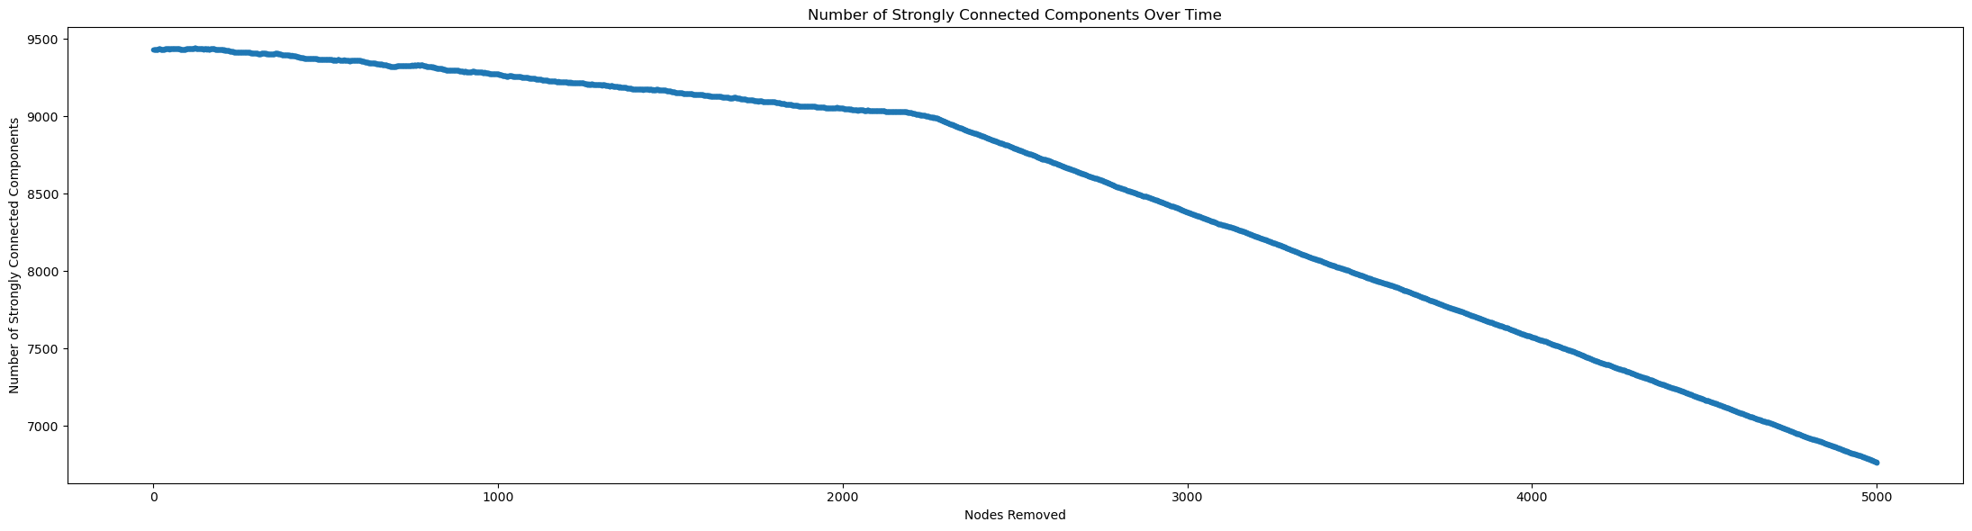
Robustness
With the objective of testing the robustness of the subset and analyzing the most important nodes at the same time we used a target attack strategy taking the nodes with highest betweenness as the main target.

Slide 15
Discussion
Picking a random sample of nodes to create a subset in this case is not a good solution
The random network ends up not maintaining its original structure
We consider the most important community the one who has nodes with highest degree and highest betweenness

Slide 16
Conclusion
By analyzing the networks created, we can see that the importance of the elements that make them up goes far beyond just one characteristic.
On the other hand, it is essential to understand how the subsets are created because, as we have seen, we do not consider the random sample to be a viable solution for gaining an in-depth understanding of the original dataset.

