Slide 1
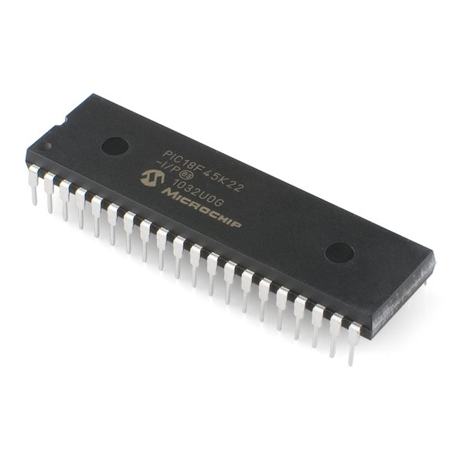

Computer
Microcontroller

Slide 2

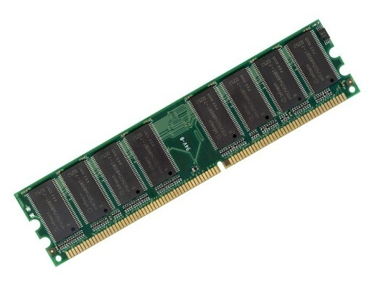

CPU
4 cores @ 2GHz
CPU
48 MHz (12 MIPS)
RAM
8GB
RAM
2048 bytes
HDD
1TB
FLASH
32kB

Slide 3
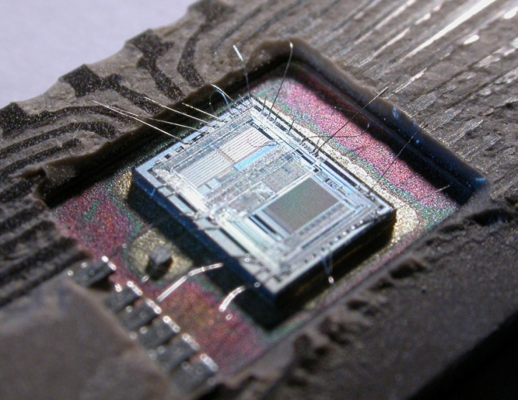
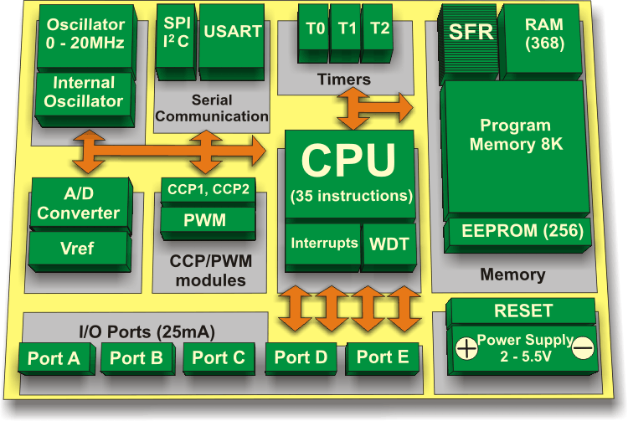
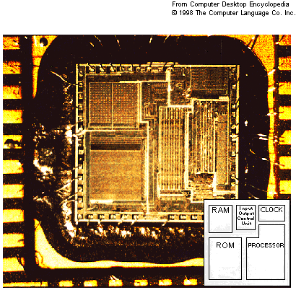

Slide 4

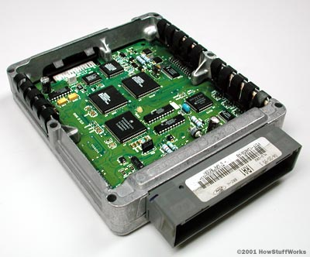

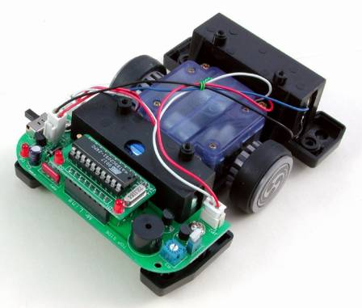
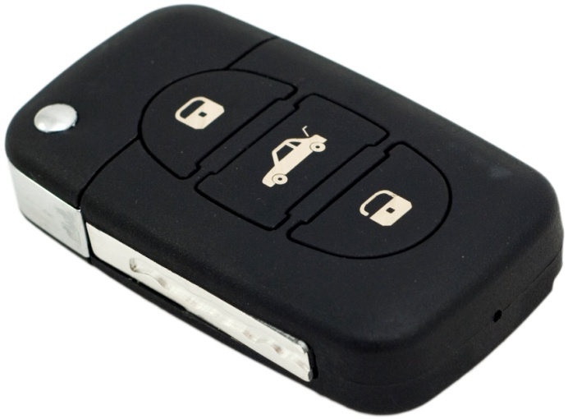
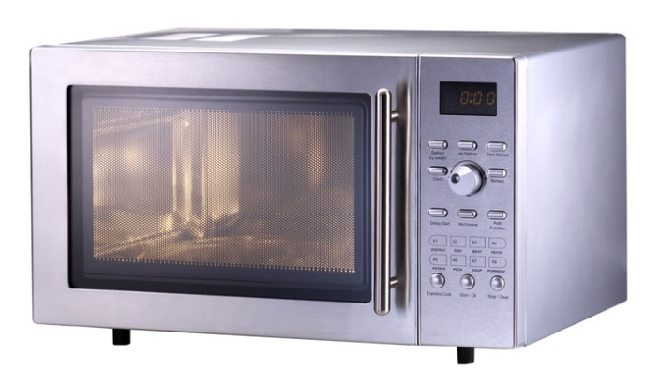

Slide 5
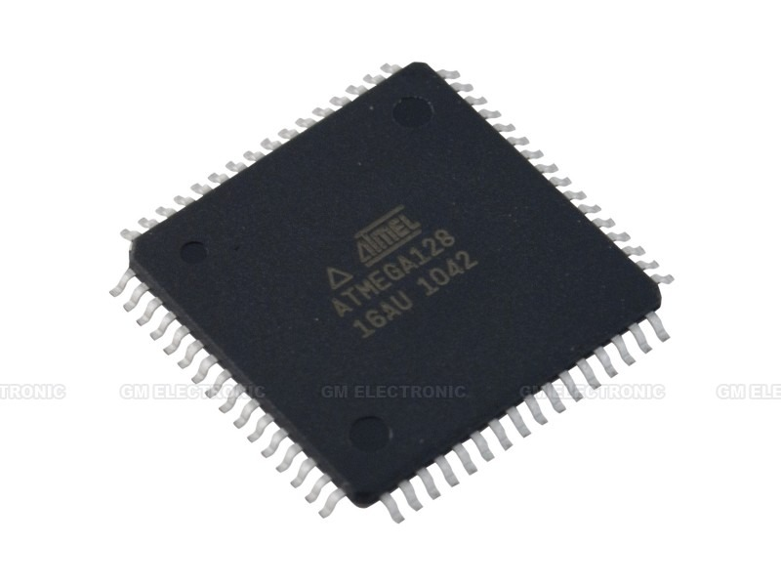
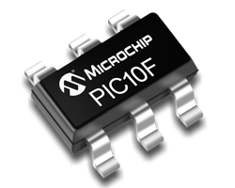
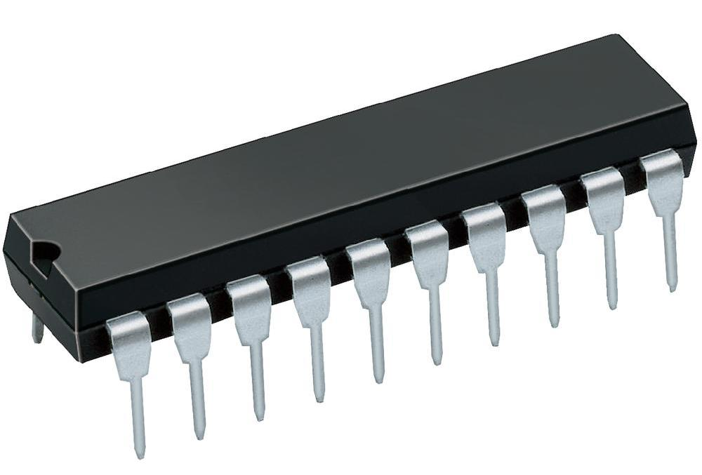
Why do we use microcontrollers?
Low power consumption
Increases with frequency (nanoWatts)
Battery powered devices
Integrates all neccesary parts
Just connect battery and your peripherals
Voltage regulator (1.8V – 5.5V), UART, USB, CAN…
Various families (8bit, 16bit, 32bit)
Various in size (PIC10F 6pin SOT-23, up to 80pin)
Small size
Cheap

Slide 6
Disadvantages?
Small memory RAM
Small program memory (ROM/FLASH)
Low speed
Programming adapters
Need electrotechnical background

Slide 7
MCU Architectures*
By word length
8bit
16bit
32bit
By memory layout
Harward
Separate memories for Program code & Data
Princeton
Program code & Data in the same memory
Notes:
Kod vie modifikovat kod -> virusy, stabilita.
To ze je 8 bitovy neznamena ze nevie pracovat s 16bitovymi alebo 32bitovymi cislami, len ich musi emulovat -> pomaly

Slide 8
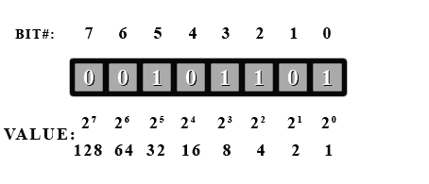
Data types
Byte (uint8)
Unsigned 0..255
Signed -128..127
Word (uint16) – 16 bits (two Bytes)
Unsigned 0..65535
Signed -32768..32767
Double word (uint32) – 32 bits (four Bytes)
Unsigned 0..4,294,967,295
Signed –2,147,483,648 .. 2,147,483,647
Notes:
Vyhodit do digitalnej casti

Slide 9
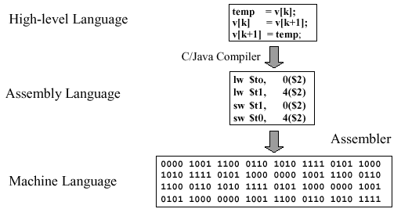
Source code, assembly, machine code

Slide 10
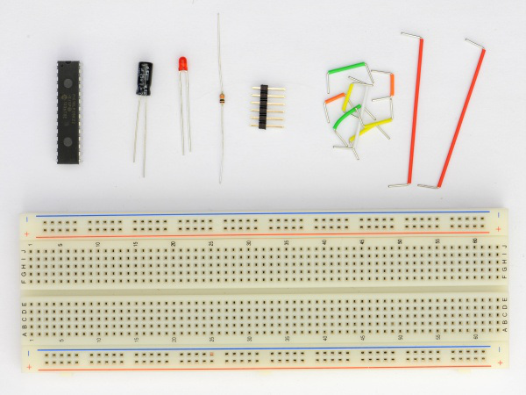
Blinking led with PIC
http://makezine.com/2010/10/13/make-it-last-build-series-hello-wor/

Slide 11
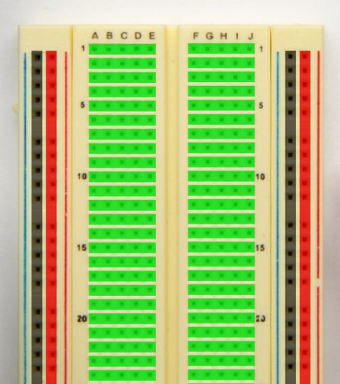
Breadboard connections

Slide 12
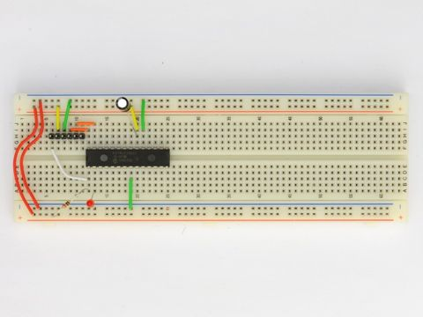
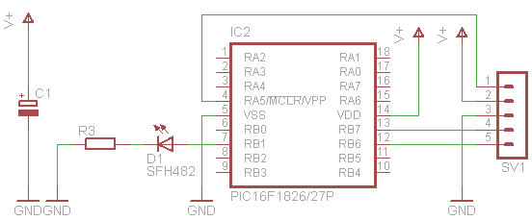
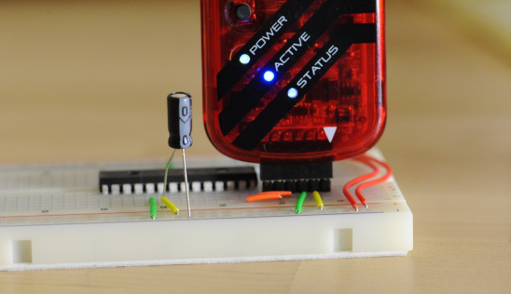
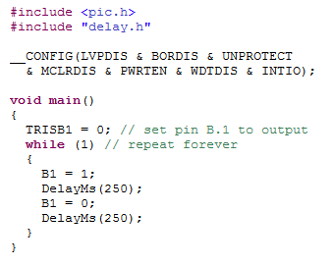
Attaching programmer to our circuit
Notes:
1. Navrhnut schemu, 2. Ulozit, 3. Napisat program, 4. Napalit a testovat

Slide 13
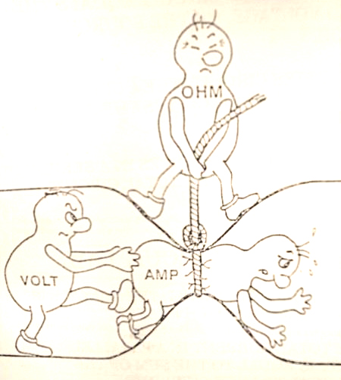
A bit of physics
Notes:
Pripravit prirovnanie s vodou

Slide 14
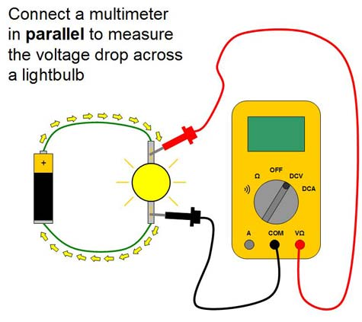
Measuring voltage (V)
Voltmeter has infinite input resistance, thus does not affect the circuit

Slide 15
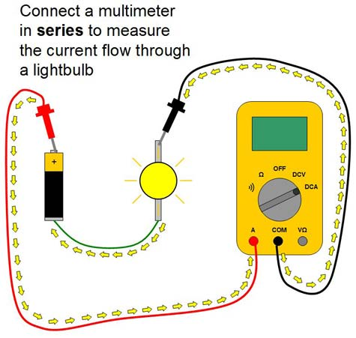
Measuring current (I)
Ampermeter has zero input resistance, thus behaving as if the probe terminals were tied together

Slide 16
Ohms law
V=I*R
Voltage = Current * Resistance
[V] = [I] * [Ω]
Volts = Ampers * Ohms
Notes:
Pridat vysvetlenie odporu

Slide 17
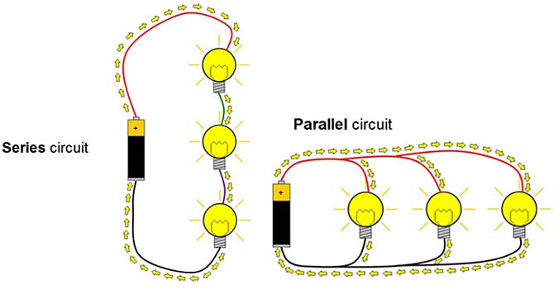
Series and parallel circuit
http://www.sciencebuddies.org/science-fair-projects/multimeters-tutorial.shtml

Slide 18
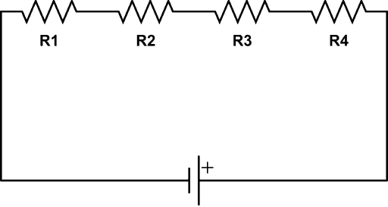
Kirchhoffs voltage law
Ur1
Ur2
Ur3
Ur4
Value of current is the same in any point of the closed loop
Current direction (I) is from positive terminal of voltage source to negative
Voltage drop on resistor is calculated from Ohms law: Ur = R*I
Direction of voltage drop on resistor matches the direction of current
In the equation put the voltages with matching direction with positive sign, opposite voltages with negative sign
I
Ub
The directed sum of the electrical potential differences (voltages) around any closed network is zero

Slide 19
Kirchhoffs voltage law
Ur4 + Ur3 + Ur2 + Ur1 – Ub = 0
Ur1 = R1 * I
Ur2 = R2 * I
Ur3 = R3 * I
Ur4 = R4 * I
Ur1
Ur2
Ur3
Ur4
Ub = (R1 + R2 + R3 + R4)*I
Rx
I
Ub
Multiple resistors connected in series are acting as single resistor,
its value is calculated as sum of the partial resistors

Slide 20
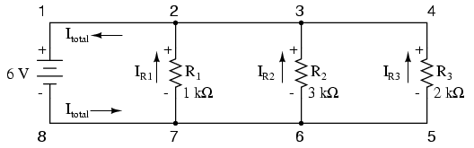
Kirchoffs current law
Ir1 + Ir2 + Ir3 – Itotal = 0
The algebraic sum of all currents entering and exiting a node must equal zero
Voltage on parallel branches is always the same
Notes:
Otocit polarity! Z plusu do minusu

Slide 21
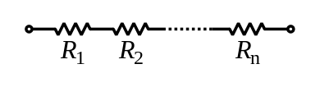
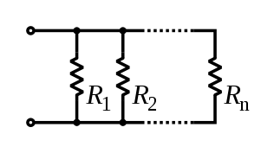


Connection of resistors

Slide 22
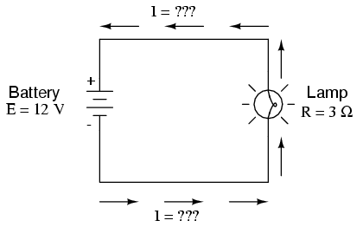
Power
P=U*I
Power = Voltage * Current
[W] = [V] * [I]
Watts = Voltes * Ampers

Slide 23
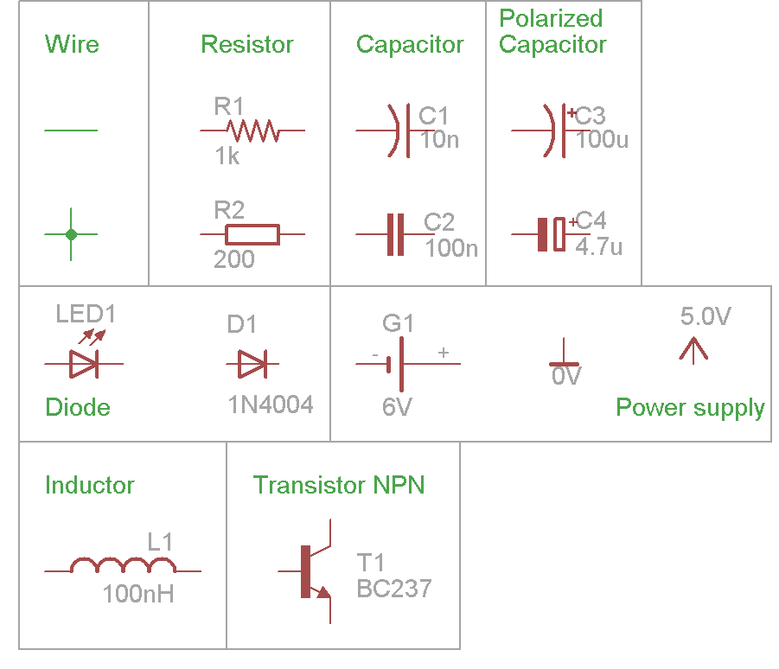
Basic schematic symbols
Notes:
Switch piezo junction

Slide 24
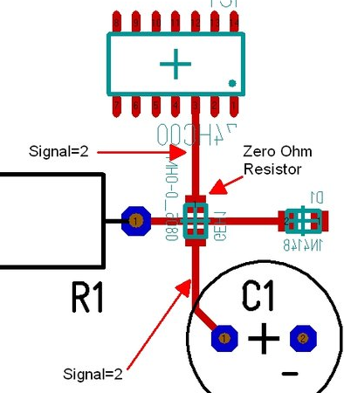
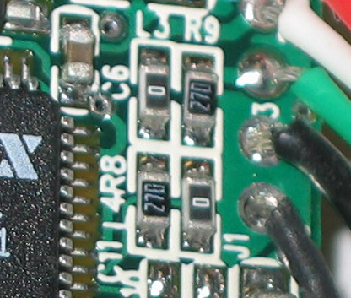
Values
Resistors [Ω, Ohms]
“0” = 0 Ω
“100” = 100 Ω
“1.2k” = 1200 Ω
“0.8M” = 800 000 Ω
Capacitors [F, Farrads]
0.1mF = 0.1*10^-3 F = 0.0001F
0.1µF = 0.1uF = 0.0001mF
10nF = 10*10^-9 F = 0.01 µF

Slide 25
Inductor / Coil*

Slide 26
Capacitor*

Slide 27
Decoupling & RC filters*

Slide 28
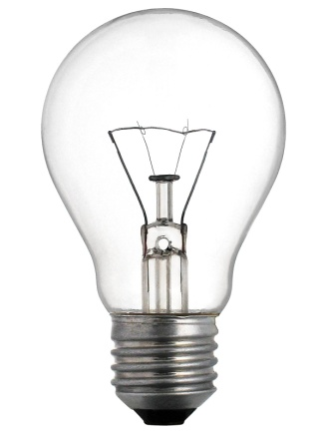
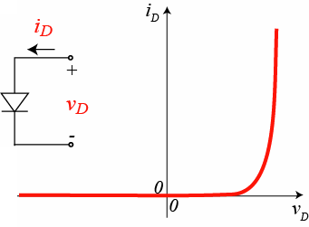
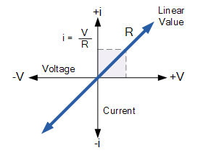
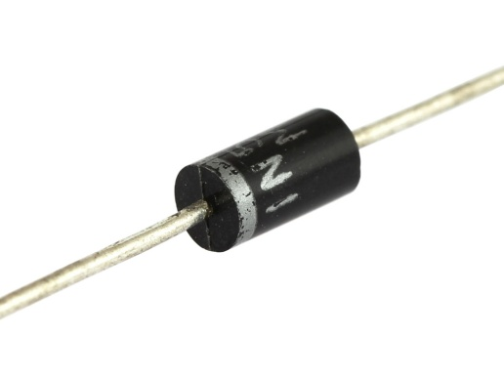
Linear & nonlinear elements
Notes:
Makky zdroj, filament = rezistor, zvysujeme napatie -> zvysi sa aj prud

Slide 29
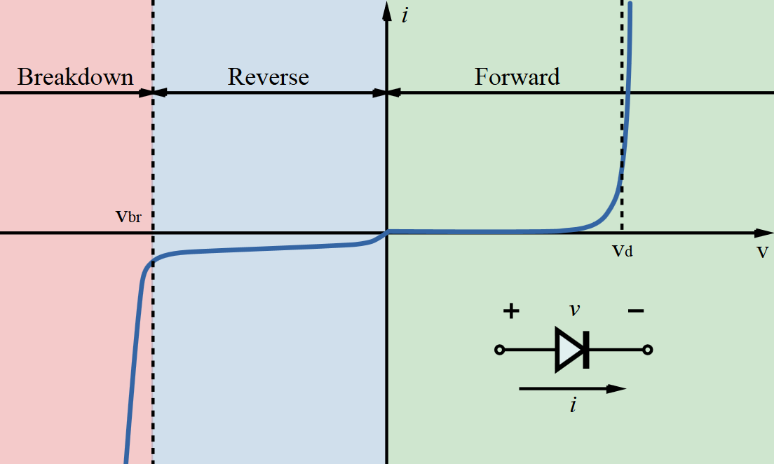
LED Current-Voltage diagram

Slide 30
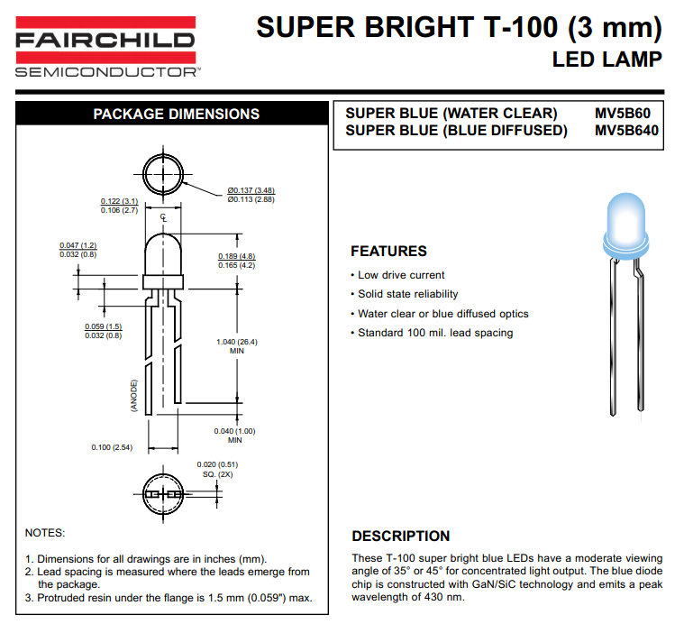
Reading datasheets

Slide 31
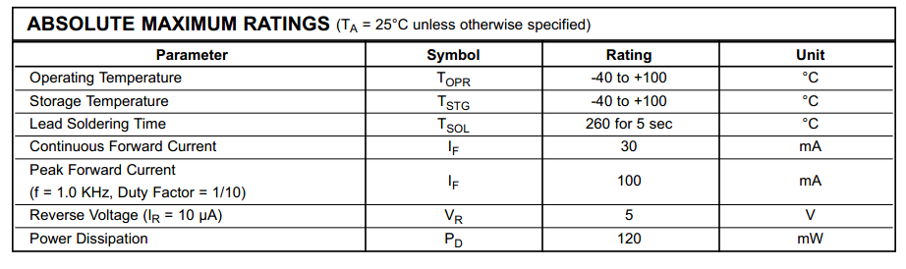
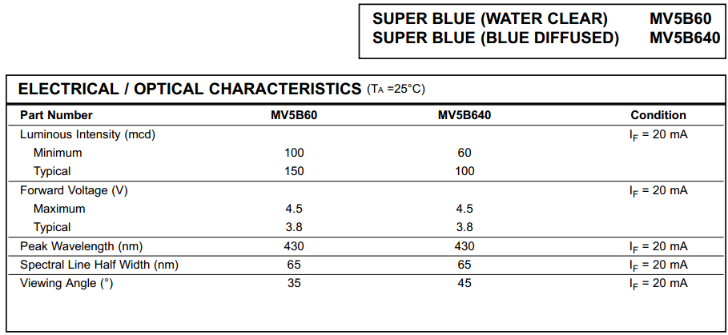

Slide 32
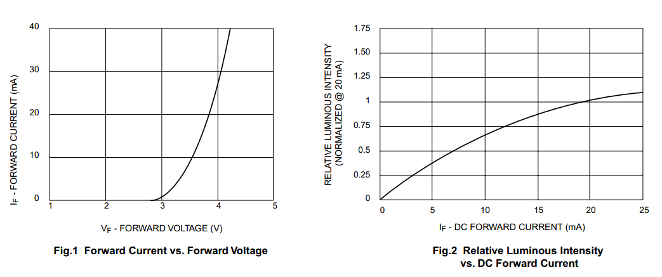
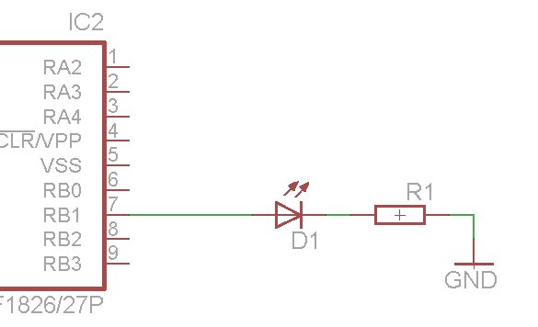
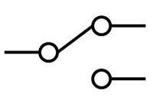
V = Vd + Vr
Vr = I * R1
Vd = 3.8V
I = 20mA = 0.02A
R1 = ? Ω
5V
0V
I
R1 = Vr/I = (V-Vd)/I = (5-3.8)/0.02=60 Ω
Vd
Vr
V
Notes:
Dosadit=substitute

Slide 33
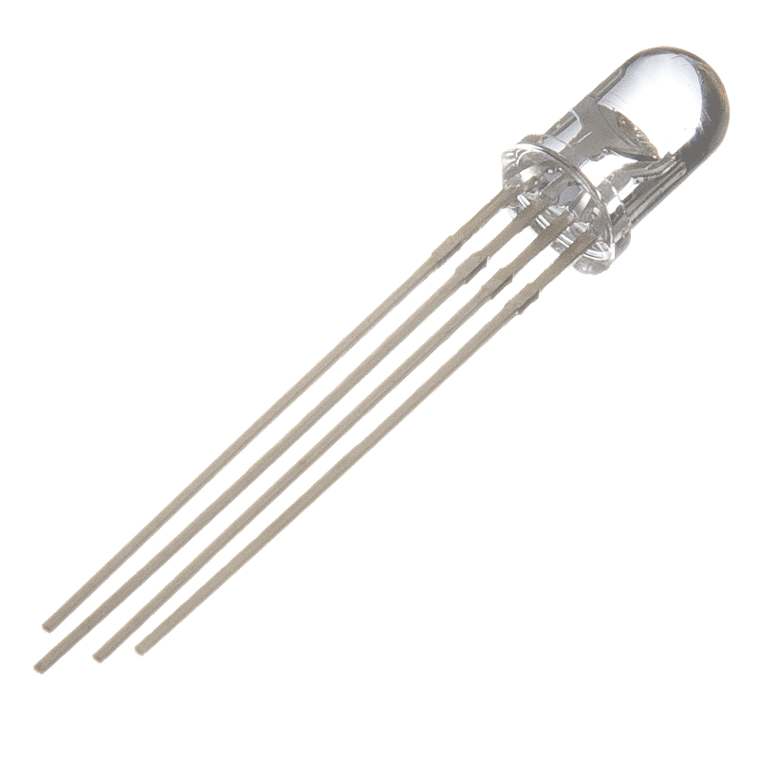
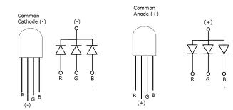
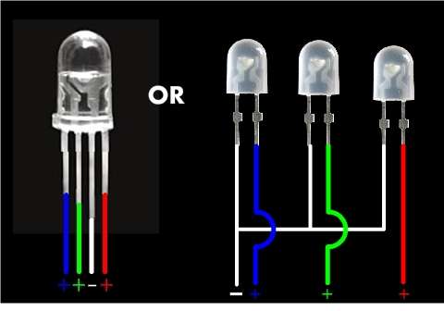
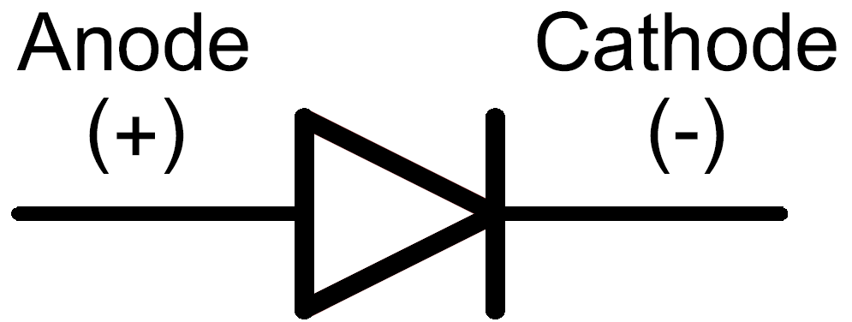
RGB Leds

Slide 34
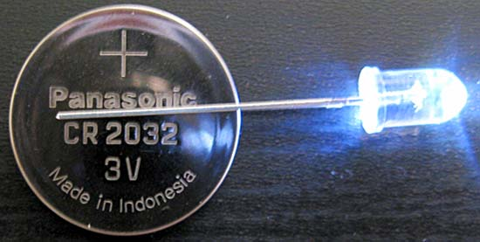
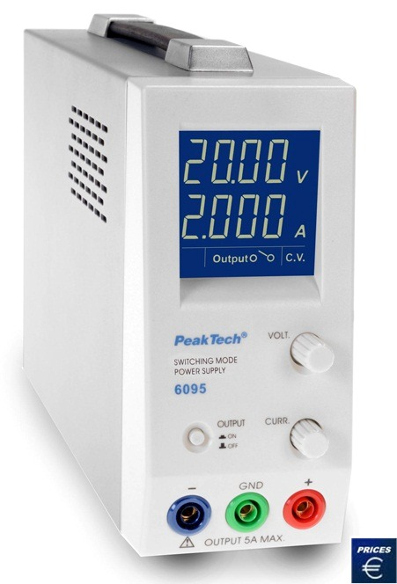
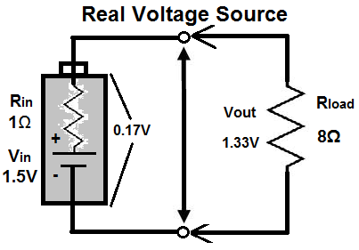
Output impedance of Power Source
Notes:
…dopisat. Output impedance of real voltage source

Slide 35
Transistor as switch

Slide 36



Voltage divider
I = Vn/(R1+R2)
VR2
Vn
Vn = 5 V
R1 + R2 = 10 000Ω
VR1
V
VR1
VR2 = I*R2
VR2 = Vn/(R1+R2)*R2
VR2 = 0.4V
I

Slide 37

Digital I/O pins
Notes:
Tristate – current limitation -> transistor & relay

Slide 38
Switching larger loads
Notes:
Tranzistor NPN, relatko

Slide 39

MCU Digital pins
Cievka & kondenzator?
RC filtre
Pull up
Output modes
Analog pin

