Slide 1
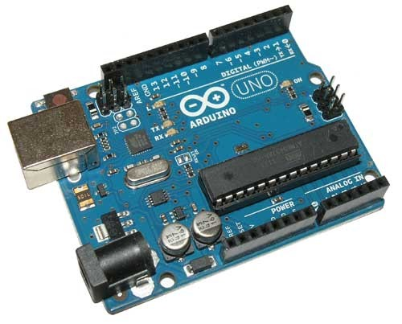
Arduino

Slide 2
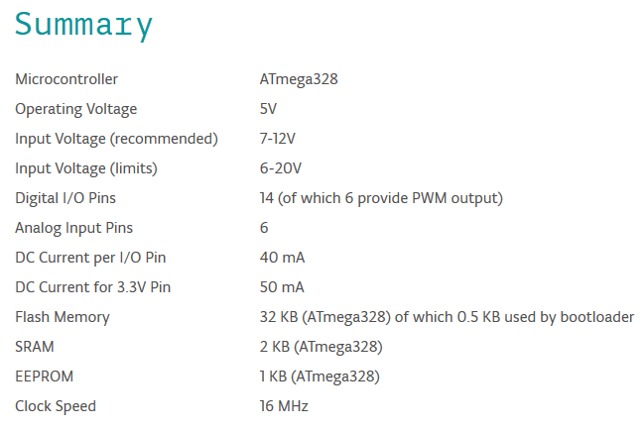

Slide 3
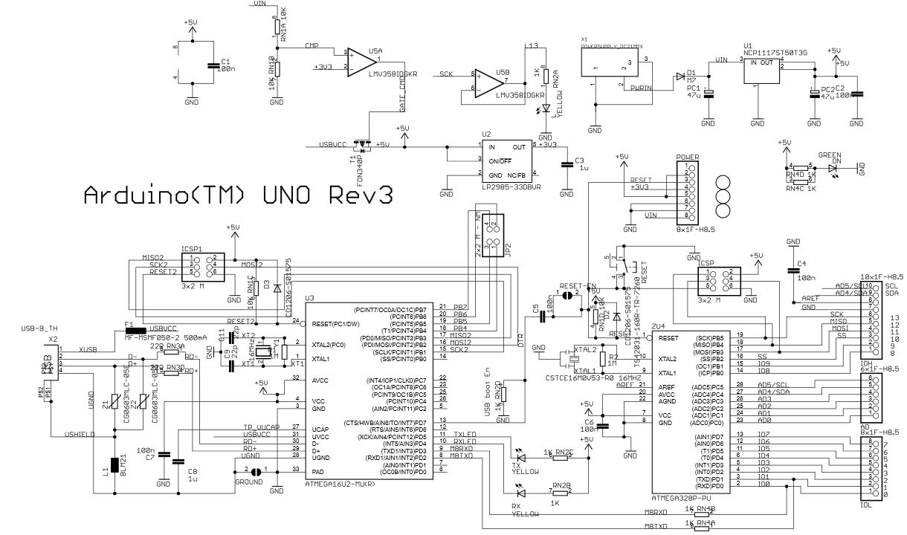

Slide 4
Power
USB powered
External DC (7..12V) - Linear 5V regulator
Linear 3.3V regulator
USB
ATMega16U2 – programming & serial comm
Safety (500mA PTC fuse)
IO
Digital pins, analog pins, PWM
Internal led at pin 13
Notes:
Cheap but not efficient

Slide 5
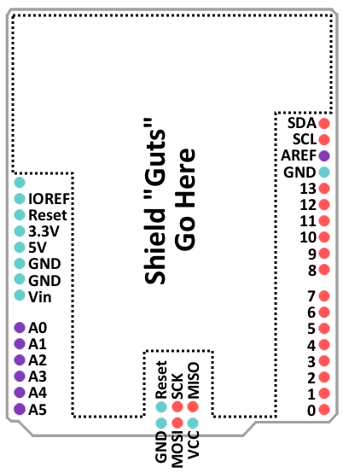

Slide 6
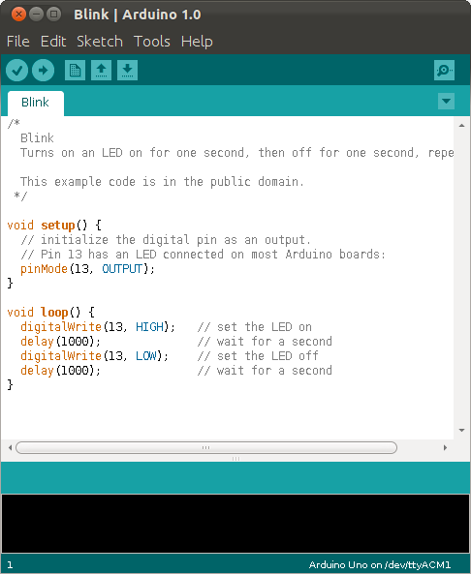
Arduino IDE
Open source & free
Wide compatibility (Mac, Windows, Android)
C / C++ language
Easy to use

Slide 7
Installing…
…

Slide 8
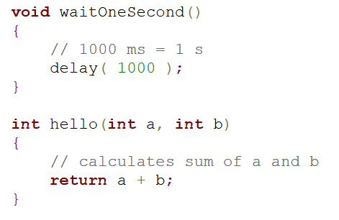
Functions
Return type
Arguments
Return value

Slide 9
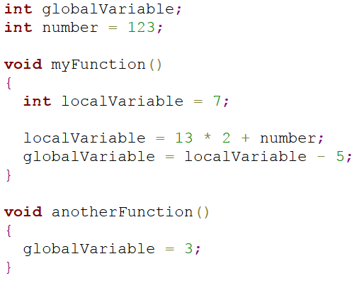
Variables
Global variables
Local variable

Slide 10
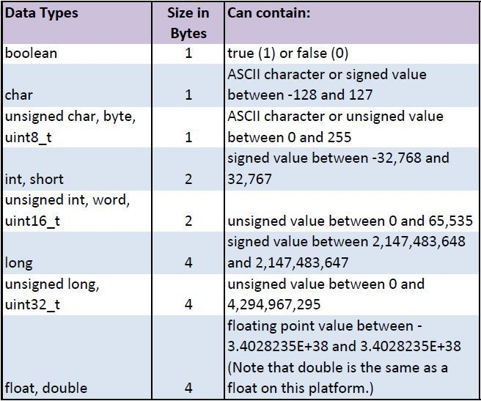
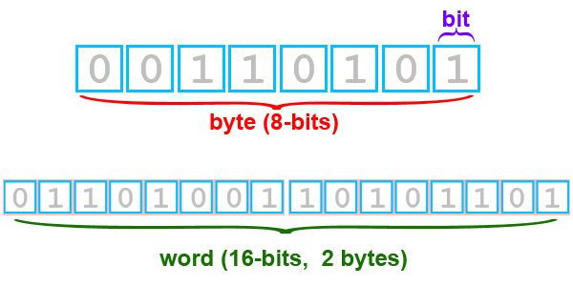
Data types

Slide 11
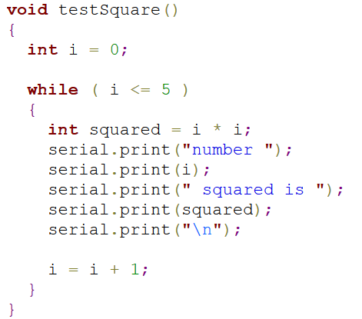
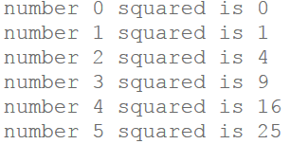
Loops

Slide 12
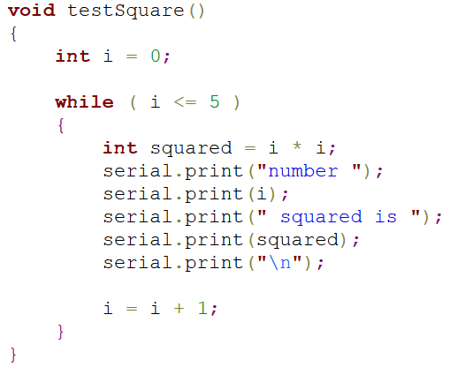
Scope

Slide 13
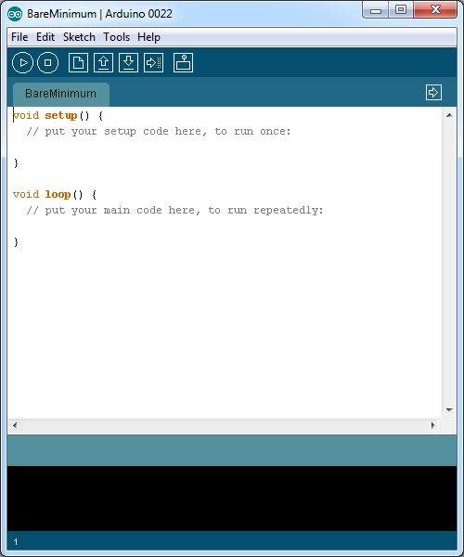
Blinking Led
Setup
Loop
pinMode(N, INPUT/OUTPUT)
digitalWrite(N, HIGH/LOW)
Delay( milliseconds )

Slide 14
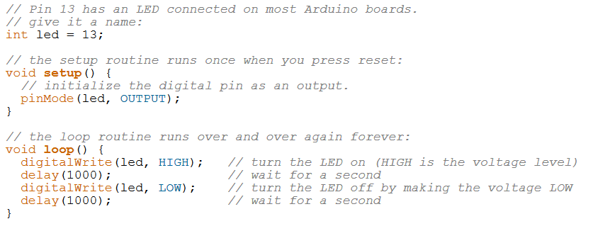
Blinking led
Write a program that blinks the led quickly 3 times and then 5 seconds waits

Slide 15
Morse code
http://en.wikipedia.org/wiki/Morse_code
Write a program that blinks out your name in morse code

Slide 16
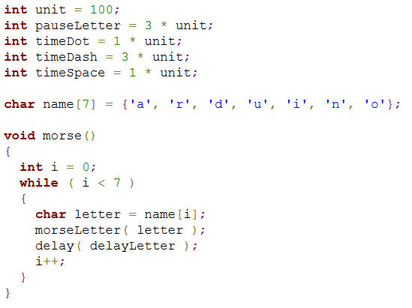
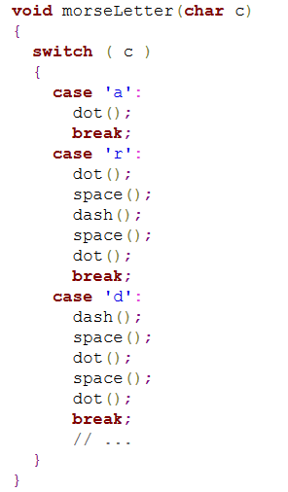
Morse code – array & switch

Slide 17
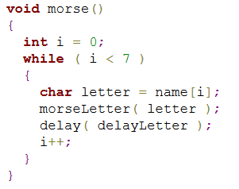
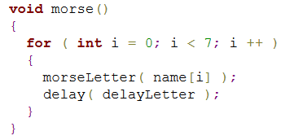
“for” loop
for( initialization; condition; increment)
Notes:
More compact code, saves 2 lines

Slide 18
If conditions

Slide 19
Communicating with PC
…Zapis aj citanie

Slide 20
PWM

Slide 21
Driving RGB led

Slide 22
AD Converter

Slide 23
Photoresistor

Slide 24
Timers & sounds

Slide 25
UART, I2C, SPI

Slide 26
Digital thermometer

Slide 27
BMP085?

Slide 28
Display HD77480

Slide 29
RGB Display

Slide 30
Wireless communication - OOK

Slide 31
Bluetooth

Slide 32
Ethernet - client

Slide 33
Ethernet - server

Slide 34
Javascript client

Slide 35
PHP server

Slide 36
Visual Micro

