Slide 1
CENELEC STANDARDS and its Application on Indian Railways for Signalling Alok Katiyar Dir/RDSO

Slide 2
Over View of CENELC Standards for Signalling Applications
Main CENELEC Standards applicable for
Software Embedded Signalling Systems are:
EN 50126 - The Specification and Demonstration of Reliability, Availability, Maintainability and Safety.
EN 50128 - Communications, Signalling and Processing Systems – Software for railway Control and Protection systems.
EN 50129 - Communications, Signalling and Processing Systems – Safety related electronic system for Signalling.
EN50159-1- Communication, signalling and processing systems - Safety-related communication in transmission.

Slide 3
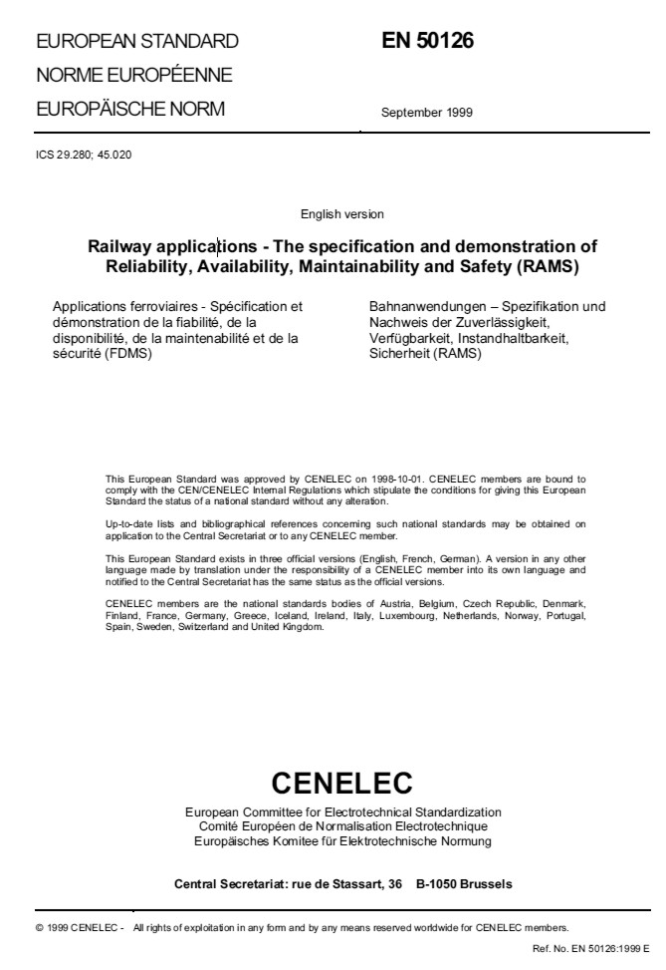
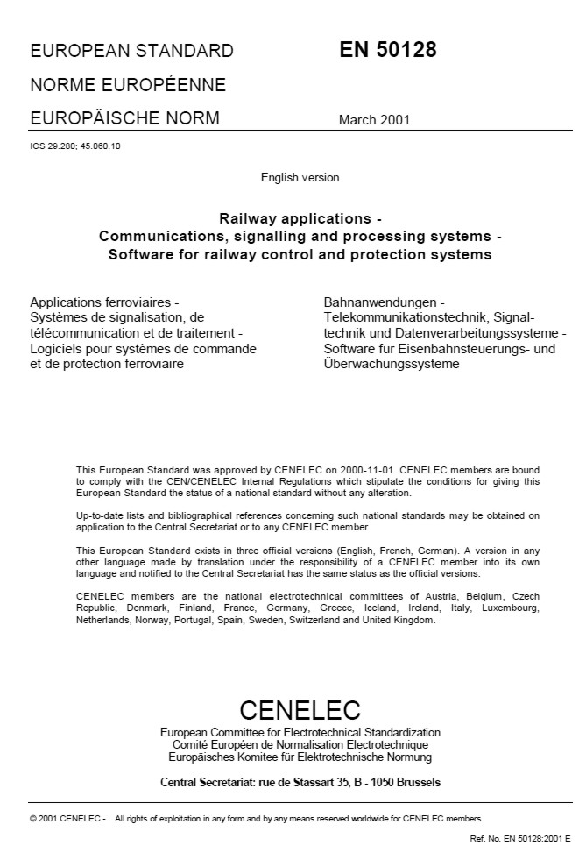
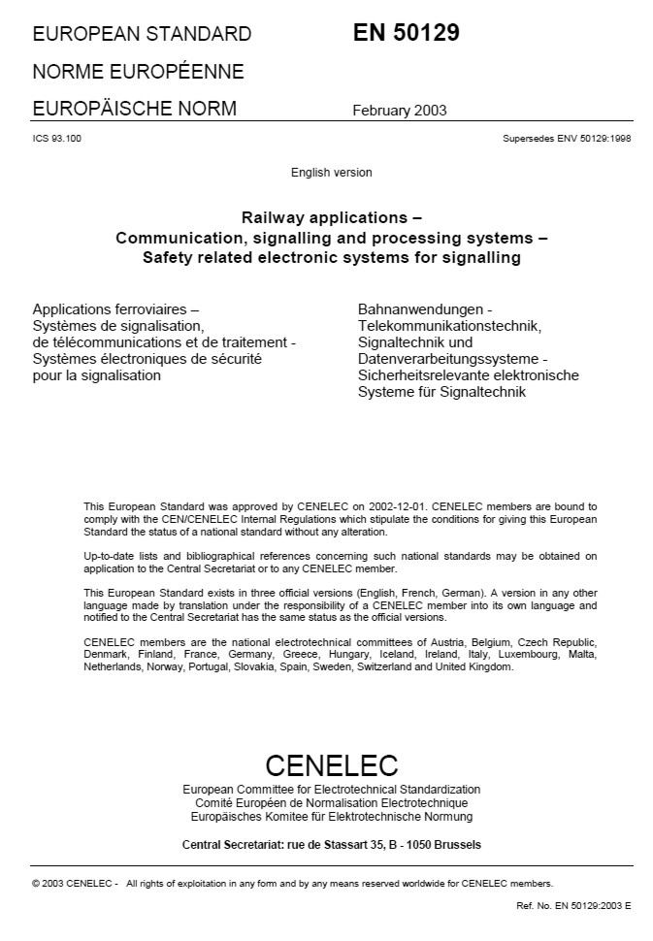
Introduction to the 5012x-CENELEC-Standards
For the approval process of Railway Signalling Systems the CENELEC norms EN 50126, 50128 and 50129 are now obligatory standards for most countries. The norms describe the life cycle process for safety relevant railway Systems that is integrated into the development process.

Slide 4
Introduction to the 5012x-CENELEC-Standards EN50126
The EN 50126 defines the terms of RAMS, their interaction and a process based on the system lifecycle for managing RAMS.
In addition, a systematic process for specifying requirements for RAMS and demonstrating that these requirements are achieved is defined.

Slide 5
Introduction to the 5012x-CENELEC-Standards EN50128
The EN 50128 specifies procedures and technical requirements for the development of programmable electronic systems for usage in railway control and protection applications, aimed at usage in any area where there are safety implications.
In contrast to the EN 50126, it is applicable exclusively to software and the interaction between software and the system which it is part of.

Slide 6
Introduction to the 5012x-CENELEC-Standards EN50129
The EN 50129 specifies those lifecycle activities which shall be completed before the acceptance stage, followed by additional planned activities to be carried out after the acceptance stage.
It is therefore concerned with the evidence to be presented for the acceptance of
safety-related systems and is highly related to the EN 50126.

Slide 7
Introduction to the 5012x-CENELEC-Standards
transform
Formal Model
In order to have a common understanding of the textual described content inside the norms, a normative safety case model is developed. For this purpose the use of more or less formal description languages is used with the purpose of expressing the normative requirements in user-friendly method.
The Generic Safety Case Model is one basis for formulating a questionnaire used for discussions with the suppliers and railway operators.

Slide 8
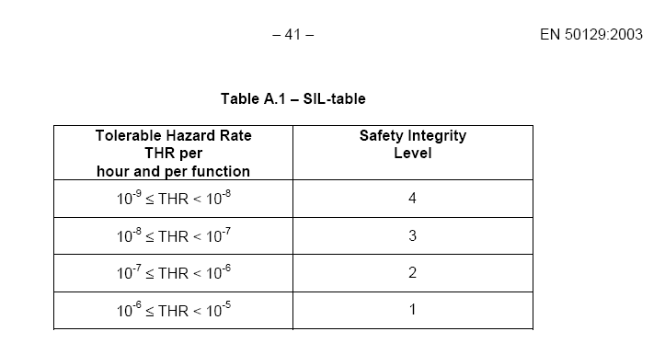
Safety Integrity Level
CENELEC Standard uses the concept of Safety Integrity Level based on the Tolerable Hazard Rate
4 SIL is defined with SIL4 being the most stringent

Slide 9
System LifeCycle as defined in CENELEC Standards
Concept
System
Definition
Risk Analysis
System
Acceptance
Operation and
Maintenance
System
Requirements
System
Validation
System level
Sub-system level
Validation
Verification
Requirements
Apportionment
Verification
Installation
Design and
Implementation
Manufacture

Slide 10

Safety Methodology
Double Life Cycle
Hazard &
Risk Analysis
Syst & Sub-Syst.
Safety Validation
Syst. & Sub-Syst.
Design
Syst. & Sub-Syst.
Validation
HW & SW
Safety Analysis
HW & SW
Safety Validation
HW & SW
Design
HW & SW
Validation
Each phase of the project
Development Activity
Specific Safety Activity
Safety Activity

Slide 11
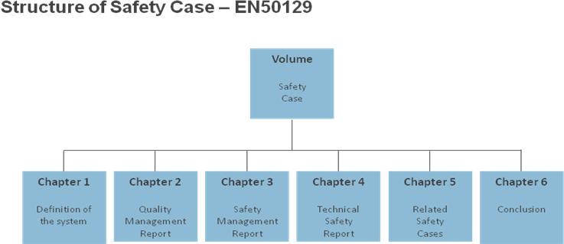
Structure of Safety Case

Slide 12
METHODOLOGY FOR SAFETY ASSESSMENT

Slide 13
Overview of Safety Strategy
Safety Strategy is based on:
The system must comply with safety requirements as par the CENELEC standards
Safety demonstrated in compliance with EN50126, EN50128 and EN50129.
The system must be fully compatible with the current systems, which are in operation.
Safety Cases to be deployed as evidence for the safety of the design.

Slide 14
SAFETY CASE (EN50129 – Clause 5.1)
Safety Case Documents shall consists of:
1) Evidence for Quality Management
2) Evidence for Safety Management
3) Evidence for Functional & Technical Safety

Slide 15
Evidence Of Quality Management (EN50129 - Cl.5.2)
QMS Document describes the process adopted to satisfy
the quality of the system, sub-system or equipment to
reduce the risk of systematic faults in every stage of the
product life cycle.

Slide 16
Evidence Of Safety Management (EN50129 - Cl.5.3)
System Safety Plan is prepared to identify safety management structure, safety related activities and procedures for safety reviews for both Software and Hardware.
Identification of System Safety Requirements.
Hazard Log is maintained to list out the identified Hazards.
Preliminary Hazard Analysis (PHA) and System Hazard Analysis (SHA) is performed at different stages of development through out the life cycle. Fault Tree Analysis (FTA), Failure Modes, Effects and Diagnostics Analysis (FMEDA), along with qualitative analysis is carried out.
Failure Rate is computed to the system level as per MIL HDBK 217 FN2 Part Stress Method and Reliability Block Diagrams. (RBD). Tolerable Hazard Rate (THR) is computed using Failure Rate (FR) and Safe Down Rate (SDR).
IV&V has carried out fail-safety testing on each component to analyze the effect for possible failure modes of the respective component, when the system is normally working. Fail-Safety is carried out for single and multiple failures. System condition under failure of each component is verified.

Slide 17
Evidence Of Functional & Technical Safety (EN50129 - Cl.5.4)
Technical Safety Report (TSR) provides the reference to technical principles which assure safety of the design and all supporting evidence. It provides the reference to the documents that discuss the practicable measures taken to prevent the occurrence of identified hazards.
Environmental Stress Screening tests are carried out at RDSO laboratories and test results are verified. (Tests as per RDSO/SPN/144).

Slide 18
Safety Acceptance & Approval (EN50129 – Cl. 5.5)
Safety Case Document provide the evidences for Quality Management, Safety Management and Technical safety report.
Safety Case Conclusion summarizes the evidence produced in the Safety Case document and justify the claim that the system is adequately safe, subject to its compliance with in the specified application conditions.
Safety Approvals are received from IV&V agencies based on the evidences produced and the test results.

Slide 19
Software Safety Integrity Level (EN50128 - Cl.5)
Derivation of System Requirements(SRS) based on Customer specification.
Identification of System Safety Requirements (SSRS)
System Safety Plan to identify safety management structure, safety related activities and procedures for safety reviews for Software.
Preparation of System Architecture Description (SAD)
Identification and Review of all safety/vital functions.
Apportionment of Safety Integrity Level to Sub-systems based on the identified safety functions.

Slide 20
Software Verification & Testing (EN50128 - Cl.11)
Software (SW) Verification Plan, SW Requirements Verification Report, SW Architecture and Design Verification Report, SW Module Verification Report, SW Source Code Verification Report, SW Integration Test Plan and SW Integration Test Report documents are produced by IV&V agency to carry out verification and testing for the required SIL.

Slide 21
Software/Hardware Integration (EN50128 - Cl.12)
Once the Hardware and Software is verified by IV&V, their
compatibility is tested during SHI.
SHI Test Plan and Test Report documents are developed.
They describe the test cases, types of tests to be performed,
And test environment including tools and support software.

Slide 22
Software Assessment (EN50128 - Cl.14)
IV&V has evaluated that the life cycle processes and resulting product is such that the software is of the defined safety integrity level and is fit for the intended application.
IV&V has produced the Software Assessment Report recommending the Software for the intended use.

Slide 23
Field Trials
Filed Trials are carried out in three phases for specified mandatory period:
1) Parallel Trials
2) Series Trials
3) Stand-alone Trials
Objective Of Parallel Trial is to assess the Functional Performance and Operation in Railway Environment..
Objective Of Series Trial is to assess the functionality in operating the Field Function in Series. Outputs are delivered only if both Systems outputs are same, thus safety is ensured by two diverse systems.
Objective Of Stand-Alone Trial is to assess the overall system , as performance and safety is verified in the previous Trials.

Slide 24
THANK YOU

