Slide 1
Modeling and Error Analysis:
Solar Farm Energy Production
DU MSDS Capstone Final Project
Gabor Horvath Sennyey

Slide 2
STAR Summary
Modeling was able to predict Production levels for a Solar Farm of capacity 468kW with Mean Absolute Error of 14.3kW or less.
Among the many Solar and Weather data available, we found that Cloud Cover significantly impacted kW-variability, while high Temperature meaningfully regulated kW Production.
We considered two primary algorithms with ability to handle missing data:
SciKitLearn's HistGradientBoosting Regressor
XGBoost Regressor
Ultimately, XGBoost Regressor was selected. Details ahead.

Slide 3
Situation
A 468kW-capacity Solar Farm wants to better understand the effects of Solar and Weather data on Production.
They’ve provided 1 year of Production, Solar, and Weather data to work with.

Slide 4
Task
The Situation leads to two natural approaches. In the case that the data is continuous (no gaps, constant frequency), we can apply “classic” Time Series analysis and modeling. If not, we can rely on Machine Learning models instead.
Understanding Solar- and Weather-influences on Production would allow for various business benefits, such as allowing the Solar Farm to account for low-production conditions and provide more consistent service to power Distributors and Consumers.
Our goal is to create models that would allow for accurate predictions of Production and, ideally, Forecasting of future Production.

Slide 5
Action
In short, data was TMY-formatted (Typical Meteorological Year) with additional farm-wide Kilowatt values.
This means we can access Features like:
Cloud Cover
Irradiation (power per unit area)
Long- and Shortwave Radiation amounts (Earthly and Solar radiation)
Temperature
The Testing data were randomly-sampled from the span of our Training data, so we were forced to model with Machine Learning. Our choice of models was additionally restricted by NaN (missing) values present in various features.
Data was modeled in various ways, ranging from simple radiation and cloud-cover Features through to Cyclically-represented Time data and inclusion of Temperature as a regulator of Production.

Slide 6
Results
We were able to create two models that provide options for ease of use and completeness in the scope of our problem.
Model 1, MAE = 13.82698
Includes Radiation, Cloud, and Temperature data, with better understanding of factors that limit Production, reducing over-predictions.
Model 2, MAE = 14.30757
Includes Radiation and Cloud data, over-predicting a bit more/worse, but avoiding further challenge in Forecasting from NaN values.
Both models allow for accurate predictions within ~3% of total Production range.
The understanding gained from Radiation and Weather features gives us a choice of how deep we want to go in fleshing out, predicting, and forecasting Production, while also being able to fill data if Production monitoring experiences downtimes.

Slide 7
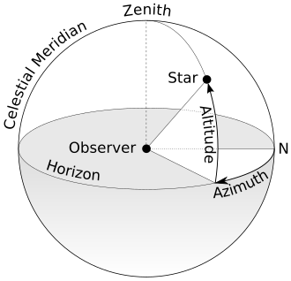
Data Introduction
Data Glossary:
'kw' - current production
'S_d' - direct beam solar radiation intensity
'airmass' - density of diffusing particulate in atmosphere
'altitude' - Solar position
'azimuth' - Solar position
'irradiation' - power per unit area from Sun
'panel_cos' - incident angle of Sunlight on panel
'sunrise'
'sunset'
'cloud_total_mean' - mean percent cloud cover
'temp_total_mean' - temperature
'radNetS_lw_mean' - mean Earthly radiation
'radNetS_sw_mean' - mean Solar radiation
and more…

Slide 8
Data Acquisition
Data was acquired from a low-participation Kaggle competition:
Various other resources were used to confirm the type/quality of the data
National Renewable Energy Laboratory (NREL)
NOAA
Typical Meteorological Year data standard
1-year span of kW, Radiation, Weather data at 15-minute resolution
Encountered significant gaps in data
Data was prepared by the source, which affected our modeling:
All Atmospheric data included NaN values
This forced us to select modeling approaches that could handle this data, as we found meaningful correlation and variance among them.
Train and Test sets were provided
Test data was randomly-sampled from the span of the year, further constraining modeling choices.

Slide 9
Data Prep & Feature Engineering
Data was assessed and prepared with the following criteria:
Identified missing values in all Atmospheric data
No imputation/interpolation
Model choice accounted for these
Transformations
Time data provided in only linear fashion (Past -> Future)
Created Cyclical representations of time by transforming to sin(), cos() of time at various scales:
Hour, Month, Day of Year, etc.
Provides more appropriate distance measure between “ends” and “beginnings” of each time scale
Feature Selection
Correlation analysis
Applied to identify meaningful secondary correlations
Solar position and Radiation data was obviously going to be meaningful
Project focused on search for other factors
Partitioning
Train-Test split, stratified by Month

Slide 10
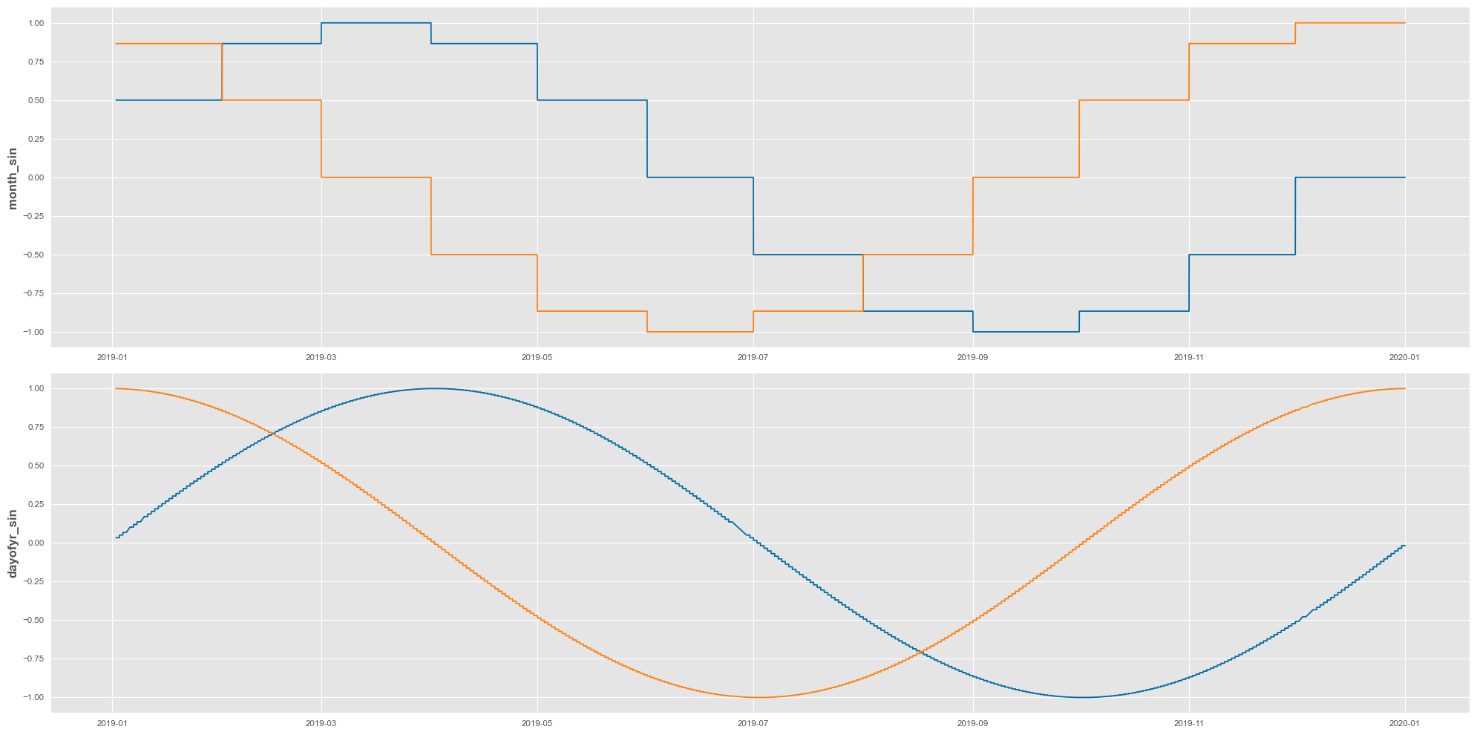
Data Prep & Feature Engineering
Cyclical Time Transform Visualization: Month, Day of Year

Slide 11
Model Selection
Data requirements allowed the following algorithms to be considered:
SKLearn HistGradientBoosting Regressor
Handles NaN’s by testing benefit of grouping them in both ways at a given Decision Tree split
Functions like Random Forest, an ensemble of trees then aggregated
XGBoost Regressor
Handles NaN’s by “learning branch directions in training”
No clear source was found as to whether this is the same logic as HGB
Creates successive Decision Trees, optimizing by improving sources of error in previous iterations.

Slide 12
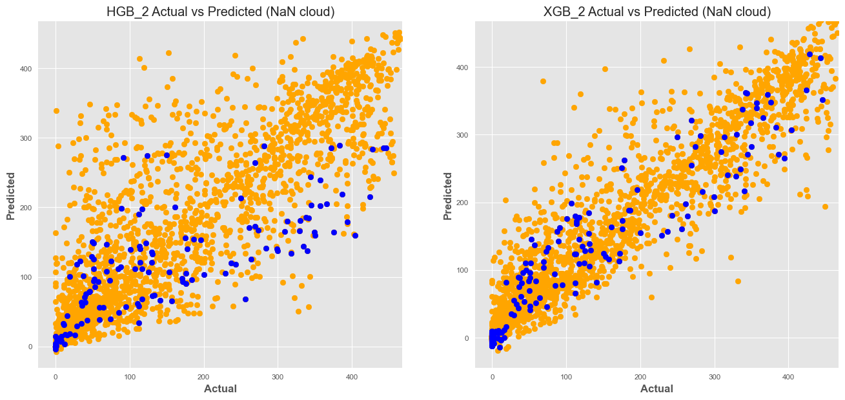
Model Selection
HGB’s possible advantage over XGB was a focus of our investigation.
Ultimately, we determined that it was not producing helpful results in the way we expected due to its stated logic. NaN values in HGB seemed to “cap” kW predictions, while causing frequent under- and over-predictions.
Due to this behavior, XGBoost was selected and optimized instead.

Slide 13
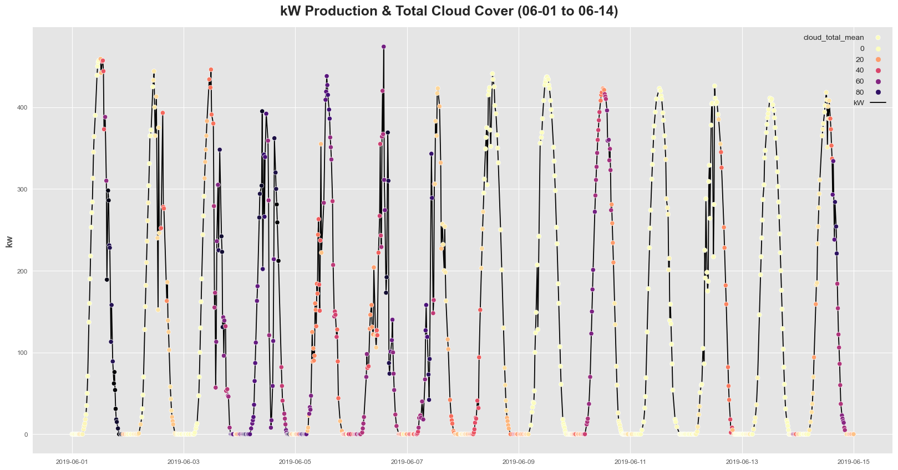
Error Analysis & Feature Selection
Investigating Variance and High-Error Predictions, in our models revealed that Cloud Cover and Temperature were meaningful regulators of kW Production. We include these features in modeling.

Slide 14
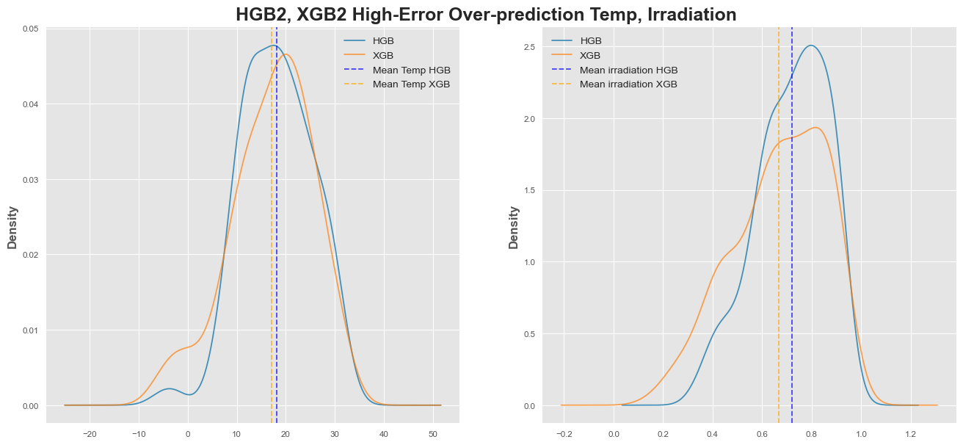
Error Analysis & Feature Selection
High-Error Over-Predictions occur when Irradiation AND Temperature are among their highest possible values:
Sample Temperature values centered 5°C higher than the whole data
Sample Irradiation centered on values well beyond the 50th percentile (~0.43) of Non-Zero, Daytime values
kW-maxima are reduced when Temperature exceeds ~12°C.

Slide 15
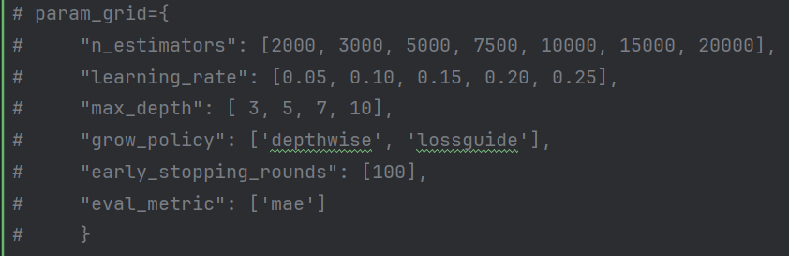
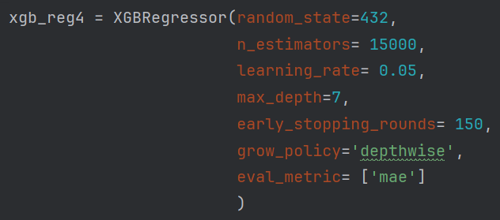
Model Optimization
Moving forward with XGBoost, we performed a GridSearch and achieved the following Validation MAE results with and without Temperature as a Feature.
 | No Temperature | Temperature
XGBoost | 14.30757 | 13.82698

Slide 16
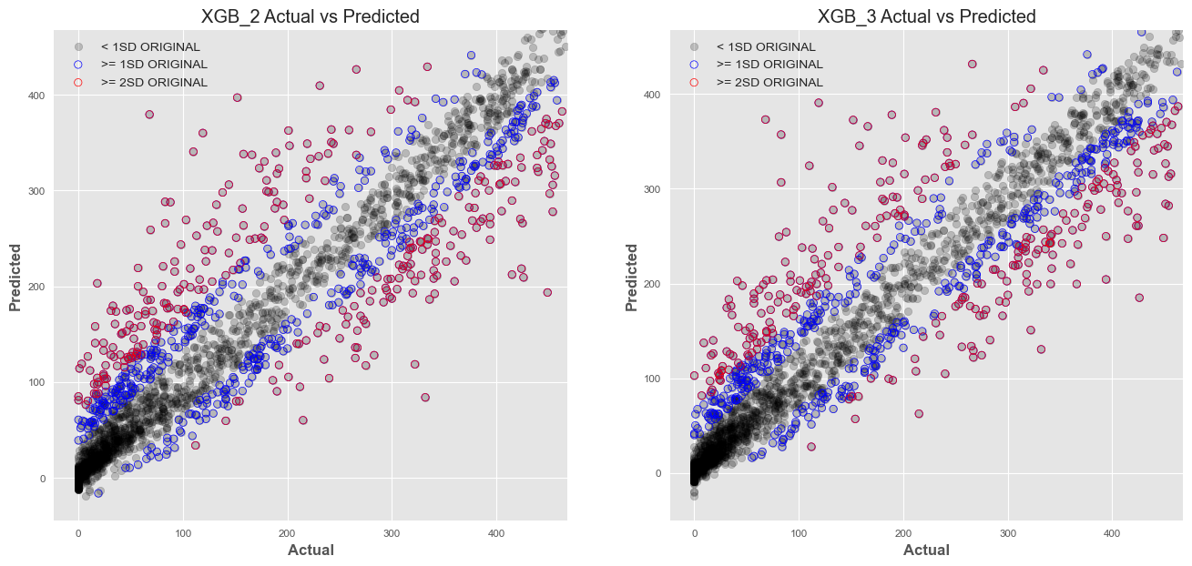
Model Interpretation
After accounting for the dynamics of Cloud Cover and Temperature, we achieved two models that behave very similarly.However, we can still pick out differences in the “spread” of Predictions, as including Temperature reduces Over-predictions, “tightening” the upper portions of our band.

Slide 17
Future Opportunities
With more time we can…
Reconstruct the entire Time Series
Fill and/or Interpolate data for “gaps” and “missing” values
Attempt to perform “true” Time Series Analysis
ARIMA-style approaches
Investigate Auto- and Partial Autocorrelations
Implement lag features
Explore Forecasting
and more…

