Slide 1
Lending Club Case Study (EDA)

Slide 2
Problem Statement
Goal
Identify the risky loan applicants from the data, so that loans can be given to only those where the amount of
credit loss will be reduced.
Objective
This company is the largest online loan marketplace, facilitating personal loans, business loans,
and financing of medical procedures. Borrowers can easily access lower interest rate loans through a fast online interface.
Lending loans to ‘risky’ applicants is the largest source of financial loss (called credit loss).
Borrowers who default cause the largest amount of loss to the lenders. In this case, the customers labelled as 'charged-off' are the 'defaulters'.
Target
Using EDA, understand the driving factors (or driver variables) behind loan default,
i.e. the variables which are strong indicators of default and derive the patterns of loan defaulters.

Slide 3
Approach followed
The approach for analysis is divided into four main parts:
a. Data understanding from the csv files provided.
b. Data cleaning (cleaning missing values, removing redundant columns etc.).
c. Data Analysis (Univariate, Bivariate).
d. Recommendations.

Slide 4
Data Understanding
Types of variables
Customer (applicant) demographic
Loan related information & characteristics
Customer behavior (if the loan is granted)
Customer Demographics
Employment length
Employment Title
Annual Income
Zip Code
Description
Loan Info
Loan Amount
Funded Amount
Interest Rate
Loan Status
Loan Grade
Customer Behavior Variables
Deliquency year
Earliest Credit Line
Revolving balance
Recoveries
ApplicationType
Loan Purpose

Slide 5
Data Cleansing
There are some columns with lot of missing values. We need to drop such records.
Removed all the null value columns.
Found the percent of values in columns which are NA and removed the unnecessary columns which will not help in analysis.
Removed text columns which are not useful for this loan disbursement analysis.
Converted datatypes as needed from object to Int / float.
Detecting outliers and deleting them for getting more clean data.

Slide 6
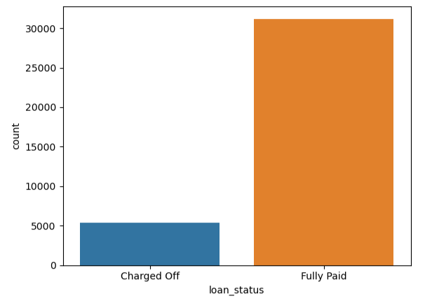
Analysis
This graph represents people who have already paid loans and defaulters. The defaulters are about 15 or 16%

Slide 7
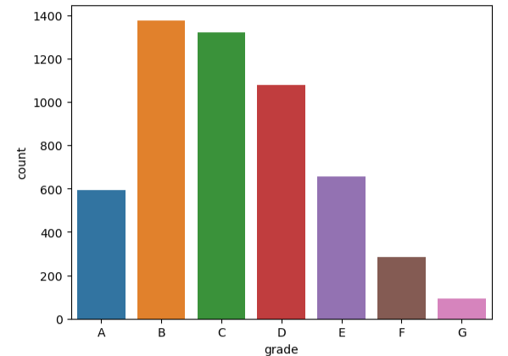
Analysis
This graph represents that majority of defaulters are in grade B

Slide 8
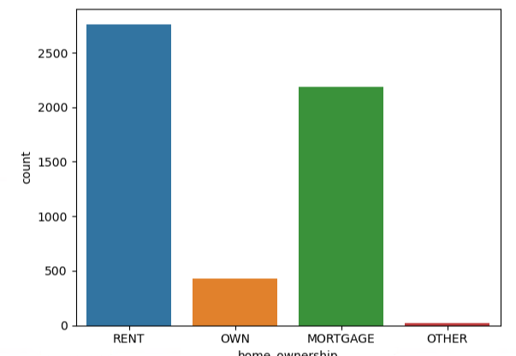
Analysis
With respect to home ownership, the members who own houses are less likely to default on the loans.

Slide 9
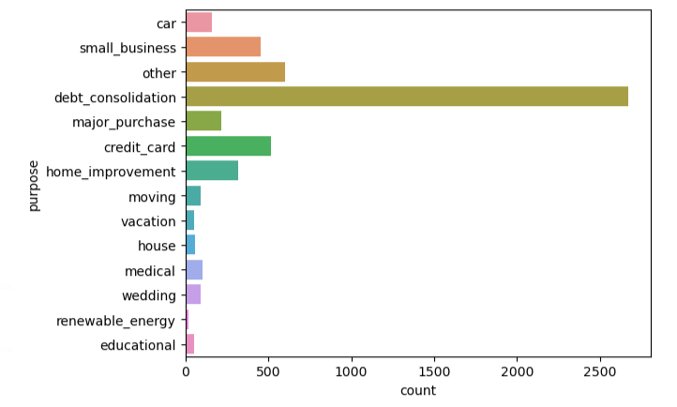
Analysis
Most of the members have a purpose of debt_consolidation which turn out to be defaulters. So when new loan is being issues, if the purpose entered is debt_consolidation then it may result in a defaulted loan.

Slide 10
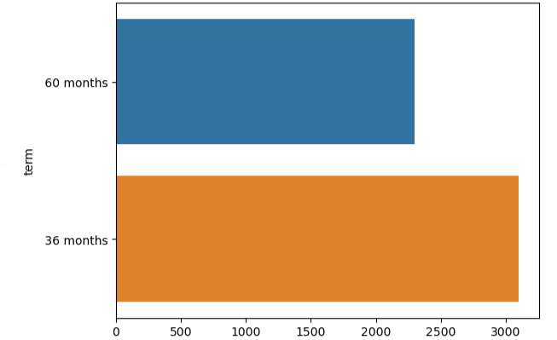
Analysis
Members who have lesser time to pay off debts are more likely to default. When given time, most of them have paid. When time is less, defaulters count is more.

Slide 11
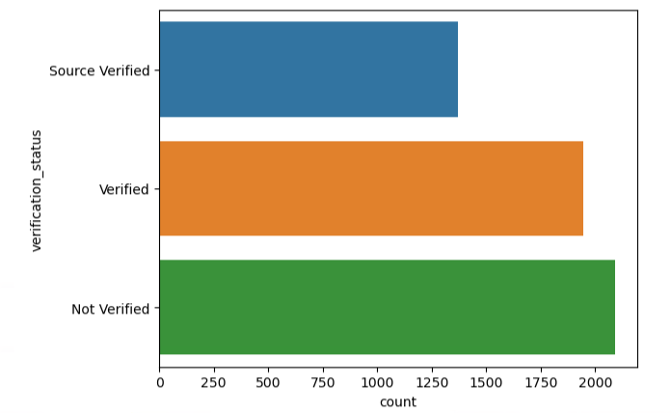
Analysis
Members whose verification status is not verified are more likely to default. This is a good indicator to make sure all the sources are verified when issuing a loan.

Slide 12
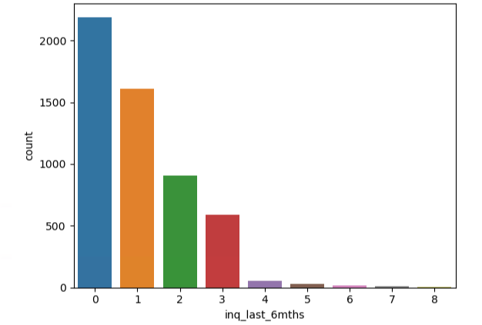
Analysis
One of the strong indicator is how many inquiries are being made over last 6 months. Here its listed that more defaulters tend to make more inquiries.

Slide 13
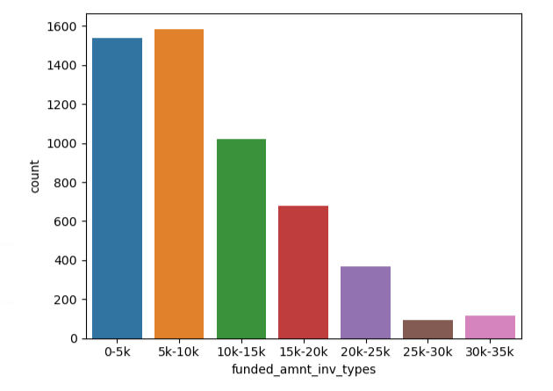
Analysis
More people are defaulters when salary is lesser than 10K. About 50% of defaulters fall into this category.

Slide 14
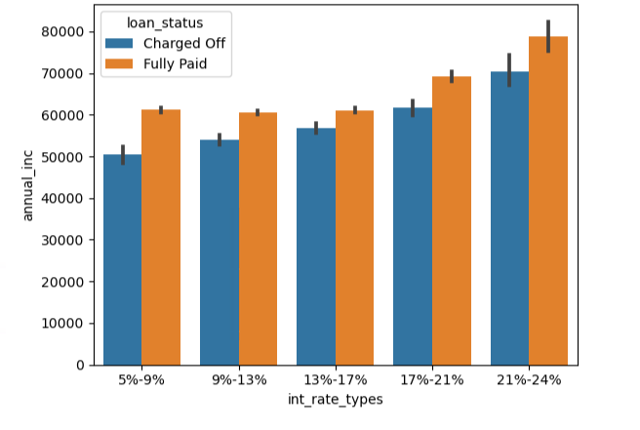
Analysis
When interest rates are higher, there is a very high chance of defaulting on a loan. When the interest is around 21 to 24% has the highest defaulters.

Slide 15
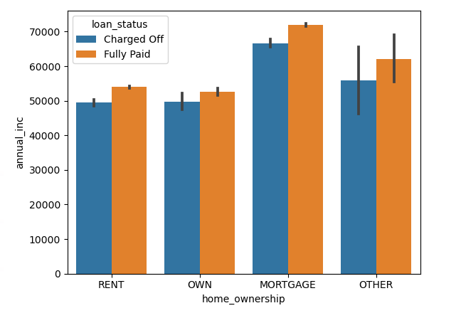
Analysis
Owning a home reduces the defaulter probability. If there is already a mortgage, then defaulter probability is higher.

Slide 16
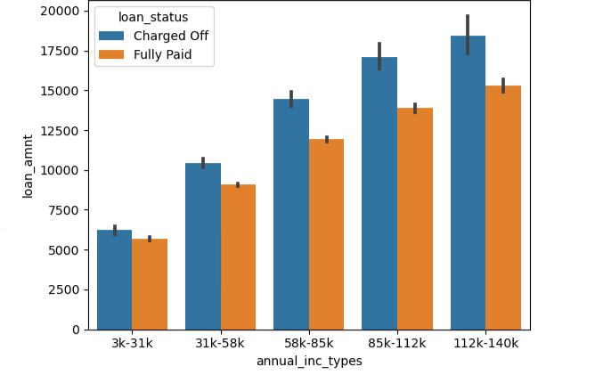
Analysis
Even though annual income is way higher, due to very high loan amount, the defaulters percentage is higher.
Loans can be issued to members who have high income and ask for less loan amounts.

Slide 17
Conclusion
From the data provided, there are 15% default rate in the data
The Probability of default cases are
When applicant has house ownership as "rent“.
When applicant is from grade B at the 5 level.
When applicant has purpose of debt clearance.
When applicant term is 36 months.
Most of the default cases when the applicant details are not verified.
When the fund amount by investor is between 5k to 10k.
When the loan amount between 5k to 10k.
When the public records are 0.
When the annual income types between 31k to 50k
When the dti is between 12 to 18
When monthly installment between 145 to 274
When the interest rate is 13% to 17%
When the application of the length 10

