Slide 1
Final Presentation NLP Concept Extraction for Bug localization
Gabriel Pawlowsky
Mentor: Naveen Kulkarni, Sunil Vuppala
Co-Mentor: Nitin Agarwal

Slide 2
Contents
Background
My Project
Noun extraction
Keyword extraction
Filtering
JATE2.0 (Scoring)
Concept identification
Results

Slide 3
Background
Extension to the Infosys Automation Platform (IAP) of Mana
Based on Natural Language Processing (NLP)
Entire Project
Fast, accurate and automated bug localization to aid resolution of L3 tickets
NLP Concept extraction from bug reports, source code documentation and online bug resolutions
Gaining an understanding of the concept’s interactions and resolution
Suggesting areas of the source code (files) in which the bug most likely occurred to a developer to aid them in fixing it

Slide 4
My project
Concept extraction from source code documentation in Java

Slide 5
Noun extraction
Reading Spark documentation (Programming & Streaming guides)
Using many common NLP techniques
Started with the OpenNLP library
But changed project structure to work with the Stanford CoreNLP library due to better support of lemmatization
Tokenization
Split documentation by stop words to analyze words individually
Part of Speech (POS) – Tagging
Distinguish between verbs, nouns, plural nouns, etc.
Lemmatization
Put words into canonical form to treat e.g. “go”, “went” and “gone” all as “go”

Slide 6
Noun Extraction - Continued
Formation of Bi- and Tri-grams
For Bigrams, candidate terms as combinations of Verb-Noun and Noun-Noun occurring together considered
For Trigrams, combinations of Verb-Noun-Noun and Noun-Noun-Noun
Text Frequency calculation for candidate terms
How often does each candidate term occur in the entire text?
Early filtering
Min. and Max. percentage cut-offs for tokens in terms of the token occurring most often to demote very infrequently occurring or very common words such as “Java”, used ~5-70%
T-Statistics used for Bi- and Tri-grams to try to determine whether they occurred by chance or are meant to occur as an n-gram, used t=2.576

Slide 7
Keyword extraction – Filtering
Generally, implementing an unsupervised approach
=> no training for the software necessary means greatly a reduced workload in real-world applications
Done by computing a score from different features for each token specific for our use-case and considering highest scoring tokens as keywords
Text Frequency-Inverse Document Frequency (TF-IDF)
Idea is to weight tokens occurring many times in the entire text less highly than those occurring many times in only certain parts/documents
Started implementation but not finished yet

Slide 8
Keyword extraction – Filtering
Did much research on more advanced techniques/libraries
Techniques such as BM25, location-in-document, Approximate Dictionary-Based Chunking, graph-based approaches, etc.
Fully-fledged general purpose keyword extraction libraries such as TextRank, JATE2.0, RAKE, LingPipe, AlchemyAPI (Commercial), many more
However, many depend on language dictionaries and have therefore only limited usefulness in a computer science context
Best turned out to be:
JATE2.0 – large number of scoring techniques and highly customizable
RAKE – very limited customizability but strong for certain use-cases

Slide 9
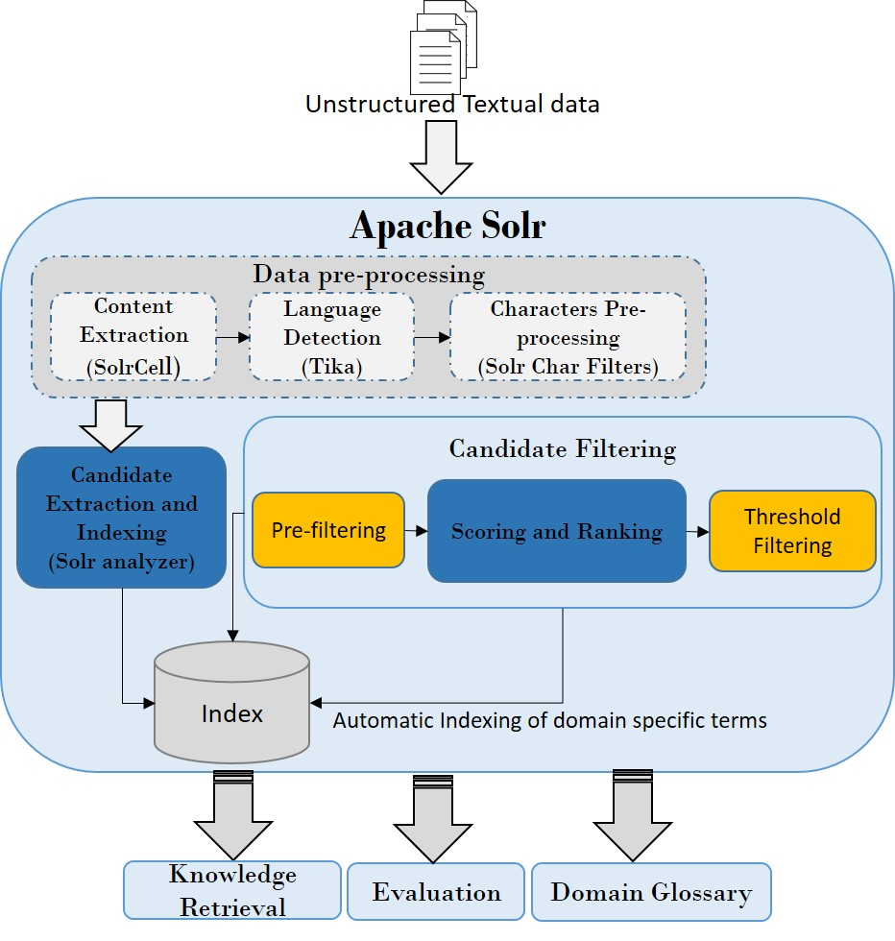
Keyword Extraction – JATE2.0
Based on Apache Solr for file indexing and keyword extraction
Thereby allowing three forms of candidate extraction:
Part-of-Speech (PoS) pattern based
Noun Phrase (NP) chunking based
N-gram based
Additionally, JATE offers various different scoring techniques:
TTF, ATTF, TTF-IDF, RIDF, C-value, ChiSquare, RAKE, Weirdness, GlossEx, TermEx

Slide 10
Keyword Extraction – JATE2.0
TTF, ATTF, C-value, ChiSquare
Output very basic concepts, mostly unigrams
ATTF and C-value (after filtration) provide best results
TTF-IDF, RIDF
Inverse document frequency based
More technical terms specific to certain parts of the documentation
Weirdness, GlossEx, TermEx
Dictionary-based; best for unusual terms such as source code concepts
RAKE
JATE implementation seems different, but python implementation of the same name scores technical terms well

Slide 11
Concept identification
In this phase, keywords that have been identified need to be evaluated for their usefulness to aid bug localization
E.g. “Node” is a useful concept, whereas “Java” is not
“task” may be a useful concept in some cases but not in others
Now useful concepts vary strongly with the use-case at hand
Thus, I have built multiple versions for different use-cases
Basic concepts
Source code concepts
More technical terms
Functioning revisited together with the results

Slide 12
Results

Slide 13
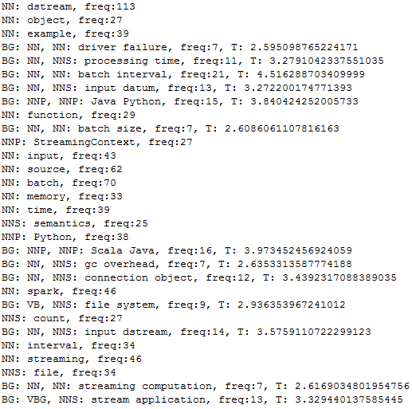
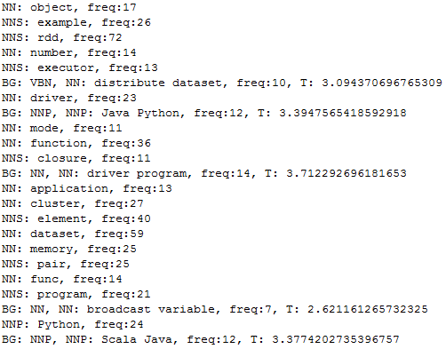
Results – Early filtration
Basic output of my noun extraction script with early filtering:
Spark Programming Guide
Spark Streaming Guide

Slide 14
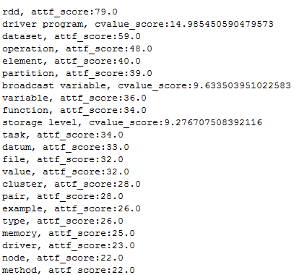
Results – Concept extraction
General-purpose concepts extraction
Chose top scorers from ATTF (mostly unigrams) and C-value (some n-grams)
Deemed only concepts as good that are contained in the nouns extracted by my program after early filtering (with percentage-cutoff and t-statistics)
Specifically to filter very common (e.g. “Java”) kewords and actual parts of the source code (e.g. “for(int i=0; i<length; i++)”)

Slide 15
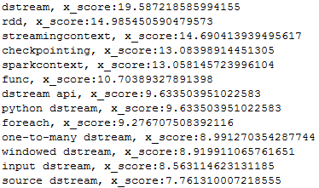
Results – Concept extraction
Source code-related concepts
Identified via direct JATE2.0 GlossEx scoring with very little filtration
Used standard English-language dictionary

Slide 16
Results – Concept extraction
More technically focused concepts
Extracted directly via official Python implementation of RAKE
('output operation', 3.909090909090909), ('external system', 3.8055555555555554), ('akka actor', 3.7142857142857144), ('advanced source', 3.7), ('batch size', 3.6904761904761907), ('streaming computation', 3.683168316831683), ('broadcast variable', 3.666666666666667), ('cluster resource', 3.65), ('sliding window', 3.5925925925925926), ('batch interval', 3.5870279146141213), ('stateful transformation', 3.571428571428571), ('input stream', 3.5625)

Slide 17
Any Questions?
Thank you to everybody involved for this opportunity and an amazing time in India!

