Slide 1
English is a STEM subject
tinyurl.com/SigmaCFG
Notes:
Normative vs prescriptive grammar ->

Slide 2
Normative grammar is lame
Normative grammar is concerned with the rules that make sentences “right” or “wrong”, developing a uniform “standard” language.
These rules often don’t match spoken language varieties.
*Bob and me played Pokemon yesterday.
Bob and I played Pokemon yesterday.
*There’s a lot of people here.
There are a lot of people here.
The cat that the dog that the man fed chased meowed

Slide 3
Descriptive grammar doesn’t make rules (kind of)
Descriptive grammar aims at describing how a language actually behaves, and how speakers perceive sentences as ill-formed or not.
Linguists are often concerned with descriptive grammars.
Yous are going to the party?
*Yous are went to the party?
There’s a lot of people here.
*A lot are of people here.
*The cat that the dog that the man fed chased meowed.

Slide 4
Rules seem to be natural to language
Speakers still perceive some new sentences as ill-formed. Why?
*This sentence ill-formed.
Speakers can say novel, well-formed sentences. How?
This sentence is well-formed.
The number of well-formed sentences is seemingly infinite. How?
This well-formed sentence was made for Sigma Camp 2025.
This well-formed sentence was made for Sigma Camp 2026.
This well-formed sentence was made for Sigma Camp 2027.
→ Generative grammar rules the structure (syntax) of sentences

Slide 5
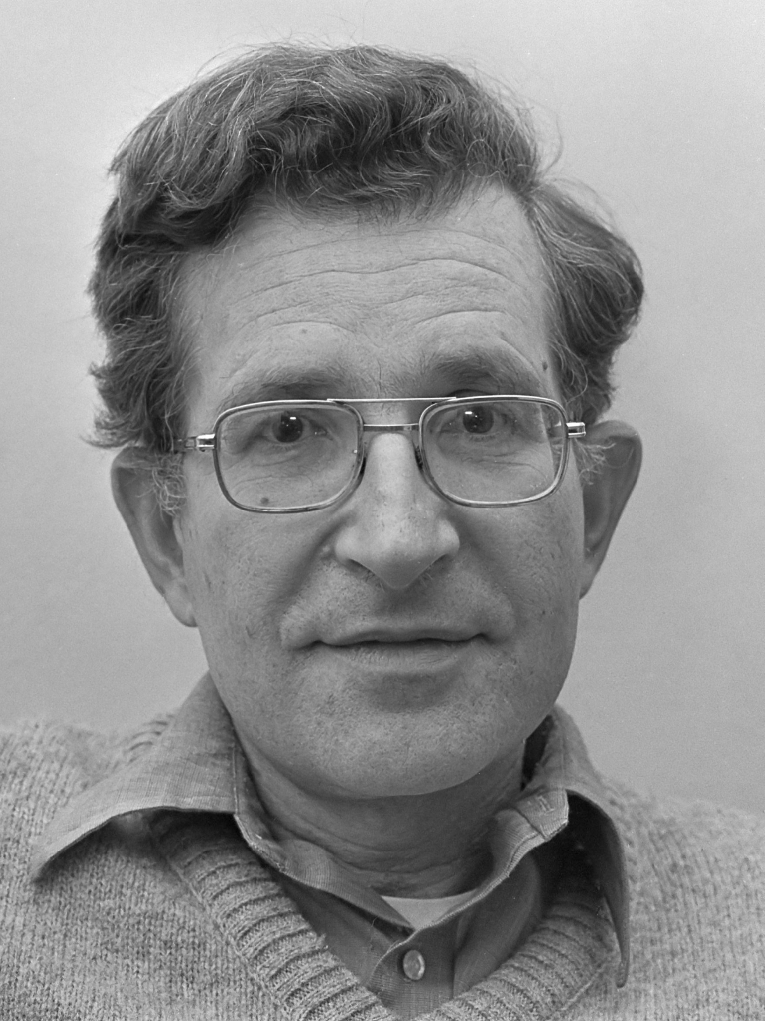
Grammar is seemingly natural and biological
Average Joe can learn a language, but his dog can’t.
Children learn languages despite a poverty of stimulus.
Languages are seemingly too complex to be learned so quickly
→ (simple) Universal grammar

Slide 6
Summary: normative vs generative grammar
Normative grammar
Generative grammar
Grammarian
Linguist
Rules
Rules
Person
Person

Slide 7
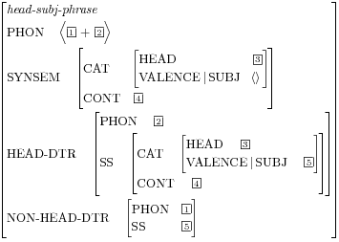
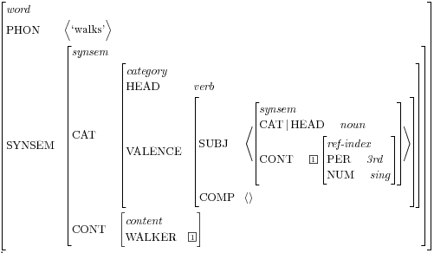
Comprehensive generative grammars can become weird...
HSPG feature structure by Lizmarie, Public domain, via Wikimedia Commons

Slide 8
Context-free grammars

Slide 9
Lexicon is the dictionary, grammar is the rule
A context-free grammar is composed of
A lexicon corresponding to a set of words with their classes
E.g. Noun → “dog”
A grammar consisting of rules of substitution, with start symbol S
E.g. Noun phrase → Article Adjective Noun
Any sentence that can be generated (or parsed) by the grammar is well-formed with respect to it, and ill-formed otherwise.
(Parsing means to show how a sentence can be predicted by the rules)

Slide 10
Example: brackets
Lexicon: { [ , ] }
Grammar:
S → S⁺ S
S → [ (S) ]
Example sentences:
[ ]
[ ] [ ]
[ ] [ ] [ ] [ ]
*[ ] [ ] [ ] [ ] [
[ [ ] [ ] [ [ ] ] ] [ ]
S
S
S
S
S
S
S
S
S
[
[
]
[
]
[
[
]
]
]
[
]

Slide 11
Sisters side-by-side, parent dominates
If a symbol X is directly above Y, then:
Y is the daughter of X
X dominates Y
X is the parent of Y
Two symbols with the same parent are sisters
S
S
S
S
S
S
S
S
S
[
[
]
[
]
[
[
]
]
]
[
]

Slide 12
Example: brackets // ambiguity
CFGs can be complex enough to convey ambiguity!
Ambiguity shows up as different tree structures parsing the same sentence.
Real languages are ambiguous, so this really is an advantage.
S
S
S
S
S
S
S
S
[
[
]
[
]
[
[
]
]
]
[
]

Slide 13
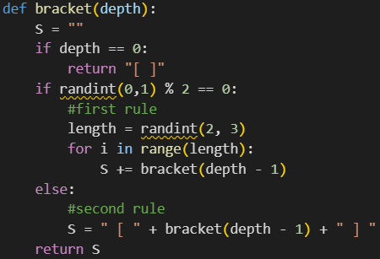
Example: brackets // the code
As you can imagine, CFG sentence generation can easily be implemented by code
Parsing is a slightly harder problem, and may need the rules to be re-written in simpler terms at the expense of conciseness
Python code for generating well-formed bracket sentences:

Slide 14
Example: English
Before jumping into English CFGs, we need to decide which types of words and phrases exist.
It is useful to separate things into nonterminal and terminal symbols
Abstract classes:
NP → Article + Noun
Lexical entries: “dog”, “see”, “an”

Slide 15
Example: English // terminal symbols
Terminal symbols can be grouped into standard grammatical classes
Noun = N → “cat” | “woman” | “telescope” | “house”
Adjective = Adj → “quick” | “slow”
Article = Art → “the” | “a”
Preposition = Pr → “with” | “in”
Verb = V → “loves” | “sees” | “runs” | “walks”
Adverb = Adv → “quickly” | “slowly”
Conjunction = Conj → “and”

Slide 16
Example: English // nonterminal symbols
Nonterminal symbols are less trivial. One can think of them as more complex, compound versions of the terminal symbols.
Noun phrase = NP → Art Adj* N
Verb phrase = VP → V (NP) (Adv)
Prepositional phrase = PP → Pr NP
They can also refer to each other
VP → V PP
NP → NP PP
NP → NP Conj NP
S → NP VP

Slide 17
a slow woman runs a quick house slowly
N → “cat” | “woman” | “telescope” | “house”
Adj → “quick” | “slow”
Art → “the” | “a”
Pr → “with” | “in”
V → “loves” | “sees” | “runs” | “walks”
Adv → “quickly” | “slowly”
Conj → “and”
NP → Art Adj* N
NP → NP PP
NP → NP Conj NP
VP → V (NP) (PP) (Adv)
PP → Pr NP

Slide 18
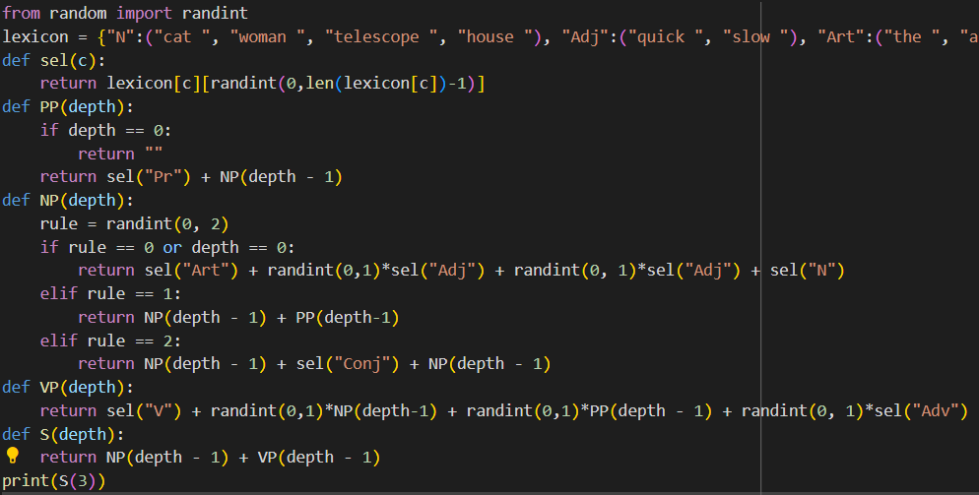
Example: English // code
The code for our grammar is a bit long, but can also be easily implemented to generate “valid” sentences!
Python code

Slide 19
Example: English // sample nice phrases
A cat walks quickly
The slow cat runs quickly
The quick cat runs quickly
The woman with the telescope loves the cat
The woman walks in the telescope
The woman walks the quick cat and the slow cat in the house
N → “cat” | “woman” | “telescope” | “house”
Adj → “quick” | “slow”
Art → “the” | “a”
Pr → “with” | “in”
V → “loves” | “sees” | “runs” | “walks”
Adv → “quickly” | “slowly”
Conj → “and”
NP → Art Adj* N
NP → NP PP
NP → NP Conj NP
VP → V (NP) (PP) (Adv)
PP → Pr NP
S → NP VP

Slide 20
Example: English // ambiguity
“With the telescope” is a daughter of VP
The cat sees the woman through the telescope
S
VP
PP
NP → Art Adj* N
NP → NP PP
NP → NP Conj NP
VP → V (NP) (PP) (Adv)
PP → Pr NP
S → NP VP
NP
NP
NP
The
cat
sees
the
woman
with
the
telescope

Slide 21
Example: English // ambiguity
S
“With the telescope” is a daughter of NP
The cat sees the woman, who is with the telescope
VP
NP
PP
NP → Art Adj* N
NP → NP PP
NP → NP Conj NP
VP → V (NP) (PP) (Adv)
PP → Pr NP
S → NP VP
NP
NP
NP
The
cat
sees
the
woman
with
the
telescope

Slide 22
Example: English // sample wrong phrases
*The slow cat
*Cat walks quickly
*The woman sees the cat the telescope
*The cat slowly loves the woman and the telescope
*The woman walks quickly in the house
N → “cat” | “woman” | “telescope” | “house”
Adj → “quick” | “slow”
Art → “the” | “a”
Pr → “with” | “in”
V → “loves” | “sees” | “runs” | “walks”
Adv → “quickly” | “slowly”
Conj → “and”
NP → Art Adj* N
NP → NP PP
NP → NP Conj NP
VP → V (NP) (PP) (Adv)
PP → Pr NP
S → NP VP
Notes:
NB: last two phrases are natural

Slide 23
Example: English // our grammar is imperfect :(
*Cat walks quickly
The woman loves
The woman and the cat walks slowly
*The slow cat walks slowly and the quick cat runs quickly
*The cats love the telescope
N → “cat” | “woman” | “telescope” | “house”
Adj → “quick” | “slow”
Art → “the” | “a”
Pr → “with” | “in”
V → “loves” | “sees” | “runs” | “walks”
Adv → “quickly” | “slowly”
Conj → “and”
NP → Art Adj* N
NP → NP PP
NP → NP Conj NP
VP → V (NP) (PP) (Adv)
PP → Pr NP
S → NP VP

Slide 24
CFGs are insufficient for linguistics
An attempt to make CFGs match natural languages soon makes them exceedingly convoluted and redundant
More advanced theories are needed to model them well
Example: Head-driven phrase structure grammars (HSPGs)

Slide 25
Computer science can be helped by linguistics
Linguistic insight can help with natural language processing (both generation and parsing)
Generative grammars are also mathematical objects that can be studied on their own right, without reference to human languages
Often, the design of a programming language and of its compiler goes through many linguistic considerations.
For example, it is useful to design a language that avoids ambiguity.
It is also useful to design a compiler that “solves” the ambiguity!

Slide 26
Your turn!
Write a CFG capable of generating valid haikus
A valid haiku has three lines, with syllables following the 5-7-5 pattern.
Example:
An old silent pond . . .
A frog jumps into the pond,
splash! Silence again.

