Slide 1
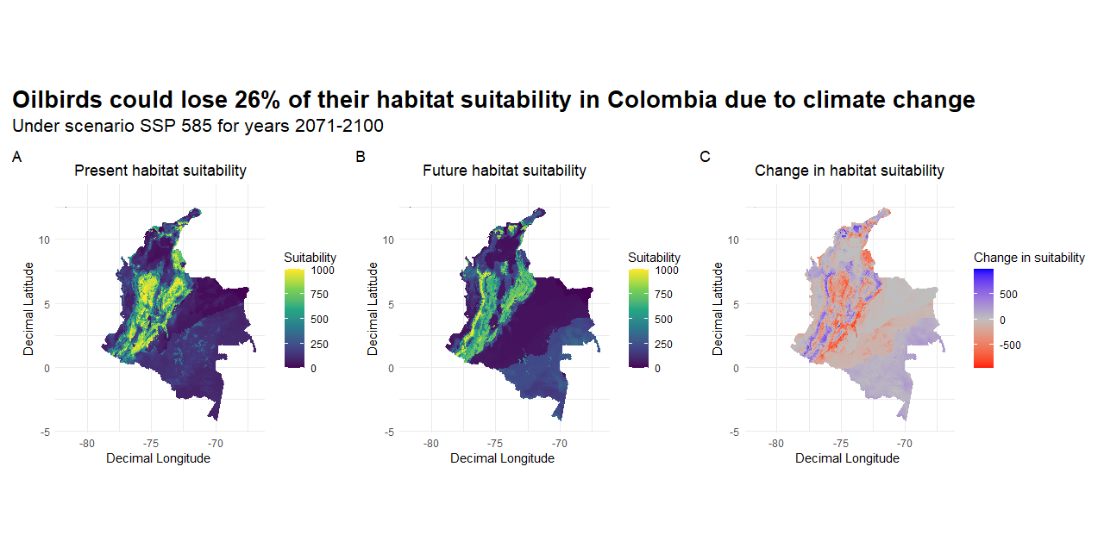
Impact of climate change on oilbird distribution in Colombia

