Slide 1
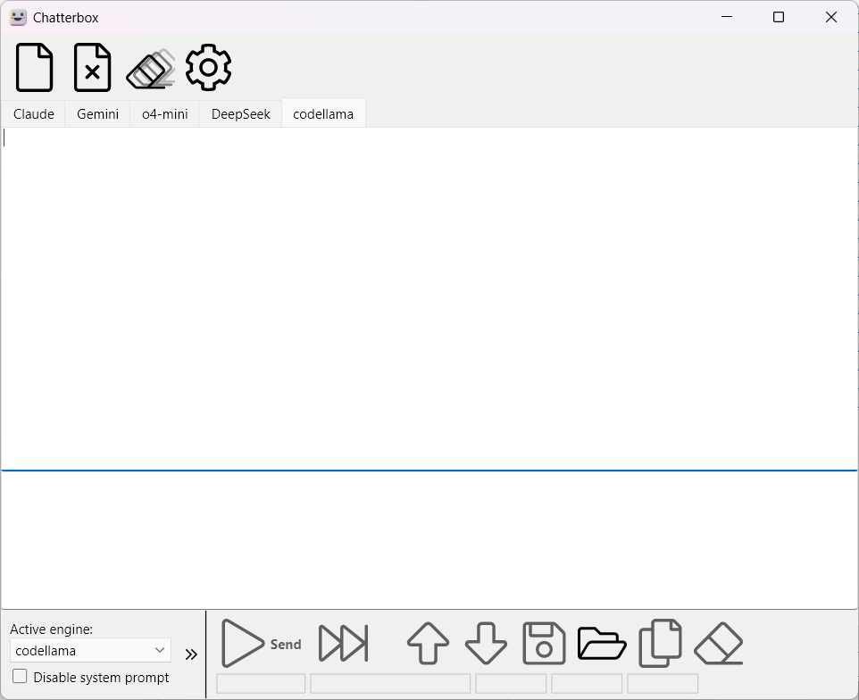
New
chat
Clear
all chat histories
Main
toolbar
Close active
chat tab
Settings
Chat
tab
Chat
toolbar
Send query in all tabs
Jump to next Q/A
Load chat
history
Change
engine
Send
query
Jump to
previous Q/A
Save chat
history
Copy last
answer to
clipboard
Clear chat history
Additional
options

