Slide 1

Machine Learning 2
Robotics Engineering – UNIGE
Gabriele Nicchiarelli – S4822677
Ivan Terrile – S4851947

Slide 2
introduction
This assignment focuses on a classification problem. It aims to evaluate and compare the predictive capabilities of various classification models on a specific robotics dataset.

Slide 3
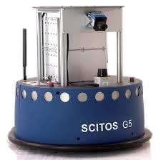
Problem
The dataset consists in a collection of data from a SCITOS G5 robot navigating through a room following the wall in a clockwise direction, for 4 rounds, using 24 ultrasound sensors arranged circularly around its ‘waist’.

Slide 4
dataset
The dataset includes 24 features corresponding to raw measurements from the ultrasound sensors (V1, …, V24).
Each sensor has 5456 measurements.
The last column of the dataset indicates the 4 classes corresponding to the robot's behavior during navigation:
Class 1: Move-Forward
Class 2: Slight-Right-Turn
Class 3: Sharp-Right-Turn
Class 4: Slight-Left-Turn

Slide 5
goal
Command the robot around the room without collisions. This is a non-linearly, multiclass, classification task.

Slide 6
code
The code is written in Python, in Jupyter Notebook format.
The algorithms are implemented using the scikit-learn library.
Three algorithms were chosen for solving the multiclass, classification problem.

Slide 7
code
In the preprocessing stage data were split in train and test sets and then standardized using Standard Scaler.
To best optimize the models, an exhausted search is done on some hyperparameters (for each model) using GridSearchCV.
The models’ performance are evaluated using balanced accuracy and confusion matrices.

Slide 8
models
Logistic regression
Support vector machine
Random forest
Performs good with linearly separable classes
Very versatile thanks to Kernels
Very robust Doesn’t require normalized data
8

Slide 9
Grid search
Grid
Logistic Regression:
C: 0.1, 1, 10, 100, 1000
Solver: lbfgs, newton-cg
Multiclass: ovr, multinominal
Support Vector Classifier
C: np.logspace(-4, 3, 4)
Kernel: linear, rbf, poly
Gamma: np.logspace(-4, 3, 4)
Random Forest
Max features: sqrt, log2
Max depth: 10, 50, 100
Criterion: gini, entropy
Cross-validation
Creates training and test splits to train the model. It is based on Stratified K-Fold.
Scoring
Balanced accuracy: average of recall scores obtained for each class. Between [0 ; 1], where 1 is the best value.

Slide 10
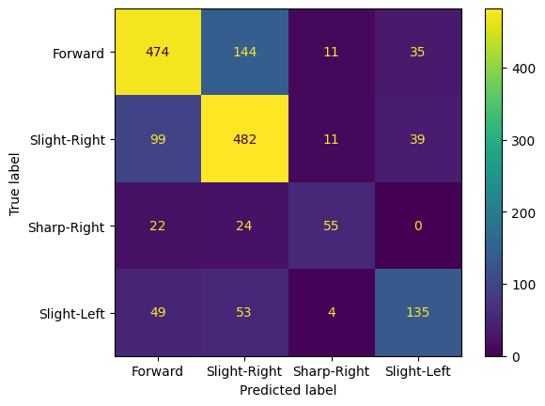
Results: logistic regression
Best parameters
Confusion matrix
C = 1000
Solver = newton-cg
Multiclass = multinomial
Balanced accuracy: 0.646

Slide 11
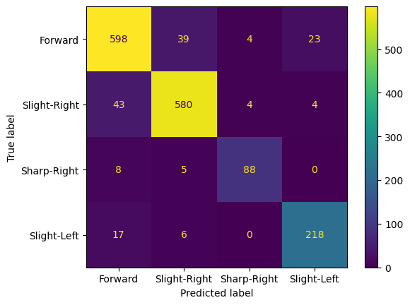
Results: SVC
Best parameters
Confusion matrix
C = 1000
Kernel = rbf
gamma = 0.021544346900318846
Balanced accuracy: 0.899

Slide 12
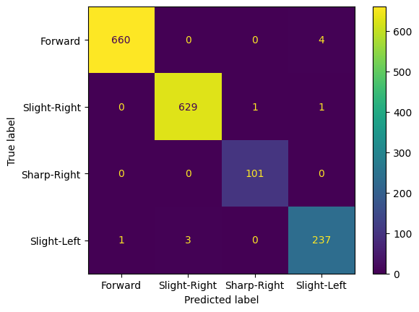
Results: random forest
Best parameters
Confusion matrix
Max depth = 100
Max features = sqrt
Criterion = entropy
Balanced accuracy: 0.994

Slide 13
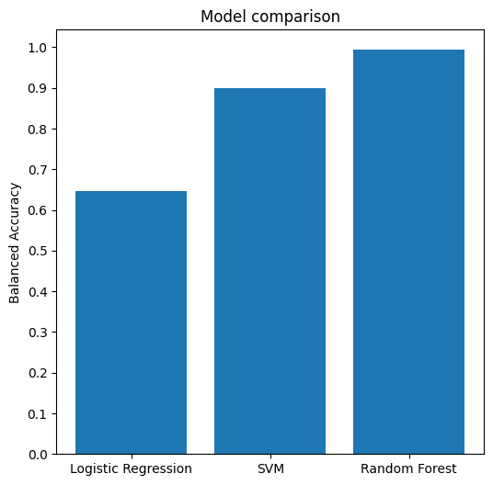
comparison

Slide 14
References
Dataset
Code
Standard Scaler
Logistic Regression
Support Vector Classifier
Random Forest
GridSearchCV

Slide 15
Thank you
Robotics Engineering – UNIGE
Gabriele Nicchiarelli – S4822677
Ivan Terrile – S4851947

