Slide 1
VRxRobot2324 Projects/Master Thesis bidding
6 Nov 2023

Slide 2
Bidding Phases
Grouping: expected 3-5 max groups composed by 2-3-4 students each
Presentations of projects
Type of project choice: Each group declares 1° choice and 2° choice among 2 types of projects:
S (standard project) → target N=[1-4] students, effort N*6/2 CFU = [3-12] CFU → about 75h/students effort
M (master thesis project) → target N=[1-2] students, effort N*(6+27) CFU included exam → about 6 months/student effort
Projects’ auction: Each group declares 1° choice and 2° choice among the presented projects. Then on the basis of the Choices Matrix each project will be assigned to each group

Slide 3
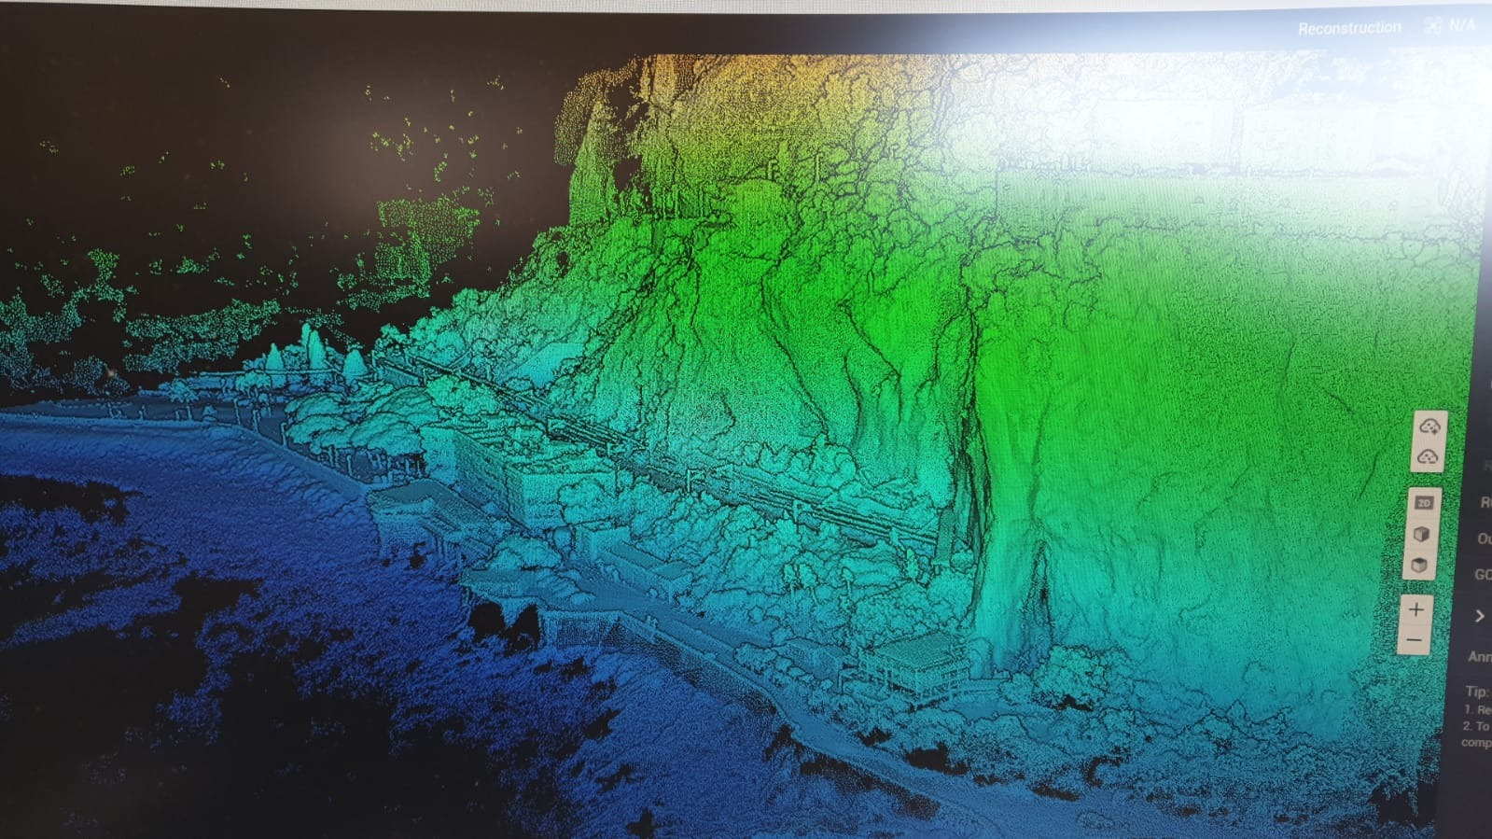
Projects #S1 (possibility of #M1, stage at Balzi Rossi MIC) - DICAPSULE (Digital Time Capsules) with Metahumans & genAI
Projects #S2 (possibility of #M2, stage at Luni Museum MIC) - LUNI TILES (Google 3D Tiles API+ UE + Cesium)
Modular research project, which can be breaked down into 2 INDEPENDENT STANDARD PROJECTS (S1, S2) or feasible as for a JOINT MASTER THESIS PROJECT #M1 + #M2 combining S1 AND S2

Slide 4
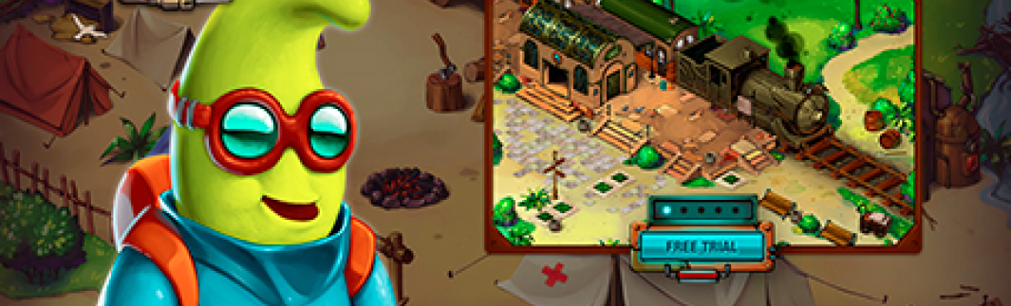
Project #S3 (also possibility #M3) : «Smart Language Learning with ChatGPT4 – Multiplayer Interactive Educational XR setup with multi-language players - AI based dialogical system»
Objective: Development of semantic dialogic Multiplayer Interactive GBL-based system able to manage multilanguage dialogical flows between players-AIbasedNPCs and players-players
Implementation: Unreal, ChatGPT, Blueprint JS / C #,…
Oculus Quest 3 for development
Possible prosecution as Master Thesis

Slide 5
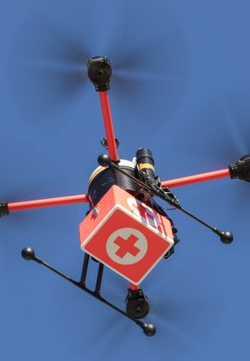
Project #S4 (also possibility #M4) - «AI-BASED SMART-AMBULANCE» – AI/WoT-based emergency ecosystem based on «drone within ambulance» for fast transport of life-saving medicines (with recharging stations and safe handhover)
Classification of emergency healthcare tasks WoT interactions («112» ontology)
Implementation of a simulated prototype of adaptive real-time path planner for mission partitioning related to transport of life-saving medicines using a fleet of smart-ambulances (equipped with drones)
In collaboration with EuroDrone and Darts Engineering

Slide 6
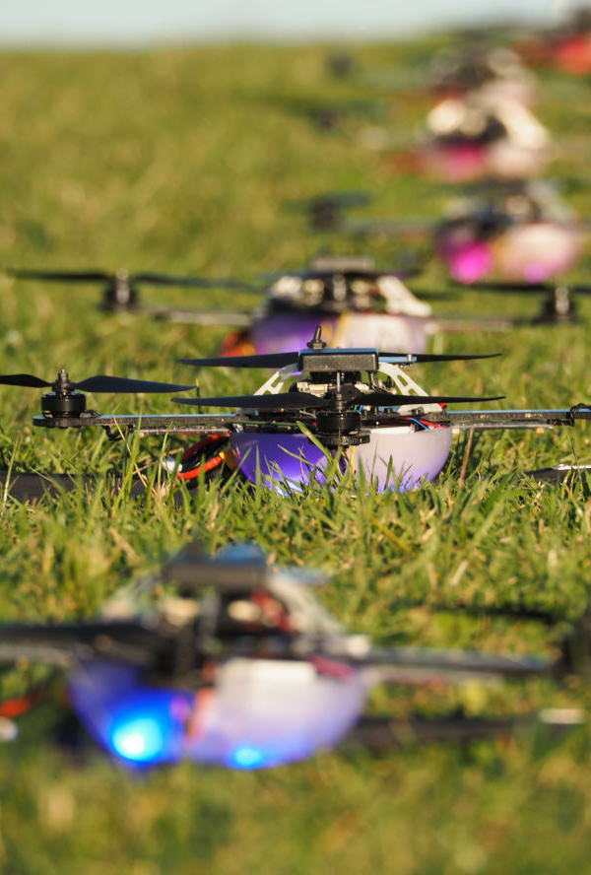
Projects #S5-#S6-#S7 (also possibility #M5) - «AI-supported DRONE Swarms Control Room» – AI/EDGEIoT-based inspection and monitoring system for #S5 - natural environments (PNRR – Spoke 3), #S6 - industrial plants (PNRR – Spoke 3) #S7 port stocking areas (PNRR – Spoke 4) -possibility (in case of thesis) research grant stages
Real implementation of a small fleet of drones
In collaboration with DICCA/DISTAV/DITEN IIT & CNR, Local Municipality of Genoa, Darts Engineering and EuroDrone

Slide 7
Groups
G1 –
G2 –
G3 –

Slide 8
Choice Matrix
G\P | S1 Balzi Rossi DICAPSULES | S2 Luni 3D TILES | S3 Smart Language Learning with ChatGPT4 | S4 AI-BASED SMART-AMBULANCE | S5 Swarms Control Room for Natural Env | S6 Swarms Control Room for Industrial Plant | S7 Swarms Control Room for Port Stocking Areas
G1
G2
G3
G4
G5

