Slide 1
Gestione Esercizi
Gabriele Alessi – SAM I4

Slide 2
Introduzione
Eserciziario
Docenti

Slide 3
Requisiti
Applicativo desktop
Impostazioni di base
Esercizi
Prove

Slide 4
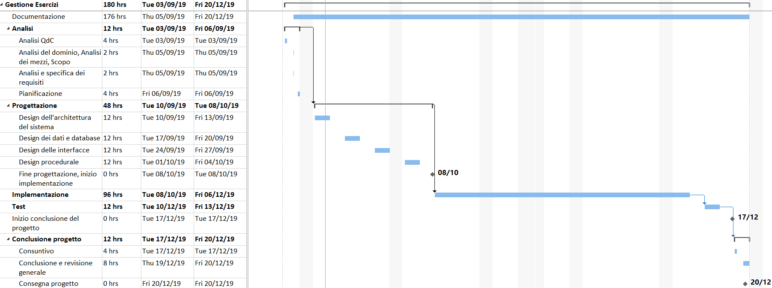
Pianificazione

Slide 5
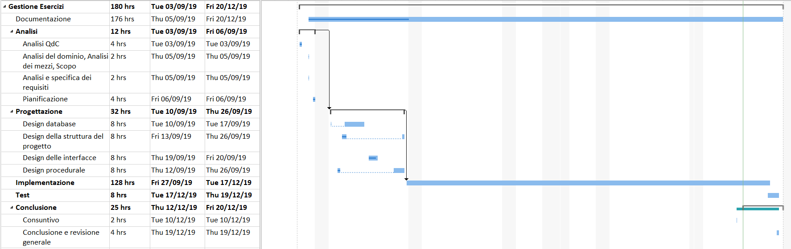
Consuntivo

Slide 6
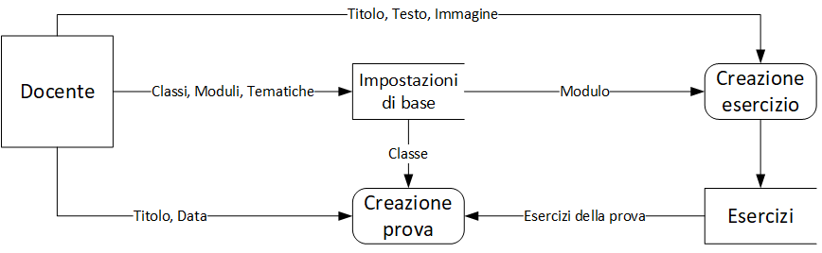
Come funziona

Slide 7
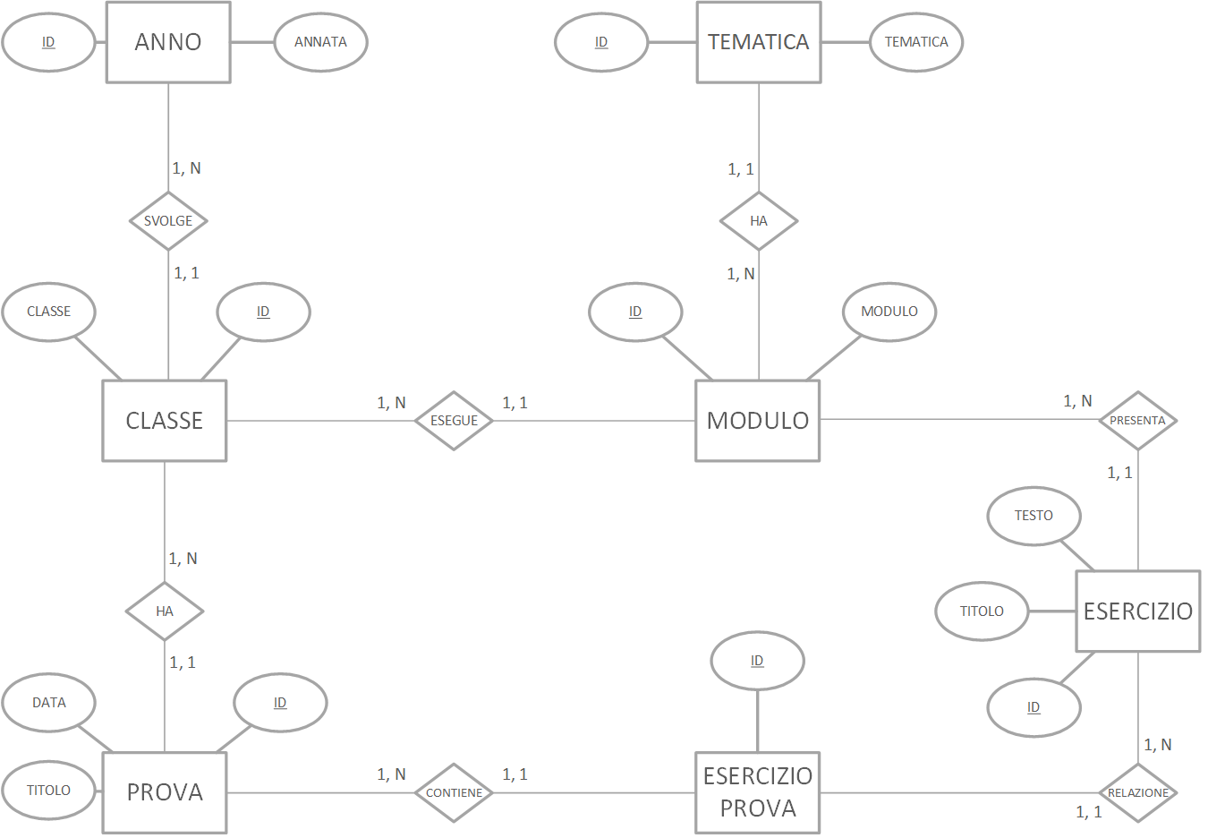
Struttura dei dati

Slide 8
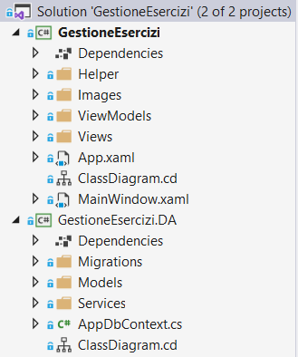

Implementazione

Slide 9
Models
public class BaseEntity
{
public int Id { get; set; }
}

Slide 10
Models
public Classe(string nome, Anno anno)
{
Nome = nome;
AnnoId = anno.Id;
}

Slide 11
Services
public interface IDataRepository<T> where T : BaseEntity
{
T Get(int id);
IQueryable<T> Get();
T Insert(T entity);
void Update(T entity);
void Delete(T entity);
}

Slide 12
Services
public abstract class DbDataRepository<C, T> : IDataRepository<T>
{
protected C context;
protected DbDataRepository(C ctx) => context = ctx;

Slide 13
Services
public T Get(int id) => Get().SingleOrDefault(be => be.Id == id);
public virtual IQueryable<T> Get() => context.Set<T>();
public virtual T Insert(T entity)
{
context.Set<T>().Add(entity);
context.SaveChanges();
return entity;
}

Slide 14
Services
public class ModuloDbRepository : DbDataRepository<AppDbContext, Modulo>, IModuloRepository
{
public ModuloDbRepository(AppDbContext ctx) : base(ctx) { }
public override IQueryable<Modulo> Get() => base.Get().OrderBy(s => s.Nome);
}

Slide 15
DbContext
public DbSet<Classe> Classi { get; set; }
public DbSet<Modulo> Moduli { get; set; }
public DbSet<Tematica> Tematiche { get; set; }
public DbSet<Anno> Anni { get; set; }
public DbSet<Esercizio> Esercizi { get; set; }
public DbSet<EsercizioProva> EserciziProva { get; set; }
public DbSet<Prova> Prove { get; set; }

Slide 16
DbContext
protected override void OnConfiguring(DbContextOptionsBuilder optionsBuilder)
{
if (!optionsBuilder.IsConfigured)
{
string dbPath =
Environment.GetFolderPath(Environment.SpecialFolder.ApplicationData)
+ "\\GestioneEsercizi";
Directory.CreateDirectory(dbPath);
optionsBuilder.UseLazyLoadingProxies().UseSqlite(
"Data Source=" + dbPath + "\\GestioneEsercizi.sqlite");
}
}

Slide 17
ViewModels
public abstract class BindableBase : INotifyPropertyChanged
{
public event PropertyChangedEventHandler PropertyChanged = delegate { };
protected void OnPropertyChanged(string propertyName) {…}
protected virtual void SetProperty<T>(…) {…}
protected void OnPropertyChanged<T>(…) {…}
}

Slide 18
MainViewModel
ViewModels
Commands
CurrentViewModel
Messenger
Messenger.Default.Register<BindableBase>(this, OnViewModelReceived);
public void OnViewModelReceived(BindableBase viewmodel)
{
CurrentViewModel = viewmodel;
}

Slide 19
ViewModels
public string Titolo { get; set; }
public string Testo { get; set; }
public BitmapImage Immagine { get; set; }
public Modulo Modulo { get; set; }
public EsercizioViewModel()
{
BenvenutoCommand = new DelegateCommand(OnBenvenuto, CanBenvenuto);
SalvaCommand = new DelegateCommand(OnSalva, CanSalva);
ModuloDbRepository repo = new ModuloDbRepository(new AppDbContext());
Moduli = new ObservableCollection<Modulo>(repo.Get());
}
private void OnBenvenuto(object obj)
=> Messenger.Default.Send<BindableBase>(new BenvenutoViewModel());

Slide 20
ViewModels
private void OnSalva(object obj)
{
if (!string.IsNullOrWhiteSpace(Nome) && Anno != null)
{
ClasseDbRepository repo = new ClasseDbRepository(new AppDbContext());
// Aggiungo la classe
repo.Insert(new Classe(Nome, Anno));
OnBenvenuto(obj);
}
}

Slide 21
Views
<Menu>
<MenuItem Header="_File">
<MenuItem Header="_Esercizi" Command="{Binding Path=EsercizioListCommand}"/>
<MenuItem Header="_Prove" Command="{Binding Path=ProvaListCommand}"/>
<MenuItem Header="_Esci" Click="Exit"/>
</MenuItem>
<MenuItem Header="_Info">
<MenuItem Header="_Guida" Command="{Binding Path=GuidaCommand}"/>
<MenuItem Header="_About" Command="{Binding Path=AboutCommand}"/>
</MenuItem>
</Menu>
<ContentControl Content="{Binding Path=CurrentViewModel}"/>

Slide 22
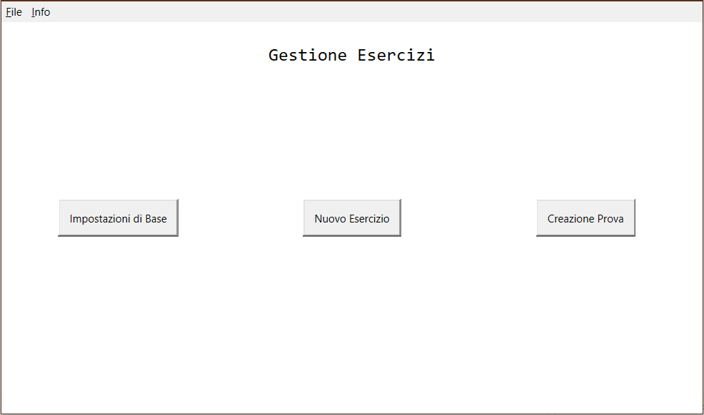
Views

Slide 23
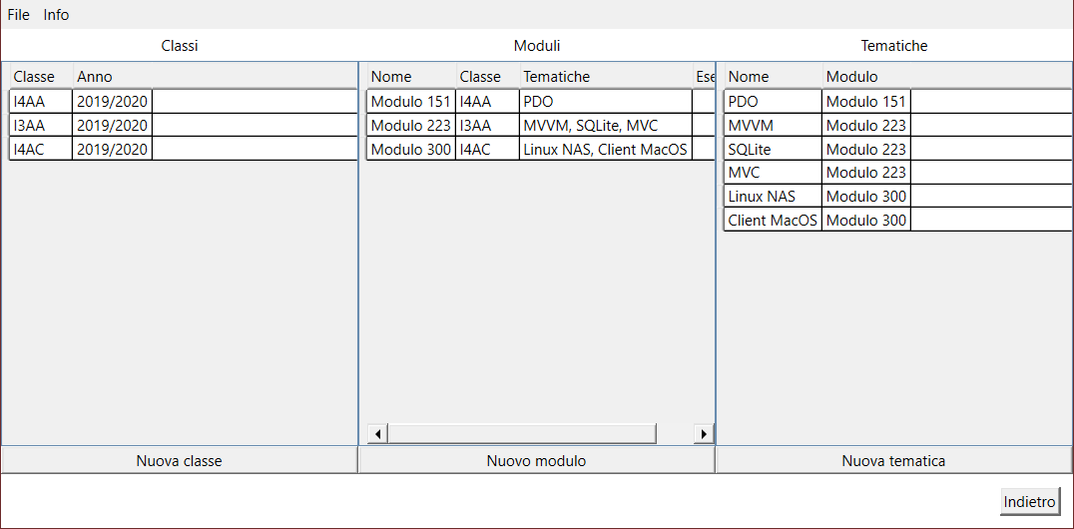
Views

Slide 24
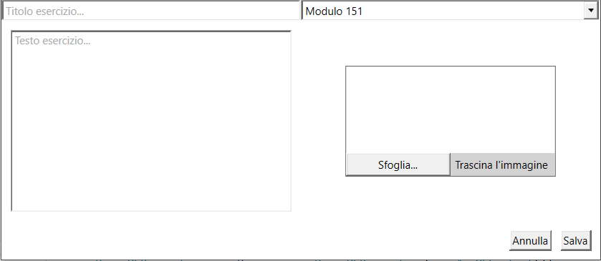
Views

Slide 25
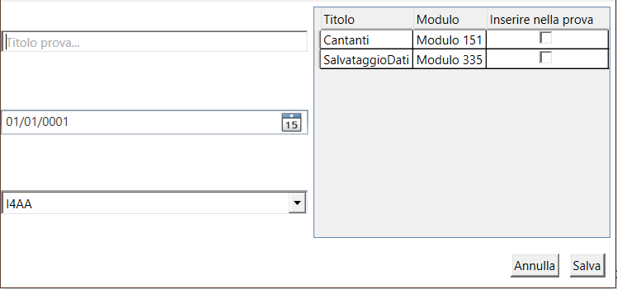
Views

Slide 26
Test
Creazione esercizio
Immagine
Creazione prova
Esercizi
Generazione documento

Slide 27
Conclusioni
Grazie per l’attenzione
Domande

