Slide 1

P1 Presentation
Gabriel Klein – {github link}

Slide 2

Project Requirements
A CLI Python application that models a store, with data stored in a backend database

Slide 3

P1 – Animal House
An animal goods store that sells anything animals, from food to toys to animal enclosures
A store that keeps track of customer animals and curates the customer’s experience based on the animal’s they own
Users can enter the animals they own and are given a list of items to shop for based on those animals
Admin users can modify the records of customers as well as modify inventory

Slide 4
Tech Stack
Python 3
MySQL 8
Git (version control)

Slide 5
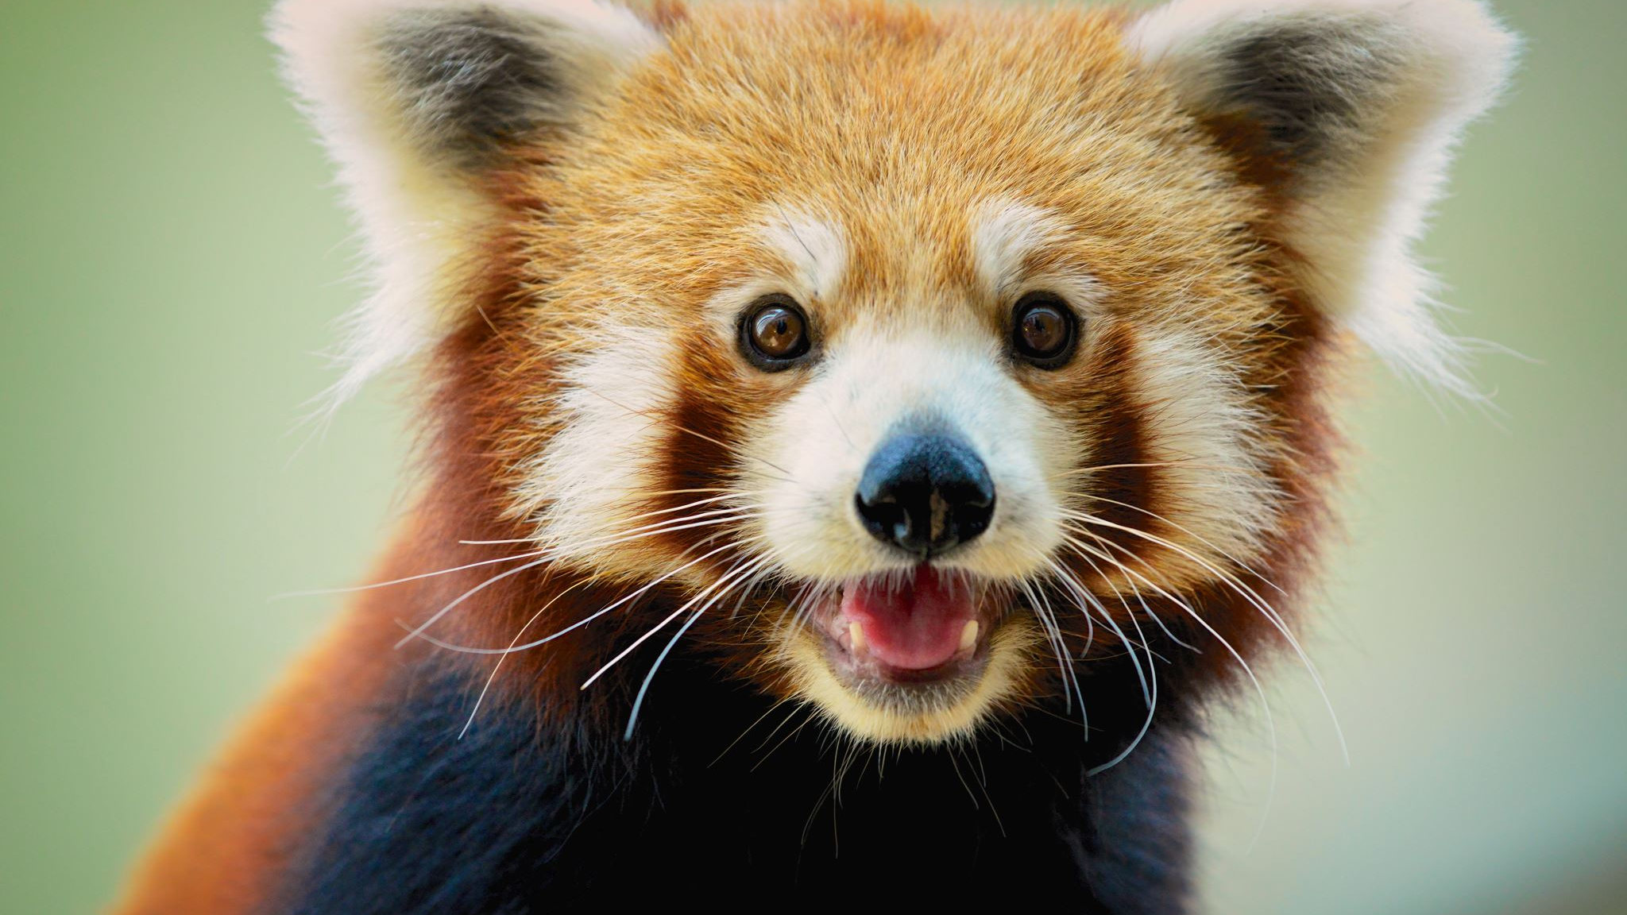
Demo

