Slide 1


SQL

Slide 2
What is SQL?
SQL stands for Structured Query Language
SQL lets you access and manipulate databases
SQL became a standard of the American National Standards Institute (ANSI) in 1986, and of the International Organization for Standardization (ISO) in 1987

Slide 3
What Can SQL do?
SQL can execute queries against a database
SQL can retrieve data from a database
SQL can insert records in a database
SQL can update records in a database
SQL can delete records from a database
SQL can create new databases
SQL can create new tables in a database
SQL can create stored procedures in a database
SQL can create views in a database
SQL can set permissions on tables, procedures, and views

Slide 4
Using SQL in Your Web Site
To build a web site that shows data from a database, you will need:
An RDBMS database program (i.e. MS Access, SQL Server, MySQL)
To use a server-side scripting language, like PHP or ASP
To use SQL to get the data you want
To use HTML / CSS to style the page

Slide 5
RDBMS
RDBMS stands for Relational Database Management System.
RDBMS is the basis for SQL, and for all modern database systems such as MS SQL Server, IBM DB2, Oracle, MySQL, and Microsoft Access.
The data in RDBMS is stored in database objects called tables. A table is a collection of related data entries and it consists of columns and rows.

Slide 6
Database Tables
A database most often contains one or more tables. Each table is identified by a name (e.g. "Customers" or "Orders"). Tables contain records (rows) with data.

Slide 7
Semicolon after SQL Statements?
Some database systems require a semicolon at the end of each SQL statement.
Semicolon is the standard way to separate each SQL statement in database systems that allow more than one SQL statement to be executed in the same call to the server.

Slide 8
Some of The Most Important SQL Commands
SELECT - extracts data from a database
UPDATE - updates data in a database
DELETE - deletes data from a database
INSERT INTO - inserts new data into a database
CREATE DATABASE - creates a new database
ALTER DATABASE - modifies a database
CREATE TABLE - creates a new table
ALTER TABLE - modifies a table
DROP TABLE - deletes a table
CREATE INDEX - creates an index (search key)
DROP INDEX - deletes an index

Slide 9
Sublanguages of SQL
DDL – Data Definition Language
- CREATE, DROP, ALTER, TRUNCATE
DML – Data Manipulation Language
- INSERT, UPDATE, DELETE
DQL – Data Query Language
- SELECT
TCL – Transaction Control Language
- COMMIT, ROLLBACK
DCL – Data Control Language
- GRANT, REVOKE

Slide 10
Multiplicity
The Multiplicity attribute of a relationship specifies the cardinality or number of instances of an Entity Type that can be associated with the instances of another Entity Type. The possible types of multiplicity are as follows: One-to-many. Zero-or-one to one.

Slide 11
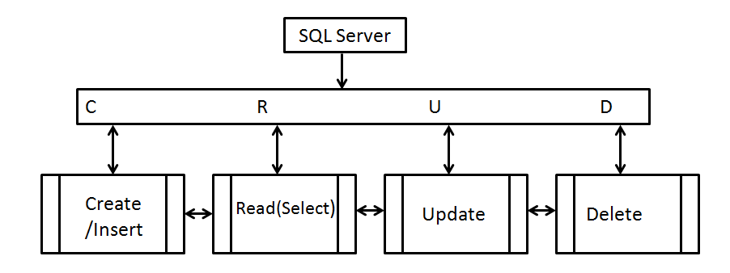
CRUD
CRUD is an acronym that stands for CREATE, READ, UPDATE, and DELETE.
The Multiplicity attribute of a relationship specifies the cardinality or number of instances of an EntityType that can beCRUD is an acronym that stands for CREATE, READ, UPDATE, and DELETE. associated with the instances of another EntityType. The possible types of multiplicity are as follows: One-to-many. Zero-or-one to one.

Slide 12
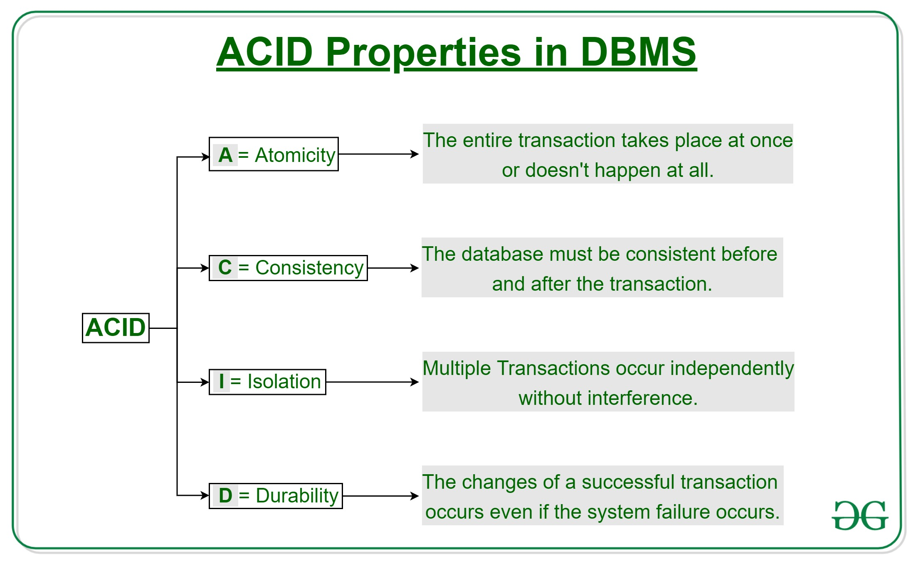
ACID Properties

Slide 13
ACID Properties(Atomicity )
By this, we mean that either the entire transaction takes place at once or doesn’t happen at all. There is no midway i.e. transactions do not occur partially. Each transaction is considered as one unit and either runs to completion or is not executed at all. It involves the following two operations. —Abort: If a transaction aborts, changes made to database are not visible. —Commit: If a transaction commits, changes made are visible. Atomicity is also known as the ‘All or nothing rule’.

Slide 14
ACID Properties(Consistency )
This means that integrity constraints must be maintained so that the database is consistent before and after the transaction. It refers to the correctness of a database. Referring to the example above, The total amount before and after the transaction must be maintained. Total before T occurs = 500 + 200 = 700. Total after T occurs = 400 + 300 = 700. Therefore, database is consistent. Inconsistency occurs in case T1 completes but T2 fails. As a result T is incomplete.

Slide 15
ACID Properties(Isolation )
This property ensures that multiple transactions can occur concurrently without leading to the inconsistency of database state. Transactions occur independently without interference. Changes occurring in a particular transaction will not be visible to any other transaction until that particular change in that transaction is written to memory or has been committed. This property ensures that the execution of transactions concurrently will result in a state that is equivalent to a state achieved these were executed serially in some order.

Slide 16
ACID Properties(Durability )
This property ensures that once the transaction has completed execution, the updates and modifications to the database are stored in and written to disk and they persist even if a system failure occurs. These updates now become permanent and are stored in non-volatile memory. The effects of the transaction, thus, are never lost.

Slide 17
NORMALIZATION
Database normalization is the process of restructuring a relational database in accordance with a series of so-called normal forms in order to reduce data redundancy and improve data integrity

