Slide 1

Hive

Slide 2
Initially Hive was developed by Facebook, later the Apache Software Foundation took it up and developed it further as an open source under the name Apache Hive. It is used by different companies. For example, Amazon uses it in Amazon Elastic MapReduce.

Slide 3
Features of Hive
It stores schema in a database and processed data into HDFS.
It is designed for OLAP. Online Analytical Processing (OLAP)
It provides SQL type language for querying called HiveQL or HQL.
It is familiar, fast, scalable, and extensible.

Slide 4
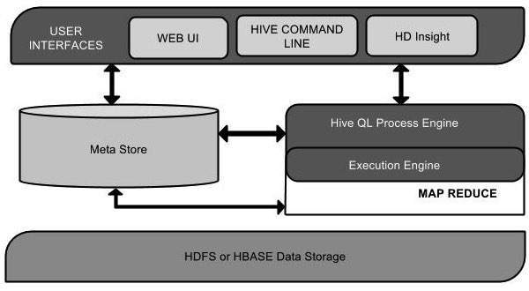
Architecture of Hive
The following component diagram depicts the architecture of Hive:

Slide 5
Hive is not
A relational database
A design for Online Transaction Processing (OLTP)
A language for real-time queries and row-level updates

