Slide 1

YARN

Slide 2
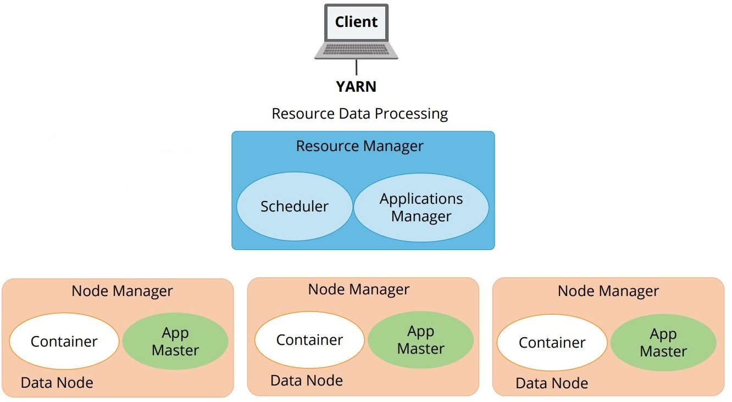
YARN Architecture

Slide 3
Input Formats
1. Text/CSV Files 2. JSON Records 3. Avro Files 4. Sequence Files 5. RC Files 6. ORC Files 7. Parquet Files

Slide 4
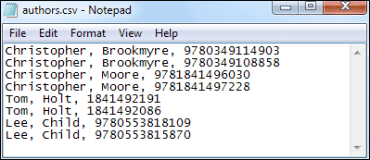
Text and CSV files
Text and CSV files are quite common and frequently Hadoop developers and data scientists received text and CSV files to work upon.

Slide 5
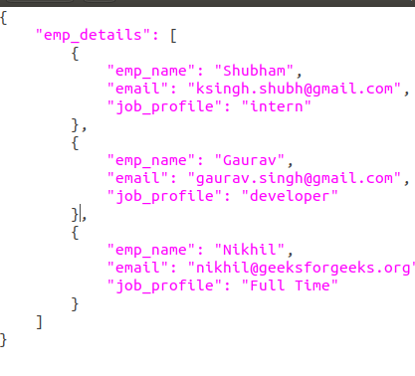
JSON Records
JSON records contain JSON files where each line is its own JSON datum. In the case of JSON files.

Slide 6
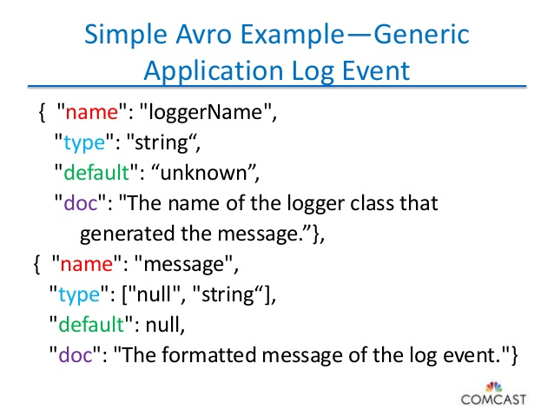
AVRO Files
Avro is quickly becoming the top choice for the developers due to its multiple benefits. Avro stores metadata with the data itself and allows specification of an independent schema for reading the file.

Slide 7

Sequence File
Sequence file stores data in binary format and has a similar structure to CSV file with some differences.

Slide 8
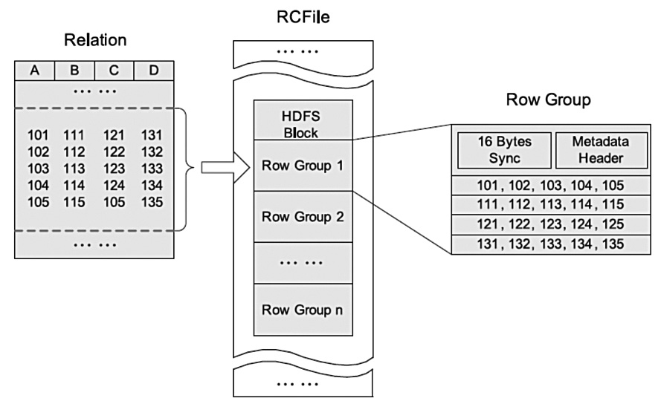
RC File (Record Columnar Files)
RC file was the first columnar file in Hadoop and query performance benefits.

Slide 9
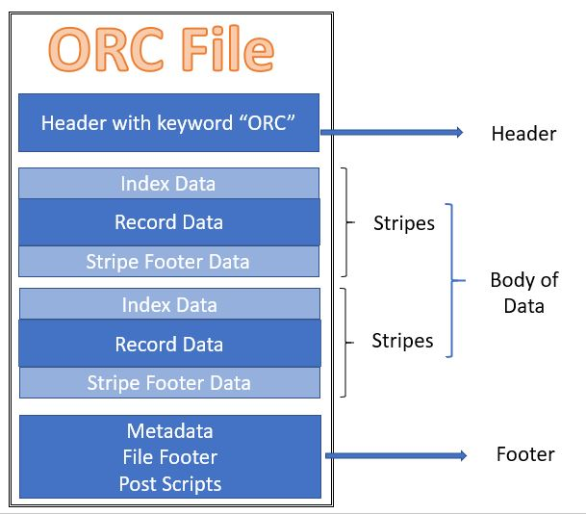
ORC File (Optimized RC Files)
ORC is the compressed version of RC file and supports all the benefits of RC file with some enhancements like ORC files compress better than RC files, enabling faster queries.

Slide 10
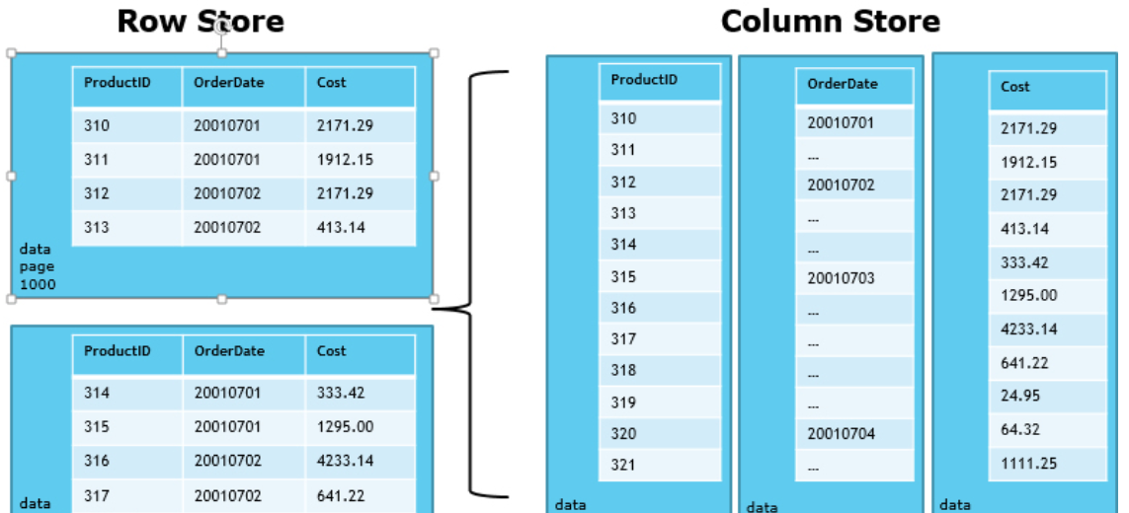
Parquet Files
Parquet file is another columnar file given by Hadoop founder Doug Cutting during his Trevni project Like another Columnar file RC & ORC, Parquet also enjoys the features like compression and query performance benefits but is generally slower to write than non-columnar file formats.

Slide 11
We can run a Hadoop in one of the 3 supported modes as below
1) Standalone Mode
By default, Hadoop is configured to run in a Standalone Mode, non-distributed mode, as a single Java process. This is useful for debugging. This does not offer you a true distributed environment. The usage of this mode is very limited and it can be only used for experimentation.
2) Pseudo-Distributed Mode
Hadoop is run on a single node in a pseudo(false) distributed mode, Just like the Standalone mode. The difference is that each Hadoop daemon runs in a separate Java process in Pseudo-Distributed Mode. Whereas in Local mode each Hadoop daemon runs as a single Java process. Again the usage of this mode is very limited and it can be only used for experimentation.
3) Fully-Distributed Mode
In the fully-distributed mode, all daemons are executed in separate nodes forming a multi-node cluster. This setup offers true distributed computing capability and offers built-in reliability, scalability and Fault Tolerance.

Slide 12
SSH Keys
SSH keys authenticate users and hosts in SSH. They are used for single sign-on and machine-to-machine access. Security and convenience!
The need for SSH Key based authentication is required so that the master node can then login to slave nodes (and the secondary node) to start/stop them, etc. This is also required to be setup on the secondary name node (which is listed in your masters file) so that [presuming it is running on another machine which is a VERY good idea for a production cluster] will be started from your name node with ./start-dfs.sh and job tracker node with ./start-mapred.sh
Make sure you are the hadoop user for all of these commands. If you have not yet installed Hadoop and/or created the hadoop user you should do that first. Depending on your distribution (please follow it’s directions for setup) this will be slightly different (e.g. Cloudera creates the hadoop user for your when going through the rpm install).

