Slide 1
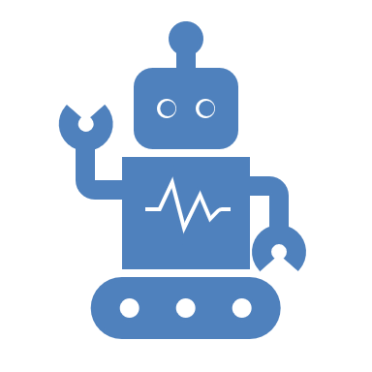
Understanding Machine Learning and its Role in Artificial Intelligence
Exploring ML, Generative AI, and their Interconnections

Slide 2
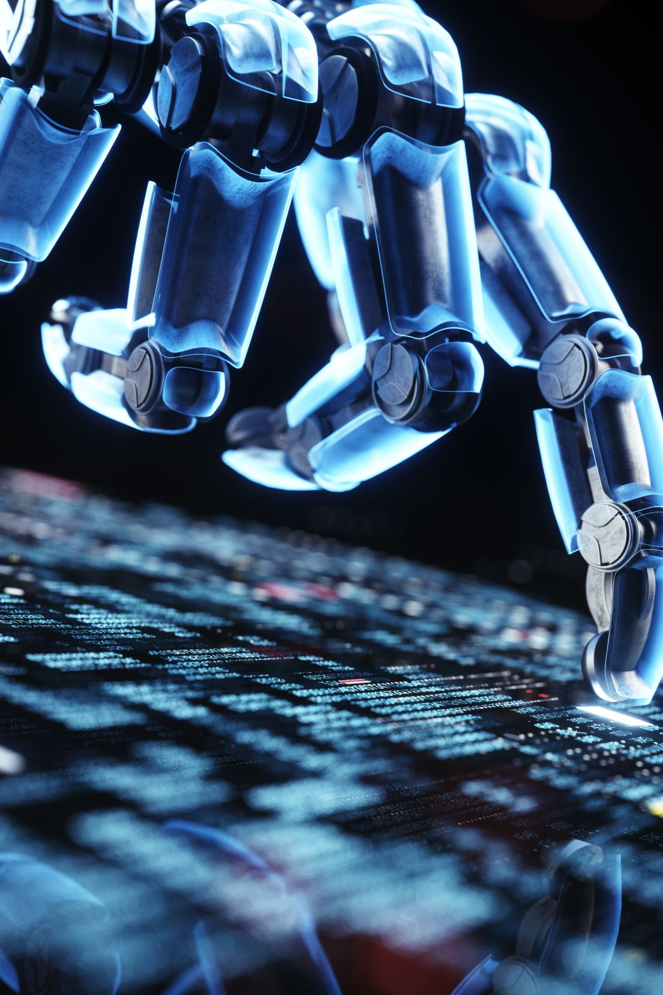
What is Artificial Intelligence (AI)?
AI is the simulation of human intelligence by machines.
Key components: reasoning, learning, problem-solving, and natural language understanding.

Slide 3
Branches of AI
Machine Learning (ML)
Generative AI
Computer Vision
Natural Language Processing (NLP)
Robotics

Slide 4
What is Machine Learning?
ML enables computers to learn from data and improve over time without explicit programming.
Types of ML:
Supervised Learning
Unsupervised Learning
Reinforcement Learning

Slide 5
Machine Learning vs. AI
AI is the broader concept; ML is a subset.
AI encompasses decision-making and knowledge-based systems.
ML focuses on creating systems that improve from experience.

Slide 6
The Machine Learning Workflow
1. Data Collection: Gathering relevant data (Tools: SQL, Python).
2. Data Preprocessing: Cleaning and organizing raw data (Tools: Pandas).
3. Model Training: Creating predictive models (Tools: TensorFlow, PyTorch).
4. Model Evaluation: Assessing performance (Tools: Scikit-learn).
5. Deployment: Real-world application (Tools: Docker, Flask).

Slide 7
Popular Machine Learning Tools
1. TensorFlow: Open-source library by Google.
2. PyTorch: Developer-friendly framework by Facebook.
3. Scikit-learn: Beginner-friendly with simplicity.
4. Keras: High-level API for deep learning models.

Slide 8
What is Generative AI?
Focuses on generating new content, such as text, images, and music.
Utilizes advanced models like GANs and VAEs.

Slide 9
How Does ML Compare to Generative AI?
Generative AI relies heavily on ML techniques.
ML is about predictions; Generative AI is about creation.

Slide 10
Introduction to Large Language Models (LLMs)
LLMs are advanced AI models trained on extensive text data.
Examples: GPT, BERT.
Applications: Chatbots, summarization, coding assistance.

Slide 11
ML’s Role in LLMs
LLMs are trained using supervised and unsupervised ML techniques.
ML enables fine-tuning and inference in LLMs.

Slide 12
ML’s Relationship with Generative AI
Generative AI models (GANs, VAEs) are built on ML foundations.
ML optimizes model performance.

Slide 13
Applications of Machine Learning
1. Healthcare (diagnostics).
2. Finance (fraud detection).
3. Retail (recommendation systems).
4. Autonomous Vehicles.

Slide 14

Applications of Generative AI
1. Content creation (text, images).
2. Gaming (character design).
3. Virtual assistants.
4. Drug discovery.

Slide 15
Challenges in Machine Learning
1. Data quality and availability.
2. Model bias and fairness.
3. Computational costs.
4. Interpretability.

Slide 16
Challenges in Generative AI
1. Ethical concerns (deepfakes, misinformation).
2. Intellectual property issues.
3. Resource-intensive training.

Slide 17
What’s Next?
1. Advancements in model efficiency.
2. Integration into everyday applications.
3. Improved ethical AI practices.

Slide 18
Key Takeaways
1. ML is a key enabler of AI, including Generative AI.
2. Tools like TensorFlow and PyTorch are essential for ML.
3. Generative AI is transforming content creation, and LLMs revolutionize NLP.

