Slide 1
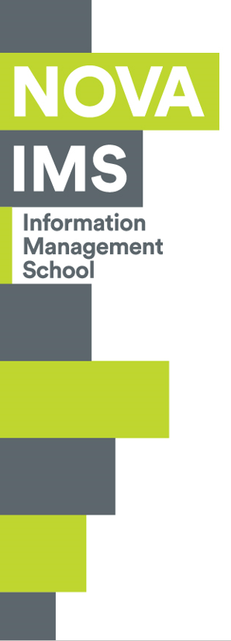
Business Cases with Data Science
Master Degree Program in Data Science and Advanced Analytics
Business Case 1: Wonderful Wines of the World
Group C
Gabriel Felipe Martins de Souza m20210598
Rogerio Domingos Paulo m20210597
Luiz Humberto Polaro Vizeu m20210554
Celso Christiano Endres Neto m20200739

Slide 2


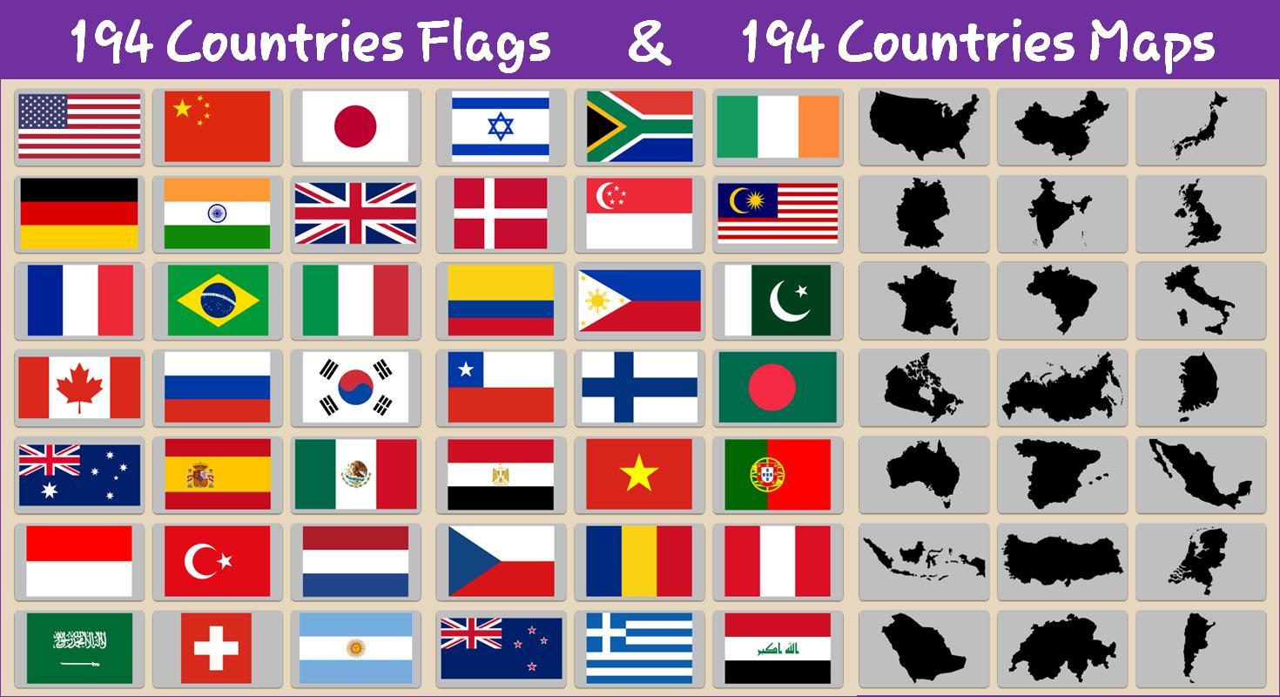

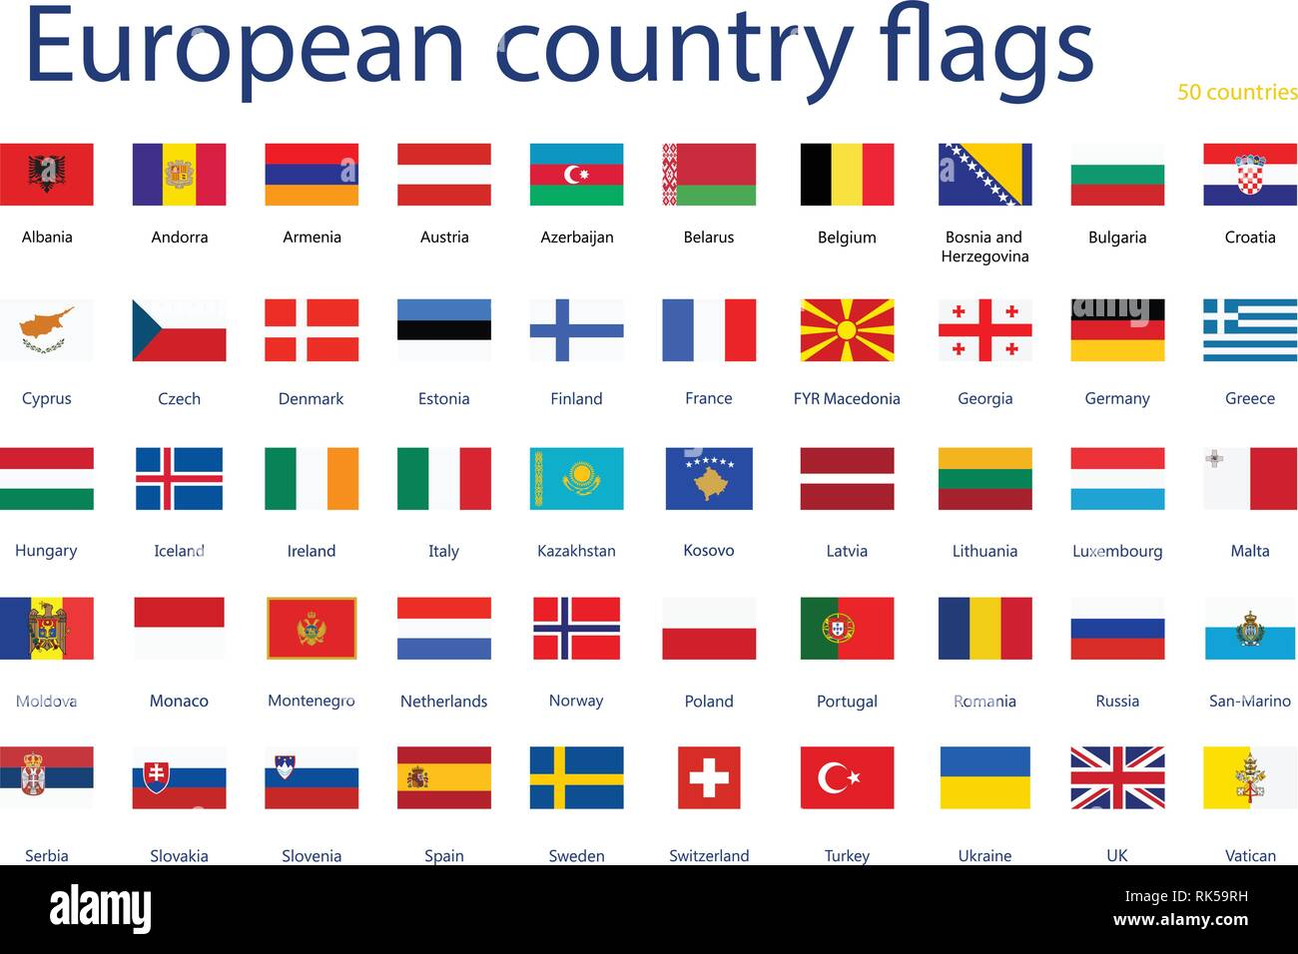
Wonderful Wines of the World
“Wonderful Wines of the World (WWW) is a 7-year-old enterprise that seeks out small, unique wineries around the world and brings their wines to its customers. Its mission is to delight its customers with well-made, unique, and interesting wines that would never travel far beyond their points of origin”
10 small Stores
WWW
E-commerce
350.000 customers (active or not)
Sample of 10.000 of active customers
Catalog
Purchase by Phone
Opportunities expected from customer segmentation:
Improvement on addressing ads to both current customers and potential new customers
Gather relevant information for drawing up loyalty programs
Inputs for cross-selling promotions
Business Understanding
Data Understanding
Data Preparation
Modeling
Evaluation
Deployment

Slide 3
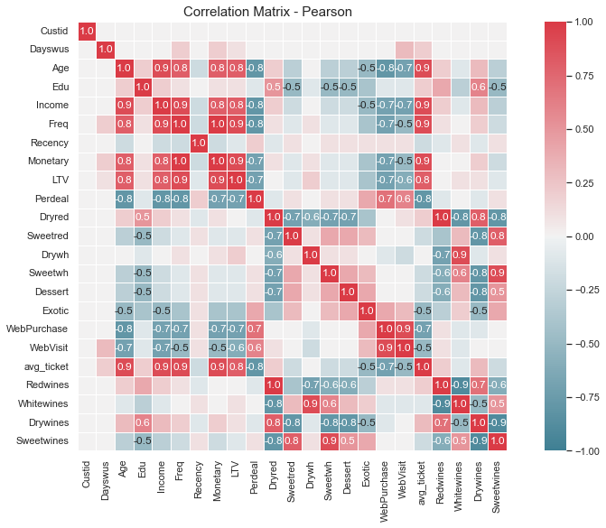
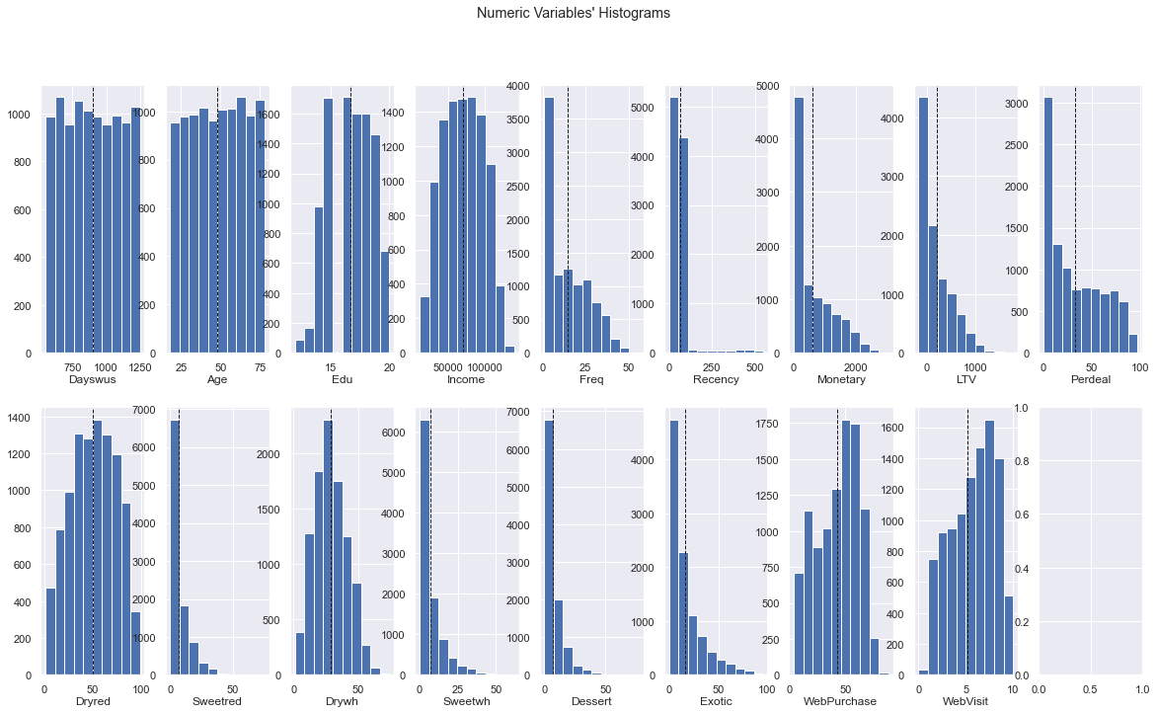
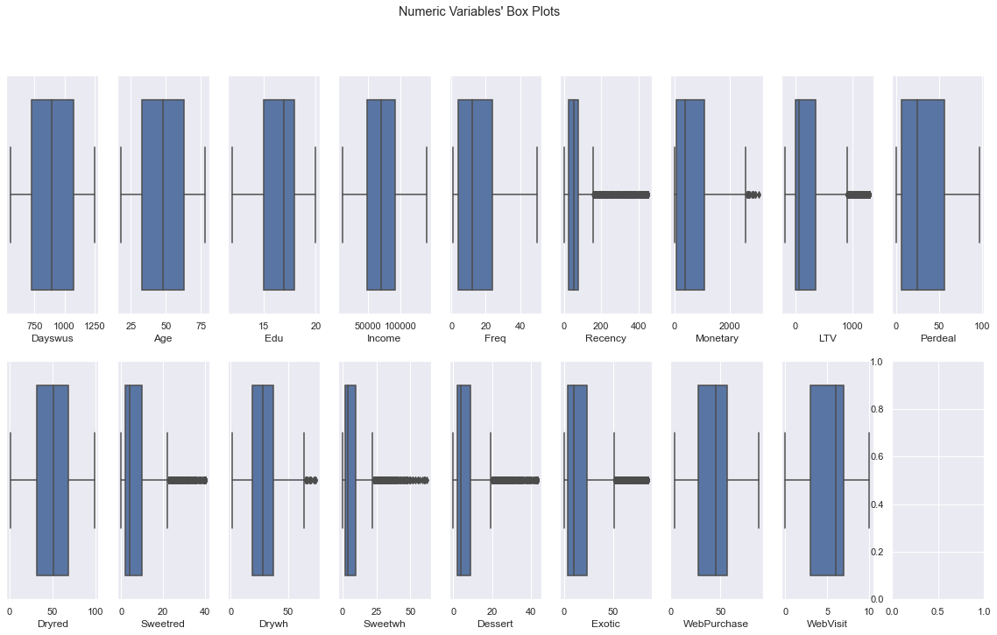
Data Understanding
The dataset presents 18 numeric variables and 10.000 entries, no missing values were detected and no inconsistencies in the scaling of the numerical variables, or in the types of data were detected. Boxplot, Distributions and Correlation analysis were performed.
Some Findings
Customers who buy online have a lower purchase frequency compared to other channels
Perdeal has strong and positive correlation with online shopping
People who buy dry red wine generally do not buy other types of wine
Dry red wine has a moderate correlation with people with more years of education (Edu)
Business Understanding
Data Understanding
Data Preparation
Modeling
Evaluation
Deployment

Slide 4
Data Preparation
In order to make the dataset more suitable to achieve our objective, the following steps were performed: Outliers Removal, Feature Engineering and Data Standardization. After that, the dataset was divided into 3 groups.
Group | Value & Demographic | Purchase Behavior | RFM
Variables | Age Edu Income Dayswus LTV Perdeal WebPurchase | Dryred Sweetred Drywh Sweetwh Dessert Exotic | Recency Freq Monetary
Business Understanding
Data Understanding
Data Preparation
Modeling
Evaluation
Deployment

Slide 5
Modeling
k-means was chosen for clustering of both groups after comparing R2 with other methods. The number of clusters was decided based on the elbow method. Hierarchical clustering was used to merge both groups. RFM Analysis was performed and used as an additional layer of stratification to the final merged clusters.
Value & Demographic Features
K-means
3 Clusters
Hierarchical Cluster
4 Clusters
RFM Analysis
Purchase Behavior Features
K-means
3 Clusters
Marketing Actions
Business Understanding
Data Understanding
Data Preparation
Modeling
Evaluation
Deployment

Slide 6
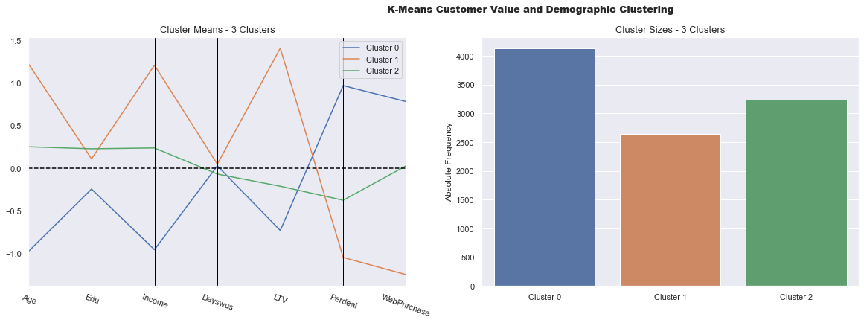
Value & Demographic Clusters
The k-means was applied considering only the Value & Demographic features.
Cluster 0: lowest LTV, lowest average age and Income. Has preference for online shopping and usually buys when discount is available. Represents 41%
Cluster 1: highest value, higher average Age and Income when compared to others and most purchases are offline and without discounts. Represents 26%
Cluster 2: When compared to Clusters 0 and 1, this cluster has an intermediate Age, Income, LTV, Perdeal and WebPurchase. Represents 32%
Class C
Class A
Class B
41%
32%
26%
Business Understanding
Data Understanding
Data Preparation
Modeling
Evaluation
Deployment

Slide 7
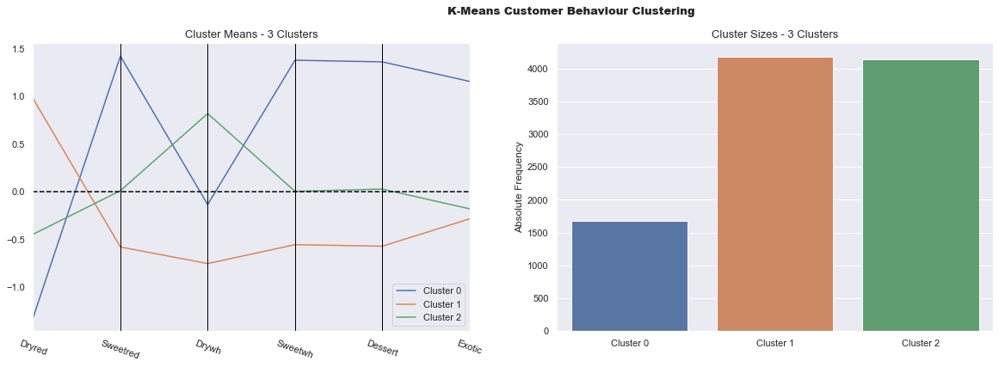
Purchase Behavior Clusters
The k-means was applied considering only Purchase Behavior features.
Cluster 0: Represents 15% of customer base. There is a preference for sweet and dessert wines as well as exotic wines.
Cluster 1: Represents 43% of customer base. There is a preference for dry red wines.
Cluster 2: Represents 42% of customer base. There is a preference for dry white wines.
Sweet & Exotic
Dry Red
Dry White
43%
42%
15%
Business Understanding
Data Understanding
Data Preparation
Modeling
Evaluation
Deployment

Slide 8
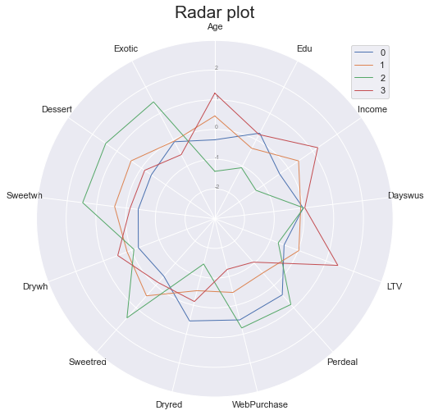
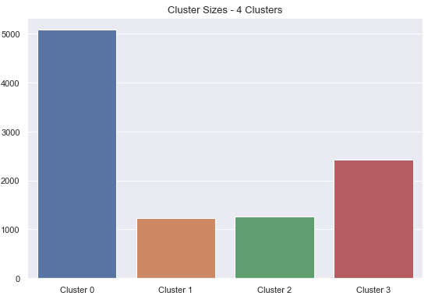
Final Merged Clusters
Hierarchical Clustering method was applied for the purpose of merging the two groups, Value & Demographic and Purchase Behavior.
Merged | Value & Demographic | Purchase Behavior
Cluster 0
Cluster 1
Cluster 2
Cluster 3
Class C
Dry Red
Sweet & Exotic
Dry White
Class B
Sweet & Exotic
Dry White
Class C
Sweet & Exotic
Class A
Dry White
Dry Red
52%
25%
11%
12%
Business Understanding
Data Understanding
Data Preparation
Modeling
Evaluation
Deployment

Slide 9
RFM Analysis
RFM Analysis was performed, and all the observations were classified in terms of Recency, Frequency and Monetary. The final classification was grouped in three different classes Gold, Silver and Bronze. The table below illustrates this classification.
RFM | Share | LTV | Frequency | Monetary | Recency
Gold | 37% | High – 2x the avg | High – 2x the avg | High – 2x the avg | Low – 20 days less than avg
Silver | 48% | Medium – below avg | Medium – Below avg | Medium – Below avg | Medium – almost equal to avg
Bronze | 15% | Low – with losses | Low | Low | High
Business Understanding
Data Understanding
Data Preparation
Modeling
Evaluation
Deployment

Slide 10
Marketing Actions Recommendation
Based on the clusters that were found as a result of the segmentation work and in order to achieve the project’s objectives, the team recommends the deployment of the following 3 marketing actions.
Customer Segmentation | Share | LTV | Age | Income | Education | Channel | Discount is Important? | RFM* Gold | RFM* Silver | RFM* Bronze
Class A – Dry White and Red | 25% | 1st | Oldest | Highest | 1st | Offline | No | 2,236 | 188 | 0
Class B – Sweet & Exotic | Dry White | 11% | 2nd | 2nd Oldest | 2nd Highest | 2nd | Offline|Online | No | 559 | 623 | 51
Class C – Dry Red and White | Sweet & Exotic | 52% | 3rd | 2nd Youngest | 2nd Lowest | 1st | Online | Yes | 912 | 3,205 | 962
Class C – Sweet & Exotic | 12% | 4th | Youngest | Lowest | 3rd | Online | Yes | 13 | 751 | 500
1
1
1
2
2
2
2
3
3
3
3
3
3
*Quantity of customers
Action 1 (Retention/member get member/recency reduction): Loyalty program in order to keep this customers active as long as possible. The program can have a format of a wine club, in which a monthly fee is paid (compatible to the current ticket) and a wine basket (compatible to the avg quantity) is sent once a month. The wines can be picked based on the customers preferences (in this case dry red and dry white, and more expensive/exclusive wines – also good for inventory management). In case a customer is willing to buy more bottles from a wine that was sent in a previous basket, they can order it and it will be delivered with the next basket. Once every X months the customer can gift a friend with the same basket they are receiving for that specific month.
Action 2 (Recency reduction/migration): Online campaign, focusing on offering the wines which are the preferences of this cluster. The objective here is to reduce recency, and with that force a migration to a better customer segmentation (from silver to gold, for example). The advertisement could be sent X days after the last purchase with recommendations of wines that were purchased by other customers from this same cluster.
Action 3 (Inventory Turnover): Online mass campaign targeting the same customer profile as Class C and prioritizing to advertise wines that are not selling well, aiming to induce inventory turnover by offering great discounts. All types of wine can be covered in this action.
Business Understanding
Data Understanding
Data Preparation
Modeling
Evaluation
Deployment

Slide 11
Thank you!
Group C
Gabriel Felipe Martins de Souza m20210598
Rogerio Domingos Paulo m20210597
Luiz Humberto Polaro Vizeu m20210554
Celso Christiano Endres Neto m20200739
11

