Slide 1

Learn. Imagine. Build. .NET Conf
Aplicações escaláveis através de Mensageria
Gabriel Schmitt Kolhrausch
STI – Society Tecnologia da Informação

Slide 2
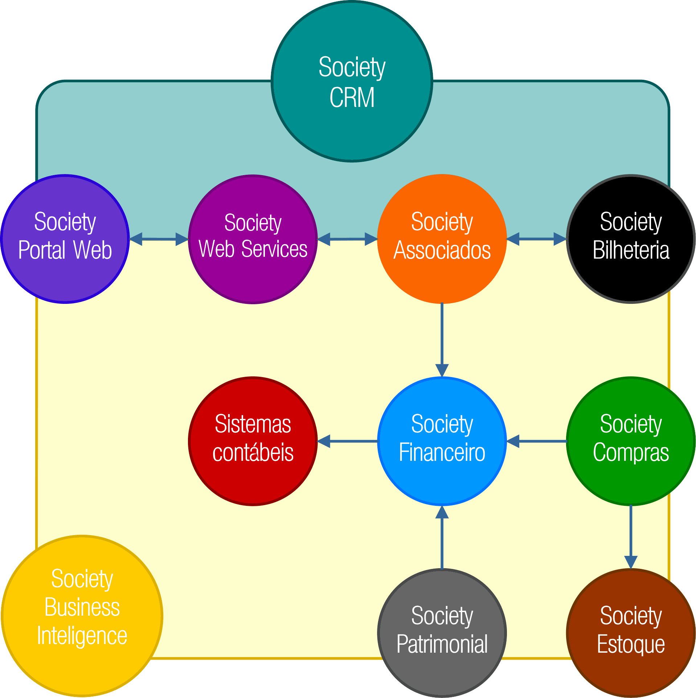

Please allow me to introduce myself
Gabriel S. Kohlrausch
gabriel@society.com.br
www.linkedin.com/in/gabrielsk
github.com/gabriel-society

Slide 3
Simple......
Life is a box of surprises
Alterar endereço
Salvar no banco de dados
Endereço:
Recalcular dívidas com novo endereço
Cidade:
Estado:
Notificar cliente da alteração nos próximos boletos
Salvar
Alterar endereço para correspondência dos dependentes

Slide 4
Still simple.....
Alterar endereço
Salvar no banco de dados
Endereço:
Recalcular dívidas com novo endereço
Cidade:
Estado:
Notificar cliente da alteração nos próximos boletos
Salvar
Aguarde...
Alterar endereço para correspondência dos dependentes

Slide 5

But....
Alterar endereço
Salvar no banco de dados
Endereço:
Recalcular dívidas com novo endereço
Cidade:
Estado:
Notificar cliente da alteração nos próximos boletos
Salvar
Alterar endereço para correspondência dos dependentes

Slide 6
Under the hood
Cliente A
Cliente B
myApp.v1-0.exe
myApp.v1-0.exe
myApp.v1-0.exe
myApp.v1-0.exe

Slide 7
Problems
Cliente A
Cliente B
myApp.v1-0.exe
myApp.v1-0.exe
myApp.v1-0.exe
myApp.v1-0.exe

Slide 8
Scale up
Cliente A
Cliente B
myApp.v1-0.exe
myApp.v1-0.exe
myApp.v1-0.exe
myApp.v1-0.exe

Slide 9
And now ... Web app
Myapp
myApp
Salvar no banco de dados
Endereço:
Recalcular dívidas com novo endereço
Cidade:
Estado:
Notificar cliente da alteração nos próximos boletos
Aguarde...
Salvar
Alterar endereço para correspondência dos dependentes
http://myapp/api

Slide 10
Under the hood
Cliente A
Cliente B
http://myapp.com
http://myapp.com
http://myapp.com/api
http://myapp.com/api

Slide 11
Scale out
Cliente A
Cliente B
http://myapp.com
http://myapp.com
http://myapp.com/api
http://myapp.com/api

Slide 12
And now ... Web app
Myapp
myApp
Salvar no banco de dados
Endereço:
Recalcular dívidas com novo endereço
Cidade:
Estado:
Notificar cliente da alteração nos próximos boletos
Aguarde...
Salvar
Alterar endereço para correspondência dos dependentes
http://myapp/api

Slide 13
Yah
http://service1.myapp/api
Salvar no banco de dados
Myapp
myApp
http://service2.myapp/api
Recalcular dívidas com novo endereço
Endereço:
Cidade:
Estado:
http://service3.myapp/api
Notificar cliente da alteração nos próximos boletos
Aguarde...
http://service4.myapp/api
Alterar endereço para correspondência dos dependentes

Slide 14
Under the hood
Cliente A
Cliente B
http://myapp.com
http://myapp.com
http://serviceN.myapp.com/api
http://serviceN.myapp.com/api
http://service1.myapp.com/api
http://service1.myapp.com/api

Slide 15
Scale out
Cliente A
Cliente B
http://myapp.com
http://myapp.com
http://serviceN.myapp.com/api
http://serviceN.myapp.com/api
http://service1.myapp.com/api
http://service1.myapp.com/api

Slide 16
What are we going to tonight Brain?
Cliente A
Cliente B
clienteA.myApp.com.br
clienteB.myApp.com.br
www.myApp.com.br
Cliente C
IasS
PasS
clienteC.myApp.com.br

Slide 17
How? Azure Cloud !!!!!!
AngularJs
Asp core - WebApi
Azure Service Bus
Message Handler
RavenDb

Slide 18
Queue
AngularJs
Asp core - WebApi
Azure Service Bus
Message Handler
RavenDb

Slide 19
Queue
AngularJs
Asp core - WebApi
Azure Service Bus
Message Handler
RavenDb

Slide 20
Queue and Async
AngularJs
Asp core - WebApi
Azure Service Bus
Message Handler
RavenDb

Slide 21
Queue and Async
AngularJs
Asp core - WebApi
Azure Service Bus
Message Handler
RavenDb

Slide 22
Queue and Async
AngularJs
Asp core - WebApi
Azure Service Bus
Message Handler
RavenDb

Slide 23
Queue and Async
AngularJs
Asp core - WebApi
Azure Service Bus
Message Handler
RavenDb

Slide 24
Queue and Async
AngularJs
Asp core - WebApi
Azure Service Bus
Message Handler
RavenDb

Slide 25
Queue and Async ..... Wait and Multi-thread
AngularJs
Asp core - WebApi
Azure Service Bus
Message Handler
RavenDb

Slide 26
Queue and Async ..... Wait and Multi-thread
AngularJs
Asp core - WebApi
Azure Service Bus
Message Handler
RavenDb

Slide 27
Queue and Async ..... Wait and Multi-thread
AngularJs
Asp core - WebApi
Azure Service Bus
Message Handler
RavenDb

Slide 28
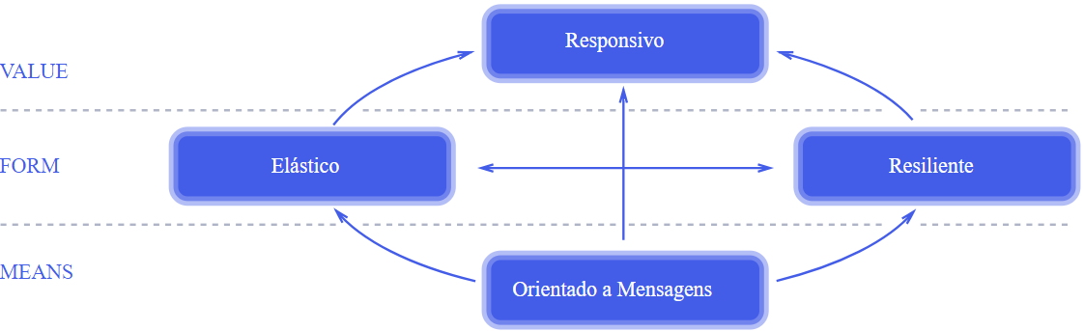
Luke, i’m your father......
https://www.reactivemanifesto.org/pt-BR

Slide 29
Demo time ……….

Slide 30



Deploy options
App Service
(Asp core static files - AngularJs)
App Service
(WebApi asp core)
Azure Service Bus
App Service
(Asp core – Always On
Message Handler)
Virtual Machine
(RavenDb)

Slide 31
Architecture
Camada
Apresentação
InputModel
ViewModel
API
API
API
Camada
Aplicação
BUS
Camada
Negócio
Bounded Context
Services
Query
Command Handler
Camada
Domínio
Domain
Camada
Infraestrutura
Repositórios
IoC
Cache

Slide 32
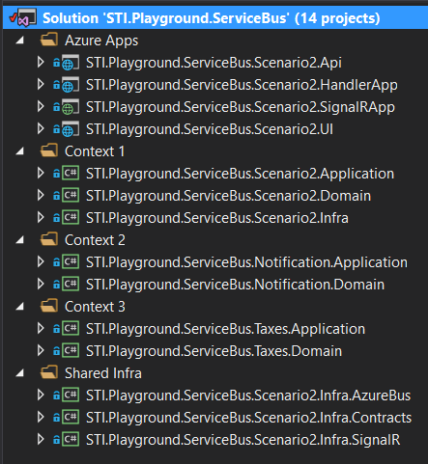
Solution

Slide 33
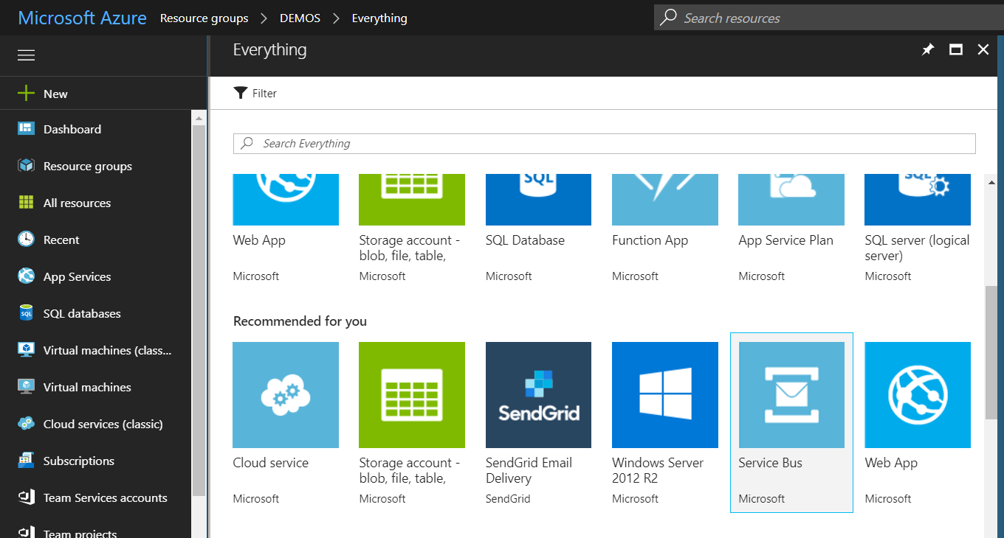
Azure Service Bus

Slide 34
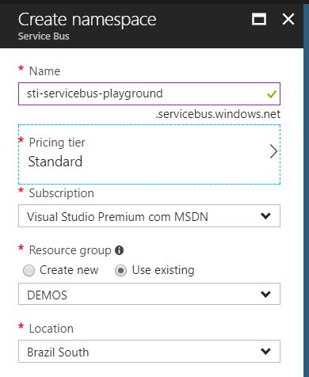
Azure Service Bus

Slide 35
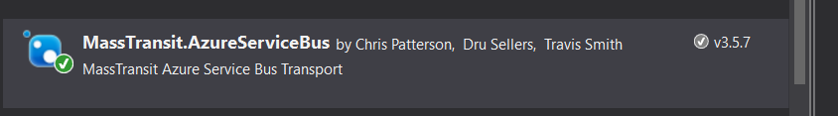
Dont forget

Slide 36
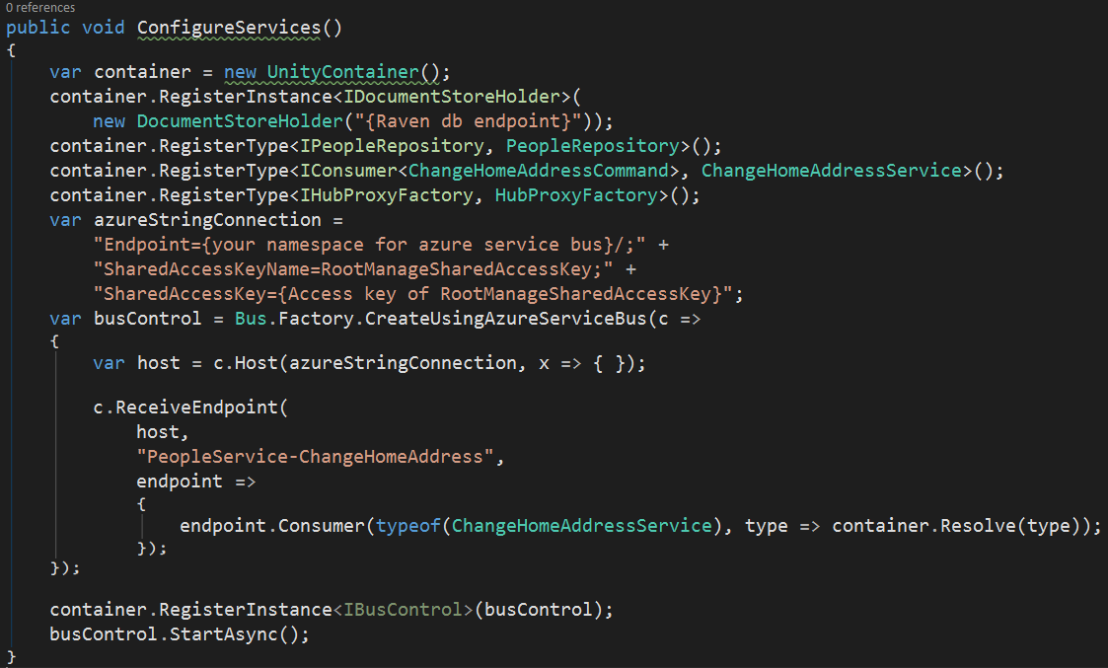
First at all ... Configure and run your handlers

Slide 37
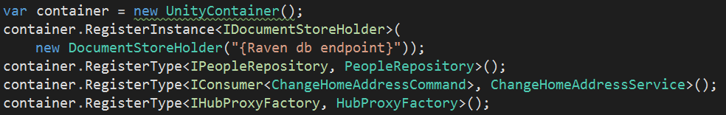
First at all ... Configure and run your handlers

Slide 38
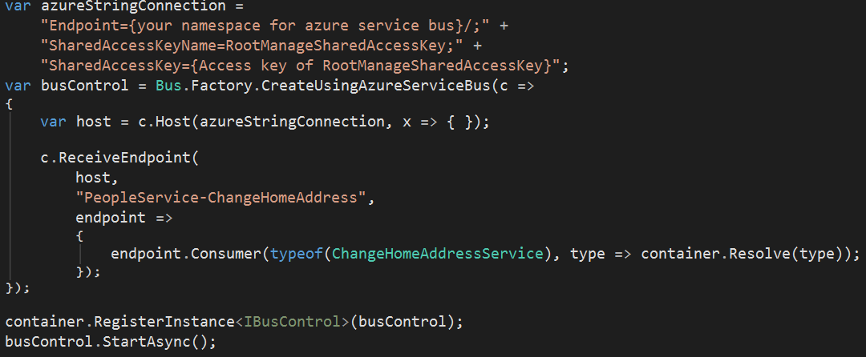
First at all ... Configure and run your handlers

Slide 39
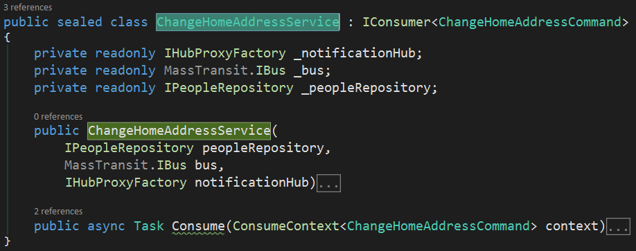
Get to the chopper!

Slide 40
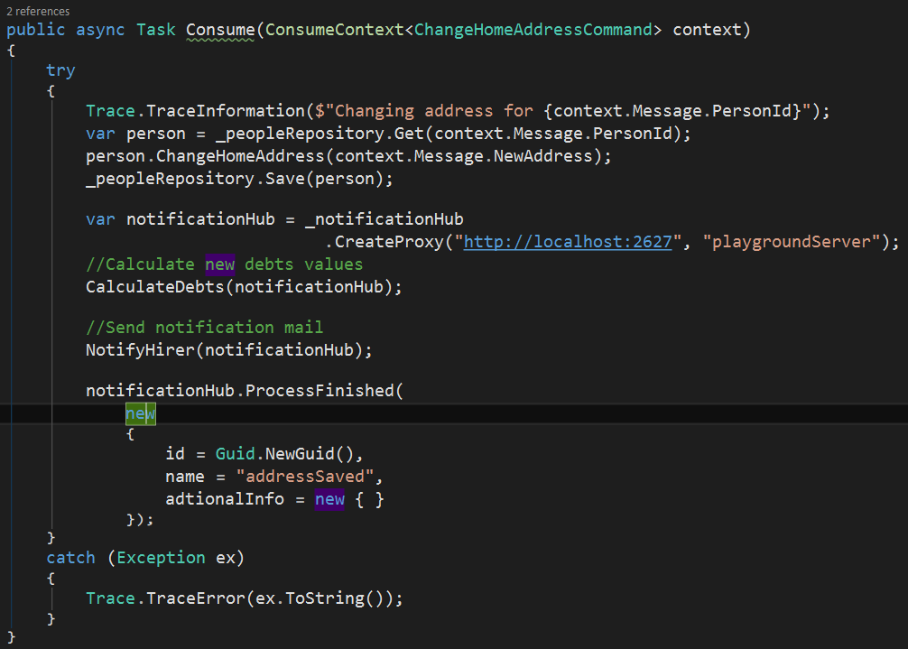

Slide 41
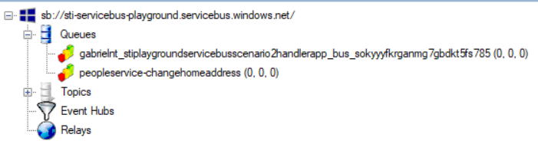
After first time......

Slide 42
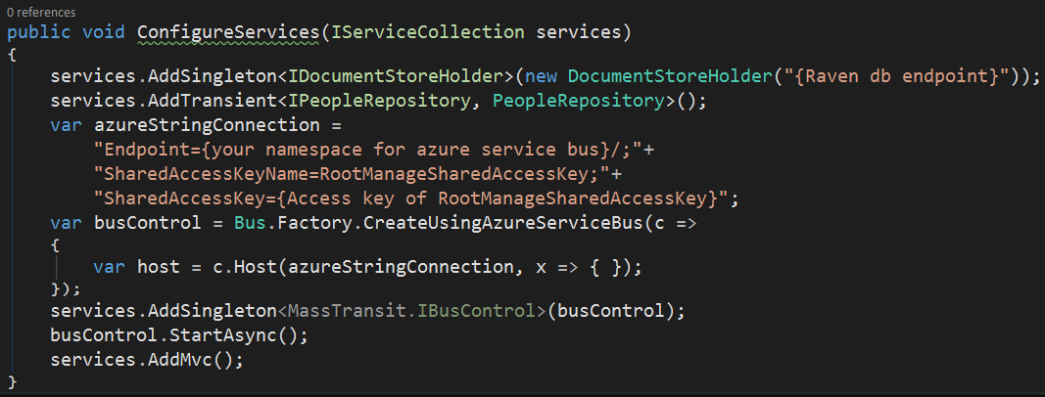
Sending commands

Slide 43
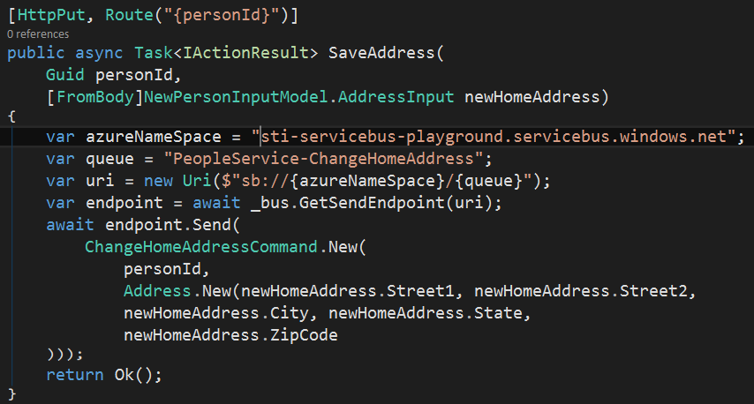
Sending commands

Slide 44
Working with events ..........
AngularJs
Asp core - WebApi
Azure Service Bus
Message Handler
RavenDb

Slide 45
Until then, everything normal....
AngularJs
Change Home Address Handler
Asp core - WebApi
Azure Service Bus
Message Handler
RavenDb

Slide 46
But
Calculate Debts Queue
AngularJs
Change Home Address Queue
Change Home Address Handler
Asp core - WebApi
Azure Service Bus
Message Handler
RavenDb

Slide 47
Microservices???
Calculate Debts Queue
Calculate Debts Handler
AngularJs
Change Home Address Queue
Change Home Address Handler
Asp core - WebApi
Azure Service Bus
Message Handler
RavenDb

Slide 48
Demo time ……….

Slide 49
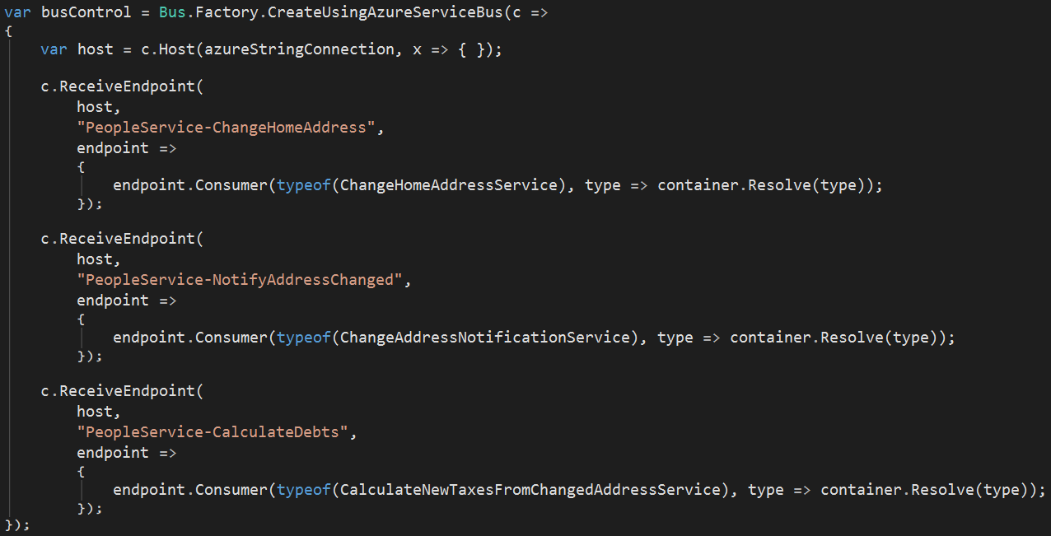
My precious .......

Slide 50
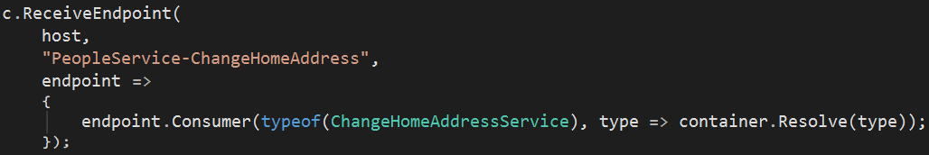
My precious .......

Slide 51
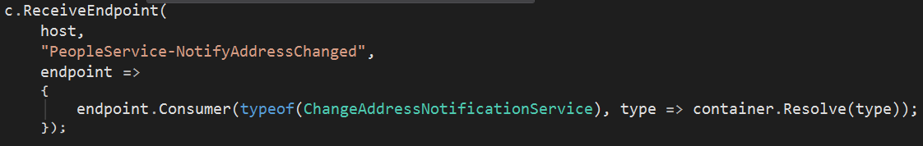
My precious .......

Slide 52
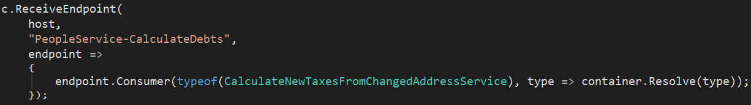
My precious .......

Slide 53
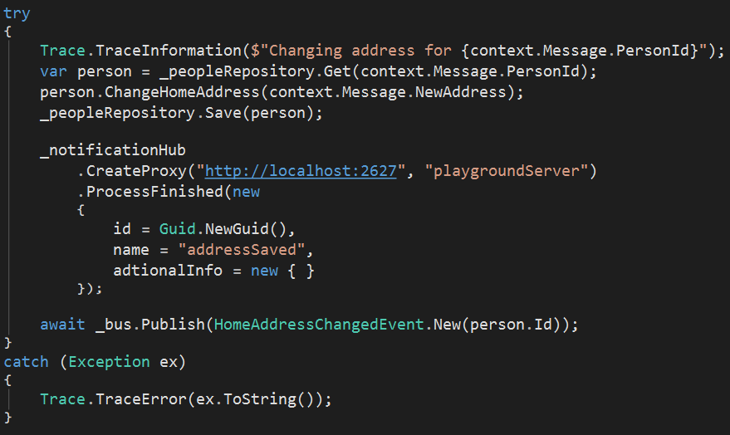
Command handler

Slide 54
Pay attention

Slide 55
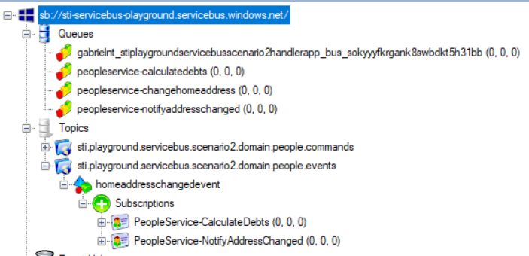
What?

Slide 56
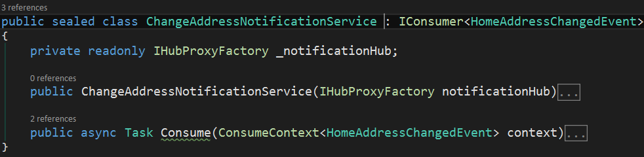
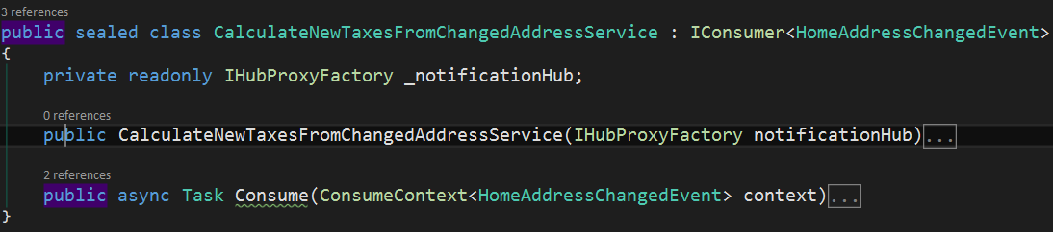
I'm not fat, I'm big-boned

Slide 57
That’s all, Folks!
Gabriel S. Kohlrausch
gabriel@society.com.br
www.linkedin.com/in/gabrielsk
github.com/gabriel-society
http://masstransit-project.com/
https://azure.microsoft.com/pt-br/services/service-bus/
https://dotnetcodr.com/2016/09/08/messaging-through-a-service-bus-in-net-using-masstransit-part-1-foundations/
https://github.com/kevinhillinger/MassTransit-AzureServiceBus-Sample

Slide 58
.NET

