Slide 1
ESH&Q Directorate
Occupational Safety & Health
and Environmental Management System
Management Reviews
September 18, 2006

Slide 2
Purpose of Meeting
“Directorate management shall” - Evaluate OHSAS 18001 OSH & ISO 14001 EMS Programs
  Adequacy –requirements implemented appropriately
  Suitability- programs “fit” BNL operations & systems
  Effectiveness- desired results being achieved
Review performance of key system components including:
    Results of audits and assessments
    Extent to which objectives and targets have been met
    Concerns of relevant interested parties
Expected Outcome
  Identify areas where focused improvement initiatives are needed
  Provide feedback and direction
Notes:
At the end of the meeting we will be seeking input on improvement areas and your assessment of the programs adequacy suitability & effectiveness.
Please feel free to stop any of the speakers during the presentations to ask questions or add comments. We try to prepared the data for your evaluation , but may have overzealous… Interactions will liven up this meeting and certainly welcome.
We will be taking minutes of the discussions during the presentation.

Slide 3
Meeting Agenda
OSH & EMS Overview
Audits & Assessments
Performance Trends
Performance on Objectives & Targets
Financial Investments
Stakeholder Communications
System Improvements and Issues
Senior Management Evaluation

Slide 4
4.1 OSH Scope
    Scope
      All organizations within the ESH&Q Directorate
  Description of ESH&Q OSH Program
      ESH&Q OSH Program Description - DH-SOP-007

Slide 5
OSH Reps
ESH&Q OSH Management Rep – P. Williams
  EWMS POC – A. Bou
  QMO POC – S. Stein
  RCD POC - K. Conkling
  SHSD POC – R. Selvey

Slide 6
5.2 ESH&Q OSH Hazards
Establish programs to manage significant hazards
Laboratory Hazards
  Traffic/vehicle
  Specialized equipment
  Bicycles
  Natural hazards (deer, ticks etc)
  Recreational Activities
  Natural Phenomena Hazards (wind, snow, flood)
Facility Specific Hazards
  Electrical
  Chemicals
  Radiological materials
  Biological materials
  Lasers
  Pressure
  Noise
  Cryogenics
  Material Handling
  Elevated work
  Construction activities
  Walking/working surfaces
  Ergonomics
Issues: Complete Risk Assessments to address hazards associated with routine skill-of-the-worker tasks

Slide 7
5.2 ESH&Q JRAs and FRAs
EWMS
  40 JRAs and 19 FRAs completed
QMO
  5 JRAs and 1 FRA completed
RCD
  35 JRAs and 2 FRAs completed
SHSD
  15 JRAs and 3 FRAs completed

Slide 8
5.3 OHSAS 18001 Internal Audit – ESH&Q
Noteworthy Practices
  All Group, Division, and Directorate Level Meetings start with a safety topic;
  SHSD, EWMS, and QMO have a large and diversified group of staff involved in the JRA/FRA process and show an exceptional leadership role and management commitment to ensure their success;
  SHSD has a Standard Operating Procedure Table with linked JRAs facilitating the workers ability to ascertain the risks and controls in place for a procedure they are obtaining documentation on.
  EWMS uses SOPs as controlling documents and change requires review of associated JRAs.
  EWMS documents changes in SBMS and provides them to all employees in a monthly publication. This monthly publication is produced and distributed by EWMS to the Entire ESH&Q directorate.

Slide 9
5.3 OHSAS 18001 Internal Audit – ESH&Q
Major Non-conformances
  4.3.1 Planning For Hazard Identification, Risk Assessment and Risk Control
    All divisions and Directorate have SOPs that are NOT current in their revision stated revision cycle.
    Radiological Control Division has no Prioritized list for FRAs, JRAs. No JRAs are completed and upper management has not produced evidence that the single FRA they have on file is approved by management

Slide 10
5.3 OHSAS 18001 Internal Audit – ESH&Q
Minor Non-conformances
  Minor Nonconformance 1
  4.3.3, Objectives
  Radiological Control Division and the Quality Management Office has poor OSH Objectives/Targets in their SAP.
  Radiological Control Division Objectives are not improvement orientated and they do not have personnel designated to achieve objectives, and lack target dates.
  Quality Management Office does not have personnel designated to achieve targets and objectives
  Minor Nonconformance 2
  4.3.4 OSH Management Program(s)
  The Quality Management Office and Radiological Control Division lack significant objectives and targets and therefore cannot have a management program to support targets and objectives that do not exist. There is a high participation for establishing and maintaining an OSH management program to achieve OSH objectives within the entire ESH&Q Directorate with the exception of the Radiological Control Division, which has shown little commitment to provide either the means or designated responsibility and authority to achieve objectives of relevant functions and levels with in the organization.

Slide 11
5.3 OHSAS 18001 Internal Audit – ESH&Q
Minor Non-confromances (cont’d)
  Minor Nonconformance 3
  4.4.2 Training, Awareness and Competence
  TQ-SAFEAWARE training will be required in all employees training before registration audit (October). Not all employees have successfully completed the course.
  Minor Nonconformance 4
  4.4.5 Document and Data Control
  ESH&Q Directorate, Radiological Control, Safety Engineering Group of SHSD, and EWMS all had SOPs that were not current.
  Minor Nonconformance 5
  4.4.6 Operational Control
  All divisions and Directorate have SOPs that are NOT current in their revision stated revision cycle.
  Radiological Control Division has no Prioritized list for FRAs, JRAs. No JRAs are completed and upper management has

Slide 12
5.3 OHSAS 18001 Internal Audit – ESH&Q
Minor Non-conformances (cont’d)
  Minor Nonconformance 6
  4.5.1 Performance Measurement and Monitoring
  The Bio Safety Subject Matter Expert in the Industrial Hygiene Group has failed to communicate with the Bio Safety Officer in the Biology Department to ensure that monitoring for Bot Tox exposure in a Biology Dept Bio Hazard Lab is available. Since the monitoring capability is required by the Biology Dept. Experimental Safety Review (ESR), the experiment should have been discontinued until the IH Group could support the exposure monitoring requirements in the ESR.

Slide 13
5.3 OHSAS 18001 Internal Audit – ESH&Q
Opportunities for Improvement
  There is no organization that has a formal method for notification of changes to JRAs, FRAs, or SOPs. A tracking and notification system would be beneficial for employees to stay abreast of changes.
  Radiological Control Division should have an Internal Requirements Management Procedure.
  SOP IH50700 “Requirements Management” requires OSH SMEs to review their subject area for regulatory changes quarterly and update SBMS. Interviews with auditors indicate that this schedule is not being maintained due to limited resources. Employees relying on SBMS for updates on legal requirements and regulations would not be updated on a timely fashion due to the inability for the IH Group to deliver necessary information.
  SOP IH50700 does require quarterly review on information provided from IARC and NTP for updating the SBMS Working with Chemicals Carcinogen and Reproductive Hazards Lists. Review of these lists is only required annually during review of the BNL Chemical Hygiene Plan.
  Targets and Objectives should be separated out from the SAP in the organizations where they have not already been done.

Slide 14
5.3 OHSAS 18001 Internal Audit – ESH&Q
Site-wide Opportunities for Improvement
  Create a procedure for when OSH elements and programs should be recommended for review.
  SBMS updates should be communicated down to workers based on BTMS training records (i.e. Personnel required to take Hazard Communication Training would be automatically be notified by email of any changes to the SBMS Working with Chemicals Subject Area.

Slide 15
5.3 Assessments - ESH&Q
Assessment Performance
  Systems Audits:
    EMS/OHSAS Internal Assessment (March)
    NSF Surveillance Assessment (June)
Internal EMS/OHSAS Audit - EMS Findings (PEMP 5.3.1.1)
Nonconformances:
  Document Control
    Out of date documents (OCFs, postings, SOPs)
  Policy Awareness
    Employee unable to verbalize policy
  Nonconformance & Corrective Action
    Not implemented when required (to address out-of-date SOPs)
  Records Management
    Tier I Records not managed per ESH&Q requirements.

Slide 16
5.3 Assessments - ESH&Q
NSF Surveillance Audit - EMS Findings (PEMP 5.3.1.1)
Self Assessment Plan Target = Zero Findings
  1 Nonconformance - Document Control
    Missing Ops Manual
    Uncontrolled legal requirements posting
  OFI - Objectives & Targets
    Lack clarity and measurability

Slide 17
5.3 Assessments - QMO
Evaluation of BNL Quality Assurance Program
  Laboratory-wide instrumentation control calibration program has not been adequately defined in that (1) institutional stewardship is not clear; and (2) instruments assigned an A3 or A4 grade level determination are relieved from a majority of the program requirements. BNL should ensure that the program does not allow for the possibility that instruments impacting data quality and regulatory compliance would not be calibrated.

Slide 18
5.3 Assessments - RCD
Assessments and nonconformances; emphasis on corrective actions
    5.3.1 BNL staff generated 33 RARs in FY06, four of them for issues where inadequate performance by RCD staff was a root or contributing cause. RCD Management critiqued all four RARs. Corrective actions included improvements to SOPs, requirements for job coverage by RCTs, and documented expectations for walkdowns as a part of work planning for complex jobs.
    5.3.2 Two ORPS for Loss of Control of Radioactive Material (one at HFBR and one at Medical 490) and one for the elevated levels of naturally-occurring radioactivity discovered in the Main Gate Roadbed. Corrective actions: down-posting radiological areas will require management concurrence to ensure all prerequisites are completed satisfactorily and any change in radiological controls are adequate.
    5.3.3 RCD published one Lessons Learned on the protective equipment considerations for work planning for mixed hazards (i.e., radiological contamination and asbestos).

Slide 19
5.4 Stakeholder Concerns - EWMS
The shipment of LLW by rail through the city is being worked on with the City of New York, the State of New York, and the counties of Nassau and Suffolk. This is an ongoing effort that is needed to support the Reactor Projects.
G-2 Project (tritium in groundwater): Heavy DOE and public involvement, addressed at CAC meetings
Compliance Issues: State had two Notice of Violations for opacity excursions at Central Steam Facility (CSF). Both NOVs have been closed with the State.
Legacy Issues: Involvement from the DOE and Regulators. Clean-up in progress for the FHWMF and the CSF.

Slide 20
5.4 Stakeholder Concerns - RCD
  5.4.1 No new regulatory drivers.
  5.4.2 BHSO has provided no specific feedback on RCD performance; feedback on the performance of the Radiological Control Management System is plentiful (e.g., recent RWP surveillance noted problems with Limiting Conditions/Void Points, RWP Records protection LTA, not all workers know the radiological controls of the RWP they are working under).

Slide 21
5.4 Stakeholder Concerns - SHSD
For stakeholder concerns, review issues and actions, if any, that are related to:
Activists: no EMS/OSH issues have been raised regarding SHSD activities.
Community: no EMS/OSH issues have been raised regarding SHSD activities.
Regulators: At the site level, the OSH consulting services provided in part by SHSD have been an issue to BHSO. The issue is the shallow depth of coverage within SHSD and in particular with Industrial Hygiene Monitoring. The quality of the services provided by SHSD IH has not been an issue, but the quantity and personnel resources available to complete a baseline IH monitoring survey for the site are key issues being tracked by BHSO. A Corrective Action Plan is in place, but it is slow in implementation because the funding needed to fully implement the program is beyond the funding within SHSD. The potential to not meet BHSO expectation is very real in the IH monitoring and Program Administration area and the Electrical Safety program. [Concern]
Unions: no EMS/OSH issues have been raised regarding SHSD activities.

Slide 22
5.5 OSH Improvements - EWMS
Tier 1 housekeeping findings tracked and trended to measure effectiveness of Housekeeping days. April 17 declared Housekeeping Day for EWMS.
Management walk-through of work areas and participation in Tier 1 inspections.
All EWMS Managers are subscribed to the Lessons Learned Subject area for each ORPS event.
Forklift use- a noise monitoring survey was performed on the forklifts at the WMF. It was determined that hearing protection was needed while operating and working around the WM forklifts. The JRA was updated to include hearing protection.
Back-up sensors installed on trucks used by Field Team.
One-third of JRAs/FRAs reviewed and updated as part of triennial review conducted in March 2006.
OHSAS 18001 Registration achieved in November 2005.

Slide 23
5.5 OSH Improvements - QMO
Additional controls that resulted from the risk assessment process are being tracked for closure.
FRA/JRA | Physical Item/Activity | Action (Controls to be Added to Reduce Risk) | ATS Status
JRA-QMO-02 (Walking) | Using stairs- indoors and outdoors | Add sign “Caution, Door Opens Out” to outside entrance doors. Handrail, banister maintenance | Open
QMO-FRA-GEN-OFF (Office Area) | Storage | Clean up and organize Room M8 | Closed
QMO-FRA-GEN-OFF | Electrical | Purchase updated appliances | Closed

Slide 24
5.5 OSH Improvements – QMO
Provided training to the lab on causal analysis
  Approximately 50 staff trained
  Additional sessions scheduled for November 2006
Hiring a Quality Engineer to manage corrective action system

Slide 25
5.5 OSH Improvements - SHSD
  For OSH and EMS improvements, focus on new training, aspects analyses, hazard analyses, improved documentation, and safety or environmental protection initiatives, etc. Show correlations, if any, to improvement in performance.
      All IH Group staff involved in operations with environmental consequences have been trained using an operation specific training program as part of IH50900.
      All SHSD operations with hazards are now included in Standard Operating Procedures. About 20 new SOPs were added in FY06 and all 160+ SOPs are up-to-date on a 3 year revision history. BHSO and DOE-CO have complimented the quality and completeness of the SOPs in two successive audits in FY05 and FY06. [Strength]
      All SHSD staff who conduct operations with health and safety hazards are trained on the specific operation via Job Performance Measures attached to Standard Operating Procedures. This policy and program is described in IH50300. Every SHSD finalized procedure has a JRA associated with it. [Strength]

Slide 26
5.5.1 OSH Improvements - SHSD
  Summarize improvement and/or compliance initiative that the organization will be undertaking that has been designed to achieve the organization’s targets, and ultimately the relevant BNL objectives.
      A SHSD objective was OHSAS registration. As part of this process the JRA/FRAs were done to complement the hazard analysis within the SHSD SOPs. SHSD has tracked 11 improvements coming from the Risk Assessment Process. [Strength]
      SHSD IH Group has the main role in the IH Baseline Monitoring Objective at the site level which related to 10CFR851 and ISM requirements. IH Qualification has proceeded at a good pace to enable the sampling to proceed, but not all topics have fully developed qualification material. The total personnel staffing level to conduct the field monitoring remains a very significant weaknesses and the use of contributed resources from other ESH&Q Directorate divisions has not yielded a good return on the number of sampling events versus the qualification investment. [CONCERN]

Slide 27
5.5.2 OSH Improvements - SHSD
  Focus on the change or actions that were implemented to attain compliance with regulatory requirements, and improve the OSH and/or environmental management systems.
      All the SHSD efforts on OHSAS 18001 have improved their OSH program. This includes formalization of the requirement management process for IH regulations. The SHSD records management system was strengthened by development of a system for OHSAS 18001 elements.
      Only minor additions were made to the SHSD EMS program to address new operations that generate environmental impacts. The IH Group conducted a self assessment on their EMS program.

Slide 28
5.5.3 OSH Improvements - SHSD
    For injury/illness reduction and pollution prevention initiatives, identify initiatives implemented and results, or planned initiatives.
      P2: none
      Illness/injury: SHSD championed one awarded S2 program for reducing injuries on water cooler bottle lifting. The supplies have been received for the program and it will be piloted to volunteer organization soon.
      SHSD championed the S2 program for the second year and used the resources of an intern to conduct the bulk of the processing of the 45 new entries.
      SHSD played a key role in the Tick Prevention task force and lead over 20 sessions of training to staff, visitors, and students on tick illness prevention. This included a “Take-5” and taped hour-long presentation in the BNL archives.

Slide 29

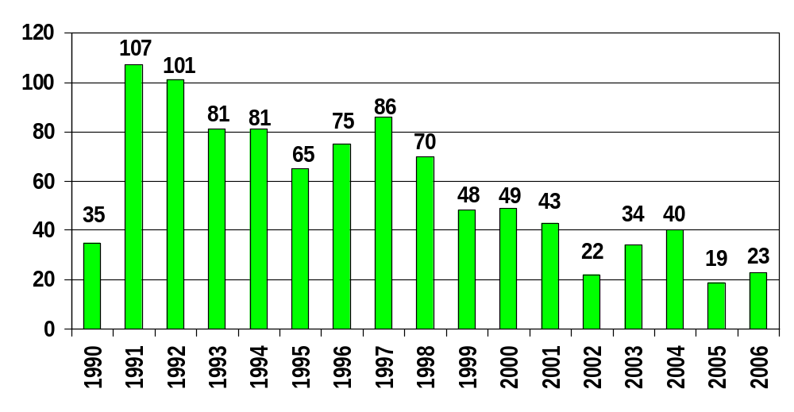
5.6 Performance Data - BNL ORPS by Calendar Year Report Submitted
As of 9/13/06

Slide 30
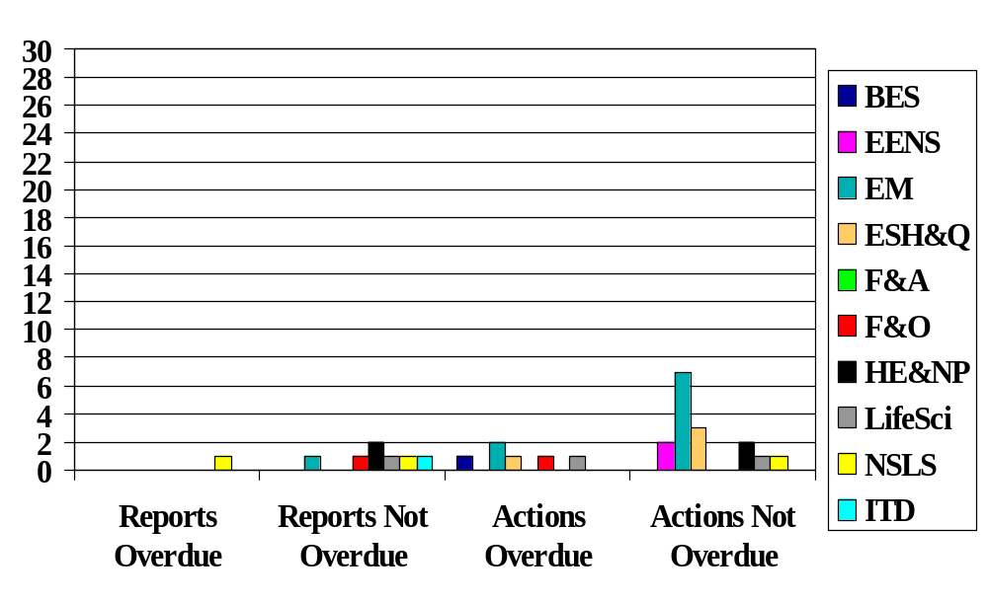
5.6 Performance Data - ORPS Reports and Actions
As of August 31, 2006
ALD

Slide 31
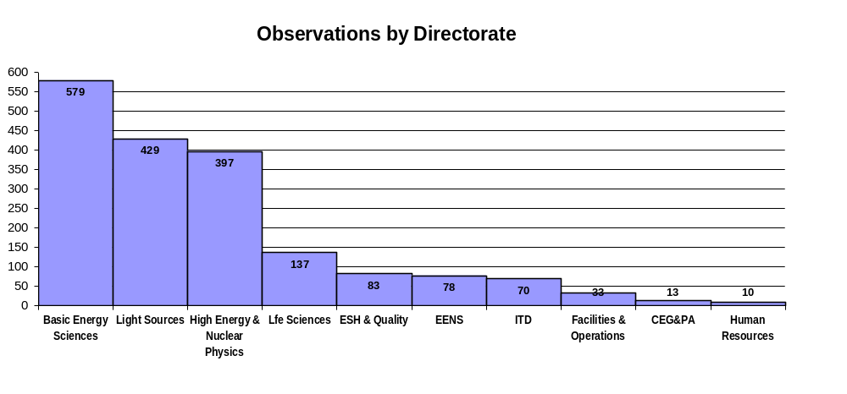
5.6 Performance Data - First, Second & Third Quarter FY06
Tier 1 Inspection Results Combined
Total Findings - 1,889
Number of Findings

Slide 32
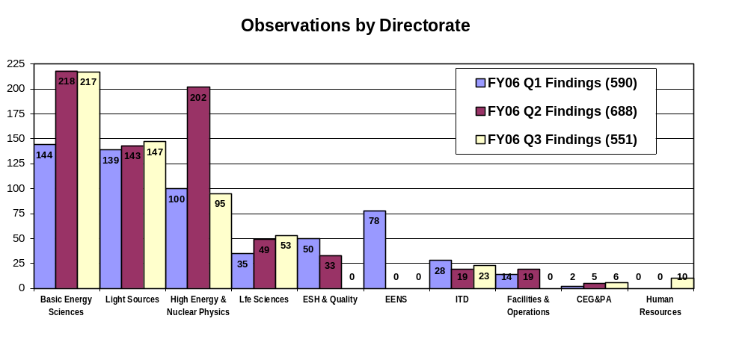
5.6 Performance Data - First, Second & Third Quarters FY06
Tier 1 Inspection Results by Directorate
Total Findings - 1,889
Number of Findings

Slide 33
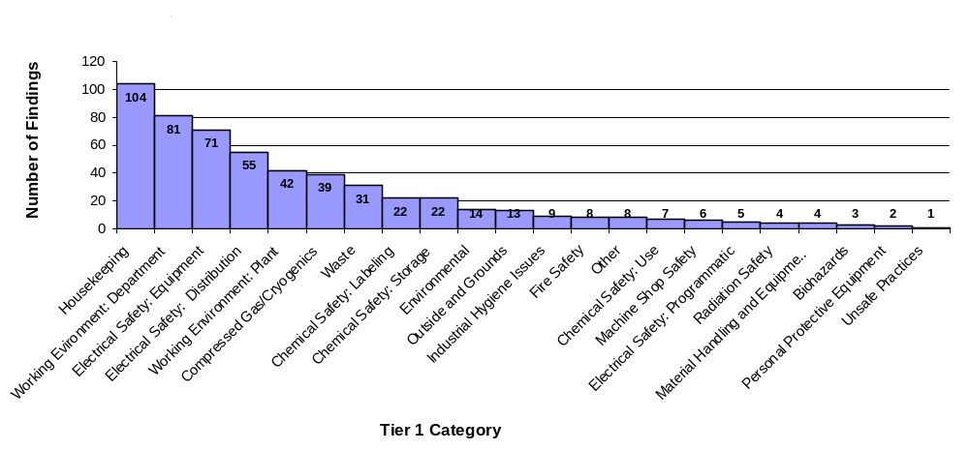
5.6 Performance Data - Third Quarter FY06
Tier 1 Inspection Results by Category

Slide 34
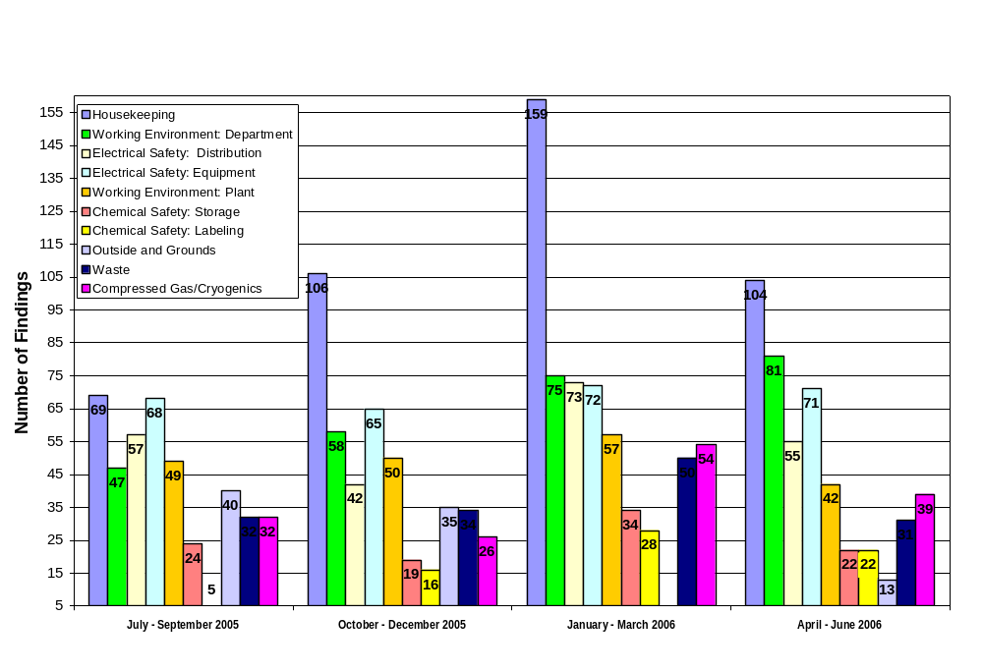
5.6 Performance Data - Tier 1 Inspection Results
Top Ten Categories/Quarter

Slide 35

5.6 Performance Data - Programmatic Bins CY (As of 9/13/06)
Personnel Contamination
Medical Department
NSLS
Physics
CA-D
BGRR Project
Plant Engineering
Utilities Struck
Material Transportation
Electrical Shock Hazards
Material Handling Issues
Waste Management
Chemistry
Environmental Restoration
Railroad Tracks
New Construction
Noise

Slide 36

5.6 Performance Data - Programmatic Review
Waste Management, 2005
  01/07 – WMD Worker Enters Controlled Area with Expired Training
  06/30 – ~2 inches (150 -200 gallons) of water flooded the equipment level at the BMRR
  04/21 – Worker injures back while moving drum
  09/16 – 500 dpm alpha cont on hand @ B650
  10/26 – Tritium Detection in Sr-90 Extraction Well SR-2
  12/19 – LL rad contamination event at B650
Waste Management, 2006
  01/20 – USQ on rusting HEPA exhaust stack @ B860 (SC3)
  02/22 – Lapse in USQ training qualification
  08/04 – HFBR Dumpster alarms BNL Radiation Truck Monitor (SC3)
  08/16 – Walk through of HFBR identifies rad/non-rad items that are not segregated

Slide 37

5.6 Performance Data - Programmatic Review
Noise, 2005
  06/07 – Personnel Exposure to Excessive Noise Lab ground water treatment plants (SC-3)
Noise, 2006
  01/18 – Noise over exposure per ACGIH TLV @ B902 (SC3)
  03/07 – Over-exposure to noise hazard @ Motor Pool Repair Facility (SC3)

Slide 38
5.6 Performance Data - EWMS
For 3 quarters of the FY, WMF have 72 findings (35% have been housekeeping). Additional Tier I performance for EWMS to be provided by D. Bauer.
OSH Related Critiques: Contamination event at Building 830 while cleaning out the Three Mile Island resin from the Hot Cell (Waste Management).

Slide 39
5.6 Performance – QMO
FY 06 Occurrence Reports and Corrective Actions
No Occurrence Reports issued for FY 06

Slide 40
5.6 OSH Performance – Tier I Inspections - QMO
No Tier I Inspection performed in FY06

Slide 41
5.6 OSH Performance - QMO
  Lost Work Day Cases = 0
  BNL Traffic Violations = 1 (parking)
  Personnel Contamination Incidents = 0
  First Aid Cases = 0
  Occupational Injuries = 0

Slide 42
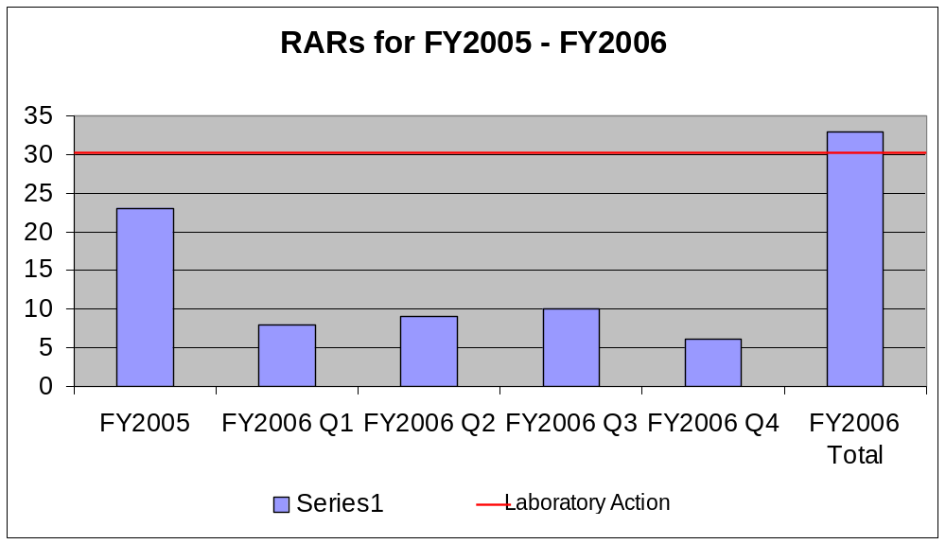
5.6 Performance Data - RCD

Slide 43
5.6 Performance Data - RCD
  OSH performance
    The RAR data over the trailing 12 months suggests a low-level trend related to contamination control may be developing. RCD Management is reviewing.
    The 3 ORPS are unrelated and do not portray a trend.

Slide 44
5.6 Performance Data - SHSD
Injury/illness rates and trends: no injuries/illness in multiple years.
Tier 1 performance: SHSD participated in the ESH&Q Directorate level Tier 1 process. In addition, the IH Group conducted 11 internal management walk through inspections of operations and areas.
OSH related critiques: One critique on IH response to site All-hands emergencies was conducted.
Occurrence reports: none
Injury/illness rates and trends at other DOE laboratories: SHSD had no injuries or illnesses in FY06.
SHSD continued to offer tick ID and offsite analysis of ticks for Lyme’s Disease.
Notes:
Soil, flora, fauna, as applicable injury/illness rates and trends: SHSD continued to offer tick identification and off-site analysis of Ixodes scapularis ticks for Lyme disease. The trend was up for analysis of all ticks was up by about 30% more analysis made in 2006 over 2004 & 2005. Fortunately the trend for Ixodes scapularis attachment to staff was down. The increase in number of analysis is positive in that knowledge of the service is spreading. The downward trend in Ixodes attachment indicates a positive trend in protective measures.

Slide 45
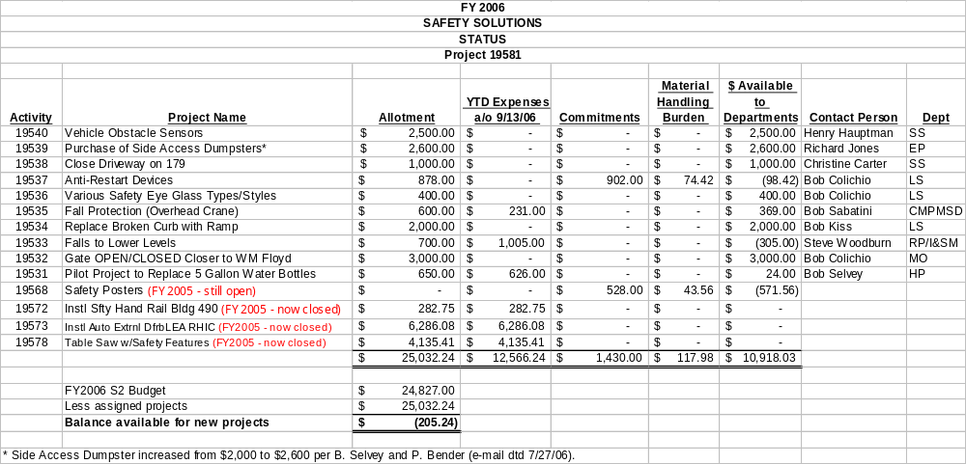
5.7 OSH Targets & Objectives - FY06 Safety Solutions Status

Slide 46
5.7 OSH Targets & Objectives - SHSD
OSH and EMS improvement targets completed: On track for completion of all OHSAS objectives. The self assessment objectives are not being met by the current staffing level in the IH Program Administration Group and the Safety Engineering Group. Unplanned funding was available for a consultant to lead the assessments, but the normal staffing of SHSD is not sufficient to conduct comprehensive program reviews and line implementation reviews. [CONCERN]
Implementation of /milestones for safety or environmental related recommendations from standing or ad hoc safety committees: SHSD satisfactorily addressed one issue on Respirator Cleaning after Fit Testing that was raised by the WOSH Committee.
Implementation of /milestones for prior year’s Integrated Management Review
Compliance with regulatory requirements:
    SHSD is running behind on compliance assessment in FY06. [Concern]
    Industrial Hygiene baseline exposure assessment is behind schedule. [Concern]
Implementation of injury/illness reduction and pollution prevention initiatives: SHSD has been the champion on the development of site level initiatives. At the Division level, no initiatives are applicable as no injuries/illnesses have occurred for multiple years.
Facility specific performance measures: The only SHSD facility specific PM was for management walk-throughs of SHSD hazardous operation areas. These assessments were completed.

Slide 47
5.7 OSH Targets & Objectives - SHSD
    SHSD is on track for Phase 3 OHSAS 18001 development. In addition, SHSD is supplying the OSH rep for the support Organizations Reporting to the director’s Office and the Phase 3 Project Manager.
    All OSHA finding for the physical plant of SHSD are corrected. SHSD has provided the project lead for the lab closure actions. (Achieved)
    SHSD is committed to staff reporting actual hours worked for the OSHA statistics. Entry of time is tracked by managers/supervisors. (Achieved)
    Material Handling: Ergo workshops provided for Lab population
    The IH Group is the Lab lead on the Compliance objective to close gaps on the IH monitoring baseline. Staff is a concern to successfully complete this Objective in a satisfactory time frame [CONCERN]
    SE & IH groups have conducted program assessment, but at less than the planned rate. This was a program that in earlier years was fully functioning and rated high on BHSO ratings, but in FY06, staffing has been shifted to other priorities and the assessment program has lagged. The demands on the staff remain, so this issue will likely remain a problem. [CONCERN]
    NRTL/AHJ program is running behind schedule due to personnel retirement and staffing shortage. [CONCERN]
    Arc Flash calculations are running behind schedule due to personnel retirement and staffing shortage. [CONCERN]
    Training on OSH Subject Areas: one class was completed in FY06. It was favorably received. Others need to be scheduled. (Achieved, marginally)
    Communications: SHSD participated with a lead role in the Summer Sunday and Safety Week promotions. SHSD is on track with demonstrations in the upcoming Healthfest. SHSD developed the S3 Employee Safety Recognition program and is in the process of implementing it. (Achieved)

Slide 48
5.7 OSH Targets & Objectives – ESH&Q
Follow-up on Items From FY05 Management Review
EMS/OHSAS Management Review Combined – Done!

Slide 49
5.7 OSH Objectives/Targets, and Performance Measures - EWMS
Objective: Evaluate status of program implementation and identify opportunities for improvement by conducting routine, programmatic, and targeted assessments.
  Target: Achieve registration to the OHSAS 18001 standard.
    Status: Registration achieved November 2005.
  Target: Zero deficiencies for EWMS
    Status: 1 minor nonconformance (document control) from external NSF audit.
  Target: Disposition of 100% of Tier I findings within 90 days.
    Status: All Tier Is performed and dispositioned on schedule.

Slide 50
5.7 OSH Targets & Objectives - EWMS
Objective: Reduce accidents, injuries, and occurrences
  Target: Tier I Housekeeping findings tracked and trended to measure effectiveness of housekeeping days in preventing reoccurrence.
    Status: April 17 declared Housekeeping Day.
  Target: Achieve OHSAS 18001 Registration.
    Status: OHSAS Registration achieved November 2005.
  Target: Each manager/supervisor subscribed to Lessons Learned issued for each ORPS event.
    Status: All EWMS Managers are subscribed to the LL area.
  Target: Management to perform periodic walkthroughs: 2 per week for work areas and 2 Tier Is per year.
    Status: Walk-throughs and Tier Is performed as required.
  Target: Track completion of required courses and JTAs: Targets are 95% for employees and 80% for guests/contractors.
    Status: Employees: 99% for ES; 99% for WM
    Guests/Contractors: 88% for ES; 100% for WM

Slide 51
5.7 OSH Targets & Objectives - EWMS
Objective: Perform work activities in support of Lab Performance Measure.
  Target: All Zeros
    Status as of third quarter:
      Zero OSHA lost workday cases (no lost time for the past 3 years for EWMS)
      Two BNL traffic violations
      Zero personnel contaminations
      Zero OSHA recordable injuries
      Zero first aid cases

Slide 52
5.7 OSH Targets & Objectives - QMO
FY06 - FY07 Objective: Support ISM Improvement Plan
WBS 1.0 Institutional Feedback & Improvement
  1.2.4 Renew Events/Issues Management Process
  1.2.5 Upgrade/Re-tool the Assessment Tracking System
WBS 3.0 Documentation Initiatives
  3.1.3 Corrective Specific Procedure Deficiencies from Evaluation of ISM at BNL
  3.1.4 Re-Align Management System Steward Reporting
  3.1.5 Roll-up Role and Responsibilities to Management System Level
  3.2. Requirements Management Implementation
WBS 4.0 Communication and Involvement Initiatives
  4.1.3 Operations Forum Evaluation/Implementation
WBS 5.0 Collider Accelerator Arc Flash Incident
  5.2.4 Lessons Learned/Best Practice Review
WBS 6.0 Ongoing Action Plans
  6.6 Inadequate Control of Procedures Action Plan

Slide 53
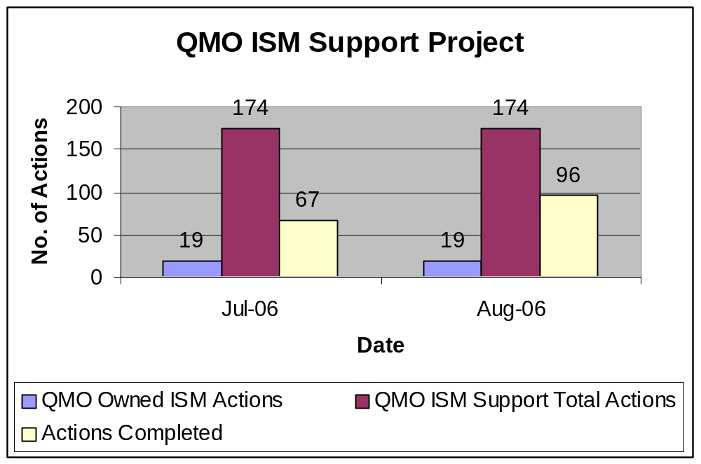
5.7 OSH Targets & Objectives - QMO

Slide 54
5.7 OSH Targets & Objectives - QMO
Objective: Technical Leadership, support for OHSAS Phase III
  Staff have done the following:
    Participated in implementation meetings
    Facilitated meetings with QMO staff to develop JRAs and FRAs
    Member on internal assessment of Life Sciences

Slide 55
5.7 OSH Targets & Objectives –QMO
Project Engineers participate in 3 Tier I inspections
  No participation to date

Slide 56
5.7 OSH Targets & Objectives - RCD
  5.5 OSH EMS improvements, etc.
    5.5.1 RCD had the following targets in FY06:
      Start a comprehensive “task analysis” for each titled position in RCD to drive improvement in job risk analyses and the Divisional Training Program (started)
      Disposition and waste accountable nuclear materials that are excess to the laboratory’s programmatic and strategic needs
      Author and publish a technical basis on hard-to-detect radionuclides in use at BNL and how they are monitored/controlled in the BNL Radiological Protection Program (done)
      Improve the use of Lessons Learned in RWP development
      Improve RCD’s process for verification of effectiveness of prior corrective actions
    5.5.2 N/A
    5.5.3 RCD had the following initiatives:
      Complete FRAs, JRAs Hazards List (done)
      Attain an injury-free year (no recordable injuries as of 9/14/06). Performance is improved over FY05 (one DART case due to an ergonomic stress). Past corrective action of providing ergonomic awareness training for field environments encountered by RCTs may be helping.
      Review and document decision for use of specific types of PPE at BGRR/HFBR (done)

Slide 57
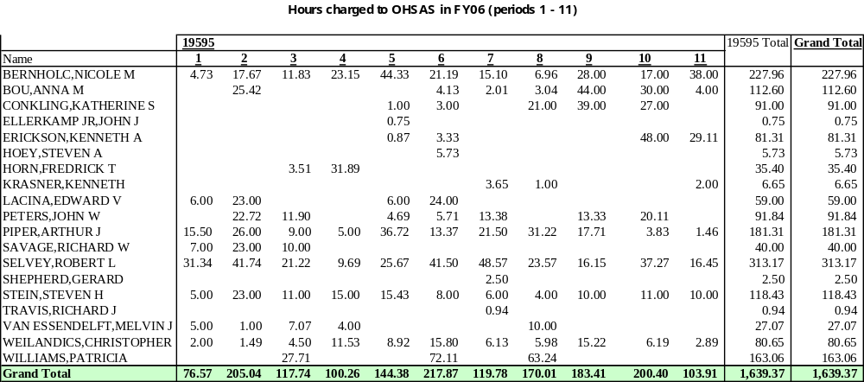
Breakout by person and period for OHSAS Charges through August 2006

Slide 58
5.8 OSH Resources/Cost - EWMS
Triennial review for EWMS JRAs
  ~120 person-hours ~$12,000
EWMS OSH and EMS System Maintenance ~400 person-hours ~$40,000
EWMS OSH and EMS related training ~350 person-hours ~$35,000

Slide 59
5.8 OSH Costs/Resources - QMO
Contributed resources for the OHSAS 18001 Phase 3 Registration Effort
5 JRAs
  Approx. 100 person-hours (managers, safety professionals and workers)
1 FRAs
  Approx. 20 person-hours
Training
  Approx. 25 person-hours
~$X,000
~$10,000
~$2,000
~$2,500
Total $XX K

Slide 60
5.8 OSH Costs/Resources - QMO RCD
Costs review (estimate is 0.5 FTE of contributed resources in FY06 from RCD)

Slide 61
5.8 OSH Costs/Resources - QMO - SHS
OSH and EMS management system maintenance and/or implementation costs
  SHSD cost for Phase 3 program for SHSD: 1250 hours + 50 hours balance= 1300 hours ($91,000 burdened)
  SHSD cost for Phase 3 Project Administration: 313 hours ($28,00 burdened)
  SHSD costs for EMS maintenance: 20 hours ($1600 burdened)
Costs associated with injuries/illnesses: none
Costs associated with cleanup of none
Costs associated with pollution prevention and safety improvement initiatives
Fines/violations none
Monitoring costs
  none for monitoring on the SHSD program;
  IH Group supports the cost of all site employee exposure monitoring which in 2006 equals $5000 from EMSL and the contributed cost from insurance carrier Liberty Mutual equivalent to an additional $35,000 Total = $40,000 in analysis cost.
  Technician and Professional time covered in the overhead= equal to an estimated 2000 hours ($140,000 burdened).
  Total cost of monitoring = $180,000
Specialized support (Du Pont consultants, ECRs, etc.)
  No services used by SHSD except $20 hours of RCD Technician for lab hood surveillance. ECR cost accounted in overhead.
  SHSD provided BNL line organizations with 10,000 hours of S&H consulting = $700,000 (burdened)
Lab-wide initiatives
  S2: $12,000 (46 entries were received)
  S3: $525
  OHSAS 18001: 1639 hours + balance of year 200 hours= 1800 hours ($124,000 burdened)

Slide 62
Management
OSH Program Evaluation
Is the OSH Program effective in achieving
OSH policy commitments?
the objectives & performance measures?
Are Objectives, Measures & Plans suitable in terms of:
OSH Impacts & Conditions?
Concerns of Stakeholders?
Current and Future Regulations?
Business Interests, Technological Capability?
Organizational or Process changes?
Should additional internal performance measures be established?
Is the OSH Program adequate in terms of:
Identifying Significant Aspects and Impacts?
Resource Allocation?
Information System?
Staff Expertise?
Procedural Requirements?
Recommended Revisions to:
OSH Policy & Commitments?
Objectives & Performance Measures?
Elements of OSH?

Slide 63
5.9 ESH&Q Management Questions - SHS
Senior managers must answer the following questions for the purpose of identifying improvement actions and assigning responsibility and resources.
  Are the occupational safety and health and environmental management systems effective in achieving policy commitments?
SHSD Industrial Hygiene programs are documented in SBMS Subject Areas. All are complete and mature by at least 2 years. All are current on their review cycle. No major issues on implementation have been raised by line organizations. The site level programs have been assessed internally and externally and only minor revisions are typically indicated. 5 Subject Areas were revised in 2006 to better define IH Exposure Monitoring requirements. [Effective]
SHSD Safety Engineering programs are partially documented in SBMS Subject Areas with the remainder in legacy ESH Standards. The remaining ESH standards are in the process of conversion to SBMS all will be completed by the end of CY2007. [Ineffective, but with completion in view]
OHSAS 18001 subject areas are interim and need to be revised by the close of CY2006 or early 2007. It may be prudent to merge key program element SA with the EMS 14001 documentation. Personnel to direct this conversion are not named and staffing free for this effort may be a problem within SHSD. [Effective, but a path to needed effort]
Worker S&H, Facility S&H, ISM, EMS, and OHSAS Program descriptions are not merged into a coherent single document, so much redundancy exists and occasional conflicts exist. [Effective, but not maximized]
If yes, record the decision; if no, record recommendations.

Slide 64
5.9.2 ESH&Q Management Questions - SHS
Are the occupational safety and health and environmental management systems effective in achieving the objectives, targets and performance measures?
  BHSO has noted insufficient staffing in SHSD to achieve the level of performance they expect- including IH monitoring baseline, electrical safety, material handling, and OSHA compliance. [Ineffective]
  If yes, record the decision; if no, record recommendations.
    An ADS has been submitted for IH monitoring and program administrators.
    An effective pathway for requesting additional Safety Engineering support is not formalized.

Slide 65
5.9.3 ESH&Q Management Questions - SHS
Are the occupational safety and health and environmental management systems adequate in terms of:
  Identifying significant aspects, hazards and impacts? With the development of Safety & Health Representatives deployed to line organizations, recognition and evaluation of IH hazards has greatly improved.
  Resource allocation?
  Deploying the IH Program administrator to the role of Safety & Health Representatives has left SHSD with 16 IH Subject areas under the program administration of 0.4 FTE. With the registration of OHSAS Phase 3, this will increase to 0.6 FTE, but that is not adequate for the need. [Concern}
  The ratio of SME to Subject Areas in Safety Engineering is 1 SME for 6 Subject Areas, and that too is insufficient. [Concern]
  Adequate funding for instrumentation and sample analysis has been achieved for 2 years in a row with the use of Liberty Mutual at the chemical analysis laboratory.
  Information systems? No staffing is available for IH exposure monitoring data entry, thus requiring professional IH to do data entry tasks.
  Organizational issues – staff expertise; procedural requirements? SHSD staff expertise on IH issues is recognized with high marks on external assessments and the IH Group’s procedures have received excellent comments in external assessment and on the NIOSH web site. SHSD Safety Engineering staffing is not adequate for the needs
If yes, record the decision; if no, record recommendations.

Slide 66
5.9.4 ESH&Q Management Questions -SHS
Are the objectives, targets and performance measures for these management systems suitable in terms of:
  Injuries /illnesses and environmental impacts?
  Concerns of stakeholders? The objective for IH monitoring directly addressed the BHSO concern and ISM and 10CFR851 requirements.
  Current and future regulatory requirements? The objective for IH monitoring directly addressed the BHSO concern and ISM and 10CFR851 requirements.
  Business interests; technological capability?
  Internal organizational or process changes?
  Should additional objectives, targets or performance measures be established?
  If yes, record the decision; if no, record recommendations.
  Site level objectives were vetted for these criteria: see...\..\OHSAS 18001 Site HP80_7\Objectives_Targets\FY06\site Objectives\FY06 Vetting of OSH Objectives per Clause 4.doc

Slide 67
5.9.5 ESH&Q Management Questions - SHS
Recommended revisions to:
  ESSH policy and commitments? none
  Objectives, Targets and Performance Measures? FY07 OSH Objectives have been drafted and a team of OSH Reps and ESH Coordinators met to review and revise them. This group is satisfied with the Objectives.
  Occupational safety and health or environmental related management systems?
  Worker S&H, Facility S&H, ISM, EMS, and OHSAS Program descriptions are not merged into a coherent single document, so much redundancy exists and occasional conflicts exist. Most ESH Coordinators, SMEs, and MS Owners believe there are too many MS, and combining and streamlining would be beneficial.
If yes, record the decision; if no, record recommendations.

Slide 68
Nonconformance Reports and Corrective Actions
Price-Anderson Amendments Act (PAAA) Noncompliance
  Institutional controls are less than adequate to ensure that lab-wide procedures (Subject Areas) and line organization internal procedures remain current and consistent
  Corrective/Preventive Actions taken:
    Internal Control Documents and SBMS Documents and Subject Areas were revised to require a review documents, using a graded approach based on the environmental, safety, health and programmatic impact, at a frequency not to exceed five (5) years
Material Handling
  Facilitated causal analysis of ORPS SC-BHSO -BNL-2006-0011 at Supply and Materiel – equipment falls off truck tailgate
  Facilitated causal analysis of ORPS SC-BHSO -PE-2006-0004 at Plant Eng. – aerial lift falls off forklift

Slide 69
Effects of Foreseeable Changes to Legislation
DOE Order 414.1C, “Quality Assurance”
  Safety Software - DOE promulgated safety software requirements to control or eliminate the hazards and associated postulated accidents posed by nuclear operations, including radiological operations. Safety software failures or unintended output can lead to undue risks to the the public and the workers.

