Slide 1
Surviving an SQA Audit
William E. Dyer, Jr.
Technologies Management Office Authoring Staff

Slide 2
Preview of Coming Attractions
Review of “Text Book SQA”
“Experience is the best teacher”
Some lessons learned from the American Time Use Survey (ATUS) CMM pilot project Software Quality Assurance Audit

Slide 3
Text Book SQA
SQA Expert Level
  What is software quality assurance (SQA)?
  Entry criteria/inputs
  Exit criteria/outputs
  Roles
  References
  Tasks
  Measures
  Very brief summary of SQA

Slide 4
What Is Software Quality Assurance (SQA)?
SQA provides visibility to management that the software products and processes in the project life cycle conform to the specified requirements and established plans.
    Entry Criteria/Inputs
    Exit Criteria/Outputs
    Roles
    References
    Tasks
    Measures

Slide 5
Entry Criteria / Inputs
Project requirements, standards, organizational standards / processes, specifications
Commitment to SQA Policy
Project software quality goals
Adequate resources committed to SQA

Slide 6
Exit Criteria / Outputs
Documented SQA Plans and procedures
Trained SQA practitioners
Results of reviews, product evaluations, and process audits
Reports of problems or nonconformance on both products and processes
Metrics of project and process status

Slide 7
Roles
Project Manager (PM) or other authority above software development organization: appoints and oversees SQA organization
SQA Manager (SQAM), if appointed: leads SQA group
SQA Group: team of individual SQA practitioners who implement this process
Senior Management: periodically reviews SQA activities and resolves nonconformance issues when necessary

Slide 8
References
Census SQA Policy
SQA Process, under SQA KPA
SQA Plan Template, under SQA KPA
IEEE/EIA 12207.0, Software Life Cycle Processes, Quality Assurance Process
Capability Maturity Model for Software (SW-CMM)
IEEE Std 1028, IEEE Standard for Software Reviews and Audits

Slide 9
Tasks
Establish SQA organization
Select SQA tasks
Create/Maintain SQA Plan
Implement SQA Plan
Create/Maintain SQA Procedures
Identify SQA Training
Identify/Select SQA Tools
Improve Project SQA Processes
Link to Task Appendix

Slide 10
Measures
Effort and funds expended for each activity
Number of SQA reviews and audits conducted (planned vs. actual)
Number of unresolved issues (elevated to PM) compared to all issues reported

Slide 11
A very brief summary of SQA activities
Garner the authority for SQA
Formulate a plan in accordance with corporate goals, CMM and IEEE standards and project software quality initiatives.
Identify the role of an SQA auditor and the tasks to be fulfilled by the service.
Report metrics

Slide 12
Entry Level SQA
As the software configuration manager for the American Time Use Survey, a CMM pilot project I was required to participate (fortunate to be involved) in the SQA audit process.
Following are some of the lessons learned from the experience.

Slide 13
SQA - Another Great Adventure …
Digging for artifacts ( la Indiana Jones)
Use the latest technology
Paper is unavoidable (Laura Croft finds a map)
A monster guards the prize (no teeth in SQA)
The entire crew shares the treasure as in:
Pirates of the Caribbean,
“Curse of the Black Pearl”
Let’s talk process improvement …

Slide 14

Digging for Artifacts
When I started gathering
Documents for the ATUS
SQA audit I did not know
what an artifact was. I
learned quickly, though, most
any schedule, memo, plan,
document, program, change request, risk assessment, directory, software archive, paper copy, electronic media, database or other communication related to the project may be reviewed.
My advice is to use SQA and audits as a tool to improve your process not because you are required to for a CMM KPA.

Slide 15
All the Latest Technology
The Census Bureau process improvement initiative is supported enterprise wide.
We have the latest technology for promoting SQA including but not limited to:
Network resources (Lotus Notes +)
Project Management Repository (PMR)
Corporate Metadata Repository (CMR)
Survey Documentation tools (SUDDS)
Hardware, software and training

Slide 16

Tomb Raiders Have Maps!
The SQA Audit for ATUS was quite a learning experience in “what not to do.”
As one of the pilot projects for CMM at the Census Bureau We were thrust into the SQA arena with little planning or forethought. We did well considering
many of our documents and procedures were developed
from scratch specifically for the CMM pilot.
Had I known then what I know now, we would have drawn
a map at the beginning of the project. So we would know
what to expect when it came time for the SQA Audit.

Slide 17
Preferred SQA Scenario
Limit the scope of the SQA Audit.
Have SDP and other process documents in place before beginning the project.
Do not make promises you can not keep.
Keep organized records and plan ahead for the SQA audit.
Learn what the task really involves before you start.

Slide 18

A Monster Guards the Prize …
(yet SQA has no teeth)
What’s this? A binary large object?
A monster with no teeth? A growing and unstoppable bureaucracy? New fad? Senior Management? Something to be feared or not?
An SQA audit is not like dealing with the IRS; there is no penalty for being late, for making mistakes or poor performance. SQA is an opportunity for growth and a chance to apply process improvement to your projects.

Slide 19
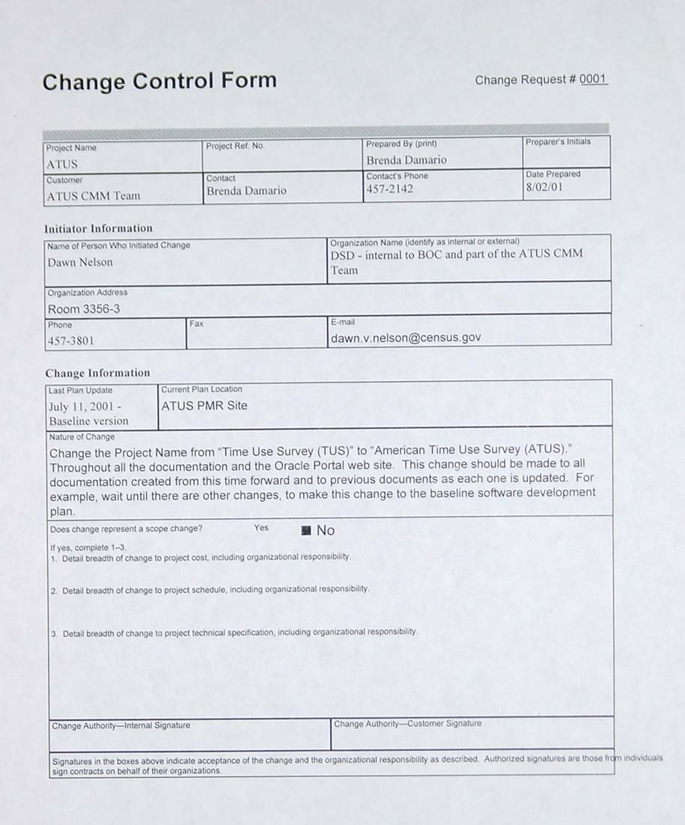
Typical Change Control Form
Change control forms are used to initiate requests for modifications of all sorts.
Changes to specifications, corrections to the instrument or even to resolve discrepancies in plans vs. implementation uncovered during an SQA Audit.
Notes:
This request was made to change the name of the survey from TUS to ATUS the “American Time Use Survey.”

Slide 20

The Crew Shares the Treasure
SQA is like the movie:
Pirates of the Caribbean, “Curse of the Black Pearl”
We all share in the benefits of process improvement, through performing activities like Software Quality Assurance Audits, or suffer the curse together.

Slide 21
Process Task 1
Establish an SQA organization
The PM appoints an individual or group responsible for SQA.
SQA must have organizational freedom, authority, and independence of the software development activities to permit objective reporting.
Return to Task

Slide 22
Process Task 2a
Select SQA tasks
The SQA Group selects the tasks that will be performed, such as those listed below:
Reviewing software products, tools, and facilities against requirements and guidelines.
Auditing software processes for compliance with standards, and with KPAs of the SW-CMM. Example process evaluation and KPA verification tasks are part of the SQA process.
Participating in Peer Reviews and Project Reviews (technical and management reviews) by providing status on compliance, problem areas, and risks.
Return to Task

Slide 23
Process Task 2b
Select SQA tasks (cont.)
The SQA Group selects the tasks that will be performed, such as those listed below:
Suggesting methods, standards, guidelines, and tools to be defined for the project and seeing that they are documented in the SDP.
Reporting results of product evaluations and process audits to the PM, senior management, affected development groups, and the Software Engineering Process Group (SEPG) as appropriate.
Collecting and reporting metrics on the status of cost and schedule, product evaluations, project quality, and audits.
Return to Task

Slide 24
Process Task 3a
Create/Maintain SQA Plan
The SQA Group documents SQA plans in the Software Development Plan or in an SQA Plan.
Consider:
· Quality objectives, in measurable terms
· Types of test and verification and validation (V&V) activities
· Entry and exit criteria for development phases
· Responsibilities of the SQA group
· Resource requirements for the SQA group
· Schedule and funding of SQA activities (Task 3b)
Return to Task

Slide 25
Process Task 3b
Create/Maintain SQA Plan (continued)
SQA participation in project plans, standards, and procedures
• Evaluations to be performed by SQA
• Audits and reviews to be conducted by SQA
• Standards and procedures used for SQA
• Documenting and tracking noncompliance issues, and the
escalation procedure
• Documentation that SQA is to produce
• Method, audience, and frequency of providing feedback on SQA
activities
Return to Task

Slide 26
Process Task 4
Implement the SQA Plan
The SQA Group performs the SQA function as defined in the SQA Plan.
Problems or nonconformance with requirements are documented and reported to the PM or appropriate authority.
Senior management addresses noncompliance issues that cannot be resolved within the project.
Return to Task

Slide 27
Process Task 5
Create/Maintain SQA procedures
The SQA Group documents and maintains the procedures that describe the details of how SQA is performed.
Return to Task

Slide 28
Process Task 6
Identify SQA Training
The SQA Group identifies training required to perform SQA tasks, based on project requirements.
Training includes training of the SQA Group and SQA orientation for the software project team members.
Return to Task

Slide 29
Process Task 7
Identify/Select SQA Tools
The SQA Group identifies tools required to perform SQA tasks, based on project requirements.
Return to Task

Slide 30
Process Task 8
Improve Project SQA Processes
The SQA Group reviews SQA processes and identifies improvements and efficiencies for future use.
SQA activities are reviewed with the PM and with senior management on a periodic and event-driven basis.
Submit suggestions for improvement of this process to SEPG using Document Change Requests.
Return to Task

