Slide 1
Integrated Systems Health Engineering
and Management (ISHEM) in Aerospace Forum
November 7-10, 2005
- NASA Quality Assurance Policy -
Brian K. Hughitt
Manager of Quality Assurance
Office of Safety and Mission Assurance
National Aeronautics and Space Administration

Slide 2
NASA missions cannot succeed
if requirements are not complied with

Slide 3
NASA personnel are not safe
if requirements are not complied with

Slide 4
Quality Assurance:
Discipline to ensure that
requirements are complied with

Slide 5
NASA Quality Policy
Risk Based:
- Designed and implemented to mitigate risk associated with noncompliance
Risk = Likelihood and consequences of non-compliance,
including the maturity, complexity, criticality, importance and
cost of work performed, as well as past quality performance
- Attain confidence levels commensurate with severity of
consequences incurred due to noncompliance
- 100% verification of critical product attributes
Critical = Material characteristics, operating conditions or
functional performance criteria that if not met can
result in loss of life, serious injury, or loss of mission
- Continual re-evaluation and adjustment due to changes to risk factors

Slide 6
NASA Quality Policy
Proactive:
Pre-work assurance measures that provide increased confidence for the meeting of prescribed requirements
- Pre-Award/Post-Award Surveys
- Document Control
- Training
- Workmanship Qualification Standards
- Supplier Outreach and Process Control Assurance

Slide 7
NASA Quality Policy
Continual improvement:
Achieve continual improvement through advocacy; awareness training; teaming and sharing of quality assurance tools, techniques and data; integration of quality assurance processes to prevent duplication of effort; and dissemination/implementation of lessons learned and best practices
- NASA Quality Leadership Forum (QLF)
- NASA Joint Audit Planning Committee (JAPC)
- Americas Aerospace Quality Group (AAQG)
- International Aerospace Quality Group (IAQG)
- Conference on Quality in the Space and
Defense Industries (CQSDI)
- Registrar Management Committee (RMC)
- Nadcap Special Process Accreditation

Slide 8
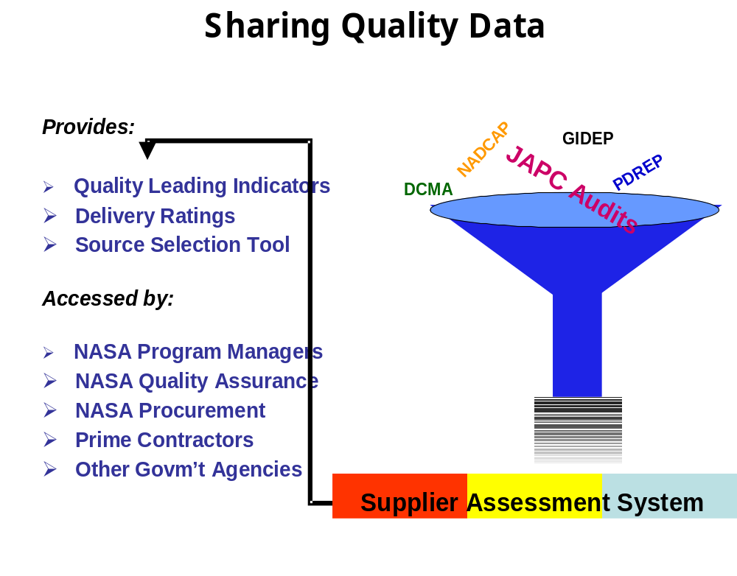
NASA
Air Force
NRO
Army
FAA
MDA
NAVSEA
NAVAIR

Slide 9
NASA Quality Policy
Flow Down
Flow applicable quality assurance requirements down to successive levels of the supply chain to ensure control of subtier suppliers and verification of safety/mission critical attributes at all levels of the supply chain

Slide 10
NASA Quality Policy
Recurrence Control
Provide for investigative and corrective actions upon discovery or notification of noncompliance
- Investigative actions shall identify the proximate and root cause(s) of noncompliance and the scope/population of noncompliant items
- Corrective actions shall include the correction, replacement, repair, or authorized disposition of noncompliant items/conditions, implementation of preventive measures to eliminate the causes of noncompliance, and validation that implemented preventive measures have effectively eliminated recurrence of the noncompliant condition

Slide 11
NASA Quality Policy
Communication
Ensure clear and mutual understanding of prescribed quality requirements among organizations responsible for contracting or assigning work, performing work, and assuring conformity of work

Slide 12
NASA Quality Policy
Competency
Be performed by persons that are competent on the basis of:
- Demonstrated knowledge, skills, and experience related to quality assurance principles and practices, and related to the specific product, process, or attribute for which assurance is being provided
- Meeting formal certification or qualification requirements where prescribed in required/invoked documents or where deemed necessary to ensure personnel competency to perform specialized quality assurance functions

Slide 13
NASA Quality Policy
Independence
Be performed by persons that are not assigned direct responsibility for ensuring that cost or schedule objectives are met

Slide 14
NASA Quality Policy
Quality Data Analysis
Include the collection and analysis of quality data for the purpose of identifying and initiating resolution of problem areas (e.g., projects, products, processes, operations, organizations), common deficiency causes, nonconformance trends, defect anomalies, and process variations

Slide 15
NASA Quality Policy
Objective Quality Evidence
Be supported by records demonstrating compliance with technical/quality requirements. Records shall be legible, traceable to the applicable product, identifiable to the applicable requirement, and readily retrievable for requirement verification

Slide 16
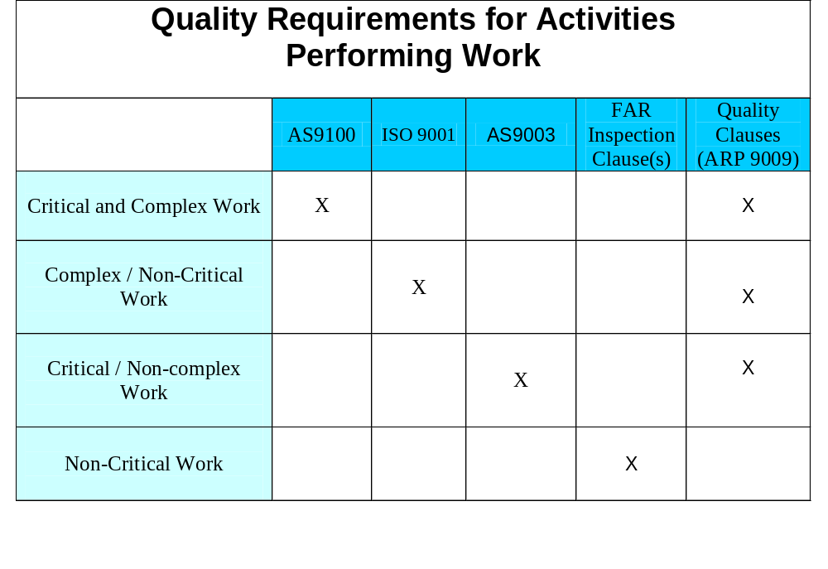
NASA Quality Policy
Quality System

Slide 17
NASA Quality Policy
Roadmap
1. Establish Requirements
2. Assure Compliance with Requirements
(Technical and Quality)
2.A Organization 2.B Customer
Performing Work (Contracting Agent)
Quality System Requirements Quality Program Elements
2.A.1 Prevention 2.A.2 Detection/ 2.B.1 Prevention 2.B.2 Detection/
Correction Correction

Slide 18
NASA Quality Policy
Government Quality Assurance
        Contract Review
        Pre-award Survey
        Document Review
        Product Assurance
        Quality System Audit
        Quality Data Evaluation
        Final Product Acceptance
        Nonconformance Reporting and
        Corrective/Preventive Action
\

Slide 19
Back-Up Slides

Slide 20
NASA Quality Policy
Critical
Loss of Life
Serious personnel injury
Loss of Mission
Loss of Significant Mission Resource
Complex
Manufacture,
Fabrication,
Assembly,
Testing, or
Integration
of
Machinery,
Equipment, or
Sub-systems

Slide 21
NASA Quality Policy
AS9100 Quality System
Quality Management System
Documentation Requirements
- Quality Manual
- Control of Documents
- Control of Records
Configuration Management
Management Responsibility
Management Commitment
Customer Focus
Quality Policy
Planning
Responsibility, Authority
and Communication
Management Review
Resource Management
Provision of Resources
Human Resources
Infrastructure
Work Environment
Product Realization
Planning of Product Realization
Customer Related Processes
Design and Development
Purchasing
- Purchasing Information
- Verification of Purchased Product
Production and Service Provision
- Identification and Traceability
Control of Monitoring & Measuring Devices
Measurement, Analysis and Improvement
Monitoring and Measurement
- Internal Audit
- Processes
- Product
Control of Nonconforming Product
Analysis of Data
Improvement
- Corrective Action
- Preventive Action

Slide 22
- Quality Roadmap -
AS9003 Inspection and Test Quality System
Management Responsibility
Quality System
Contract Review
Design Control
Document and Data Control
Purchasing
Control of Customer Supplied Product
Product Identification and Traceability
Process Control
Inspection and Testing
Control of Nonconforming Product
Corrective Action
Handling, Storage, Packaging, Preservation and Delivery
Control of Quality Records
Internal Quality Assessment
Training
Servicing
Statistical Techniques

Slide 23
NASA Quality Policy
Quality Contract Clauses
Quality System
Material Identification, Damage, Count
Right of Access
Flow Down Requirements
Certificate of Compliance (C of C)
Certificate of Compliance Raw Material
Certificate of Compliance - Calibration
Special Process Certification
Calibration System
Configuration Management System
Change Authority
Critical Processes
Government Source Inspection (GSI)
Contractor Source Inspection (CSI)
First Article Inspection
Nondestructive Inspection (NDI) /
Nondestructive Test (NDT) Certification
100% Attribute Clauses
Limited Operating Life Items
Limited Life and Age Control (Shelf
Life)
Packaging Requirements
Packaging Handling & Labeling
Shipping Documents
Nonconformance Reporting
GIDEP
Record Retention
Electrical Wire and Cable Test Report
EEE parts Date of Manufacture
EEE Single Lot / Date Code
Electrostatic Discharge (ESD)
Protection Program
High-Strength Fasteners
Pressure Vessels
Solvent Containers

Slide 24
- Quality Roadmap -
Contract Quality Clause Examples
Certificate of compliance- Raw materials
“Organization will include with each shipment the raw material manufacturer's test report (e.g., mill test report) that states that the lot of material furnished has been tested, inspected, and found to be in compliance with the applicable material specifications. The test report will list the specifications, including revision numbers or letters, to which the material has been tested and/or inspected and the identification of the material lot to which it applies. When the material specification requires quantitative limits for chemical, mechanical, or physical properties, the test report will contain the actual test …
Calibration System
“The organization shall have a documented calibration system that meets the requirements of ISO 10012, “Quality assurance requirements for measuring equipment”, or the “American National Standard Institute (ANSI)/National Conference of Standards Laboratories (NCSL) Z540-1, General Requirements for Calibration Laboratories and Measuring and Test Equipment”.

Slide 25
Code of Federal Regulations: Part 287–
Guidance on Federal Conformity Assessment
“Each agency should coordinate its conformity assessment activities with those of other appropriate government agencies and with those of the private sector to reduce unnecessary duplication.”

Slide 26
- Quality Roadmap -
FAR Inspection Clause
“The Contractor shall maintain an inspection system acceptable to the Government covering supplies under this contract and shall tender to the Government for acceptance only supplies that have been inspected in accordance with the inspection system and have been found by the Contractor to be in conformity with contract requirements.”

Slide 27
Government QA Program Elements
Contract Review
Assurance that contracts contain necessary/appropriate quality requirements and clauses based on the criticality, complexity, maturity and cost of the product supplied, and based on organization quality history.
Pre-award Survey
Assessment of organization’s quality system and capability to comply with contract requirements, including review/acceptance of organization’s documented quality manual and associated quality system procedures. Performed prior to contact award for new organizations and organizations with poor quality history.
Document Review
Verification that quality system procedures and technical data/drawings are properly documented and compliant with contract requirements. Performed on a periodic basis and whenever substantive changes are made. Selection of documents based on criticality, complexity, and cost of product supplied; criticality of process/attribute documented by procedure/data/drawing; and quality history.
Product Assurance
  Physical examination, measurement, and non-destructive testing of products; witnessing of manufacturing, fabrication, assembly, integration, and test processes; and review of recorded data for conformance to requirements. Selection, sample size, and frequency based on the criticality, complexity, maturity, and cost of product supplied, and quality history.
  Government Mandatory Inspection Points:
Quality System Audit
Review of organization’s quality system to validate compliance with invoked quality program requirements, including internally developed procedures and operating instructions. The quality system audit may be conducted as a single audit or as a combination of audits. For AS 9100 invoked quality systems, the review shall be performed at least annually. For AS 9003 quality systems, the review shall be performed no less than once every three years. The following quality system elements must be reviewed, as a minimum.
  a. Personnel training, qualifications, and competence
  b. Purchasing
i. Supplier evaluation/selection
ii Purchasing information and flow-down of technical/quality requirements
iii Verification of Purchased Product
c. Quality Management System Documentation and Control of Documents
d. Preservation of Product, and foreign object prevention, detection, and removal
e. Calibration and Control of Monitoring, Measuring and Test Devices
f. Product Identification, Traceability, and Identification of Inspection/Test Status
g. Control of Nonconforming Product
h. Monitoring and Measurement
i. Internal Audit/Assessment
ii. Monitoring and Measurement of Processes
iii. Monitoring and Measurement of Product (Inspection and Testing)
i. Data Analysis
j. Nonconformance Reporting and Corrective Action
k. Configuration Management/Control
l. Design and Development Control
m. Production Control and Process Control

Slide 28
Government QA Program Elements
Nonconformance Reporting and Corrective/Preventive Action
Documentation of customer identified technical and quality system non-conformances, and assurance of effective corrective/preventive action . Corrective action requests shall be elevated to the appropriate level of management based on problem criticality, recurrence, or non-responsiveness. As appropriate, based on the nature/criticality of the nonconformance, corrective action requests shall require identification of the root cause(s) of the nonconformity, scope of the nonconformity, remedial corrective actions concerning the product(s) found to be nonconforming, and long term preventive measures. As deemed necessary, based on the severity and history of the nonconformity, customer follow-up shall be performed to ensure effective accomplishment of corrective/preventive action.
Quality Data Evaluation
The collection, evaluation, and use of quality data to identify problem areas, trends, defect anomalies, process variations and process capabilities. Sources of data include organization generated metrics, customer identified non-conformities, and quality data reported by customer delegated representatives, or Government agencies. Data shall be evaluated at established periodic intervals for the purpose of:
  Adjusting the frequency and content of customer oversight actions, including allocation of quality assurance personnel resources
  Providing a basis for acceptance/rejection of the organization’s quality system and written procedures
  Notifying contracting/purchasing offices of significant quality problems
  Providing a basis for understanding or recommending improvements to critical processes and materials that cannot be verified by inspection or test
  Notifying the organization of problem areas and trends identified
Subcontracted Work
Customer source inspection of subcontracted work shall be performed as necessary to ensure that the organization maintains effective oversight of subcontractors, or where performance of mandatory inspection points at the subcontractor’s facility is deemed in the customer’s interest.
Government inspection of subcontracted supplies or services shall be performed for Government Mandatory Inspection Points:
  That can only be performed at the subcontractor’s location
  Where performance at a later point in time or at any other location would require uneconomical disassembly, destructive testing, or special required instruments/gauges/facilities only available at the subcontractor location
  Where performance at any other location would destroy or require the replacement of costly special packaging
  Where considerable cost to the Government or unacceptable delay in schedule would result from downstream identification of non-compliant products
Final Product Acceptance
Formal acceptance of delivered product based on:
  Final product inspection
  Validation that there are no outstanding corrective actions resulting from customer or organization identified nonconformances that affect acceptability of product
  Validation that there are no outstanding engineering departures impacting acceptability of product, and that all applicable engineering departures have been approved by the proper technical authority
  One-for-one accountability and validation that all GMIPs have been successfully accomplished

Slide 29
NASA QUALITY LEADERSHIP
FORUM (QLF)
MISSION STATEMENT
The Quality Leadership Forum (QLF) is an aerospace forum that meets semiannually for the advancement of quality assurance practices. The principal objectives of the QLF are to:
Integrate quality approaches
Standardize quality practices
Resolve current problems
Improve use of quality resources
Define and analyze quality risks
Communicate lessons learned
Share best practices
Improve quality processes

Slide 30
What is the JAPC?
  Joint Government – Industry Forum
  - Planning, coordinating, integrating supplier audits
  Sharing supplier quality data
  Resolving supplier quality issues
  Sharing best practices/ lessons learned
  Standardizing Auditing Practices
  Developing Agency-Wide Metrics

Slide 31

Supplier Outreach Process Control
Assurance Program
The SOPCA Program GOAL is to…
THANK Supplier’s and their workforce
  Recognize the company and outstanding individuals
  Encourage Suppliers to be proactive
SHARE lessons learned and best practices
  Communicate expectations, successes, program issues
  Receive feedback of Supplier’s perspective
PROVIDE tools, resources and awareness products
  Websites: Quality Suppliers , Quality Leadership Forum
  Training tools: Root Cause Analysis, Continuous Improvement, Audit best practices, process control training videos, etc.
CAPTURE Supplier data to share within the Agency
  NASA Supplier Information Surveys
  Conduct Process Control visits; data used to address issues (if any) in a supportive manner.

Slide 32
NASA Supplier Assessment System (SAS)
  Goal: To provide a tool which will assist NASA Centers and other Government agencies in evaluating the ability of their suppliers to meet specified quality standards.
  Objectives:
  - Provide visibility into leading indicators of supplier quality
- Expand our knowledge base of supplier data and audit results
- Improve communication
- Decrease surveillance costs and enhance the use of Government resources
- Improve supplier relations with fewer audits/assessments
- Increase leverage with suppliers by sharing information across agencies
- Provide access to standardized audit tools

