Slide 1
®
ENVIRONMENTAL
MANAGEMENT SYSTEM (EMS)
Paving the Way for Wider Acceptance
John H. Bridges III, REM, CHMM, CPEA
Environmental Compliance Coordinator
Jbridge4@email.usps.gov
December 3, 2001
Notes:
Thank you, Mr. Chairman. There is great news to share with you about our environmental program.
This morning, I will explain our strategy to realize CustomerPerfect! through environmental management.
I will share some examples how we are implementing this strategy.
And you will see how our environmental program supports our customers, our business, our employees and the communities we serve.

Slide 2
Winning with Principles
EMS improvements boost economic returns and assists to make a significant contribution to the bottom line.
Strategy
Be innovative to create and increase value
Provide operational return on investments
Contribute to overall business, not just environmental impacts
Establish a new environmental management system framework

Slide 3
EMS and Operational Success
Environmental impacts are expected, which forms the need for an EMS. Contributions from an EMS framework can provide a standard for excellence, which:
Drives continual environmental improvements
Reduces environmental impacts based on legal requirements
Provides a business and operational benefits
It’s the right thing to do
Notes:
Let me begin with a question.
Why does the Postal Service have an environmental program?
We are subject to a number of environmental laws and regulations at the federal, state and local levels.
And, there are significant business drivers. We recognize that reducing waste through pollution prevention directly affects our bottom line. Environmental management is really a quality issue.
But the real reason we practice environmental stewardship is because it is the right thing to do.
Our customers and our employees expect it. In fact, they demand it. One recent poll found the environment to be the third most important issue that Americans will face in the 21st century.
Protecting our environment for future generations is important to every American.
And that’s why we are serious about being good, “green” neighbors in every community we serve.

Slide 4
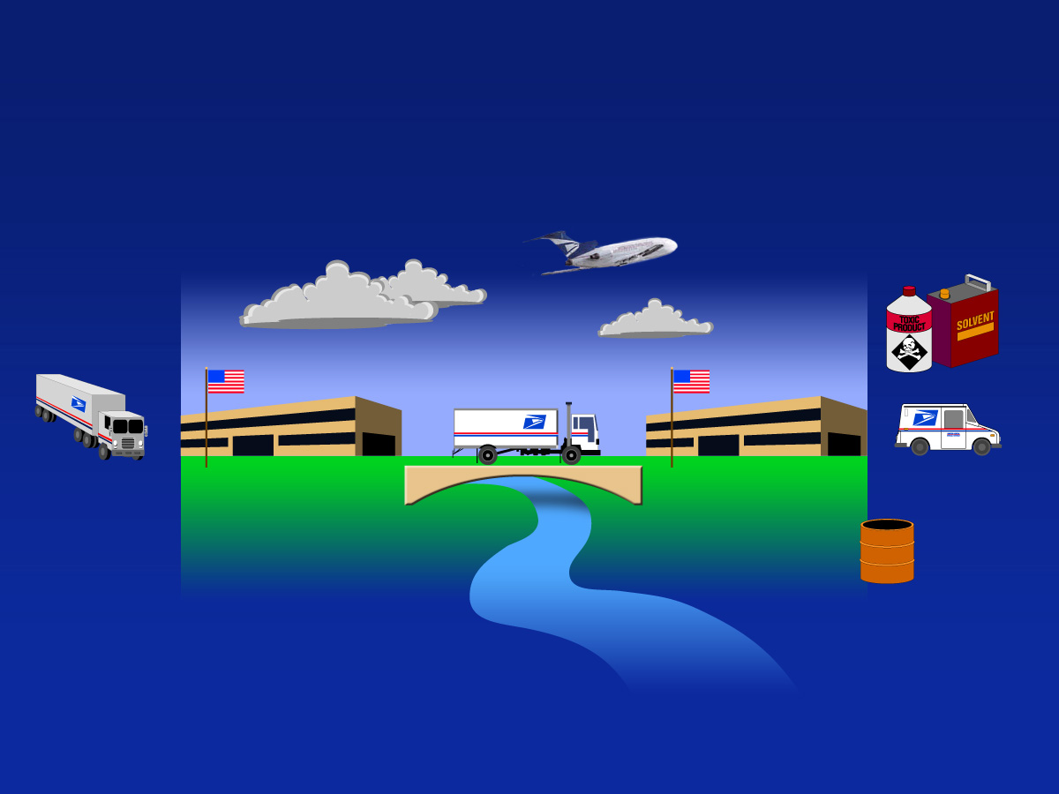
Rethinking the linkage of environment
Clean Air Act
Toxic Substance
Control Act
Environmental
Consciousness
Begins Here
Resource
Conservation
and Recovery
Act (RCRA)
Energy Policy Act
Clean
Water Act

Slide 5

EMS Opportunities
Reduction in training needs
Eliminate redundant inspections
Consistency in operations
Cost savings!
… Focus new energy
on issues of productivity
and cost control
Five-Year
Strategic Plan
FY 2001-2005

Slide 6
Adopt an Integrated Approach
ORG. GOALS
ENVIRONMENTAL
POLICY
ENVIRONMENTAL
ASPECTS
LEGAL & OTHER
REQUIREMENTS
SIGNIFICANT
ASPECTS
COMMUNICATION
DOCUMENTATION
DOCUMENT CONTROL
RECORDS
NONCONFORMANCE
EMS
AUDITS
OBJECTIVES
&
TARGETS
MONITORING
&
MEASUREMENT
MANAGEMENT
PROGRAMS
STRUCTURE TRAINING EMERGENCIES OPERATIONAL CONTROLS
MANAGEMENT
REVIEW

Slide 7







Framework incorporation at all levels
EMS - Focused Planning
Compliance
USPS
Personnel
EPA -
Facilities
Regulatory
OSHA
Strategy
Stewardship
Personnel Health & Safety
Social
Management
Requirements
Program
Spill
BPI
Costs
Response
Metrics
Responsibility
Strategic Planning
Inbound
Logistics
Transportation
Delivery
Bottom line
Suppliers
Processing
Distribution
Service
Operations and Maintenance
Environmental Management System
Overhead Purchasing Transportation Operations
Reductions / Shared Services:
EH&S Function
Integrated Plans
Consolidated Training
Professional Expertise
Reduce Workers Comp / Injuries
Prioritize Performance
Supply Chains:
Product and Risk Management
Materials Management
National Contracts
Strategic Leverage
Intranet / E-Transactions
Integrated Performance
Enterprise Logistics:
Fuel Utilization -- Costs
Partnership Agreements
Vehicle Space Complement
Emission Impacts
Network Profiling
Improve Performance
Customer Services:
Staffing Complement
Enhanced Productivity
Standardized Goals
Financial Metrics, not SPLY
Strategic Plans
Establish Performance
Opportunities
,

Slide 8
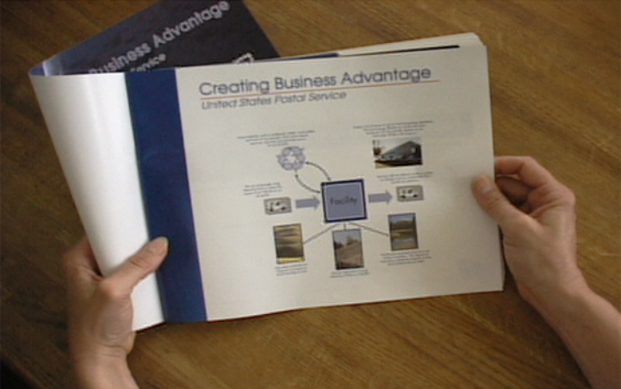
Lessons Learned
Benefits
Environmental Management System
– Key processes are linked and
measurable
– Participation is critical to success
– Shared responsibility
– Reduction in waste
streams, disposal costs
and labor
– Working towards a common goal
Notes:
Once again, our employees are demonstrating that public service and world-class performance can be one and the same.

Slide 9
Managing our EMS through Stewardship
Reflections
Contributions
– Key processes are linked and
measurable
– Participation is critical to success
– $200,000 cost avoidance
– LQG to CESQG Status
– 43 noncompliance findings to 3 minor after EMS
Recyclable/
Reusable Materials
Process,
Product, or
Service
Chemicals/
Raw Materials
Process
Wastes
Notes:
Once again, our employees are demonstrating that public service and world-class performance can be one and the same.

Slide 10
Summary
  By continuing to build on our successes and plan for the future, we will realize a “triple” bottom line that benefits:
  Our environment
  Our Postal business
  Our customers and communities
Notes:
The American people expect environmental stewardship from government and business.
We have explained how we will meet their expectations.
Our environmental initiatives will build upon our successes. And we have a strategy for future progress.
We expect the results to benefit a “triple bottom line.”
That means benefits for our environment, for our business, and for the communities we serve.
Thank you.

