Slide 1
NASA Environmental Management System (EMS) Pilot Test Program
Michael J. Green
Environmental Management Division
NASA Headquarters
Washington, DC

Slide 2
TEST PROGRAM REVIEW
Factors affecting EMS
Initial assessment
EMS development activities
Agency challenges
Cost analysis
Potential benefits
Lessons learned

Slide 3
FACTORS AFFECTING EMS
Size of installations
  Land area - 150 to 80,000 acres
  Population - 1,000 to 10,000 on-site personnel
Complexity of installations
  Laboratories, test stands, wind tunnels, hangars, shops
  Includes tenant organizations and private enterprises
Large contractor work force
  Several GOCO facilities
  About 4 contractor employees per civil service employee
Geographic variability - 10 states

Slide 4
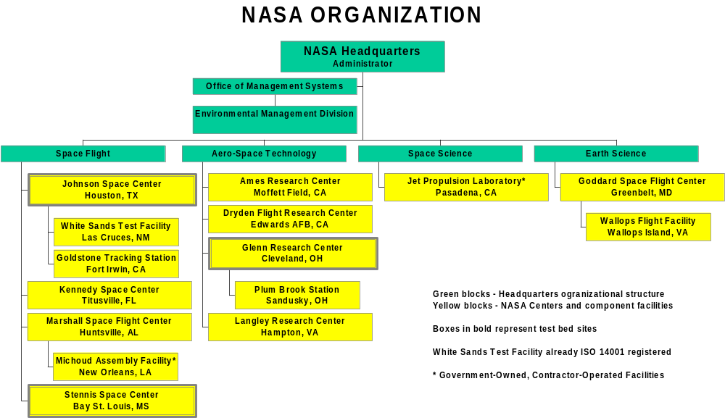

Slide 5
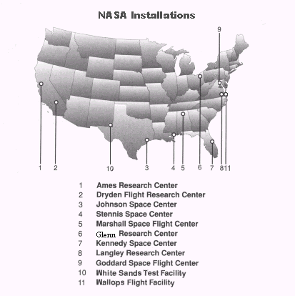

Slide 6
INITIAL ASSESSMENT
Business Case & Gap Analysis conducted in 1998
  Included Headquarters and 12 NASA installations
ISO 14001 recommended as NASA’s EMS model
  NASA was accomplishing 80% of ISO 14001 requirements
  Many elements of ISO 9000 can be utilized (e.g., corrective action, document and records management)
  Existing processes can be utilized (e.g., emergency response)
  Internationally recognized
  Protocols can be used for evaluation & performance tracking
  Allows flexibility
  Contractor acceptability

Slide 7
EMS DEVELOPMENT ACTIVITIES
Development of Agency EMS Procedures Manual
  Developed by NASA team from 5 Centers
  Consistent Agency approach but flexible at implementation level
Implementation at Glenn, Johnson and Stennis
  Test sites provide lessons learned for Agency implementation
  Developed implementation guidance
  Includes independent Verification and Validation
Cost and Benefits Report
  Identify projected costs, benefits, and lessons learned
  Will use data to facilitate Agency-wide implementation
Presentation of results to management

Slide 8
ELEMENTS OF NASA EMS
Environmental Policy
Planning
  Aspects & Impacts
  Legal & Other Requirements
  Objectives & Targets
  Environmental Mgmt Program
Corrective Action
  Monitoring & Measurement
  Nonconformance, Corrective & Preventive Action
  Records
  EMS Audits
Implementation & Operation
  Structure & Responsibility
  Training & Awareness
  Communication
  EMS Documentation
  Document Control
  Operation Control
  Emergency Preparedness & Response
Management Review
Metrics

Slide 9
AGENCY CHALLENGES
Quantifying costs and benefits
Developing EMS metrics
Clarifying HQS & Center roles and responsibilities
Obtaining senior management commitment
Determining how EMS will apply to contractors
Deciding how to implement EMS across Agency
Handling intensive up-front activities with limited staff
Deciding how to apply EMS to new programs
Managing aspects, impacts, objectives & targets
Holding each activity accountable for its aspects & impacts

Slide 10
COST & BENEFITS ANALYSIS
Compare baseline EMS that meets requirements of Executive Order with ISO 14001 compliant EMS
Obtain better understanding of cost and level of effort of implementation
  Develop budget estimates
  Comparison of NASA versus contractor cost and hours
  Training requirements
  Data management requirements
  Time requirements for implementation
Identify potential benefits

Slide 11
BASELINE EMS
EMS implementation planning
Identify priority environmental impacts
Training, awareness & competence
Internal & external communication
Documentation & document control
Corrective action program
Environmental functional reviews
Miscellaneous activities (e.g., regulatory review)

Slide 12
UNIQUE EMS ACTIVITIES FOR
ISO 14001 REGISTRATION
Additional communication & training activities to prepare for registration
Documentation of management review
ISO 14001 Registration process
  Internal EMS audits
  Training of internal auditors
  Preparing for and supporting registration audits
  Registration costs

Slide 13
EMS DEVELOPMENT COSTS
(Includes contractor & gov’t hours)
Business Case & Gap Analysis (13 facilities)
Agency-wide procedures, cost analysis & support
Implementation at 3 sites
  Glenn Research Center
  Johnson Space Center
  Stennis Space Center
$ 300,000
$ 600,000
$ 445,000
$1,450,000
$ 550,000

Slide 14
EMS IMPLEMENTATION COST
Baseline EMS
  Implementation Planning
  Identify impacts & develop management plans
  Training and awareness
  Communication
  Documentation & document control
  EMS auditing & corrective action
  (Does not include compliance audits)
  Miscellaneous
ISO 14001 unique activities
  Communications & unique site requirements
  Registration process (includes site support)
80 %
  12 %
  21 %
  17 %
  8 %
  12 %
  4 %
  6 %
20 %
  10 %
  10 %

Slide 15
IMPLEMENTATION HOURS NORMALLIZED
BY CENTER POPULATION
Glenn 5,243 hr ÷ 4,000 = 1.3 hr per capita
Johnson 17,692 hr ÷10,500 = 1.7 hr per capita
Stennis 10,521 hr÷ 4,500 = 2.3 hr per capita Average = 1.8 hr per capita

Slide 16
IMPLEMENTATION COST NORMALLIZED
BY CENTER POPULATION
Glenn $445K ÷ 4,000 = $111 per capita
Johnson $1,450K ÷10,500 = $138 per capita
Stennis $550K ÷ 4,500 = $122 per capita Average = $129 per capita
Note: Includes cost of data tracking, initial training, and other one time developmental activities

Slide 17
PROJECTED MAINTENANCE
About 1 fte to serve as EMS representative
  Updating documentation
  Continued coordination efforts
About 1 fte equivalent for other activities
  Internal audits
  Follow-up training
  Management reviews

Slide 18
Potential Benefits
    Mission delay reductions
    Change order reductions
    Environmental impact reductions
    Reduced liability
    Increased compliance
    Increased management support and involvement
    Increased pro-activity
    Reduction of single-point failures
    Continual improvement
    Decreased energy use, water use, and materials reductions
    Health benefits
    Decreased # of fines and NOVs
    Decreased employee time (fewer inspections)
    Reduced # of inspections
    Written procedures, process consistency, & repeatability
    Increased efficiency
    Improved communications

Slide 19
Potential Benefits
    Prioritization of funding projects
    Increased # of green building designs
    Increased # of sustainability projects
    Better NASA reputation (Center and Agency)
    Better relationship with stakeholders
    Increased trust and satisfaction from customers
    Increased # of pollution prevention initiatives
    Cost reductions
    Increased safety
    Reduced # of regulations
    Reduced # of spills
    Increased affirmative procurement
    Increased recycling revenue
    Solid waste reduction

Slide 20
LESSONS LEARNED
Early planning & communication critical
  Substantial time required for planning & meetings to achieve support
Senior management involvement critical
  Needs to be more than annual management review
  Involvement needs to be visible
Build on existing procedures & systems
  Establishing document management, recordkeeping, corrective action systems can be significant undertaking
  Requires understanding of systems

Slide 21
LESSONS LEARNED
Cross-organization involvement critical
  Establish core team representing different organizations and points-of-view
  Use the core team to help with buy-in
  Contractor involvement critical
  Work with each organization to establish their responsibilities & management of aspects & impacts
  High visibility program facilitates involvement

Slide 22
LESSONS LEARNED
Develop training/communications program
  Tailor training to situations & individual responsibilities
  Provide core team & key personnel with training early
  Combination of class room, OTJ, and facilitated training
  Keep people informed of progress
  Use existing tools (e.g., newsletters)
  Consider web based techniques
  Consider special promotions
  Training is not a one-time event

Slide 23
LESSONS LEARNED
Flexibility needed due to varied activities
EMS Representative is a key player
  Needs authority to make decisions on EMS implementation
Review results throughout implementation
Keep it simple at working level!
  Normally only 1 or 2 aspects & impacts require management at the working level
  Clarifies individual and organizational responsibilities
  Individual employees find this to be acceptable

Slide 24
POINT-OF-CONTACT
Michael Green
Environmental Management Division
NASA Headquarters (Code JE)
Washington, DC 20546
Phone: (202) 358-1097
e-mail: michael.j.green@hq.nasa.gov

