Slide 1
Auditing an EMS for Conformance with EO 13423

Slide 2
Agenda
Discussion of OFEE Clarification of Conformance Requirements
Discussion of general EMS auditing and requirements of EO 13423
Discussion of general auditing process and tools

Slide 3
Declaration of Conformance
Facilities previously identified under E.O. 13148 as “appropriate facilities” and already underway with implementation as of the date of the E.O., shall ensure their EMS is fully implemented by December, 2008, …
C. Declaration of Conformance
(1) Full implementation. For the purpose of conformance to E.O. 13423, an EMS shall be considered fully implemented when (1) it has been the subject of a formal audit by a qualified party outside the control or scope of the EMS, (2) audit findings have been recognized by the appropriate level of the agency implementing the EMS, and (3) the appropriate senior manager accountable for implementation of the EMS has declared conformance to EMS requirements.

Slide 4
Clarification – January 2008
Reasons for the declaration process
  Credible evidence that EMS is properly implemented
  Someone senior is accountable for the EMS
Formal audit – follows generally accepted practices for EMS audits
  Audit plan, document review, physical audit for conformance to the Standard, consistency within the EMS and evidence of continual improvement, audit report and out-briefing with senior managers

Slide 5
Clarification (cont)
Qualified party: Working knowledge of ISO 14001 and general auditing skills, good to have proper scientific background – team should have appropriate skill set and knowledge – nice to have formal lead auditor training
Outside the control or scope of the EMS: independent and objective – not involved in the development of the EMS or day-to-day implementation

Slide 6
Clarification (cont)
Findings recognized at appropriate level: information on whether the EMS is suitable, adequate and effective has been presented to senior management AND those individuals have followed through on the recommendations – corrective action is defined, planned and endorsed
Appropriate senior manager declared conformance to EMS requirements: a signed statement or letter affirming the EMS has been properly developed and implemented consistent with the goals of EO 13423

Slide 7
Clarification (cont)
Outside audits conducted every three years – declaration renewal up to each agency
The audit is to see if the EMS is working properly and identify opportunities for improvement
The management recognition ensures problems are addressed and improvement is proceeding
The declaration process ensures those declaring have adequate basis for declaration and are accountable for the statement of conformance
“Self declaration” and “first party audit” are no longer part of the federal EMS dialogue

Slide 8
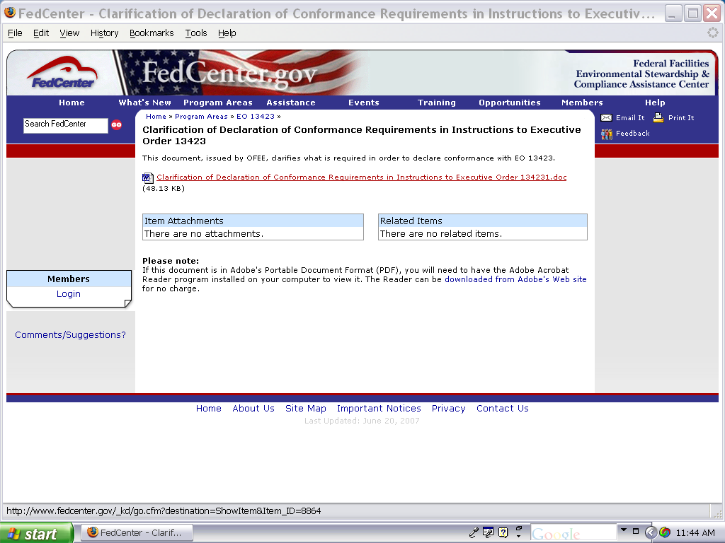
Clarification

Slide 9
Environmental Management System Audit
A systematic and documented verification process of objectively obtaining and evaluating evidence to determine whether an organization’s environmental management system conforms to the environmental management system audit criteria set by the organization, and for communication of the results of this process to management.

Slide 10
What is Required by EO 13423?
EMS shall be reviewed and updated annually or more frequently, as appropriate,
Conformance declaration by 12/08
Once conformance has been declared, the EMS shall then be audited by a qualified party outside of the control or scope of the EMS at least every three years from the date of the initial declaration. Conformance declaration shall be renewed as appropriate based on agency guidance.

Slide 11
EMS Audit
Performed by those with EMS auditing training/experience
Addresses both documentation and implementation of the EMS
Not a performance audit or a compliance audit
  Does the system conform to set criteria?
  Has EMS been properly implemented, maintained – continual improvement?
Provides periodic “snap-shot” assessment to verify system
Provides information to management and organization to allow continual improvement
Goal is to improve the EMS!

Slide 12
Internal vs. External Audits
Internal audits are conducted by participants of the EMS being audited (can be employees, or consultants as agents of the organization).
External audits are conducted by auditors from outside the scope of the EMS in question (but can be from same organization).
External, third party audits are conducted by independent, ISO 14000 registrars.
In all cases, audit should cover same elements!!!!

Slide 13
Audit Criteria
Policies, practices, procedures or requirements against which the auditor compares collected audit evidence about the subject matter.
Requirements may include but are not limited to standards, guidelines, specified organizational requirements, and legislative or regulatory requirements.

Slide 14
Audit Evidence
Verifiable information, records or statements of fact.
Audit evidence, which can be qualitative or quantitative, is used by the auditor to determine whether audit criteria are met.
Audit evidence is typically based on interviews, examination of documents, observation of activities and conditions, existing results of measurements and tests or other means within the scope of the audit.

Slide 15
Audit Findings
Results of the evaluation of the collected audit evidence compared with the agreed audit criteria.
The audit findings provide the basis for the audit report.

Slide 16
Audit Conclusion
Professional judgement or opinion expressed by an auditor about the subject matter of the audit, based on and limited to reasoning the auditor has applied to audit findings.

Slide 17
AUDITING TOOLS AND TECHNIQUES

Slide 18
The Three C’s of Auditing EMS
Conformance
Meets the requirements
(implements the “shalls”)
Consistency
Various elements inter-related
(e.g., significant aspects reflected in emergency planning)
Continual Improvement
Mechanisms in place to improve
(including fixing non-conformances and improving performance)

Slide 19
Basic Rules of Auditing
Be objective - i.e., do not keep an audit going until you find a problem
Be fair and consistent
Stay focused on the criteria
Stay within the scope and plan
Remember, the audit is there to improve the EMS

Slide 20
Audit Planning
Addresses the specifics of who, what, where, when, and how
Identifies auditors
Identifies when the audit(s) will occur
Identifies what format, checklists, etc will be used
Establishes specific agendas
Must align with site procedure for auditing

Slide 21
Audit Approach
Can do either all at one time, or divided up throughout the year.
If divided, it is probably best to audit all EMS elements in various parts of the facility (e.g., motor pool, labs)
Keep in mind the issue of consistency!

Slide 22
Audit Approach (cont.)
Audits typically include:
  Interviews
  Site Reconnaissance
  Records review
In any type of audit, the auditor will compare evidence to criteria, and develop findings

Slide 23
Specific Evidence to Look For
Consistency of identified aspects and observed aspects
How activities match procedures
Employee awareness of relevant EMS elements
Addressing non-conformances through the non-conformance process
Effectiveness and adequacy of the system.
Clear top management commitment

Slide 24
Interview skills
Attitude of the auditor
Purpose of the interview
Types of questions; open, closed, leading, antagonistic, vague
“Tell me about”

Slide 25
Typical Questions of any Employee
1. What does the EMS policy say and what does it mean to you?
2. What is your familiarity with the EMS program?
3. What do you do in case of a procedural
nonconformance?
4. What do you do in case of a emergency?
5. What kind of training have you received?
6. How do you communicate environmental concerns or
ideas?
7. What do you do if you receive environmentally-
related communication from external parties?

Slide 26
Typical Questions of Critical Operations
1. What are the significant aspects and impacts associated with your function?
2. How do you know what to do?
(Ask for procedures and operating criteria).
3. What specific training have you received?
4. What are the objectives and targets associated with your function?
5. What is your responsibility for monitoring and measurement activities?
6. What records do you keep?
7. (Any other specific questions prompted by answers 1-6 and/or specific circumstances?)

Slide 27
Types of Interviewees -
Follow the Significant Aspect
Facility management and management representatives
Department managers
EMP responsible parties
Document control and record departments
Engineering
Operations employees (plant, administration)
Human resources and training
Contractor management and purchasing
Security

Slide 28
What Auditors Look for in Terms of Documentation
Does your documented system respond to the standard?
Do the procedures describe what’s really happening?
Is the documentation controlled?
Are all employees informed?
Are the procedures followed, by everyone, all the time?
Is there objective evidence that the procedures are being followed?

Slide 29
Typical Documents and Records to Review (by Element)
Aspects Procedures
Aspects list
Significant determination information
Significant aspects/impacts list
Legal and Other Requirements
Listings of applicable legal and other requirements
Appropriate instructions for compliance
Permits, manifests, etc.

Slide 30
Objectives and Targets and Environmental Management Programs
Minutes/notes of objectives and target development
List of objectives and targets
Related action plans
Structure and Responsibility
Job descriptions
Organizational charts

Slide 31
Training Awareness and Competence
Training needs listings/matrix
Manuals, course materials
Sign-in sheets
Test records, certificate copies, etc.
Communication
Specific work instructions
Records of communication and correspondence

Slide 32
Document Control
Documents, procedures, and manuals
Operational Control
Critical operations/aspects listing/matrix
Specific work instructions
Environmental issues and instructions within other work instructions
Contractor policies, work orders, etc.
Supplier requirements

Slide 33
Emergency Preparedness and Response
Emergency plans and protocols
Practice and drill results
Monitoring and Measurement
Objectives and target action plans
Specific procedures and work instructions
Records of monitoring and measurement data collected

Slide 34
Nonconformance, Corrective and Preventive Action
Corrective actions reports
Evidence of discussion and follow-up (meeting notes, etc.)
Records
Records
EMS Audit
Specific audit procedures, checklists, forms
EMS audit notes and working documents
EMS audit reports

Slide 35
Management Review
Meeting agendas and attendance
Meeting minutes and action items
Evidence of follow-up actions, reports, etc.

Slide 36
Summary
Ensure good auditing skills
Remember the “three C’s” -Conformance, Consistency, Continual Improvement
Let the standard be your guide
Remember the goal is to improve the EMS

Slide 37
Resources
Interviewing Techniques for Auditors – USDA course AUDT7012G
Auditing guide on OFEE website: http://ofee.gov/ems/training/EMS_INTERNAL_AUDITOR_TRAINING2.pdf
www.FedCenter.gov

