Slide 1
NASA OSMA SAS ‘01
Criteria For Focused Data Collection
William M. Wilson
SRS Information Services
Software Assurance Technology Center
http://satc.gsfc.nasa.gov/

Slide 2

Problem Statement
Rigorous software quality research is hindered by a critical shortage of comprehensive and consistent NASA data sets.
Rigorous research is essential to developing effective software quality and assurance guidance.

Slide 3

NPD 2820.1 Says: Measure !
But Measure What?
Resources
    Staff • Equipment
    Funds • Legacy
    Facilities • Supplies
    Tools • Practices
Activities
    Management • Acquisition
    Development • Assessment
    Modification
Products
    Documents • Artifacts
Events
    Time Of Occurrence

Slide 4

Task Objective
Identify criteria for focusing data collection efforts on measures that:
    Address priority management issues
    Satisfy research information needs

Slide 5

Priority Management Issues
Meeting Schedule & Assessing Progress
Conserving Resources & Controlling Costs
Monitoring Product Growth & Stability
Assuring Product Quality
Optimizing Development Performance
Ensuring Technical Adequacy

Slide 6

Researchers Needs Data That Is:
  Accurate and Unambiguous
  Orthogonal To Primary Data
  Consistent Throughout The Project
  Common Across Projects
  Defines Project And Its Environment

Slide 7

Task Approach
Focus Criteria Hierarchical Structure
❍ Key Project Issues
➢ Key Questions
➢ Measurement Categories
➢ Focus Questions
➢ Specific Measures
Standard Data Reporting Forms
FOCUS Tool

Slide 8
Focus Criteria Document Structure
Body Of Document = Tables
Issue, Key Question,
Measurement Category
Category, Specific Measures
Focus Questions, Specific Measures
Appendix A
Specific Measure
Definitions
Appendix B
Specific Measures
Versus
Key Questions
Appendix C
Forms

Slide 9
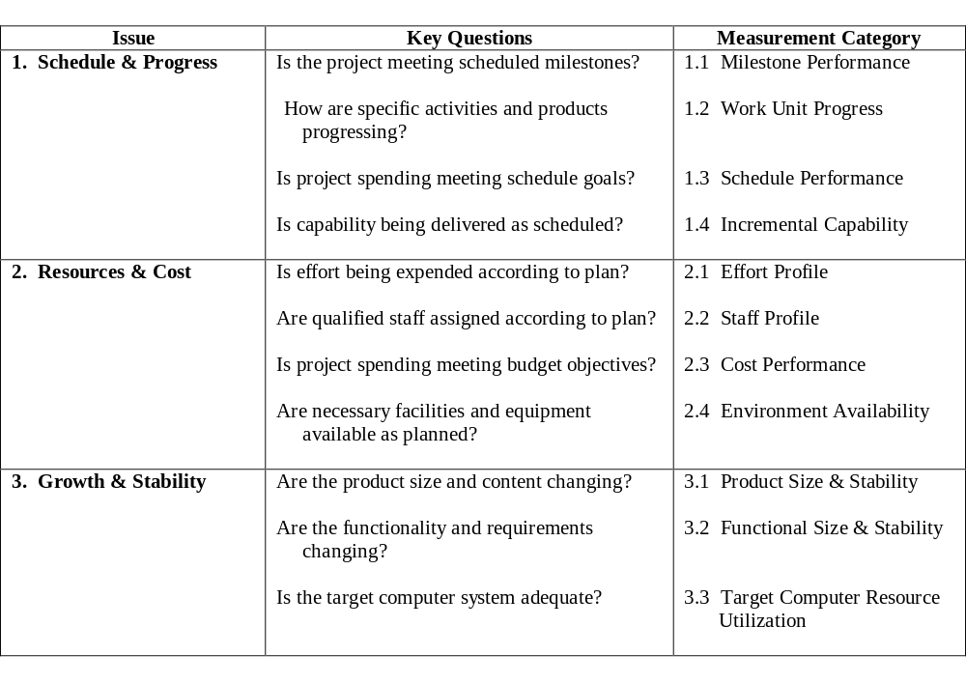
Issue, Key Question,
Measurement Category Table

Slide 10
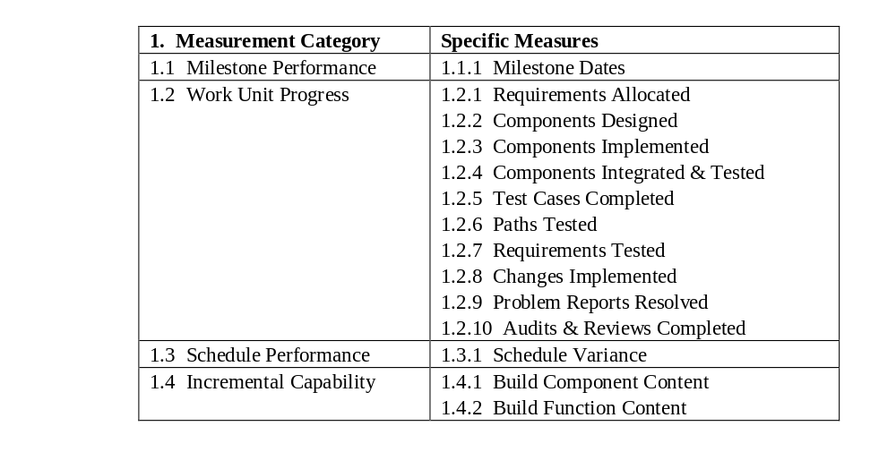
Measurement Category,
Specific Measures Table

Slide 11
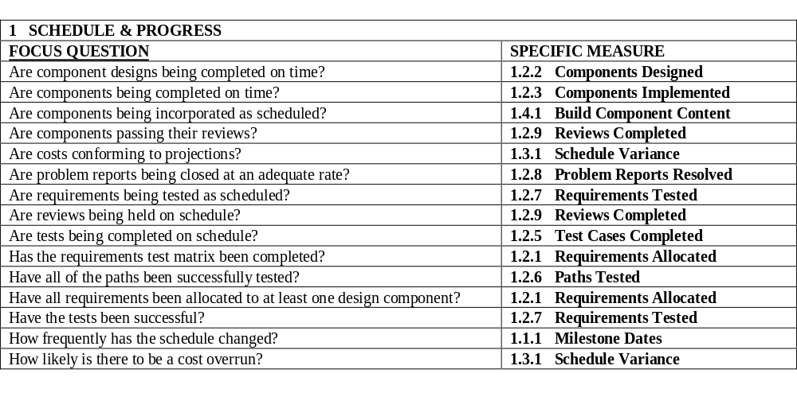
Focus Questions,
Specific Measures Table

Slide 12
Appendix A
Specific Measures Definition
1.1.1 Milestone Dates
Planned and actual start and end dates for individual activities and events provide status visibility of the
projects working level activities. This information allows the project manager to focus attention and resources
on those items that are significant or repetitive sources of delay.
Focus Questions
Is the schedule realistic?
How many activities are scheduled concurrently?
How frequently has the schedule changed?
What is the risk of not delivering on schedule?
Data Items Collected: Data Source/Criteria
Date a project milestone event is scheduled to occur • Approved Project Plan
Date a project milestone event actually occurs • Approved Revisions to Project Schedule
Number of times each event has been rescheduled • Approval Of Review Report
Activity/Event Name • Closeout of all Review Item Discrepancies (RID)
Component ID/Name • Development Plans
Scheduled Start Date • Development Schedule Revisions
Actual Start Date • QA Sign Off
Scheduled completion Date • Task Completion Notice
Actual Completion Date
Responsible Organization/Individual
Dependent Activity /Event Name

Slide 13
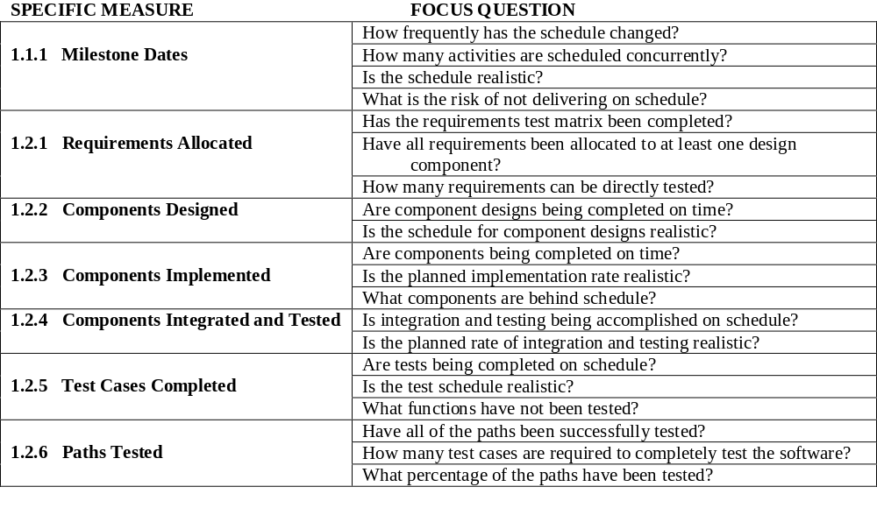
Appendix B
Specific Measures,
Focus Questions Table

Slide 14
Appendix C
Reporting Forms
Form 001 Project Profile
Form 002 NASA Software Description Outline
Form 003 Staff Personnel Profile
Form 004 Project Staff Status Report
Form 005 Schedule Reporting Form
Form 006 Weekly Staff Effort Data Collection Sheet
Form 007 Staff Effort Summary Sheet
Form 008 Product/Item Description
Form 009 Earned Value Report
Form 010 Development Progress Report
Form 011 Control Progress Report
Form 012 Software Change Request
Form 013 Problem and Nonconformance Report
Form 014 Software Failure Report
Form 015 .Resource Management Report
Form 016 Computer Resource Utilization Report

Slide 15
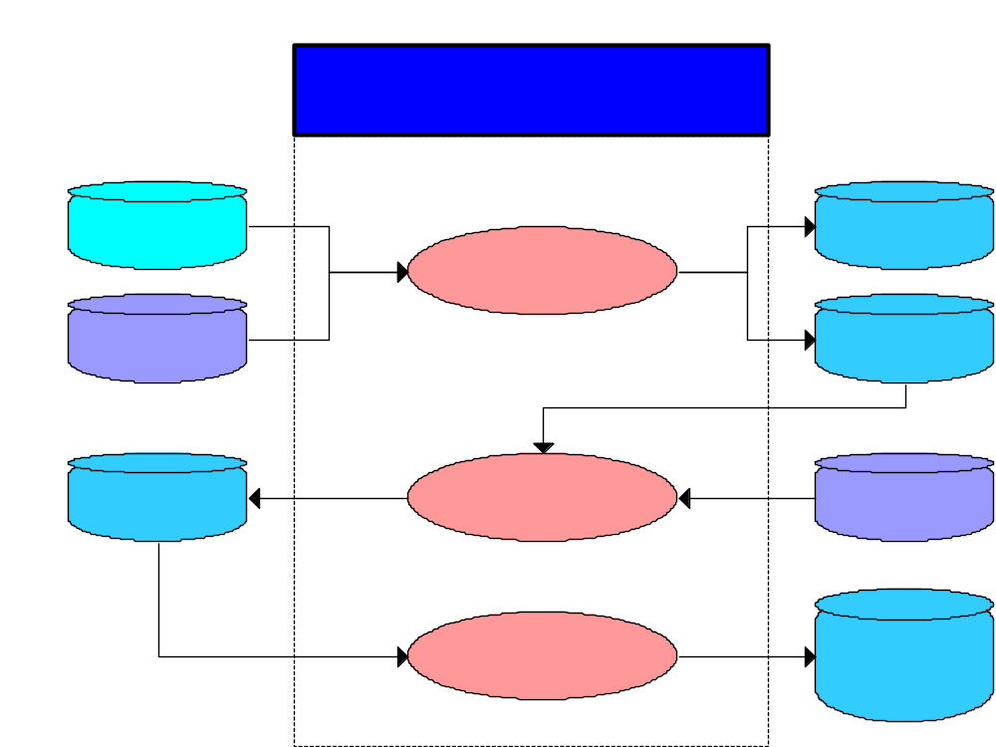

Slide 16
Overview
Focus scheme uses
FOCUS Tool uses
6 Common Issues
17 Key Questions
17 Measurement
Categories
148 Focus Questions
51 Specific Measures
16 Data Collection
Forms
275 Key Words

Slide 17
Summary
Focus Scheme Documentation:
      Complete, But Open Ended
Focus Scheme Pilot Project:
      In Progress
FOCUS Tool:
      Proof Of Concept Tests

