Slide 1
ISO 9001 at GSFC
Tom Weisz
May 14, 2008

Slide 2
What is ISO 9001?
(ANSI/ISO/ASQ Q9001-2000)
Quality Management System Requirements
ISO 9001 is a set of requirements placed on an organization’s business system that puts a focus on product quality through process control.
The ISO 9001 requirements with the widest application at GSFC are:
    Quality Objectives
    Documentation Requirements, including Records
    Design and Development
    Production Controls
    Procurement
    Training
    Inspection and Testing
    Internal Audits
    Control of Nonconforming Product
    Corrective Action

Slide 3
NASA Requirements
NPD 1280.1, NASA Management System Policy
  Each NASA center is required to have a management system that meets a minimum set of criteria
  ISO 9001 or AS9100 may be used to satisfy the NPD
  Third party assessment of management system implementation required
NPD 8730.5, NASA Quality Assurance Program Policy
  Work that is both critical and complex shall be performed in accordance with the quality system requirements of AS9100.
  Critical, but not complex, work shall be performed in accordance with AS9100, ISO 9001, or AS9003.
GSFC is Registered to ISO 9001
GSFC is Compliant to AS9100

Slide 4
ISO 9001 at GSFC
At GSFC, the requirements of ISO 9001 are met through the set of processes called the GSFC Management System (MS)
An ISO 9001 compliant quality management (or business) system provides a good foundation for an effective and efficient organization.
Using the MS as the baseline approach to our core work will help ensure consistent quality and give us a basis for future improvements.
GSFC achieved initial ISO certification (to the 1994 version of ISO 9001) by passing a third party registration audit in August 1999.
The current NASA registrar, NQA, performs semi-annual surveillance audits of GSFC in March and September (typically) of each year.
Recertification audits occur every three years
  Next audit is September 2008.

Slide 5
Scope of the GSFC Management System
Science Enabling
  This includes: the grants process; providing data to the science community; science support tools; proposal support process; and the science research management process.
Technology Development
  This includes the technology research and development management process; mission-specific products; technology transfer process; and technology commercialization.
Systems Development
  This includes space flight systems; sounding rocket, aircraft and balloon carrier systems; and ground-based mission operating and data acquisition systems. Sounding rocket and balloon experiment payload development is included where external commitments exist or where needed to meet the safety, interface control, or operational requirements of the carrier systems.
Program/Project Management
  This includes cost, schedule and technical control; review and reporting; procurement; mission operations; and safety and mission assurance.
Communicate Knowledge
  This includes the research publication process and the maintenance of those databases accessible to the public whereby the results of GSFC research are shared.

Slide 6

The Management System Document Pyramid
Tier 1 – Quality Manual (GPR 1280.1)
Tier 2 – Center Procedures
Tier 3 – Directorate/Organization Procedures
Tier 4 – Work Instructions
Tier 5 – Quality Records

Slide 7
What do I Need to Know?
Does my job fall under the GSFC Management System?
What is GSFC's Quality Policy?
With customer satisfaction as our primary goal:
  GSFC is committed to meeting or exceeding our customer's requirements
  We achieve excellence in all of our efforts
Who is the Management Representative for GSFC's Management System?
  Judy Brunner is the Management Representative and Chairperson of the Center's Management System Council (MSC).
  The Code 200 Representative to the MSC is Ray Rubilotta and Tom Weisz is the Alternate Representative.

Slide 8
What do I Need to Know?
How do I access documents and forms that are applicable to my job?
  Directives (e.g., GPR’s and work instructions) and some forms are accessible via the Goddard Directives Management System (GDMS) (http://gdms.gsfc.nasa.gov).
What are my responsibilities concerning records?
  If you have responsibilities for completing or storing records, you will also need to complete those records correctly and be able to locate and retrieve those records if needed.
  The various directives: GPD’s, GPR’s, PG’s, and work instructions identify records to be kept. GPR 1440.8, Records Management, provides additional information on this subject.
What are my responsibilities concerning nonconformances?
  Employees are required to document all nonconformances for MS products in the Nonconformance Report / Corrective Action (NCR/CA) System located at http://ncr.gsfc.nasa.gov.
  GPR 5340.2, Control of Nonconformances; and GPR 1710.1, Corrective and Preventive Action, provide additional information on this subject.

Slide 9
What do I Need to Know?
What training am I required to have? (GPR 3410.2)
  “GSFC Management System Overview”
  “GPR 1410.1, Directives Management Overview”
  Mishap Reporting Familiarization
    GPR 8621.1, Reporting of Mishaps and Close Calls
  Job specific training
  Document training on GSFC Form 17-112 (new and reassigned GSFC employees on or after January 4, 1999)
What else do I need to do if my job falls under the GSFC MS?
  You will need to be able to explain your work processes and demonstrate that you are performing your work in accordance with the directives (e.g., GPR’s and work instructions) that document how your work/process is performed.
  You may also be contacted during an audit or may be involved in management system actions or activities.

Slide 10
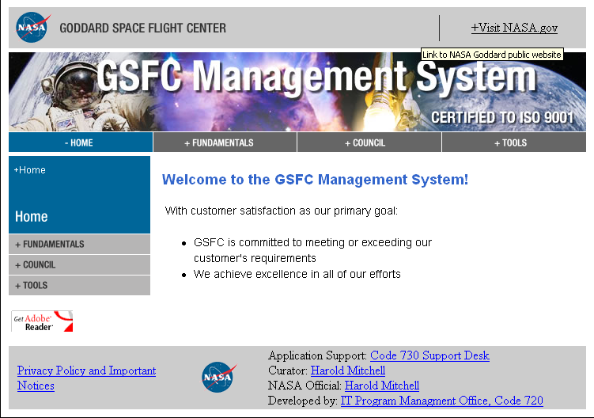
GSFC Management System Website http://gsfcmanagementsystem.gsfc.nasa.gov

