Slide 1
GSFC QMS
Management Review
01/01/2001 -- 06/30/2001
Charles Vanek
Management Representative
July 9, 2001
Notes:
From January to June 2001. We are supposed to have a Management Review ever quarter. The problem was scheduling-Al is currently required, by GPG, to be present-QMSC recommends that we change that to AL or Bill or Mary must be present for a Management Review.

Slide 2
Agenda
Internal Quality Audits
Product and Process NCRs and CAs
Customer Feedback
Review of Action Items
Internal Audit Schedule
DNV Periodic Audit
QMS Changes
ISO 9001:2000 Changes

Slide 3
Internal Quality Audits
Implementation of first half of CY2001 audit schedule was completed on plan, with focus on top-down audits of projects.
Fourteen audits were performed this reporting period, with an average number of NCRs/audit at 3.1 (versus 2.7 the previous reporting period).
  34% are Document Control problems.
  25% of the NCR’s generated in these Audits are still open.
  Of all of the open NCR’s, 55% are over 100 days old, and several are even older.

Slide 4
Internal Quality Audits(cont.)
NCR processing timeliness and effectiveness remains an issue.
  The cause continues to be a lack of regular attention to NCR status at the Directorate/organizational level.
  When NCR status reports are presented to the EC, immediate progress is noticeable.
  Action: QMC2000-00002 (already in the system-Code 100 responsibility) requires a revision to GPG 1060.2 Management Review and Reporting for Programs and Projects to incorporate NCR status in the normal course of our Management and Program/Project reviews. Scheduled completion 9/1/01.
Notes:
However Action QMSC2000-00002 will not completely fix the problem. GPG 1060 addresses only Program and Project reporting. Organizations such as Code 200 and OHR still would not be periodically reporting NCR status. Currently we do not have a GPG on how we do reporting to the EC (i.e. bimonthly Monday reports)
This is because the EC functions are not under the QMS scope. Although there is no reason that we could not, or should not, have a document (GPG) that describes our EC management functions (Directorate/Office Status Reporting, Business Planning, Internal Financial/Resource Planning, etc.)

Slide 5
Product / Process NCRs
No discernible new trends in NCR’s this reporting period.
NCR/CAS search tools do not easily accommodate compilation of trends over time. Most tools yield a snapshot in time. Month-to-month trending (for example) can be done but is burdensome.
  To accommodate and encourage Directorate and organizational level NCR status review, the NCR/CAS CCB is investigating the establishment of more powerful search tools

Slide 6
Customer Feedback
Three Customer Complaints were entered this reporting period. None remain open from prior periods.
  NCR CODE1502001020901 – MIPR acceptance (448-2), funding documents, 506 authority, and reimbursable JONs processes take too long, negatively impacting account certification.
    Status – Code 150 examining causes for delays. Expected CA completion: 9/30/01

Slide 7
Customer Feedback(cont.)
  NCR FMD2001021501 – Chilled water outage caused SES cryopumps and helium skid shutdown during MAP Observatory test. (No damage to Observatory reported).
    Status – Outage notification procedures not adequate. Targeted CA completion: 07/01/2001 (OVERDUE)
  NCR FMD2001040901 – Overhead bridge from 295 to GSFC has numerous large potholes.
    Status: Closed. Bridge resurfaced on 5/4/01. Bridge scheduled for major restoration as part of FY02 CoF project.

Slide 8
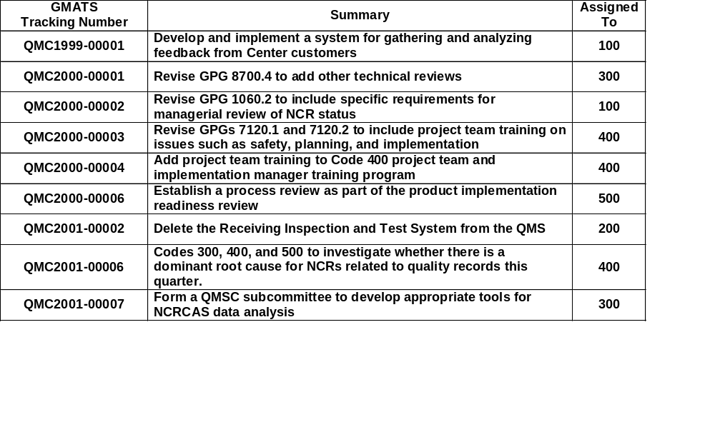
Review of Action Items

Slide 9
QMC1999-00001
Action: Develop and implement a system for gathering and analyzing feedback from Center customers.
Assigned to: Code 100
Status: Action folded into overall ISO 9001:2000 transition planning. Procedures to be in Center review by 9/1/2001.

Slide 10
QMC2000-00001
Action: Revise GPG 8700.4 Technical Review Program to add other technical reviews.
Assigned to: Code 300
Status:
  Revised GPG 8700.4, Integrated Independent Reviews, in Center review.
  Added GPG 8700.6, Engineering Peer Reviews, in Center review.

Slide 11
QMC2000-00002
Action: Revise GPG 1060.2 Management Review and Reporting for Programs and Projects to include specific requirements for (program and project) managerial review of NCR status.
Assigned to: Code 100
Status: Action folded into overall ISO 9001:2000 transition planning. Procedure changes to be in Center review by 9/1/2001.

Slide 12
QMC2000-00003
Action: Revise GPGs 7120.1 Program Management and 7120.2 Project Management to include project team training on issues such as safety, planning, and implementation.
Assigned to: Code 400
Status:
  In process of incorporating additional changes
  The revision of the two GPGs will be in Center review by 9/1/01

Slide 13
QMC2000-00004
Action: Add project team training to Code 400 project team and implementation manager training program.
Assigned to: Code 400
Status: The training programs are being defined in the revisions to GPG 7120.1 Program Management and GPG 7120.2 Project Management. Expected in Center review by 9/1/01.

Slide 14
QMC2000-00006
Action: Establish a process review as part of the product implementation readiness review.
Assigned to: Code 500
Status:
  Code 500 proposed to Code 400 that new projects conduct a project team retreat, including an assessment of institutional issues, such as the evaluation of developmental processes and associated risks.
  Code 500 provided suggested issues, listing items which are thought to be frequently missed
  Code 400 is evaluating the list.

Slide 15
QMC2001-00002
Action: Delete the Receiving Inspection and Test System from the QMS (will incorporate into existing Work Order Authorization System).
Assigned to: Code 200
Status: Proposal is to eliminate the RITS WOA by using regular WOA to record incoming inspections. Supplier data would be moved from SPS to RITS database. This would streamline user requirements while retaining supplier information for procurements. Has been delayed until August.

Slide 16
QMC2001-00006
Action: Codes 300, 400, and 500 to investigate whether there is a dominant root cause for NCRs related to quality records this quarter.
Assigned to: Code 400
Status:
  GPG Quality Records List determined to be too restrictive with little value. Most records NCR’s related to QRL format issues.
  GPG 1440.7 revision makes QRL optional. Currently in signature cycle.

Slide 17
QMC2001-00007
Action: Form a subcommittee of the QMSC to develop appropriate tools for analyzing NCRCAS data. (This action was a re-focusing of the closed QMC2001-00003 action)
Assigned to: Code 300
Status: Action has been assigned to the NCR/CAS CCB. Expect to be done in consonance with ISO 9001:2000 transition planning to establish easy to use nonconformance metrics tools which support Center and Directorate objectives.

Slide 18
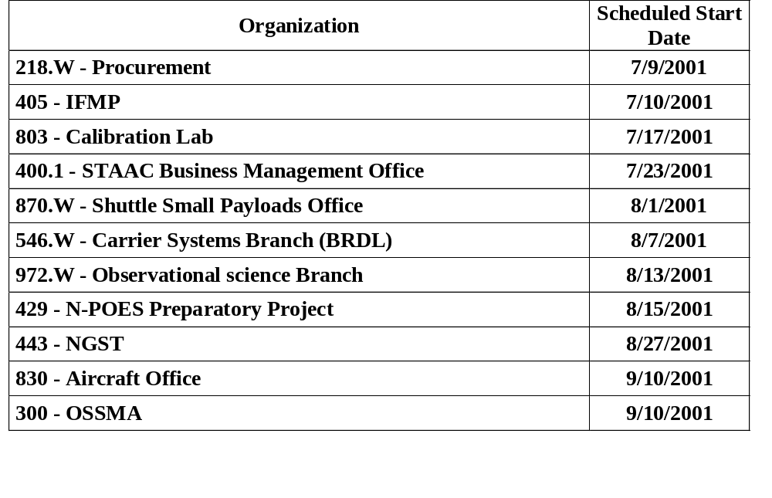
Internal Audit Schedule

Slide 19
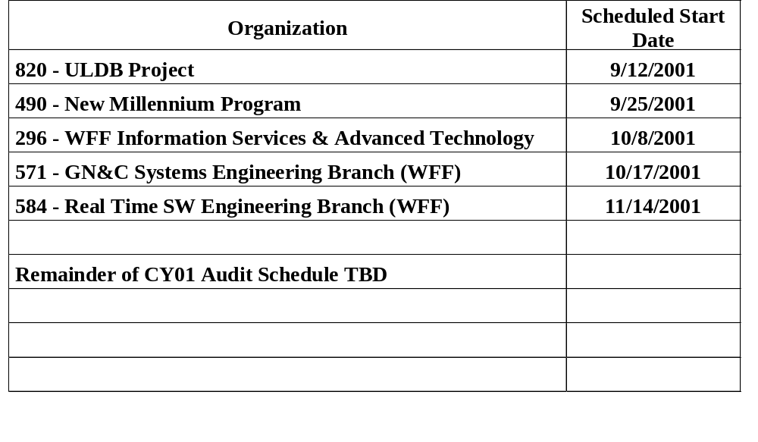
Internal Audit Schedule

Slide 20
4th Periodic Audit
Schedule: Scheduled for two days (August 16-17, 2001)
Location: WFF and Greenbelt
Status:
  Schedule confirmed with DNV; audit plan expected week prior to audit.
  The five NCN’s from previous audit were closed out on schedule

Slide 21
QMS Changes
Nonconformance Control
  In concert with drafted GPG 7120.4, In-House Development and Maintenance of Software Products, minor software nonconformances will no longer be required to be entered into NCR/CAS. Requires change to GPG 5340.2.

Slide 22
QMS Changes(cont.)
ISO 9001:2000 Transition Planning
  Training classes held (1 two-day course for QMSC, 3 one-day courses for ISO Directorate Reps). More planned in FY02.
  Four-hour Executive Council training/discussion forum planned in near future (NOT YET APPROVED)
  Eleven GPG’s identified as requiring revision (mostly nominal). All due in GDMS review by 9/1/01.
  Extensive modification/addition to management responsibility GPG’s required to address new ISO 9001:2000 emphasis: objectives, continuous improvement, customer communication, and metrics

Slide 23
ISO 9001:2000 Changes
Scope
  Exemptions from scope of QMS are limited to areas which cannot impact product quality. (Infrastructure is now specifically addressed by ISO 9001:2000)
  “Expert” waivers from ISO compliance are no longer acceptable.
Continual Improvement
  Quality Policy is required to be expanded to include commitment to continual improvement

Slide 24
ISO 9001:2000 Changes(cont.)
Metrics
  Must establish Objectives at appropriate levels that are measurable and tied to quality policy
  Need to have systematic processes to measure customer satisfaction in a proactive fashion
  Must establish methods to measure the performance of our key processes
Greater Top Management Involvement
  Greater emphasis/involvement in our Periodic Audits

Slide 25
Executive Council
We need to decide on:
  QMS Scope
  Our training

