Slide 1
Endcap Muon Project - CSC
Nelson Chester
Chamber Project Engineer
DOE/NSF Review
February 17 - 19, 1999

Slide 2
OUTLINE:
Chamber Project Engineer
Chamber Engineering
  Drawings/BOM’s:
    ME234/2 (assembled at FNAL)
    ME2/1 & 3/1 (provide Kits for PNPI)
    ME1/2 & 1/3 (provide Kits for IHEP)
Factory Layout
  Production at Lab 8
    Floor Plan / Production Rate / Flow
  Production in MP9
    Floor Plan / Production Rate / Flow
QA/QC System
  Travellers
  Discrepancy Reports
Environment, Safety, and Health
Procurements & Kits for Foreign Sites
Summary and Conclusions

Slide 3
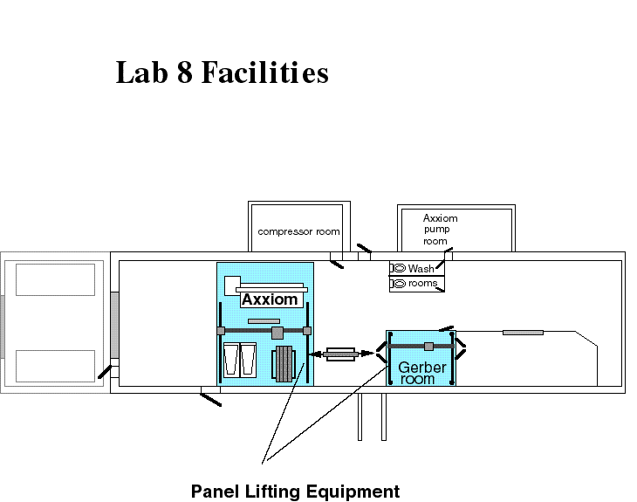
Lab 8 Facilities

Slide 4
Drawing / BOM Status
Chamber Drawings BOM’s Required
ME 234/2 (FNAL) Complete* Complete* March 1, 1999
ME 2/1 (PNPI) 80% 99% April 1, 1999
ME 1/2 (IHEP) 0% 50% April 1, 1999
ME 3/1 (PNPI) 60% 80% Sept. 30, 1999
ME 1/3 (IHEP) 70% 50% Sept. 30, 1999
*Some Changes Req’d. for P2’’

Slide 5
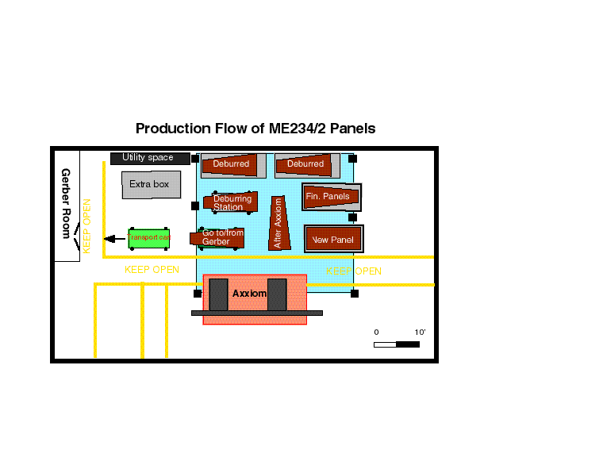
Lab 8 - Large Panel Flow

Slide 6
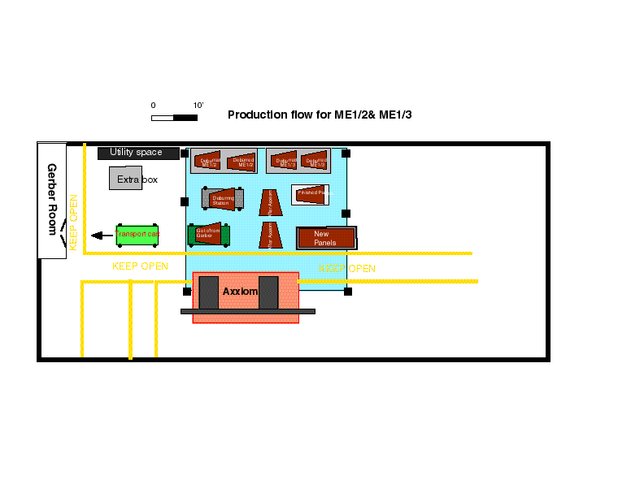
Lab 8 - Small Panel Flow

Slide 7
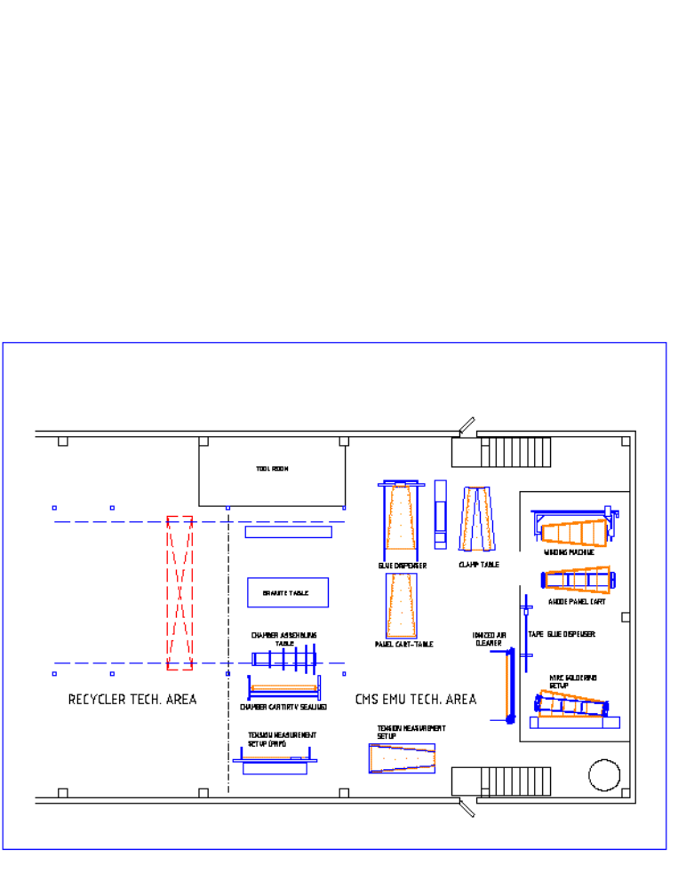
MP 9 - Pre-Production Setup

Slide 8
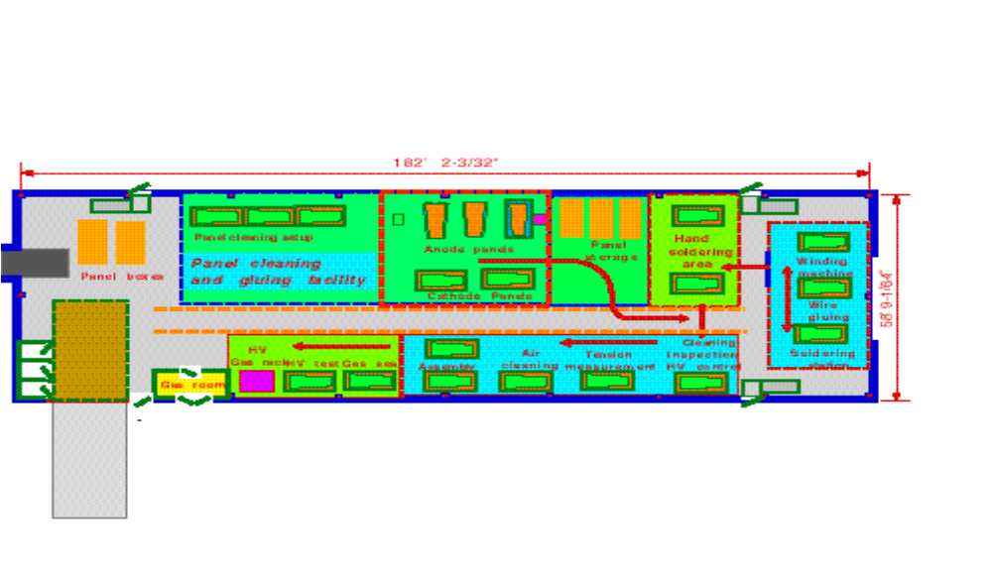
MP 9 - Full Production Setup

Slide 9
Quality Assurance & Control
Use the infrastructure already in place at Fermilab and within Technical Division (TD) that has led to the success of past mass production projects (the Main Injector Magnet Program being the last).
Create and follow a Compact Muon Solenoid-Cathode Strip Chamber (CMS-CSC) Specific Quality Implementation Plan (SQIP) with oversight by the TD Quality Assurance Officer and implemented by the Fermilab Project Site Management as approved by the CMS Project Management.
Integrate Quality Assurance and Quality Control into all aspects of the CMS-CSC Project Design and Manufacturing as defined in the CMS-CSC SQIP.

Slide 10
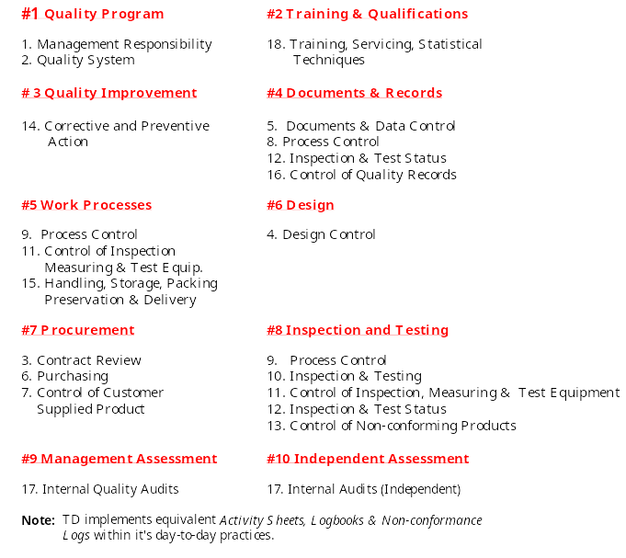
Quality Element Cross Reference
- CSC SQUIP vs Magnet Quality Plan -

Slide 11
Tool Design & Drawings
Panel Preparation Tooling Complete:
  Axxiom Machine
  Gerber Machine
  Panel Handling Equipment on Order
Major Assembly Tooling Complete:
  FR4 Strip Epoxy Gluing Station
  Epoxy Curing Station
  Anode Wire Winding Station
  Anode Wire Gluing Station
  Anode Wire Soldering
  Ionized Air Cleaner
Carts, Racks, and Assembly Tables Complete:
  Anode Panel Cart
  Panel Assembly Table/Cart
  Chamber Assembly Table
  Sealing (RTV) & Transport Cart
Quality Assurance Tooling:
  Anode Panel Tension Tester Complete
  HV Test and Train Instrumentation Complete
  Cosmic Ray Test Station Complete
  Vendor and FNAL Panel Inspection Tooling Under Development

Slide 12
Production Technicians
Lab 8 FTE’s
Axxiom Machine 0.7
Gerber Machine 1.0
Inspect, Clean, & Wrap 1.0
Handling & Shipping 0.3 Total 3.0
IB 4
Kit Preparation and Shipping 1.0
MP 9 FTE’s
Panel Preparation 1.6
Anode Winding 1.0
Machine Soldering 1.0
Hand Work 1.5
Assembly 1.5
Test 1.0
Handling & Shipping 0.4
Total 8.0

Slide 13
Production Rate Summary
Avail. Days = 260 Days - 10 Hol. - 5 Vac. = 245 Open Plant Days (Max. Days Machines Run) = 100%
Panel Production - Lab 8
Axxiom Machined Panels: Req’d. / yr: = 721 Panels Max.
Capacity @ 4 per Day = 180 Days Max.
= 74% of Capacity
Gerber Machined Panels:
Req’d. Long = 265 Panels @ 2.5 Panels / Day = 106 Days to Complete
Req’d. Short = 353 Panels @ 3.0 Panels / Day = 118 Days to Complete
Capacity @ 2.5 / 3.0 Panels / Day = 224 Days to Complete = 92% of Capacity
Chamber Assembly - MP 9:
50 Chambers Assem. / yr. Req’d. = One / Week Conservative Capability
Anode Panel Prep., Wind, Solder = Five /Week Conservative Capability

Slide 14
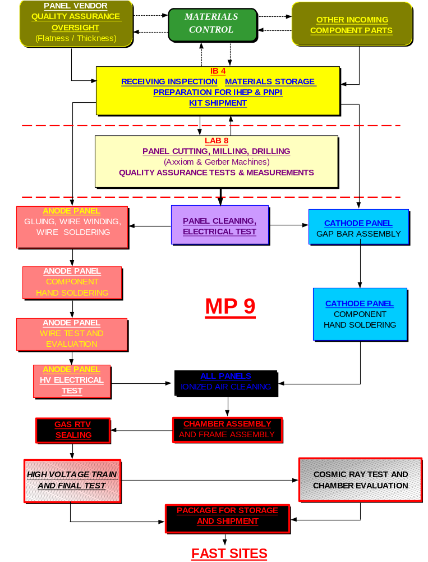
Overall Production Flow
ICB & IB4
Materials Control
Technical Division
Lab 8
Panel Preparation
Particle Physics Div.
MP 9
Chamber Assembly
IB 4
Kit Assembly and Shipping
Technical Division

Slide 15
Chamber Procurement Status
Panel Material- WBS 1.1.3.2.4.1 - 4.5
In Fermi Inventory:
  3100 5’ x 12’ Sheets (Skins) GE @ $164.40 ea = $510,400
  1100 4’ x 12’ Sheets (Skins) GE @ $131.74 ea = $144,914
  84 Ship Crates, GE, 50 shts. ea. @ $120.00 ea = $ 10,080
  14 Panels from Plascore - 5’ x 12’ @ $550.00 ea = $ 7,700
  (R & D Samples)
  Total $ 673,094
Pending Procurements:
  Pre-Production Panel order from Plascore
  P2’’ (ME 234/2) Pre-Production Parts
  Production Order of Panels from Plascore
  Balance of Procurements to be in concert with Production Schedule
  Kit Preparation for IHEP and PNPI to be per Manufacturing and Delivery Plans and Schedule as agreed upon.

Slide 16
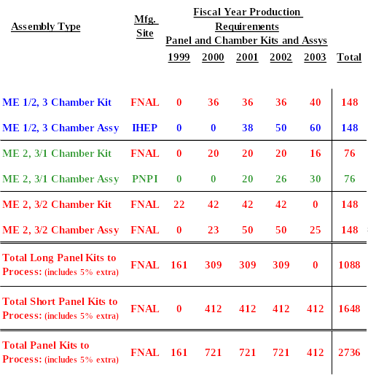
Production Manufacturing Plan

Slide 17
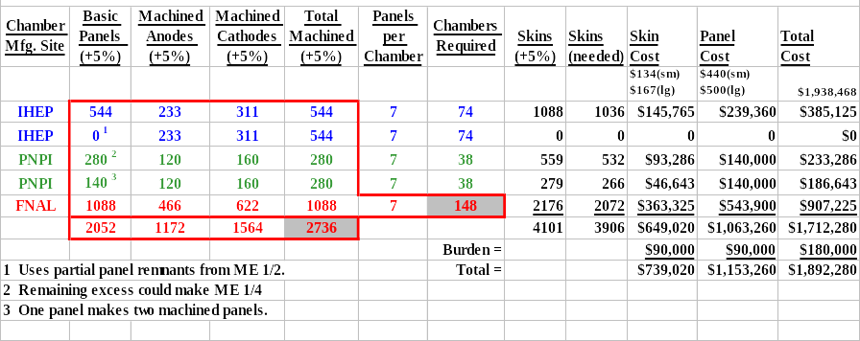
Chamber & Panel Count & Cost

Slide 18
Lab 8 E S & H
Concerns and Actions
1. How panels are unpacked, loaded onto and off of Axxiom and Gerber Machines, and repacked for movement. Human manual effort presents safety and health risks.
2. Airborne machining particulate may cause health risks.
3. Locating panels on Gerber machine requires workers to stand on top surface of Gerber machine. Provision for safe access must be provided.
4. Operators must be properly trained before using equipment to avoid injury.
1. Vacuum lifting & transport system evaluated, selected, and ordered such that together with panel transport carts, to eliminate safety and health risks.
2. Little airborne material is generated. Operators instructed to use proper protective equipment. Vacuum systems to be used to capture waste materials.
3. Approved ladders to be used for this purpose.
4. Only trained operators to use equipment. Equipment Operating Procedures and Travellers being developed to guide operators though manufacturing process. On the job training planned to bring operators up to speed.

Slide 19
MP 9 E S & H
Concerns and Actions
1. Manual Panel Cleaning cannot be sustained.
2. Operators must be protected from moving parts of winding machine and wire that is under tension during winding. Panel must be protected against coming loose during winding.
3. Human reaction to epoxies must be addressed.
4. Human sensitivity to light and fumes from soldering station must be addressed.
5. Operators must be protected from touch hazards during the panel and chamber high voltage tests and cosmic tests.
6. Operators must be properly trained before using equipment to avoid injury.
1. An automated cleaning machine to be purchased from outside vendor.
2. Guards have been installed over pulleys and belts; Operators are otherwise stationed by the control panel where there is no danger. The wire tension and wire mass is such that there is no danger posed of a wire under tension breaks.
3. Operators do not directly handle epoxy - machine dispensed. Operators instructed to wear proper protective equipment.
4. Vacuum system installed to collect fumes at soldering station; Curtains installed to shield light from eyes Video camera installed for remote viewing of operation.
5. Proper materials to be used and proper procedures to be followed.
6. Only trained operators to use equipment. Equipment Operating Procedures and Travellers being developed to guide operators though manufacturing process. On the job training planned to bring operators up to speed.

Slide 20
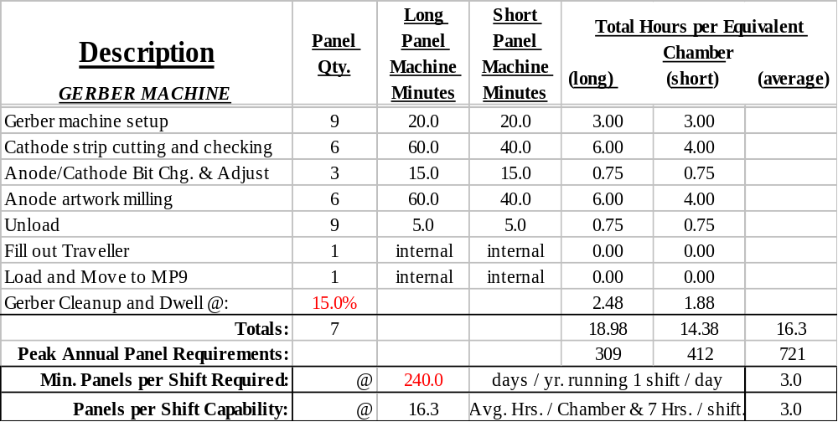
Gerber Machine Production Rates

Slide 21
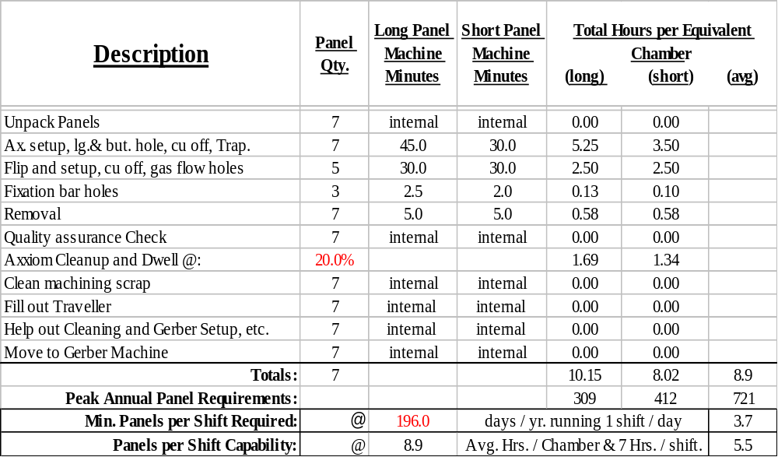
Axxiom Machine Production Rates

Slide 22
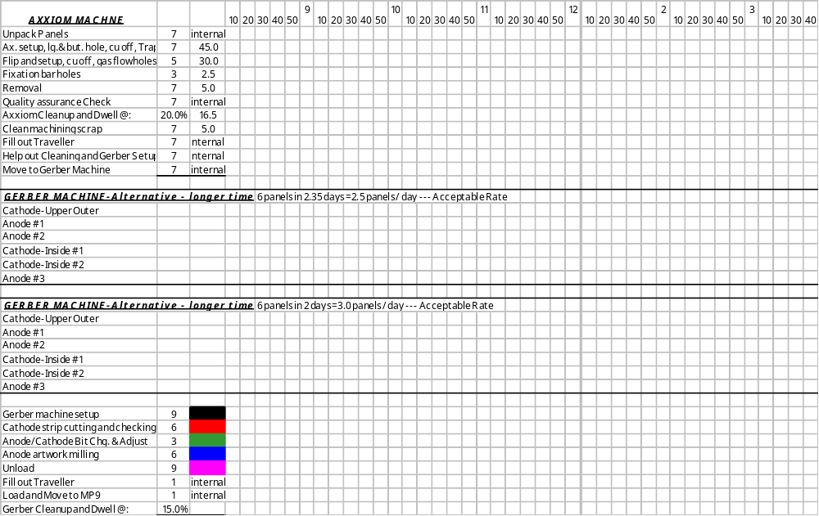
Axxiom & Gerber Machine Operations

Slide 23
MP 9 Production Machine Rates
Required: 1 Chamber/wk = 3 Anodes + 4 Cathodes + Assembly
Conservative Capability:
Cleaning Machine 15 min/panel est. = 140/wk
Anode Bar Glue & Cure 1 panel/day = 5/wk
Winding Machine 1 panel/day = 5/wk
Wire Gluing Machine 1 panel/day = 5/wk
Soldering Machine .75 panel/day = 4/wk
Wire Tension Tester 1 panel/day = 5/wk
Ionized Air Cleaning 1 panel/day = 5/wk
Hand Component Work 1 panel/day = 5/wk
Final Assembly 1Chamber/wk = 1/wk
High Voltage Test & Train 1 Chamber/wk = 1/wk

Slide 24
Summary and Conclusions
Drawings and BOM’s are coming along.
Remaining ME 234/2 issues must be resolved
Production Rates, Floor Plans, and Work Flow Well Understood and Workable
Firm QA/QC and ES & H Plans in place and being Administered
Procurement Plans are Understood;
Plans for Kits to PNPI and IHEP to be Finalized.

Slide 25
Discrepancy Report
What is it
A document used to describe the essential information about a nonconforming condition that has taken place. The nonconformance may be a discrepancy with respect to the design specifications, to the traveler (manufacturing process), or to other conditions that are not normally expected.
Why is it used
To identify the condition and communicate to all those that “have a need to know” that there is a deviant condition, and what is being done about it.
To document for historical purposes in a place where the record may easily be found the essential information about the discrepancy and how it was dealt with.
When it is to be used
Whenever a condition occurs in that does not conform with the established specifications, engineering drawings, manufacturing practices, or otherwise the normally expected conditions or results.
Who is to fill out the paperwork
To identify the condition and communicate to all those that “have a need to know” that there is a deviant condition, and what is being done about it.
To document for historical purposes in a place where the record may easily be found the essential information about the discrepancy and how it was dealt with.

